Slide 1

KORA
Development
progress report
Milestone alignment, delivery status, risks and recovery plan
Reporting date | 12 October 2026
Prepared from the GitHub project and Kora_Likha Product.xlsx
Notes:
Sources:
https://github.com/users/BurnIMJerome/projects/2
C:\Users\My PC\Downloads\Kora_Likha Product.xlsx

Slide 2
Executive status
02
The delivery pipeline does not match the planned phase gate
RED
22 / 369
6 / 91
18 days
Full board Done
MVP1 Done
Until code freeze
Behind the planned
milestone sequence
6.0%
6.6%
30 Oct
Testing & Stabilization starts today, but no work is in Review or QA.
Management decision
Reduce and freeze the MVP1 release scope now, or formally move the code-freeze and launch dates.
Source: GitHub Project Dev View and Timeline worksheet, reviewed 12 Oct 2026
Notes:
GitHub Project counts observed 12 Oct 2026.
Timeline source: Kora_Likha Product.xlsx, Timeline!B3:R47.

Slide 3
Delivery dashboard
03
Status counts show limited movement into active delivery and test
Board counts
 | Full | MVP1
Done | 22 | 6
In Progress | 1 | 0
Ready | 1 | 1
Review | 0 | 0
QA | 0 | 0
Backlog | 345 | 84
Completion is a card-count measure. Items have no visible effort estimates, so it does not represent weighted engineering effort.
Source: GitHub Project Dev View; MVP1 filter returned 91 matching items
Notes:
Full board: Backlog 345, Ready 1, In Progress 1, Review 0, QA 0, Done 22, Failed 0.
MVP1: Backlog 84, Ready 1, In Progress 0, Review 0, QA 0, Done 6, Failed 0.
Source: https://github.com/users/BurnIMJerome/projects/2

Slide 4
Progress against the planned timeline
04
The plan has entered testing while most release work remains in backlog
Milestone | Planned date | Current evidence | Assessment
Scope alignment | 17–25 Sep | Backlog definition and prioritization still ongoing | AMBER / RED
Product development | 28 Sep–9 Oct | 22 Done overall; 6 Done in MVP1 | RED
Testing & stabilization | 12–30 Oct | 0 in Review and 0 in QA | RED
Code freeze | 30 Oct | 18 days remain; gates not evidenced | AT RISK
Beta testing | 30 Oct–30 Nov | Depends on a stable release candidate | AT RISK
Launch | 1 Dec | Depends on recovery in October | AT RISK
The workbook's development exit criteria require complete agreed development, peer review, merged PRs, no critical blockers and testable builds.
Source: Kora_Likha Product.xlsx, Timeline worksheet
Notes:
Source: Kora_Likha Product.xlsx, Timeline!B3:R47.

Slide 5
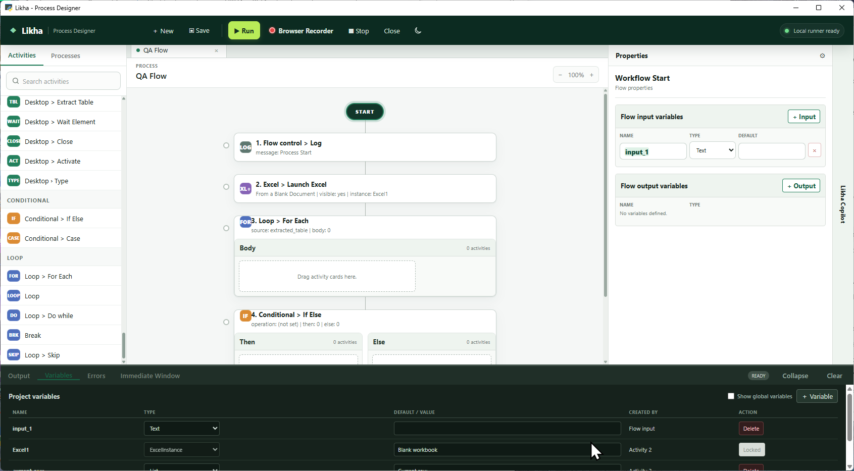
Delivered capabilities
05
The Done column shows useful foundations across Flow, activities, application UI and agents
22 items are Done
Flow designer
Precise card insertion, keyboard shortcuts, comment and uncomment, Intellisense and modular activity architecture
Programming and collections
Create List, Update List Item, Read List Item, Matches, Output Data Table, Else If, Multiple Assign and related activities
Application and agent UI
Product screenshot from the KORA documentation repository
Global Variables, Agent Home, Variable Panel improvements and product rebranding
Source: GitHub Project Done column; KORA documentation assets
Notes:
Source: GitHub Project Done column reviewed 12 Oct 2026.
Image: repository file docs/images/process-designer.png.

Slide 6
MVP1 delivery pipeline
06
Most release-labelled work has not entered development
Ready
Agent Publish function #352
Assigned to BurnIMJerome. Maps to the Agent MVP1 publish, versioning and rollback requirement.
Pipeline gap
No MVP1 item is in development, review or QA.
Source: GitHub Project Dev View filtered by label:MVP1
Notes:
Source: https://github.com/users/BurnIMJerome/projects/2/views/1?filterQuery=label%3AMVP1

Slide 7
Main delivery risks
07
The schedule depends on immediate scope and workflow decisions
Risk | Severity | Evidence and impact
Schedule-phase mismatch | CRITICAL | Testing has started on the plan; nearly all MVP1 work remains in Backlog
Code-freeze feasibility | CRITICAL | 85 MVP1 items are not Done with 18 days remaining
Unclosed release scope | HIGH | Backlog definition and prioritization remain ongoing
No QA flow | HIGH | Review and QA both contain zero items
Completion evidence gaps | HIGH | Several planned capabilities have no verified completion status
Weak effort forecasting | MEDIUM | No visible estimates or target dates on board items
Item-count completion is directional. The board does not provide enough sizing data for an effort-weighted forecast.
Sources: GitHub Project status counts and Timeline exit criteria
Notes:
Sources: GitHub Project reviewed 12 Oct 2026; Kora_Likha Product.xlsx, Timeline!B37:I47.

Slide 8
Recovery plan and decisions
08
A viable October code freeze requires a smaller release baseline and daily movement into QA
Window | Recovery action | Required outcome
12–13 Oct | Freeze the October release baseline; assign owners, criteria and dates | A realistic MVP1 list
14–23 Oct | Move small testable batches through development, review and QA | Daily completed work
24–30 Oct | Stop nonessential features; run regression, smoke and acceptance checks | Evidence-based go / no-go
Management decisions required
1
Scope
Which MVP1 items are mandatory for the release candidate?
2
Schedule
Keep October 30 and reduce scope, or move the milestone dates?
3
Capacity
Who owns development, review and QA for each workstream?
4
Quality gate
What test evidence and defect threshold permit beta entry?
Recommendation: revalidate the 30 Oct code-freeze commitment by 13 Oct 2026
Notes:
Recovery actions derived from the report's schedule, pipeline and exit-criteria analysis.

