Slide 1

GROUP 5
INTRO TO
SOFTWARE
ENGINEER
POTPAL
POTPAL

Slide 2
PotPal
OUR TEAM
22127234 - CAO HOÀNG LỘC
22127257 - PHẠM MINH MẪN
22127418 - NGUYỄN KHÁNH TOÀN
22127422 - LÊ THANH MINH TRÍ
22127450 - PHẠM ANH VĂN

Slide 3
PotPal
CONTENTS
1.
PROJECT VISION
4.
ANALYSIS & DESIGN
2.
PROJECT MANAGEMENT
5.
SOFTWARE TESTING
3.
REQUIREMENTS
6.
DEMO

Slide 4
PotPal
PROJECT
VISION
Problem Statement
Product Position Statement
Users / Markets

Slide 5
PotPal
PROBLEM
STATEMENT
Difficulty finding affordable, reliable laptops
Confusion, wasted time, wrong purchases.
Slow website performance
Frustration, wasted time, inaccurate purchase decisions.
PotPal Laptop Website
A platform for easy comparison, clear interface, and competitive pricing
Optimize loading speed and user experience.

Slide 6
PotPal
PRODUCT POSITION
STATEMENT
Target Customers: Students, officiers, and general consumers.
Requirements: A simple and efficient way to find and buy laptops that meet specific needs.
Product: PotPal – a user-friendly laptop shopping platform.
Features:
Curated selection of laptops.
User-friendly comparison tools.
Easy and fast Order.
Transparent pricing.

Slide 7
PotPal
USERS /
MARKETS
User
Students,officiers and general consumers.
A simple and efficient platform to find and buy laptops tailored to their needs.
Market
Competitors: Generic online marketplaces and well-known laptop stores.
Differentiation:
Focuses on customer’s shopping experience.
Provides detailed product insights , and transparent pricing.
Optimizing ordering process

Slide 8
PotPal
PROJECT
MANAGEMENT
Team Structure and Responsibility

Slide 9
PotPal
TEAM
STRUCTURE
Lê Thanh Minh Trí | Project Manager, Technical Leader
Nguyễn Khánh Toàn | UI/UX Designer, Frontend Developer
Phạm Minh Mẫn | UI/UX Engineer, Frontend Developer
Cao Hoàng Lộc | Tester, Business Analyst, Backend Developer
Phạm Anh Văn | Database Designer, Backend Developer

Slide 10
PotPal
SOFTWARE
REQUIREMENTS
Use-case model
Non-functional requirements

Slide 11

PotPal
Performance
Load within 5 seconds.
Support up to 100 concurrent users.
Usability
Simple, user-friendly interface.
Reliability
Minimal downtime during testing.
Frequent data backups.
Security
Basic safeguards to protect user data (e.g., prevent SQL injection).
Maintainability
Code comments for easier debugging.
Modular structure for future updates.
Compatibility
Responsive for desktop and mobile.
Support for major browsers (Chrome, Firefox).
NON-FUNCTIONAL
REQUIREMENTS

Slide 12
PotPal
USE-CASE
MODEL

Slide 13
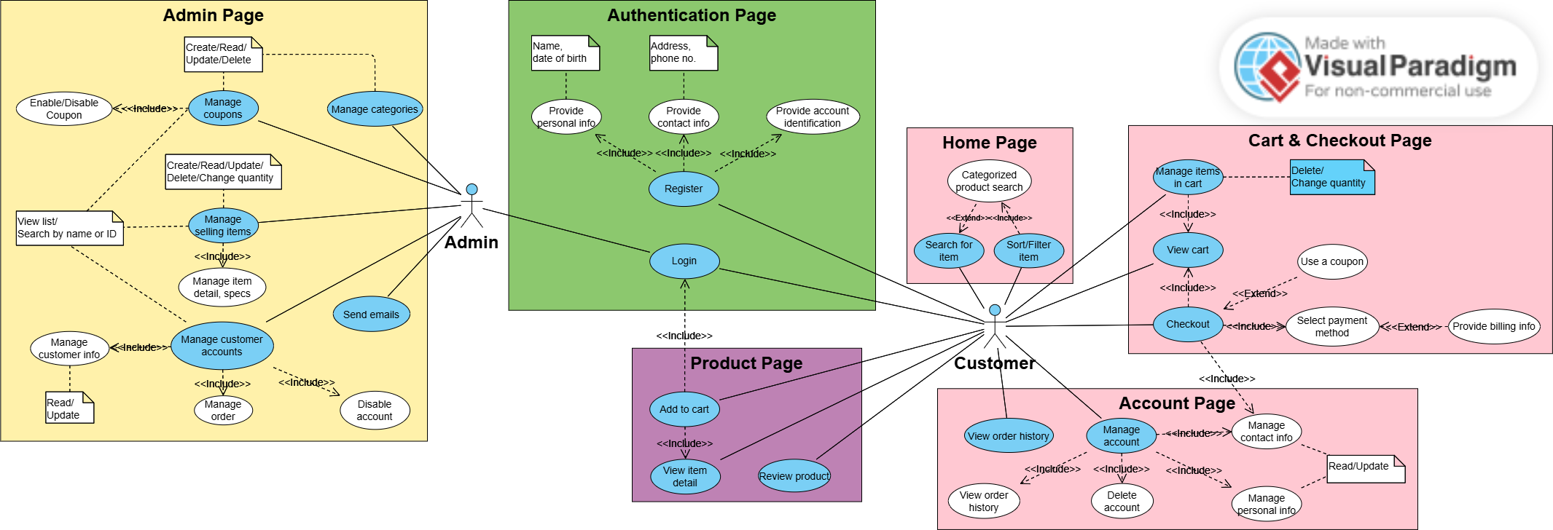
PotPal

Slide 14
PotPal
SOFTWARE
ARCHITECTURE
Architecture (MVC)
Technologies

Slide 15
PotPal
M-V-C
LOGICAL VIEW

Slide 16
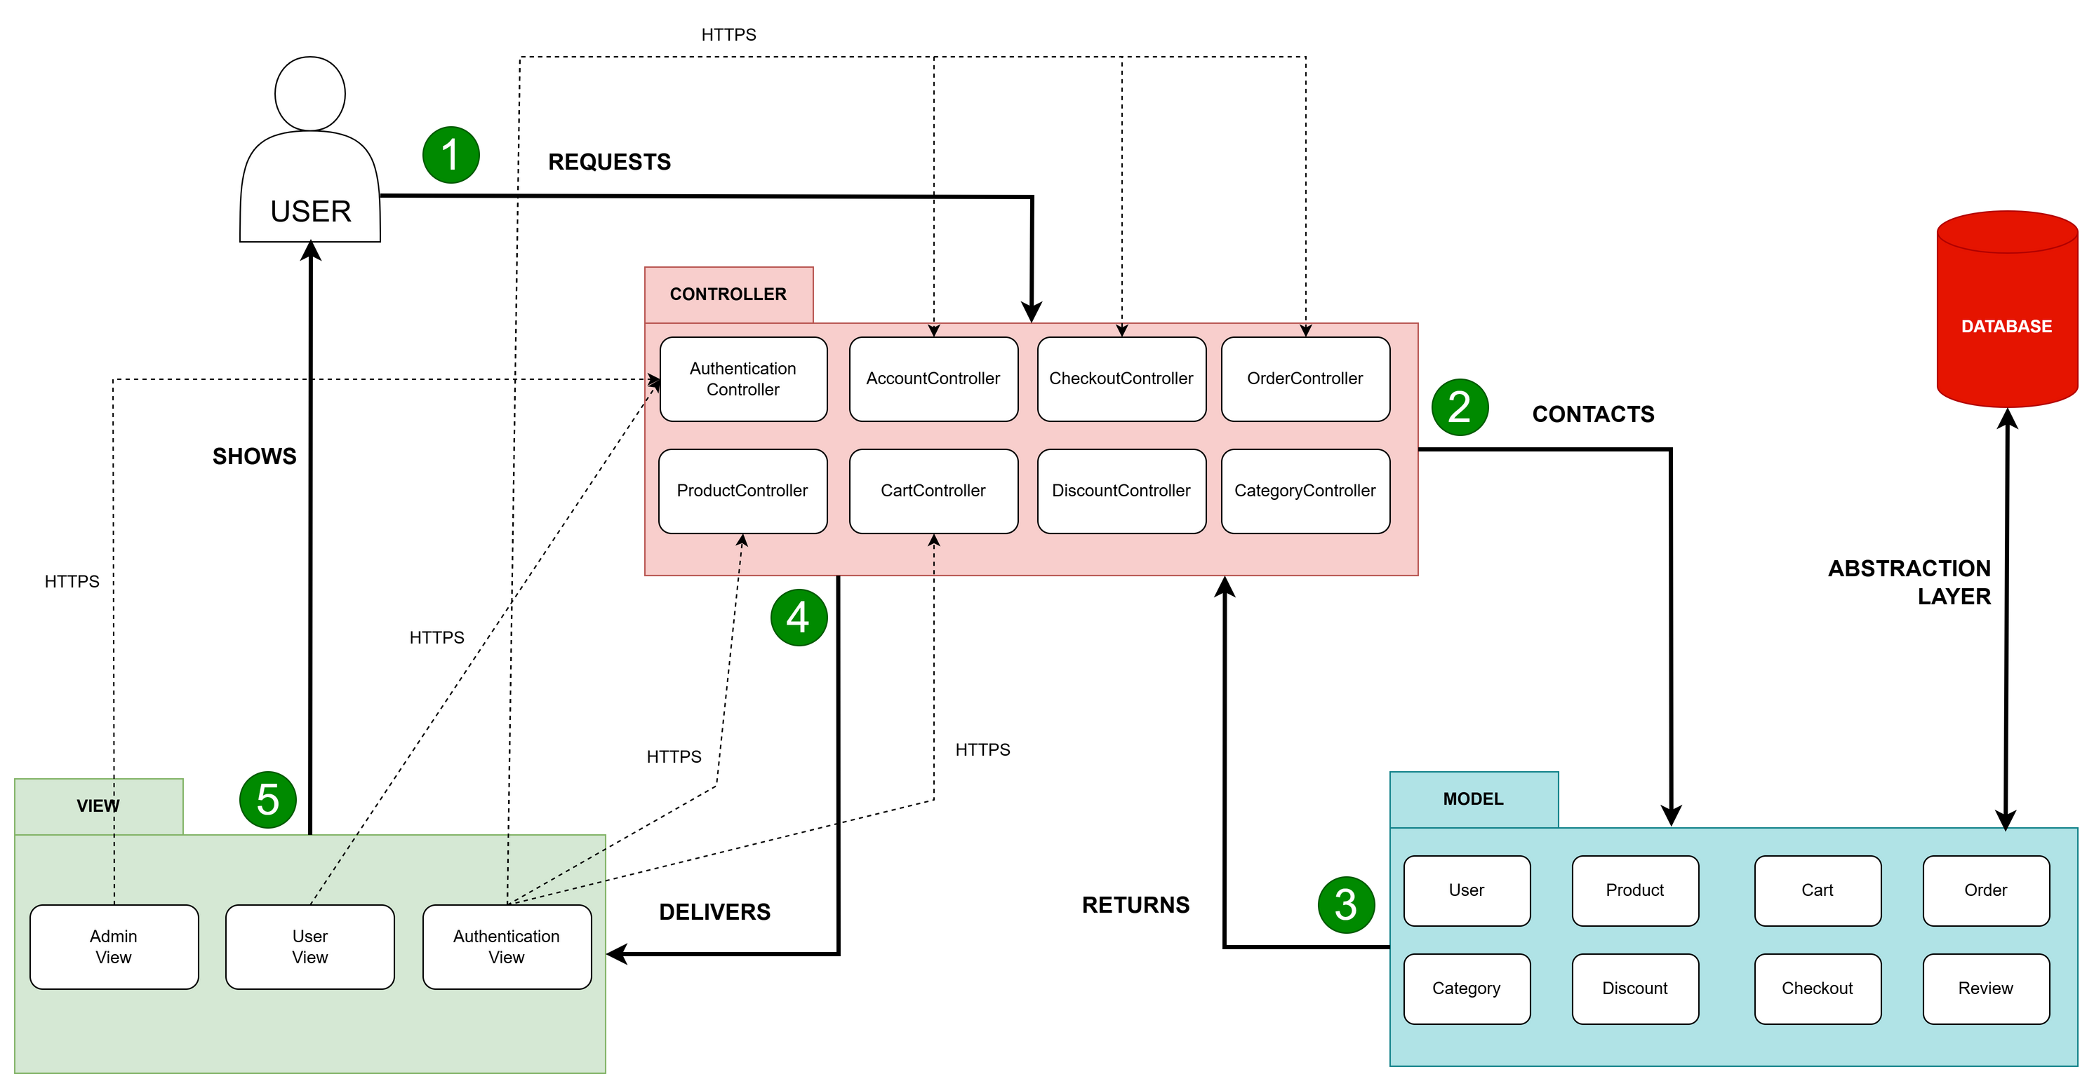
PotPal

Slide 17
PotPal
TECHNOLOGIES
Frontend: Vue.js
Backend: Express.js
Database: MySQL
Deployment: Vercel
Design: Figma
Diagrams: draw.io, Visual Paradigm

Slide 18
PotPal
SOFTWARE
TESTING
Test Plan
Test Results
Automated Testing

Slide 19
PotPal
Operating System:
Windows 11
Developing Environment:
Visual Studio Code (latest version)
Web Browsers:
Google Chrome (latest version)
Microsoft Edge, Opera GX
Deployment:
GitHub
Vercel
TESTING
ENVIRONMENTS

Slide 20
PotPal
TEST
PLAN
Features:
Areas:
UC01: Cart Management
UC02: Products Management
UC03: Products Search
UC04: Accounts Management
UC05: Orders Management
Functionality
Compatibility
Integrity
Usability
Ease of use

Slide 21
PotPal
TEST
RESULTS
UC01: 5 test cases - 3 passes / 2 fails
UC02: 5 test cases - 4 passes / 1 fail
UC03: 5 test cases - 4 passes / 1 fail
UC04: 5 test cases - 5 passes / 0 fail
UC05: 5 test cases - 5 passes / 0 fail

Slide 22
PotPal
AUTOMATED
TESTING
Tools: Katalon Studio v10
Feature: Record and Playback
Test cases: 7 test cases - 3 runs each
Multiple test cases may be executed in one script
Results: No defects found

Slide 23
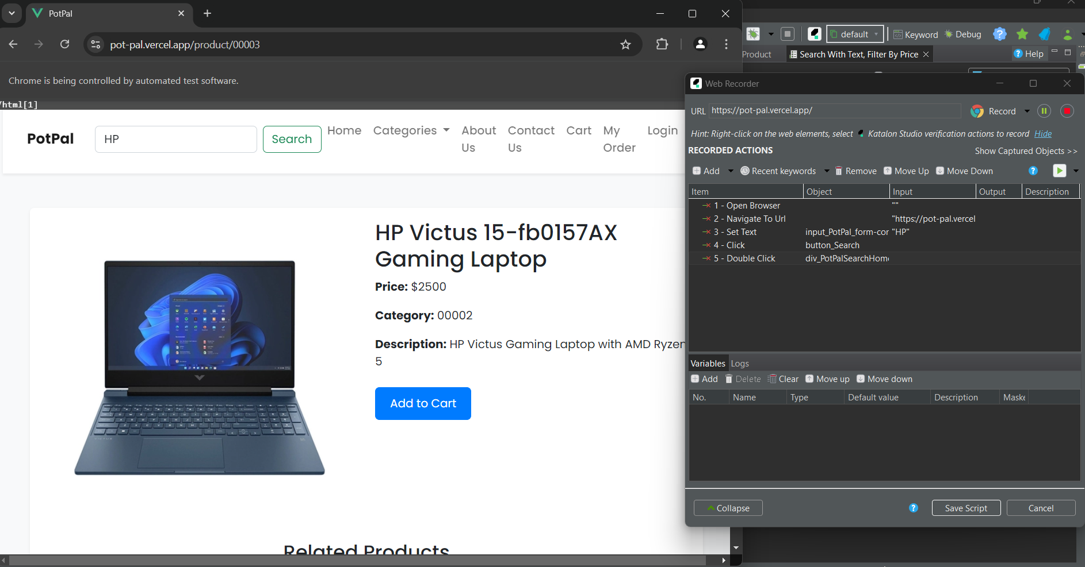
PotPal

Slide 24
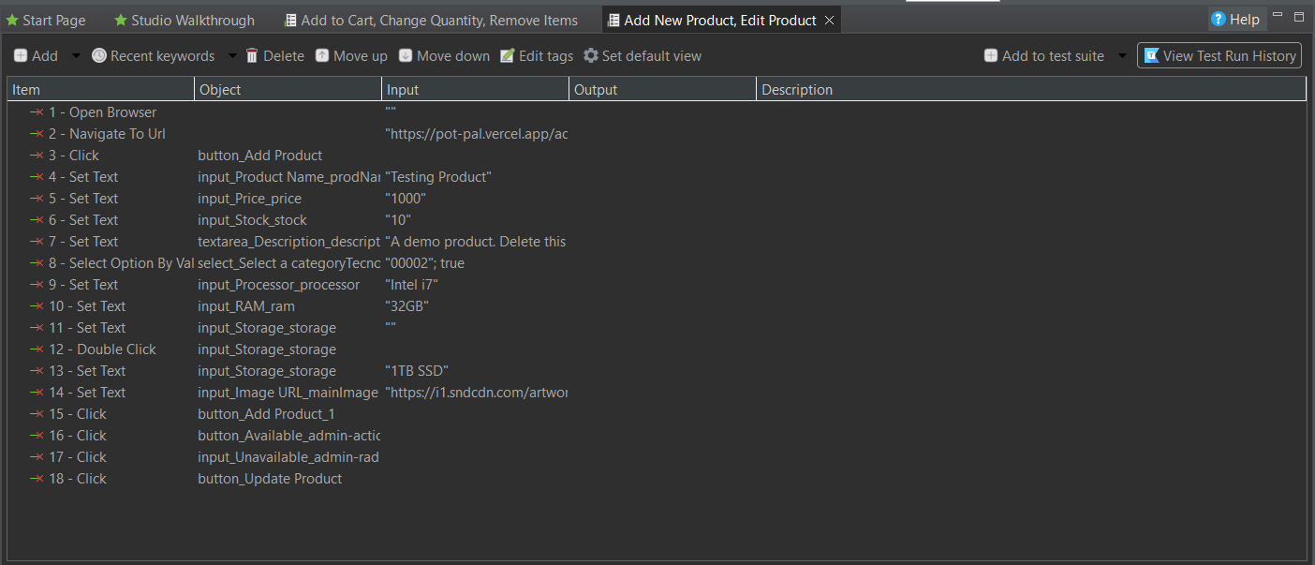
PotPal

Slide 25
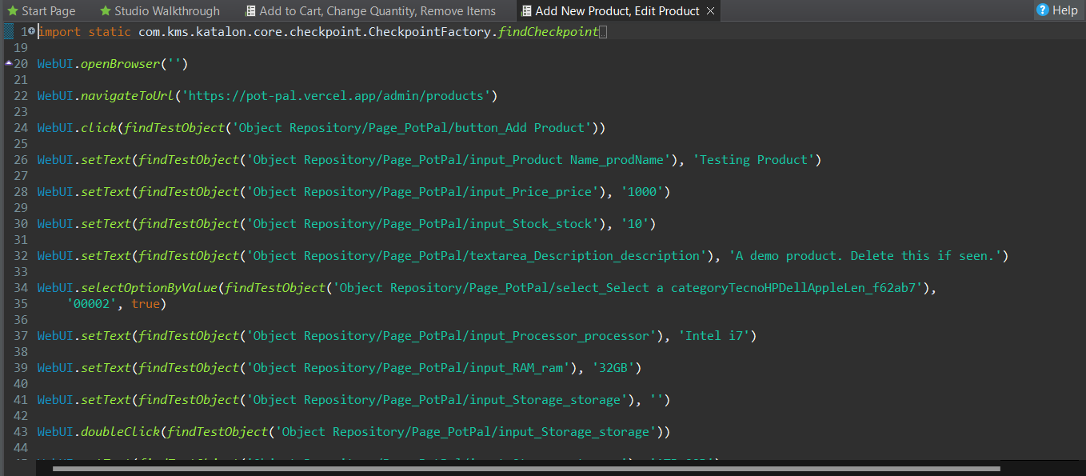
PotPal

Slide 26
PotPal
DEMO
PRODUCT

Slide 27
OUR WEBSITE
https://pot-pal.vercel.app/
THANK
YOU!

