Slide 1
Bacchus Winery
Group 3
Joshua Gruidl, Jacob Hayes, Anthony Milton

Slide 2
The Bacchus Winery
The Bacchus Winery underwent a change in management three years ago, and new business methods are needed to improve the winery’s performance. As a multi-grape vineyard, Bacchus has multiple distributors to carry the varied options and multiple suppliers to ensure the bottles are available to fill with wines.

Slide 3
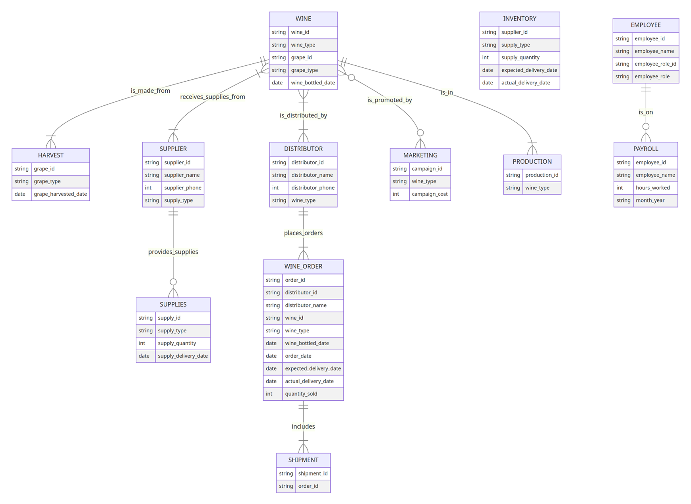
The Situation
To compose a comprehensive business relational diagram, the overarching interactions that make up the winery must be laid bare.
Bacchus Relational Diagram
Business Rules:
An Employee is on one or many Payroll reports.
A Supplier may have one or many Supplies deliveries.
One or many Distributors may carry one or many Wines.
One type of Wine may be made by one or many Harvests.
One or many types of Wine may be supplied by one or many Suppliers.
One Distributor can place one or many Wine_Orders.
One Wine_Order includes one or many Shipments.
One Wine may have zero, one, or many active Marketing campaigns.
Assumptions:
Each supplier provides a unique set of supplies, and there is no overlap in the types of supplies provided.
The winery operates on a monthly supply cycle.
The winery has a system in place to track employee hours.
All wines are distributed through the same distribution channels.
The winery has a system in place to track wine sales and distribution.
The winery operates year-round.

Slide 4
The Opportunity
Database management provides a unique opportunity for insight for Bacchus. With the ability to compile large amounts of data and process reports, we are able to fine-tune a more focused picture of each aspect of the business. Specifically, the owners, Stan and Davis Bacchus, want to have information on supplier delivery times, wine distribution, and employee time. We can provide reports for all of these requests.

Slide 5
Snapshot Report Goals
Are all suppliers delivering on time?
Is there a large gap between expected delivery and actual delivery?
What can we know about wine distribution?
Are all wines selling as expected?
What distributor carries which wines?
How many hours are each of our employees working during the last four quarters?

Slide 6
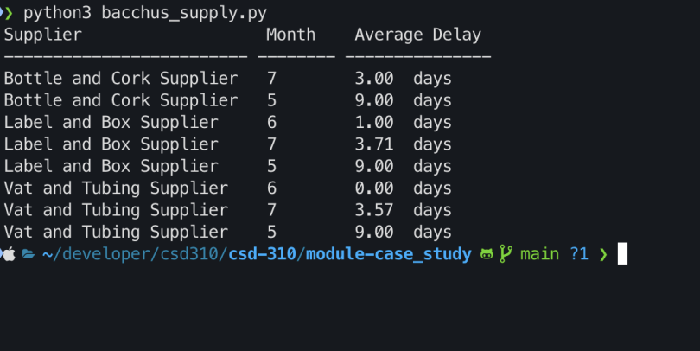
Report 1 - Supplier Delivery Report

Slide 7
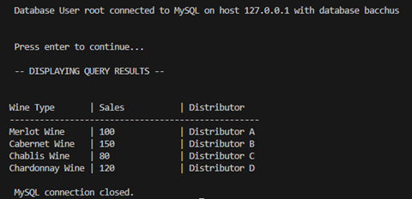
Report 2 - Wine Distributor Report

Slide 8
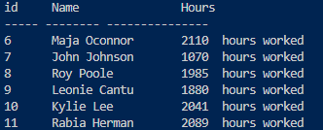
Report 3 - Employee Hour Report

