Slide 1
Software Engineering and Design
CS1 – Task 4 (Requirements Specification)
Sergii Bilousov
Denis Shevchenko
Nicolas Schmid
Christoph Sutter
Karol Ugorcak
Michel Hosmann

Slide 2
Use-Cases

Slide 3
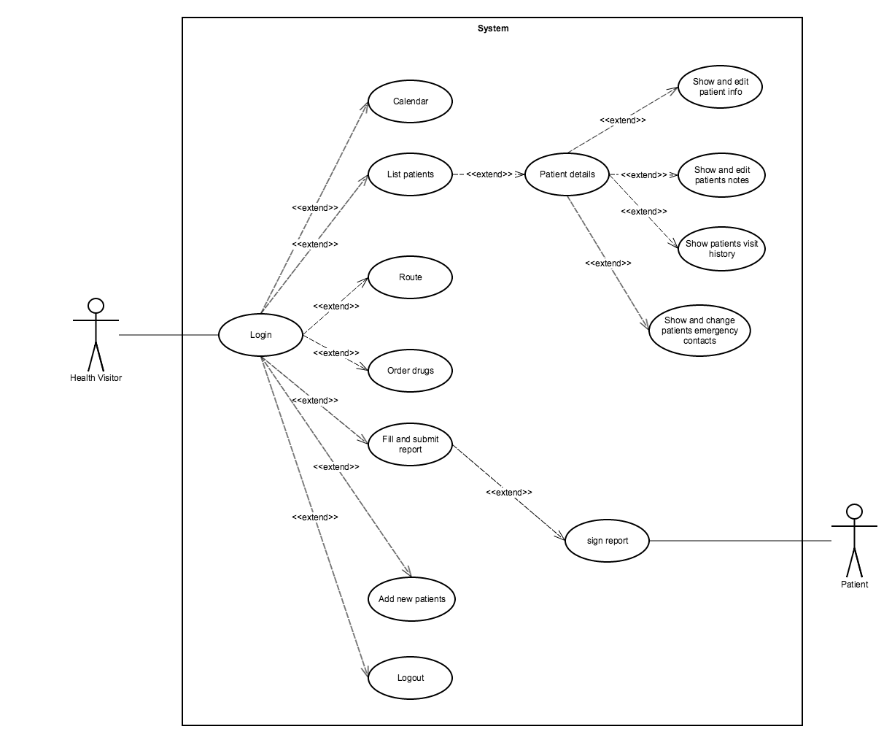
Use-Case Diagram

Slide 4
System Architecture

Slide 5
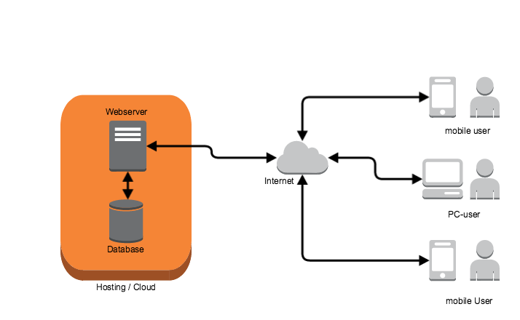
System Architecture

Slide 6
Software Evolution

Slide 7

Software Evolution

Slide 8
Testing

Slide 9



Testing
- Functional testing / Unit testing
- Usability testing
- Security testing

