Slide 1
Software Engineering and Design
CS1 – Task 3 (Design Thinking)
Sergii Bilousov
Denis Shevchenko
Nicolas Schmid
Christoph Sutter
Karol Ugorcak
Michel Hosmann

Slide 2
Scoping

Slide 3
Problems to Solve
Where and when shall a user be
Geo-Location
Path-planning (driving + time estimation per client)
What shall a user know about client (patient)
Health conditions / Allergies
Which/how many drugs (for educated)
Which treatment/help (general)
How can a user improve the quality and be efficient
Taking notes / writing a log
Creating / Following a task-list (plus time-control)
How can a user quickly find info about treatment
Printing Datasheets / Invoices
Creating contracts with clients (patients) or family members

Slide 4
Out-of-Scope & Efficiency measures
Out-of-Scope
Emergency handling
Efficiency measures
Time-control for treatment needed
Patient satisfaction

Slide 5
Research

Slide 6
Health Visitor
Visits clients at home
Aim: help / take care of people, prevent diseases
Typical tasks
Hygiene
Nutrition
Support for kids

Slide 7
Interview
Conducted two interviews with professional health visitors
Main findings
Functions of interest
Scheduling (schedule re-planning), Patient data, Travel time evaluation and automatic document preparation
Data sharing with doctors
5-6 patients per day
Two types of health visitors: with medical background and without
Usual visits: 1-time or less per week (1-3 hours) and be ready 24h / 7 days a week
Every month schedule changes

Slide 8
Health Services Research
UK: National Health Service
Nurses and midwives with additional qualification
Different help/support/advice for
Children and parents
Adults (including relationships / mental illnesess)
Collaboration with other agencies in social services
CH: Spitex
Non-profit organization
Support and help in private field
About 27 000 people
…

Slide 9
Synthesize

Slide 10
Health Visitor Personae
We have defined two profiles
Spitex Employee
Bob is 51yo., 16 y. at Spitex
Food and medication delivery + daily support
Very tight schedule
Does not have a PC, recently bought a smartphone
Midwife
Alice is 24yo., did an apprenticeship as nurse
Occasionally does visit women who want to give birth at home
Struggles with paper work associated
Speaks only German/French
She is digital native

Slide 11
Design

Slide 12
Storyboards
We had 12 stories in the beginning
Iteration 1
We eliminated duplicats / out-of-scope stories
Iteration 2
Based on interviews we have excluded stories that would not be in the field of interest of the user
Iteration 3
Selected several most promising stories as key features
Path Planning / Calendar / Schedule management
Patients details
Medication delivery / control
Registering new patients
Reporting to central office

Slide 13
Prototype

Slide 14
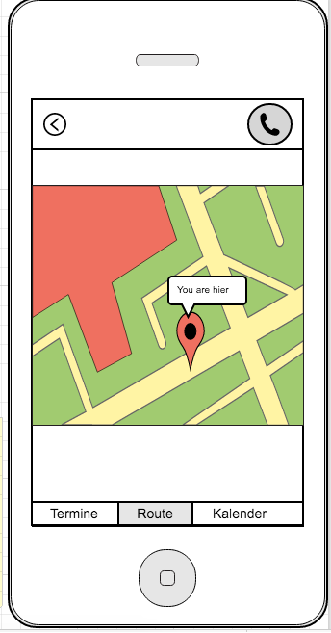
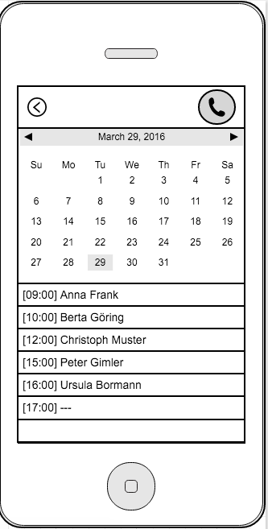
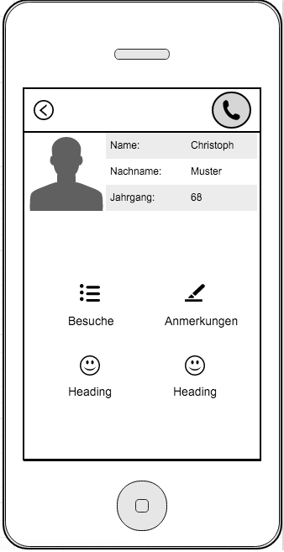
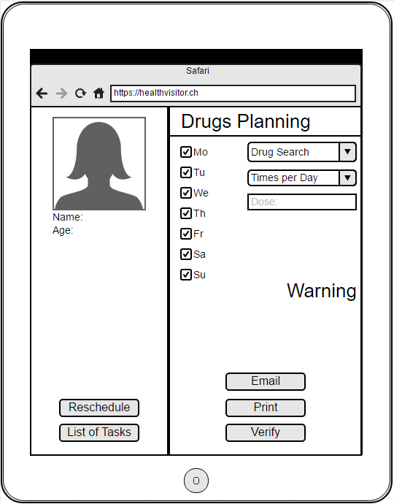
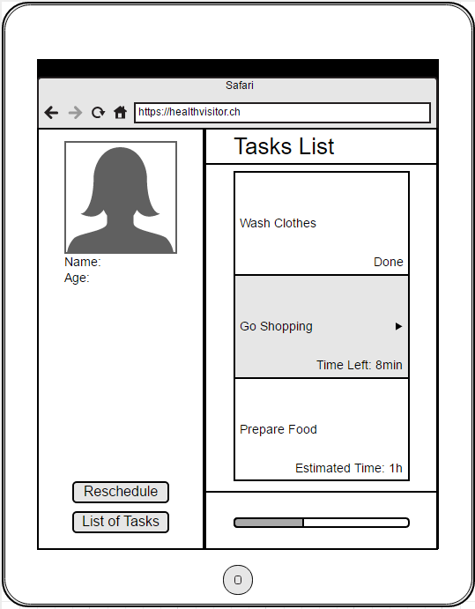

Slide 15
Validate

Slide 16
Validation & Results
Collected two replies about prototypes
From digital-native
Will use app: strong yes
Complexity: very low
Inconsistent functions: strong no
Feel secure to use: strong yes
From non-digital-native
Will use app: yes
Complexity: low
Inconsistent functions: strong no
Feel secure to use: neutral

Slide 17
Questions?

