Slide 1
CS1 Task 14: FINAL PRESENTATION
Group Blue
DIENSTAG, 14.06.2016

Slide 2
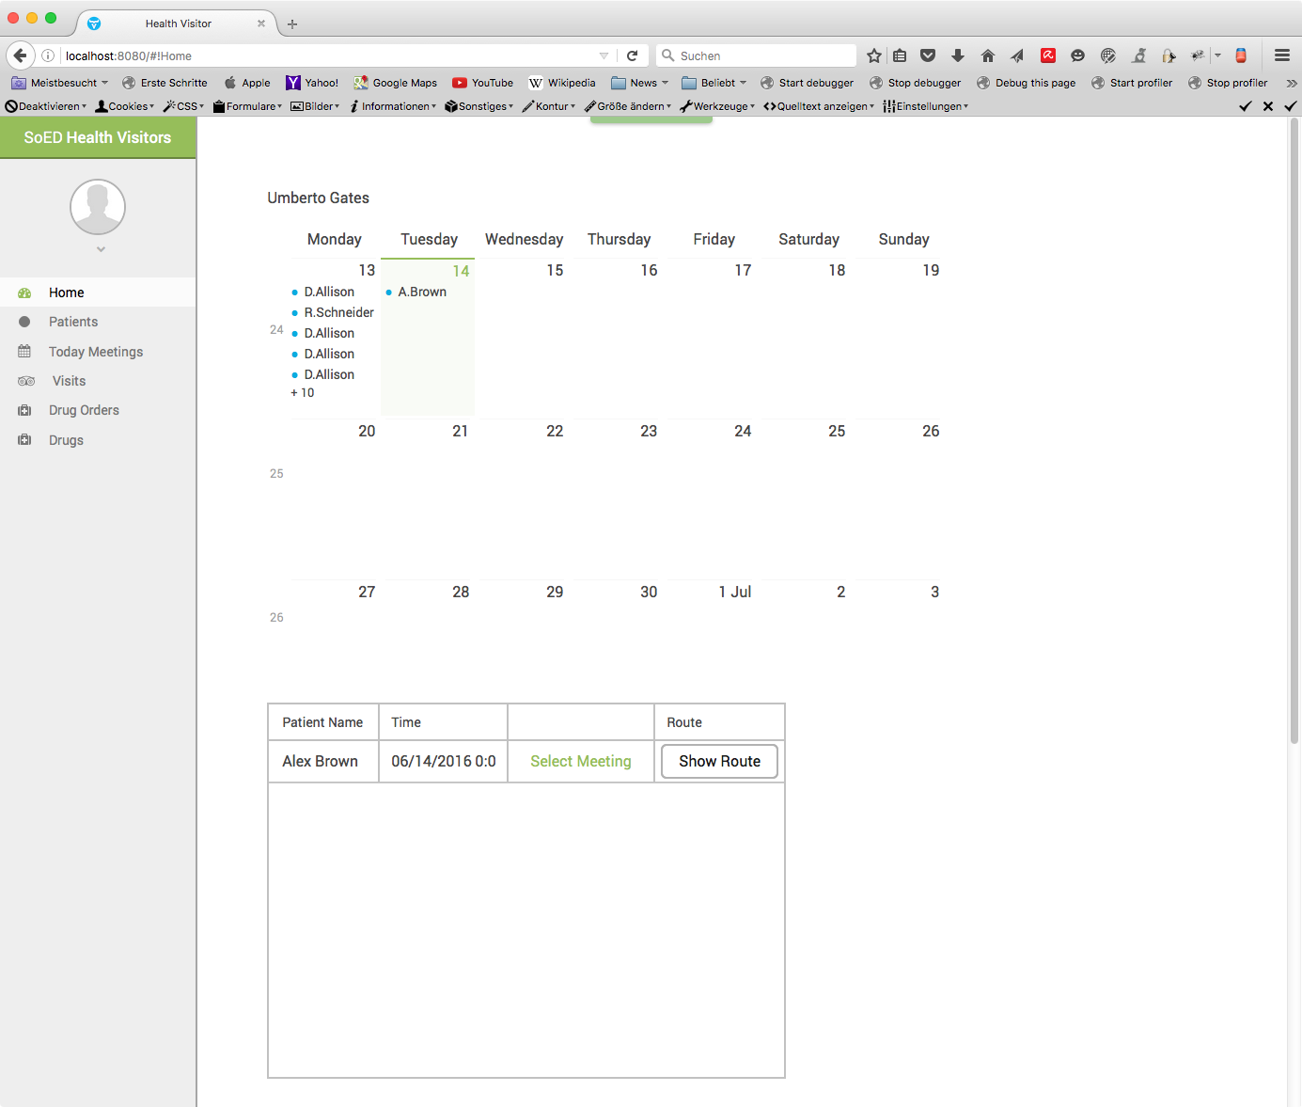
DEMONSTRATION

Slide 3
Contributions & Learnt: Sergii Bilousov
CONTRIBUTIONS:
...
LEARNT:
...

Slide 4
Contributions & Learnt: Denis Shevchenko
CONTRIBUTIONS:
Entities (Database)
google maps route
calendar
LEARNT:
JPA
Google Maps API
vaadins

Slide 5
Contributions & Learnt: Karol Ugorcak
CONTRIBUTIONS:
Patient (Entity, View), PatientList (View)
LEARNT:
Persistence, Entities
Git
Vaadin
SCRUM-method

Slide 6
Contributions & Learnt: Michel Hosmann
CONTRIBUTIONS:
Drugs, DrugOrder (Model, View, Entity),
DrugCart, send DrugOrder by Email
LEARNT:
How you (should) use Git
How Java Persistence API works
...never to use Vaadin again

Slide 7
Contributions & Learnt: Christoph Sutter
CONTRIBUTIONS:
PatientVisitHistoryListView, EmergencyContactView/Edit (Model,View,Entity)
LEARNT:
How Repositories work... Several people working at the same Project
How a Project is structured (Scrum)
Using API‘s isn‘t always more comfortable, but it makes life easier

Slide 8
Contributions & Learnt: Nicolas Schmid
CONTRIBUTIONS:
Persistence, Entities, JPA
Generic Models
Visits view
MailService, Logging, Maven, general project setup, ...
LEARNT:
GIT
Vaadin

Slide 9
lessons learnt: storyboard ↔ requirements ↔ design ↔ implementation
Specifying is a complete different thing, compared to implementing
If doing so, even a small project turns into a big one
Learn about many techniques how to specify

Slide 10
lessons learnt: Scrum retrospective
„Daily updates“
immediate feedback
„expensive“ administration
didn‘t learn a lot about Scrum (all effort was put into vaadin)

Slide 11
lessons learnt / Feedback : Course
Project only 25% of final grade → very high effort
More “real-world” project appreciated (or something you can identify with…)
Split group into designers/specifiers and developers starting with the beginning of the course

Slide 12
Questions
?

