Slide 1
Software Engineering and Design
CS1 – Task 3 (Design Thinking)
Sergii Bilousov
Denis Shevchenko
Nicolas Schmid
Christoph Sutter
Karol Ugorcak
Michel Hosmann

Slide 2
Scoping

Slide 3
Problems to Solve
Where and when?
Path-planning
Info about client?
Health conditions / Allergies
Drugs
Treatment
Improve the quality / be efficient
Taking notes
Task-list / time control
Printing Datasheets / Invoices
Contracts (patients / family members)

Slide 4
Out-of-Scope & Efficiency measures
Out-of-Scope
Emergency handling
Efficiency measures
Time-control for treatment
Patient satisfaction

Slide 5
Research

Slide 6

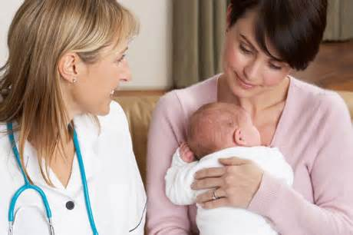
Health Visitor
Visits clients at home
Aim: help / take care of people, prevent diseases
Typical tasks
Hygiene
Nutrition
Support for kids

Slide 7
Interview
2 interviews with professional health visitors
Main findings
Scheduling (schedule re-planning), Patient data, Travel time evaluation and automatic document preparation
Information sharing
5-6 patients per day / 1x per week (1-3 hours)
Two types: with medical background and without
Every month schedule changes

Slide 8
Health Services Research
UK: National Health Service
Nurses and midwives with additional qualification
Different help/support/advice for
Children and parents
Adults (including relationships / mental illnesess)
Collaboration with other agencies in social services
CH: Spitex
Non-profit organization
Support and help in private field
About 27 000 people

Slide 9
Synthesize

Slide 10
Health Visitor Personae
We have defined two profiles
Spitex Employee
Bob is 51yo., 16 y. at Spitex
Food and medication delivery + daily support
Very tight schedule
Does not have a PC, recently bought a smartphone
Midwife
Alice is 24yo., did an apprenticeship as nurse
Occasionally does visit women who want to give birth at home
Struggles with paper work associated
Speaks only German/French
She is digital native

Slide 11
Design

Slide 12
Procedure
12 stories in the beginning
Iteration 1
Eliminated duplicates / out-of-scope stories
Iteration 2
After Interviews: excluded stories (not in field of interest)
Iteration 3
Selected most promising stories
Path Planning / Calendar / Schedule management
Patients details
Medication delivery / control
Registering new patients
Reporting to central office

Slide 13
Prototype

Slide 14
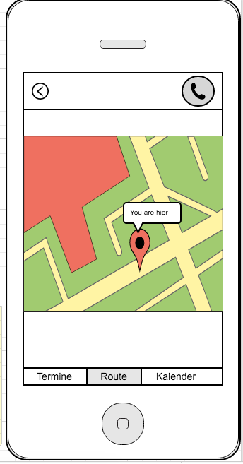
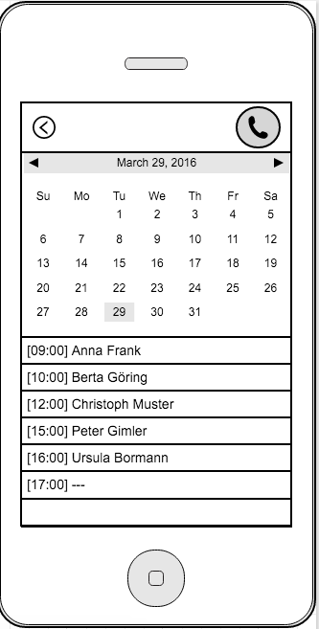
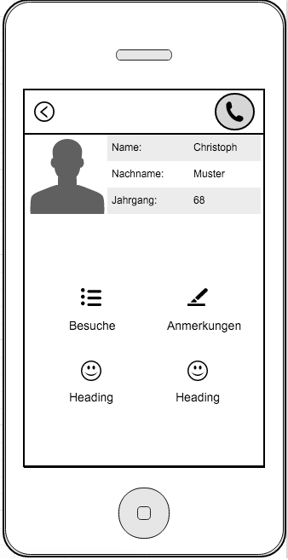
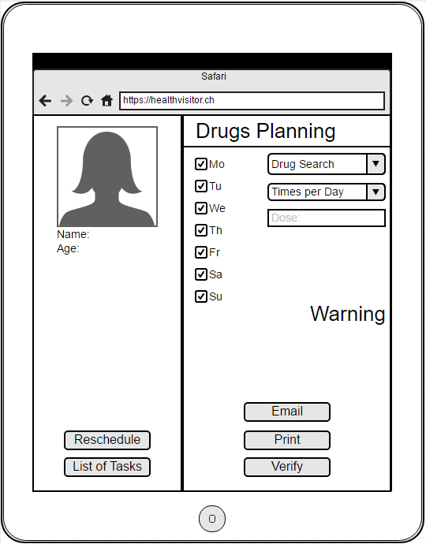
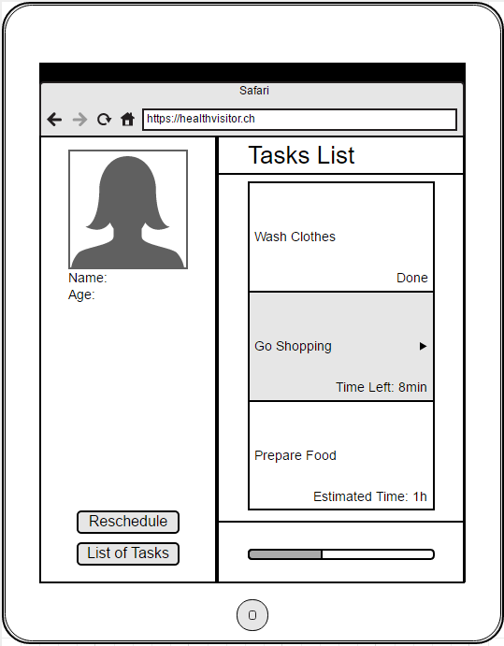

Slide 15
Validate

Slide 16
Validation & Results
Collected two replies about prototypes
Digital-native
Will use app: strong yes
Complexity: very low
Inconsistent functions: strong no
Feel secure to use: strong yes
Non-digital-native
Will use app: yes
Complexity: low
Inconsistent functions: strong no
Feel secure to use: neutral

Slide 17
Questions?

