Slide 1
SE Process
01.03.2016, Team Blue

Slide 2
Overview
Decision Process
Process Model
Activities, Goals, Tasks & Outputs
Stakeholder analysis

Slide 3
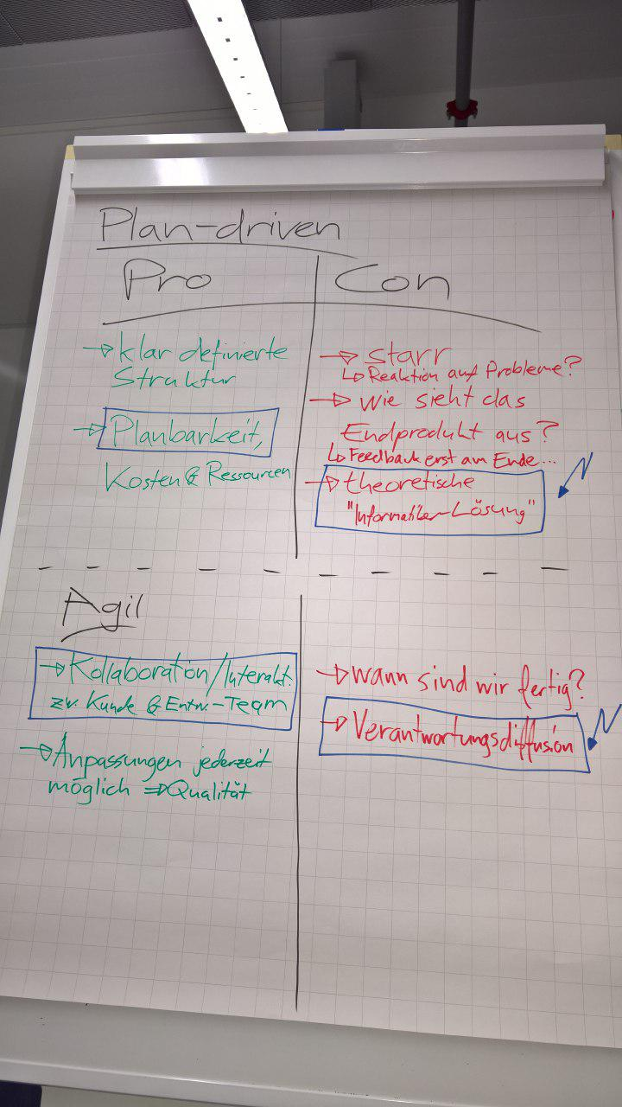

Slide 4
Process Model („Hybrid“)
Planning
Development
Review
Requirements
Testing
Project Requirements
Finalizing Product
Timeline

Slide 5
Activities | Goals | Output | Tasks
Project Requirements | project outline | project plan | schedule, resource allocation, …
Timeline | keep track of project state | steps, appointments | constant awareness
Planning | create tasks, assign employees | resource and task plan | reflect and assign tasks
Development | create next release | New software version | work on tasks
Testing | assert functionality | Test protocol, feedback | implement tests and run regression tests
Review | get customer feedback | Redefine backlog | meet, talk and reflect
Requirements | implement feedback from review | new / updated requirements | create / update specifications
Finalizing | deploy Software & collect money | perfect software | deployment, get customer approval

Slide 6
Stakeholder Analysis
Interest
C
A
D
B
Influence

Slide 7
Stakeholder analysis
Wert | Stakeholder | Interests | Want to hear | Measurements
C | Doctors | less work | „makes your life sooo much easier!“ | good communication
C | Nurses | less work, simple implementation | „ | „
C | Health Visitors | „ | „ | „
C | Receptionists | „ | „ | „
D | Medical records staff | „ | „doesn‘t affect you“ | „
A | Development Team | meaningful work | „best project ever!“ | „
A | Project Manager | succesful project within (time-) budget, reputation | „you did good boy.“ | good planning and leadership
B | Product owner | successful project below budget and before deadline | „all is going as planned.“ | „

