Slide 1
CS1 Task 12 / 13: Class diagram & State pattern
Group Blue
Montag, 30.05.2016

Slide 2
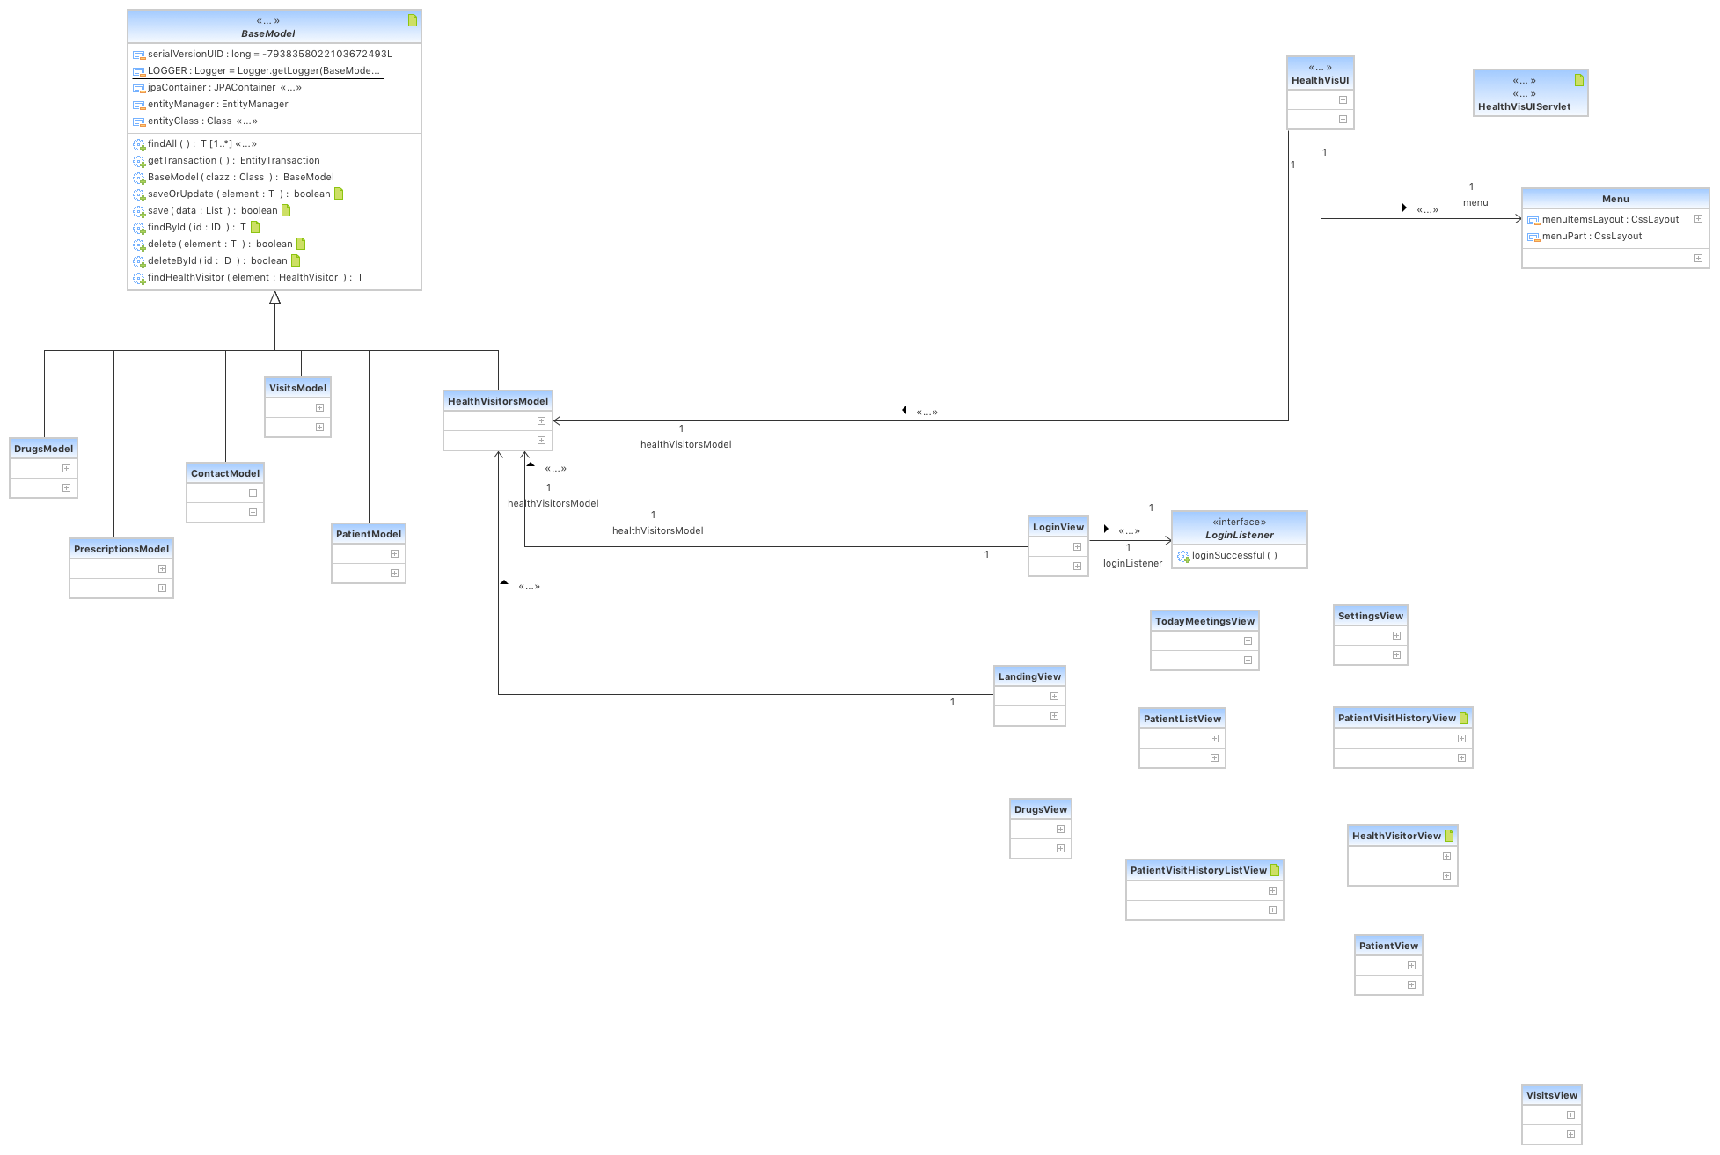
Models, views & controller

Slide 3
Models

Slide 4
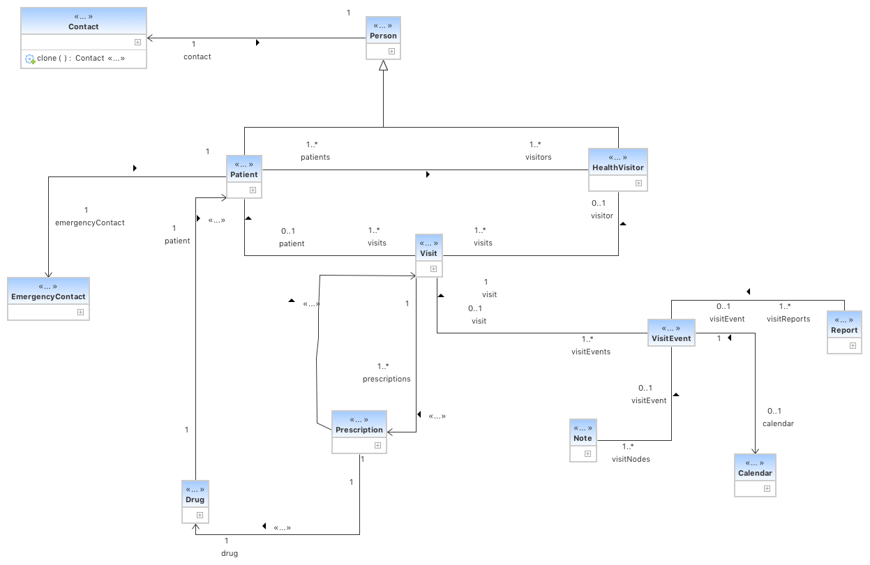
Entities

Slide 5
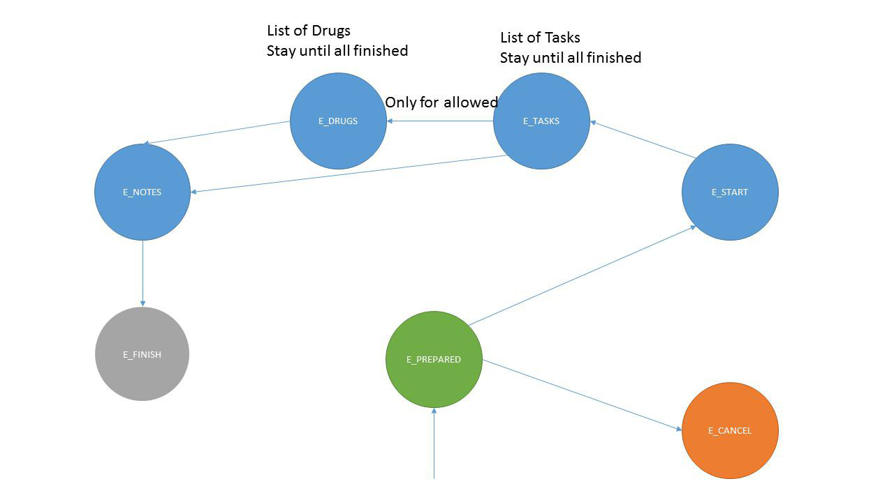
State Pattern

Slide 6
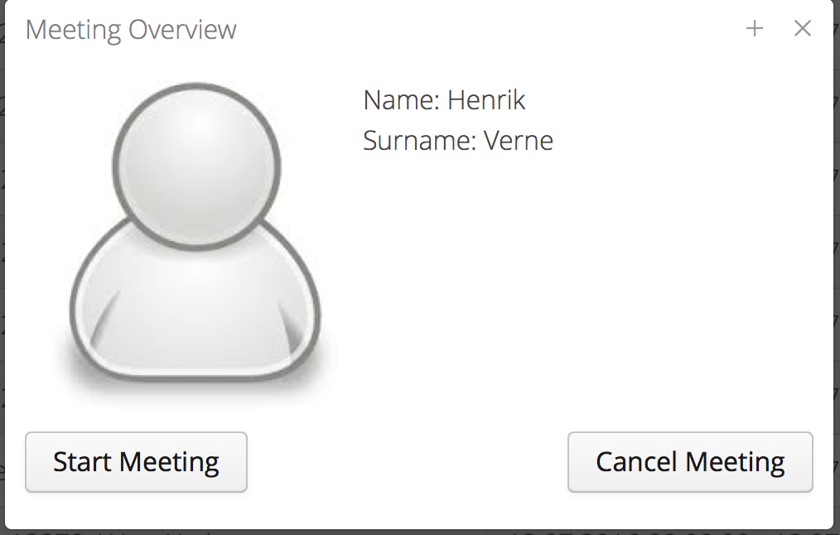
State Pattern

Slide 7
Questions ?

