Slide 1
CS1 Task 12: Class diagram
Group Blue
Montag, 30.05.2016

Slide 2
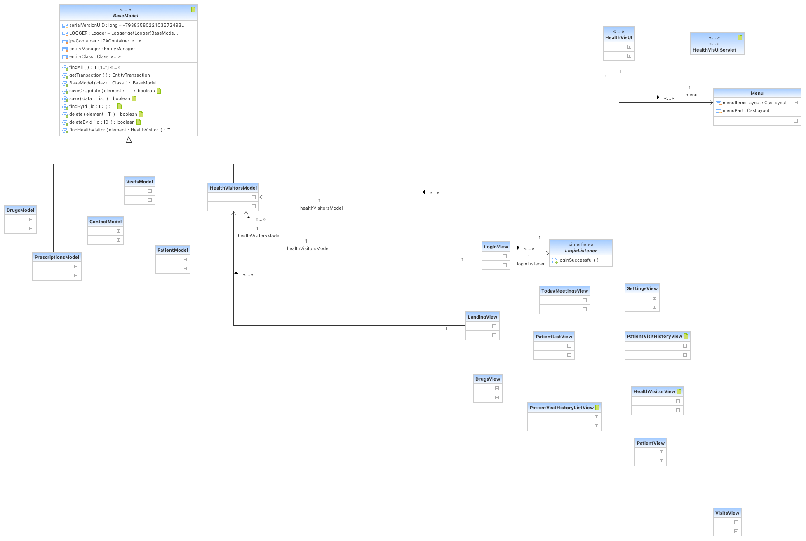
Models, views & controller

Slide 3
Models

Slide 4
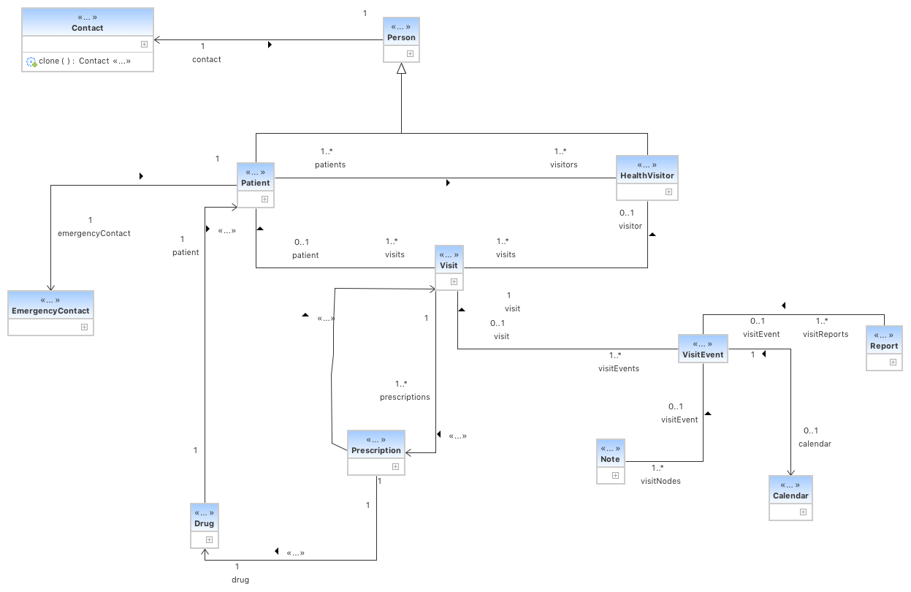
Entities

