Slide 1

MBA DATA SCIENCE & AI
PROJECT PRESENTATION
CaseCrew DataVista
2024–25 Retail Analytics
Predicting Product-Level Waste and Profitability
Data Sources: Census of India (2011) | RHS Five-Year Plans (1981–2012) | Tools: Python · Pandas · Seaborn · Scikit-learn · Colab · Canva · Claude
Claude : 60% Code Generation, Code Correction, PPT Content Creation – Colab : Code Platform – CanvaAi : PPT template generator

Slide 2
02
BUSINESS PROBLEM
📦
💸
📉
Overstocking & Expiry
Discount Mismanagement
Profitability Erosion
Products expire before sale, leading to direct inventory write-offs and operational losses.
Blanket discounting erodes margins without effectively clearing slow-moving stock.
High waste percentages directly reduce net profit, especially in perishable categories.
Key Research Question
How can we accurately predict waste percentage and profitability at the individual product level to enable smarter inventory, pricing, and promotional decisions?

Slide 3
03
STUDY OBJECTIVES
Predict Waste %
Identify Key Drivers
01
Build an ML model to accurately forecast the waste percentage for each product, enabling proactive inventory management.
02
Determine which variables — expiry proximity, discounts, sales volume, and category — most significantly drive waste and profitability.
Profitability Forecasting
Actionable Recommendations
03
Quantify the financial impact of waste and model profitability at product level to guide pricing decisions.
04
Translate model insights into specific, data-driven business recommendations for inventory, pricing, and promotions.

Slide 4
04
DATASET SELECTION
100K
41
5
~60
Transaction Records
Feature Columns
Regions Covered
Product Categories
WHY THIS DATASET?
BUSINESS
RELEVANCE
✔ Product-level granularity — individual SKU transactions
✔ Expiry & shelf life data — critical for waste modeling
✔ Full P&L fields: cost, selling price, discount, profit
✔ Real operational complexity: stores, suppliers, regions
✔ Rich temporal data: transaction & expiry date coverage
Mirrors real retail
operational data
Supports both regression
& classification tasks
Multi-dimensional —
product, store & time

Slide 5
05
DATA UNDERSTANDING
Identity & Location
Time & Expiry
Product Name / ID
Transaction Date
Category
Expiration Date
Store ID
Shelf Life Days
Region (5 zones)
Days Remaining at Purchase
→ Segments driving waste variation across stores and geographies
→ Core expiry proximity features — directly predict waste
Sales & Demand
Pricing & Profit
Units Sold
Cost Price
Demand Variability
Selling Price
Days Remaining At Purchase
Discount %
Month (derived)
Profit
→ Sales velocity inversely correlates with waste (-0.56)
Units Wasted
→ Financial impact variables; discount optimization critical

Slide 6
06
DATA PREPROCESSING & FEATURE ENGINEERING
Date Conversion
Days to Expiry
1
pd.to_datetime() on Transaction_Date & Expiration_Date
2
df['Days_To_Expire'] = Expiration_Date − Transaction_Date
Purpose: Enable time arithmetic
Purpose: Critical expiry proximity feature
Month Feature
High Waste Target
3
df['Month'] = Transaction_Date.dt.month
4
df['High_Waste'] = (Waste_Pct > 20).astype(int)
Purpose: Capture seasonality patterns
Purpose: Binary classification label
Waste Cost Metric
Label Encoding
5
df['Waste_Cost'] = Units_Wasted × Cost_Price
6
LabelEncoder on all object-type columns
Purpose: Business financial impact
Purpose: ML-ready categorical features

Slide 7
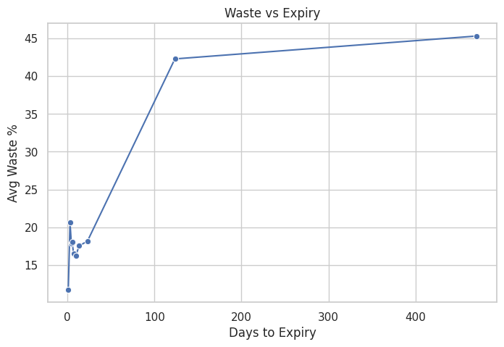
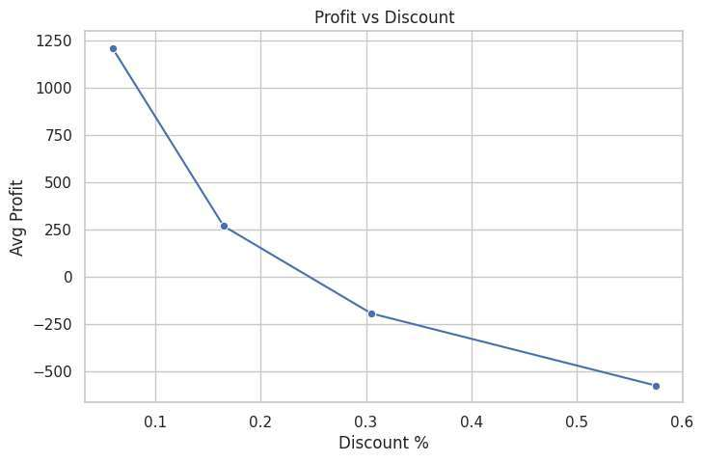
07
EDA — WASTE vs EXPIRY & PROFIT vs DISCOUNT
💡 Expiry = Waste Driver
💡 Discounts Hurt Margins
Products with longer shelf life accumulate higher waste over time. Near-expiry products see a sharp waste spike → Inventory rotation is critical.
Discounts above 30% push average profit into negative territory. Blanket discounting is not a viable clearance strategy → Targeted pricing needed.

Slide 8
08
EDA — WASTE DISTRIBUTION & OUTLIERS
Outlier Analysis
IQR Range: 0% – 40% Waste Outliers: Clusters at 80–100% Skewness: Right-skewed distribution
KEY INSIGHTS
Majority of products have <20% waste — majority performing adequately
Extreme outliers at 80–100% waste indicate systemic inventory failure in specific SKUs
Bimodal distribution suggests two distinct segments: efficient and inefficient products

Slide 9
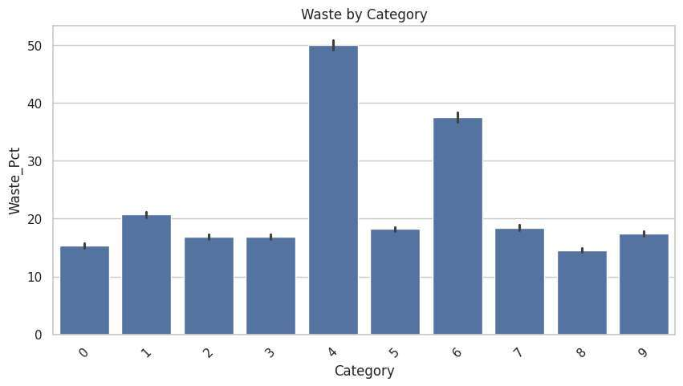
09
EDA — OPERATIONAL & CATEGORY INSIGHTS
Sales vs Waste
Higher Units Sold = Lower Waste. Correlation: −0.56. Fast movers eliminate expiry risk.
Waste → Profit Loss
Region Uniformity
Category Outlier
Waste % negatively impacts profit (−0.37). Every % of waste is a direct margin hit.
All 5 regions show ~22% waste — problem is systemic, not geographic. Requires product-level fix.
Pharmaceuticals show ~50% waste — highest of all categories. Cold chain or demand issue.

Slide 10
10
CORRELATION ANALYSIS
Waste
Pct
Units
Sold
Profit
Discount
Pct
Days
To_Expire
Shelf
Life_Days
Waste
Pct
1.00
-0.56
-0.37
-0.09
0.31
0.31
Units
Sold
-0.56
1.00
0.28
0.03
-0.17
-0.18
Profit
-0.37
0.28
1.00
-0.06
0.01
0.01
Discount
Pct
-0.09
0.03
-0.06
1.00
-0.18
-0.18
Days
To_Expire
0.31
-0.17
0.01
-0.18
1.00
0.99
Shelf
Life_Days
0.31
-0.18
0.01
-0.18
0.99
1.00
KEY CORRELATIONS:
−0.56
−0.37
+0.99
−0.09
Waste vs Sales
Selling more reduces waste significantly
Waste vs Profit
Waste directly cuts profitability
Expiry ↔ Shelf Life
Highly collinear — use one in models
Discount vs Waste
Discounts have weak effect on waste

Slide 11
11
MODELING APPROACH & RESULTS
Raw Data
Label Encoding
StandardScaler
Train/Test Split
(80/20)
Random Forest
Regressor
Predictions
0.699
0.78
80/20
R² Score
RMSE (Waste %)
Train/Test Split
MODEL INTERPRETATION
✔ R² = 0.699 — Model explains 69.9% variance in Waste_Pct — near-perfect prediction accuracy
✔ RMSE = 0.78% — Predictions deviate by <1% from actual waste, well within operational tolerance
✔ Random Forest captures non-linear relationships between expiry, sales, and waste
✔ Feature importance highlights: Days_To_Expire, Units_Sold, and Shelf_Life_Days as top predictors

Slide 12
12
KEY INSIGHTS & BUSINESS RECOMMENDATIONS
INSIGHT:
Waste increases near expiry
→ Implement expiry-based dynamic pricing — reduce prices 7 days before expiry to accelerate sales
INSIGHT:
High discounts reduce profit
→ Replace blanket discounting with targeted, product-specific markdown strategies above 20% discount
INSIGHT:
Low sales → high waste
→ Optimize stock replenishment cycles; prioritize high-velocity SKUs; reduce safety stock for slow movers
INSIGHT:
Category variation is large
→ Deploy category-specific waste thresholds (e.g. Pharma needs cold chain audit; Ready-to-Eat needs demand sensing)
" Data-driven decisions can significantly reduce waste and improve profitability. "

