Slide 1
R functions and packages
Claudia HGE - https://github.com/ClaudHGE
Burnley Campus Postgraduate Group (BCPG)

Slide 2
What are functions?
We might remember the mathematical functions like
f(x) = x + 2 ^----------- make a function where ^--------- x is the variable ^------ and returns: ^^^^^ the variable plus two

Slide 3
Why do we use functions?
if we have one value to sum (100), it’s easier to use a calculator, and type
100 + 2
[1] 102
but, what if we have a hundred different numbers?
my100 <- sample(1:1000, 100) head(my100)
[1] 575 634 919 561 991 1000

Slide 4
Why do we use functions?
It’s easier to apply a function:
my100plus2 <- my100 + 2 head(my100plus2)
[1] 577 636 921 563 993 1002
These type of functions are a piece of cake to R, but the R function can get as complex as you wish

Slide 5
R Functions
R have way too many functions incorporated, e.g.,
sum(my100plus2) # sum() returns the sum of every element in the vector
[1] 50381
length(my100plus2) # length() returns the number of elements in a vector
[1] 100

Slide 6
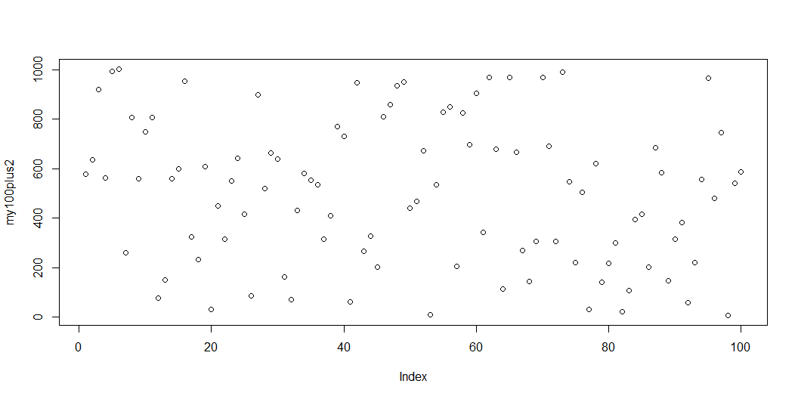
R Functions - arguments
# plot() returns a graph. Notice the arguments plot(my100plus2)

Slide 7
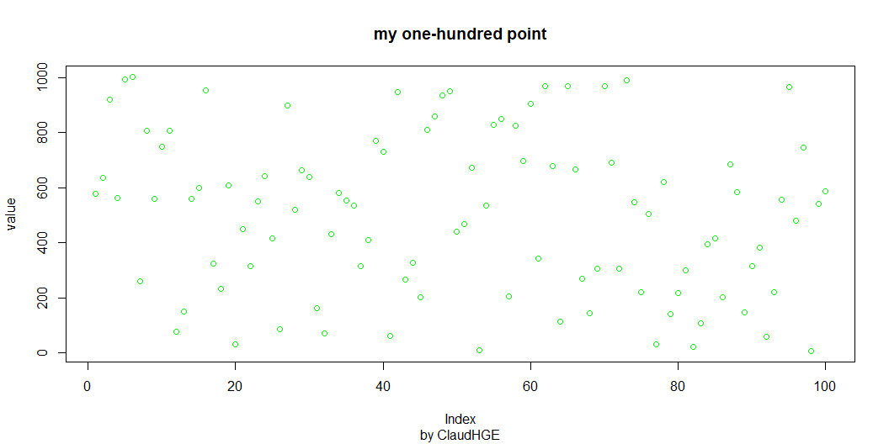
plot(my100plus2, main = "my one-hundred point", ylab = "value", sub = "by ClaudHGE", col = 'green')

Slide 8
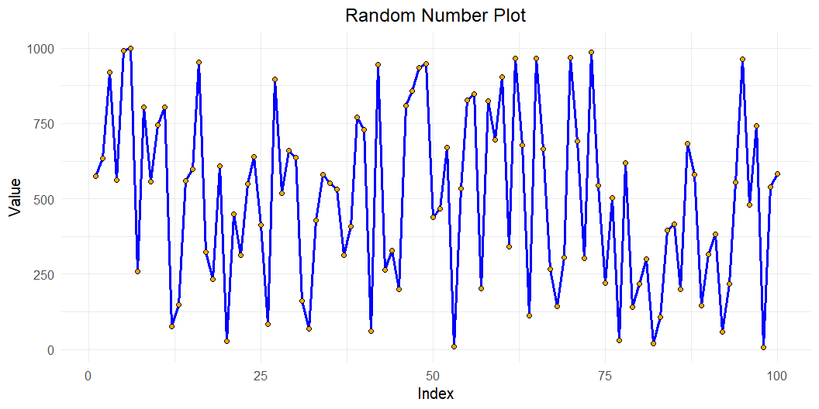
Functions in packages
Although R has tons of functions, there are packages that bring us more
#install.packages("ggplot2") to install the package library(ggplot2) # Load the package data <- data.frame(Index = 1:100, Value = my100) # make the data readable to the function # Create the plot with aesthetics ggplot(data, aes(x = Index, y = Value)) + geom_line(color = "blue", size = 1.2) + # Line color and size geom_point(shape = 21, fill = "orange", size = 2) + # Points with shape and fill theme_minimal(base_size = 15) + # Minimal theme with base font size labs(title = "Random Number Plot", # Title of the plot x = "Index", y = "Value") + # axes label theme(plot.title = element_text(hjust = 0.5)) # Center the title

Slide 9
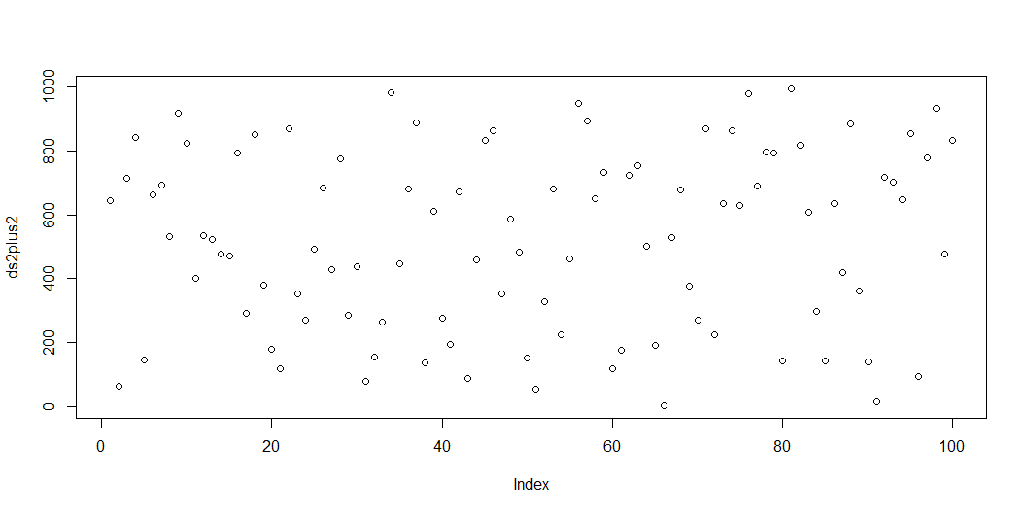
Functions in packages
R is a collaborative world and users sometimes create their own packages that are available to any other user.
Now, we used a data set with 100 numbers, what if you (may) have multiple data sets?
You can copy and paste your code and make changes here and there
ds2 <- sample(1:1000, 100) ds2plus2 <- ds2 + 2 sum(ds2plus2)
[1] 52154
plot(ds2plus2)

Slide 10
or you can create a function
Functions are reusable!
type fun and create the function
plusplot <- function(ds) { plus2 <- ds + 2 print(sum(plus2)) plot(plus2) return(plus2) }

Slide 11
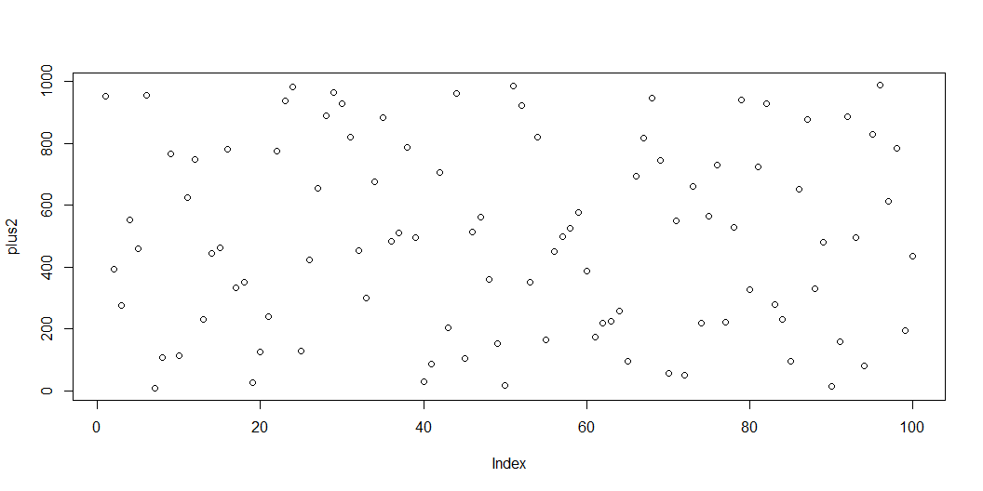
use the function
Now, the function is ready to be used
ds3 <- sample(1:1000, 100) # your data ds3_2 <- plusplot(ds = ds3) #apply the function to the data
[1] 49558

Slide 12
head(ds3_2)
[1] 954 394 275 554 461 955

Slide 13
Reusability
You can use this function as many times as you want as long as it is loaded.
Every time you clean your Global environment you’ll need to run it again.
You would need to copy and paste the function to every new project that uses it, or you can save it in a file and run it using source().
But what if you have multiple functions? at some point you’ll find it annoying having to run the functions again and again. library() is simple and easy!

Slide 14
Packages
Packages are a collection of functions that we can load on our machine or share with others. Let’s create a package! If you want to share it with others, one easy way is via GitHub!
Anatomy of a package:
Metadata: DESCRIPTION name of the pkg, description, version, dependencies
Source code: .R files in the R/ dir
roxygen comments inside the .R files that describe how the fun operates, arguments, …
namespace for the exported and imported functions
tests and other things

Slide 15
Steps to create an R Package
1. Create a GitHub repo
Go to GitHub and create a new repository for your package.
2. Create Create an R Project Open RStudio.
Click on the “Project” menu > “New Project.”
Choose “Version Control” > “Git.”
Enter the URL of your GitHub repository and select a local directory.

Slide 16
Steps to create an R Package
3. Install Required Packages
install.packages(c("devtools", "usethis")) library(devtools) library(usethis)
4. Create the Package, add licence
usethis::create_package(".") usethis::use_mit_license()

Slide 17
Steps to create an R Package
5. Create the function file
usethis::use_r ("name_of_the_function")
6. Write the function and Insert roxygen comments go to the menu bar:
Code > Insert Roxygen Skeleton. ctl+alt+shift+r
7. Document the Package:
devtools::document()

Slide 18
Steps to create an R Package
8. Check, Commit, Load, Install
devtools::check() usethis::use_git(message = "your commit message") # do this often devtools::load_all() devtools::install()

Slide 19
Install a package from GitHub
devtools::install_github("GitHubUser/package_name") library(name_of_the_package) ?name_of_the_function #get help # use the function: name_of_the_function(arguments)

Slide 20
Resources
Book: R Packages (2e) (r-pkgs.org)
Building R packages with devtools and usethis | RStudio https://www.youtube.com/watch?v=EpTkT6Rkgbs
It’s a Great Time to be an R Package Developer! - posit::conf(2023) https://www.youtube.com/watch?v=hfqjyeA_z7s

