Slide 1

Forecasting Apple Inc’s Quarterly Net Sales
A Time Series Analysis by Nicole Burns
College of Information Technology | Western Governor's University | Graduate Capstone

Slide 2
Table of Contents
Introduction
Problem Statement & Hypothesis
The Data Analysis Process
The Results
Limitations
Proposed Actions
Expected Benefits
Sources

Slide 3

Introduction
MSDA Student
B.S. in Accounting—Purdue University
Former Derivatives Trader
Interested in Data Science in Finance

Slide 4
Problem Statement
The first company with a 3 trillion dollar market value.
Their financial performance and growth trajectory are of interest to stakeholders.
The ability to forecast future sales with a high level of accuracy is essential.
Hypothesis
Can a SARIMA model effectively forecast Apple’s quarterly revenue with > 80% accuracy?
$H_{0}$: A SARIMA model can’t effectively forecast Apple’s quarterly revenue at a model accuracy of > 80%.
𝐻_0: A SARIMA model can’t effectively forecast Apple’s quarterly revenue at a model accuracy of > 80%.
$H_{1}$: A SARIMA model can effectively forecast Apple’s quarterly revenue at a model accuracy of > 80%.
𝐻_1: A SARIMA model can effectively forecast Apple’s quarterly revenue at a model accuracy of > 80%.

Slide 5

The Data Analysis Process
Data Collection
Data Preparation
Exploratory Analysis
Predictive Modeling
Model Evaluation
The dataset was downloaded in CSV format via Yahoo Finance
After transposing, datatypes were converted, commas were removed, and revenue values were reduced to improve readability. All columns not pertinent to the analysis were omitted.
Model fit and forecast accuracy were evaluated.
After creating train/validation splits, a SARIMA model was built using the ‘auto_arima’ function to select the best parameters. The model was used to generate forecast values.
An ADF test and visualizations were generated to understand the trends and patterns within the dataset.

Slide 6
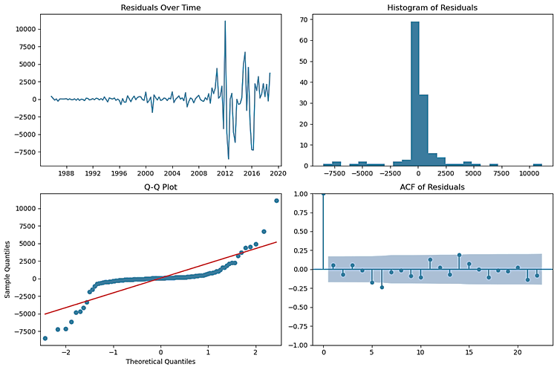
The Results
Model Fit
The model managed to account for a significant amount of the data’s autocorrelation, which is a positive outcome.
The distribution and extreme values in the residuals suggest that the model could be improved.
The spikes in residuals over time, the skewed histogram, and the deviations from normality of the tails in the Q-Q plot indicate that the model may not be fully capturing all the data’s underlying patterns.

Slide 7
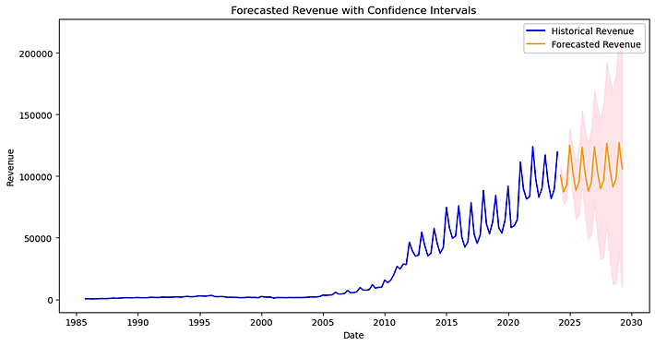
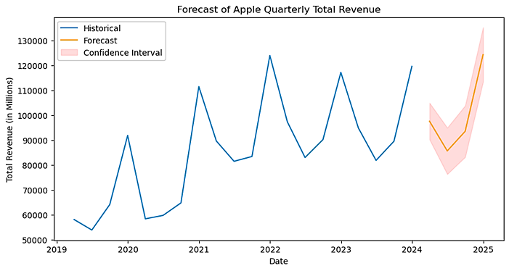
Results cont.
Forecast
Long Term—Projections spanning 21 quarters into the future display wide confidence intervals suggesting that there is uncertainty in the forecast as time increases. MAPE yielded moderate results at 33%, inferring a 67% accuracy.
Short Term—Utilizing the last 5 years of historical quarterly revenue and projecting 1 year into the future, showed a significant improvement with a MAPE of ~3.97% and ~96% accuracy.

Slide 8
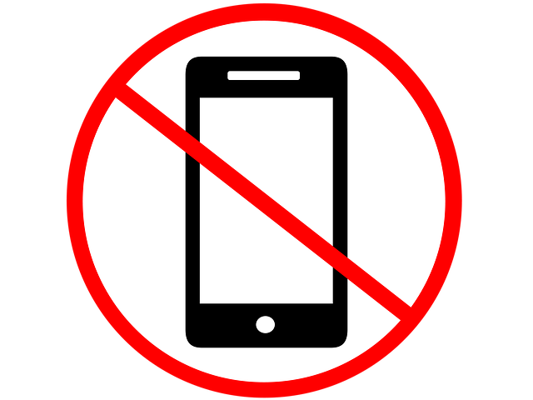
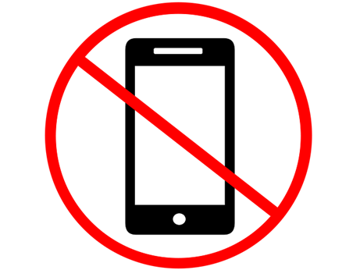
Limitations
Revenue is only recorded annually and quarterly, limiting the amount of data the model is trained on. The more data for training, the more reliable the prediction accuracy is.
Much of the dataset is considered irrelevant due to time frames. Years like 1985 aren’t comparable to recent times economically or regarding Apple’s current consumer sentiment. This is also why forecasting too far into the future creates uncertainty.

Slide 9
Proposed Actions
Employ the SARIMA model primarily for short-term revenue forecasting, treating it as an informative tool rather than a prediction.
Future research should include external factors to build a model that better accounts for external influences and trends.
Pair SARIMA with other forecasting methods or machine learning models to enhance prediction accuracy.

Slide 10
Expected Benefits
The analysis revealed that a SARIMA model is capable of utilizing Apple’s short-term historical quarterly revenue to effectively forecast future quarterly revenue with over 90% accuracy.
This insight enables stakeholders interested in Apple’s future performance to use this information as a foundation for strategic decisions.
Counter in external factors and utilize a combination of forecasting methods to validate the results obtained in this study.

Slide 11


Sources
Title Page Photo by Unknown Author is licensed under CC BY-NC and provided by Bing
Patra, T. D.-D. (2023, September 24). Sarima vs Arima for Timeseries Analysis Model. Medium. Retrieved April 3, 2024, from https://dhirajpatra.medium.com/sarima-vs-arima-for-timeseries-analysis-model-a600ab544b1f
Vaswani, A., Prasad , Dr. P. C., & Padhi, Dr. P. K. (2023). Journal of University of Shanghai for Science and Technology. Time Series Analysis: An Application of SARIMA Model in General Trade to Forecast Sales, 25(3), Retrieved April 3, 2024, from https://jusst.org/wp-content/uploads/2023/03/Time-Series-Analysis-An-Application-of-SARIMA.pdf. https://doi.org/10.51201/6735
Vlastelica, R., & Bloomberg. (2023, June 30). Apple just made history by becoming the first company with a $3 trillion market value-’all powered by a device people look at 4 hours a day’. Fortune. Retrieved April 3, 2024, from https://fortune.com/2023/06/30/apple- history-3-trillion-market-value/
Yahoo! (2024, April 1). Apple Inc. (AAPL) income statement. Yahoo! Finance. Retrieved April 1, 2024, from https://finance.yahoo.com/quote/AAPL/financials

