Slide 1

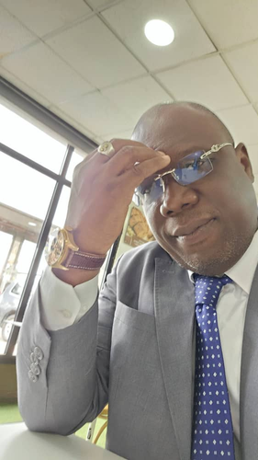
Msc Software Engineering Program
Financial engineer since 2009, my present job is to work as a Consultant in Management. To I’m employee in a consulting firm established in Ivory Coast where may position is CEO. Actually, I lead this company since it formation on the sixth of jun 2015.
A little bit about myself
HUGUES V. MEL
Financial Engineer
1

Slide 2

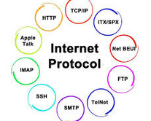
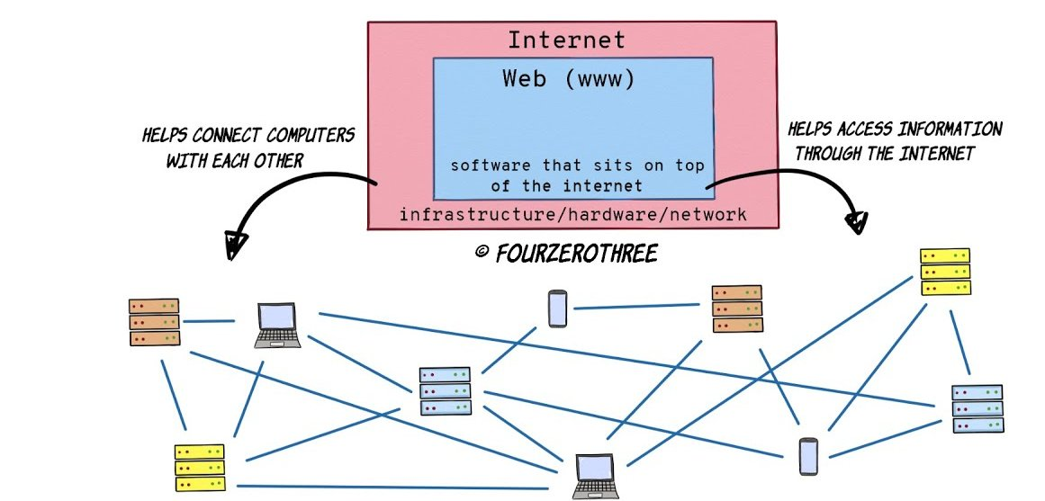
This project the second assignment of February 2025
MSc Software Engineering Program
Agenda
Topic 1
Topic 2
Topic 3
HOW DOES THE WEB WORKS?
WHAT DO I NEED TO BE A WEB DEVELOPER?
WHY DID I CHOOSE TO LEARN WEB DEVELOPMENT?

Slide 3


I. HOW DOES THE WEB WORKS ?
The web, or World Wide Web (WWW), is a system of interconnected documents and resources that are accessed over the internet. It works through a combination of technologies and protocols that allow users to retrieve and view information stored on servers. Here's a breakdown of how the web works:
1. Key Components of the Web
The web relies on the following key components:
a. Clients (Web Browsers)
- Clients are devices (e.g., computers, smartphones) that users use to access the web.
- Web browsers (e.g., Chrome, Firefox, Safari) are software applications that retrieve and display web pages.
b. Servers
- Servers are special computers that store and deliver web pages and other resources (e.g., images, videos) to clients.
- When a user requests a web page, the server processes the request and sends the appropriate files.
c. Internet
- The internet is the global network that connects clients and servers.
- It allows data to be transmitted between devices using standardized protocols.
d. Protocols
- Protocols are rules that govern how data is transmitted and received over the internet.
- The most important protocol for the web is HTTP/HTTPS (Hypertext Transfer Protocol/Secure).

Slide 4
II. WHY DO I NEED TO BE A WEB DEVELOPER ?
As both a Financial Engineer and Consultant in Management to have strong skills in computer science, namely in software engineer a demand of modern our modern times. Therefore, continue to learn in the fields that can help me enhance the quality of what I have to deliver daily to my company is a very motivating for me.
III. WHY DO I NEED CHOOSE WEB DEVELOPMENT ?
My passion for web development comes from my first days as an employee in a web agency. At that time in the 2000s, I discovered HTML and since then I have always been fascinated by it without being able to master it, this program of Master of computer Science is a great opportunity for me.
CONCLUSION
In summary, the web works through a combination of clients, servers, protocols, and technologies that enable
users to access and interact with information stored on the internet.

