Slide 1

Msc Software Engineering Program
1

Slide 2
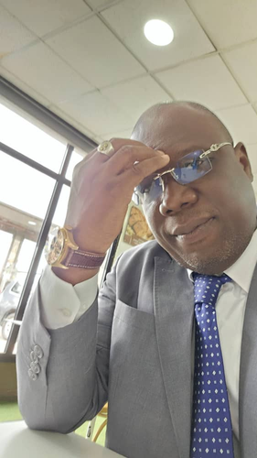
Msc Software Engineering Program
Financial engineer since 2009, my present job is to work as a Consultant in Management. To I’m employee in a consulting firm established in Ivory Coast where may position is CEO.
A little bit on me
HUGUES V. MEL
Financial Engineer
1

Slide 3



This project the second assignment of February 2025 cohorte of Msc Software Engineering Program
Agenda
Topic 1
Topic 2
Topic 3
HOW DOES THE WEB WORKS ?
WHAT DO YOU NEED TO BE A WEB DEVELOPER?
WHY DID YOU CHOOSE TO LEARN WEB DEVELOPMENT ?

Slide 4


1. HOW DOES THE WEB WORKS ?
Indeed,

Slide 5
In this checkpoint, you are going to create a presentation (max 5 slides) where you will explain the following subjects:
How does the web work?
What do you need to be a web developer?
Why did you choose to learn web development?
Hint: The purpose of this presentation is not to copy-paste information from the Internet but to learn how to research, ask precise questions, and find the best answers. In other words, the goal here is to learn how to learn.

