Slide 1
James Turrell
By Luis Brito and Kevin Vincent

Slide 2
Bio
James Turrell was born on May 6, 1943. He was born in Los Angeles, California. He has a B.A. Degree in Psychology, from Pomona College. Since the 1960’s, Turrel has created bodies of art that center around the conception and matter of light. His work is composed of honoring the optical and emotional effects that light has on an individual.

Slide 3
New Media
- James Turrell’s body of work contains artistic pieces that are wholly dependent on the users interaction and participation.
-His art requires the audience to view the medium, light, as a resource that is on demand in different forms and times throughout the day.
-James’ work blends digital and traditional forms to create manipulatable new media.

Slide 4
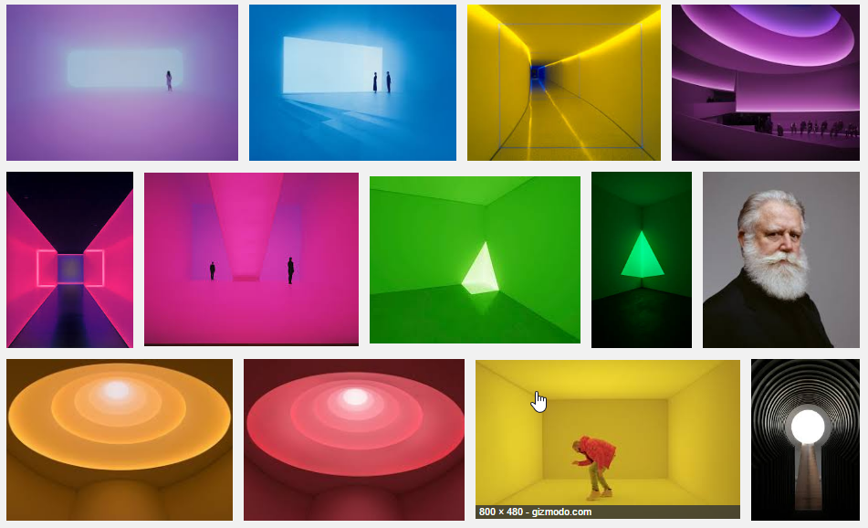
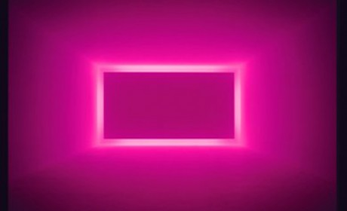
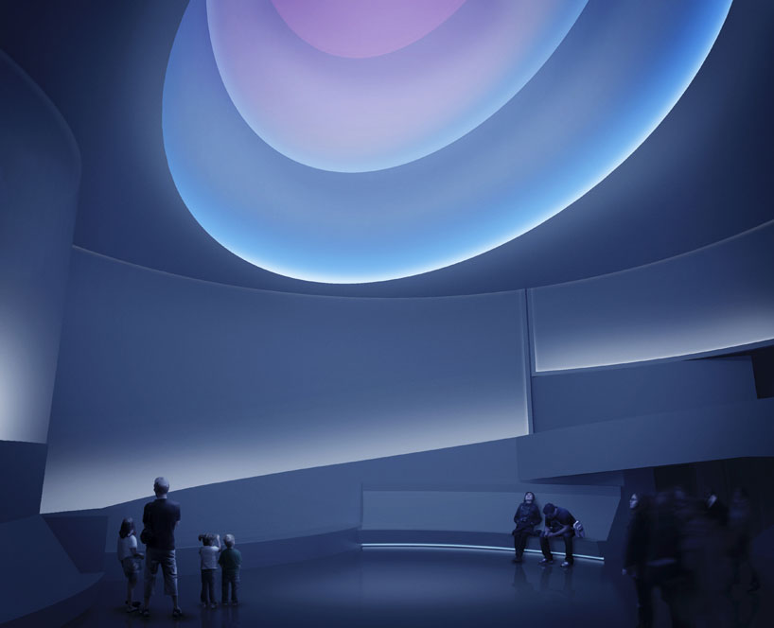
Examples
LACMA
Guggenheim

Slide 5
Successes and Failures
Roden Crater: http://rodencrater.com/
Shallow Spaces: http://jamesturrell.com/work/type/shallow/
Art featured in LACMA
Art featured in the Guggenheim
Spent a year in jail after being arrested in 1966 for coaching young men on how to avoid the Vietnam war draft.
John D. and Catherine T. MacArthur Foundation Fellowship in 1984
National Medal of Arts in 2013
Inspired “Hotline Bling”: https://www.youtube.com/watch?v=uxpDa-c-4Mc

Slide 6
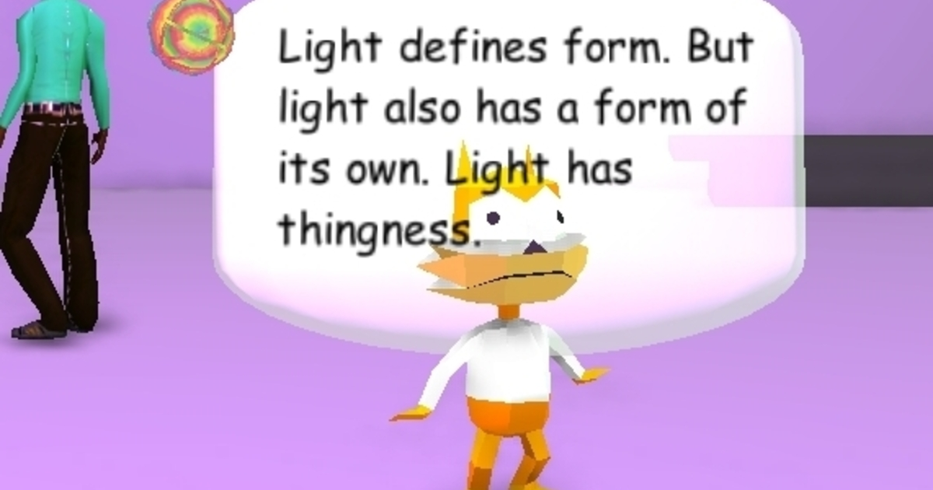
Why we chose him: Luis
I chose James Turrell because of his works’ closeness to games. James Turrell’s pieces are very heavily rooted in involving the viewer as an active participant in his art. When navigating the space within and around a James Turrell artwork, it’s very easy to find a new or different perspective on the art and space around you. I feel as though this has a lot of applications for New Media.
LACMA recently displayed a digital exhibit to accompany their physical exhibit of James Turrell’s work. It’s in video game form and coincides within the same space that I work in, medium wise.

Slide 7
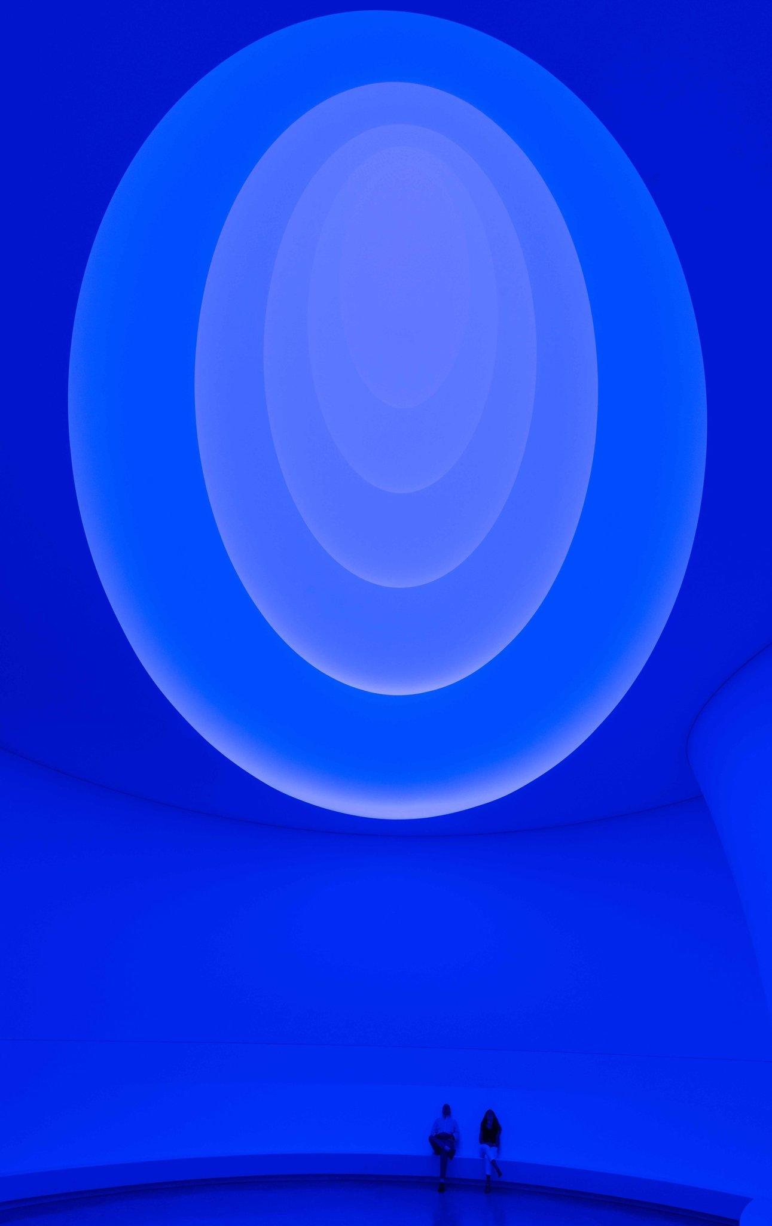
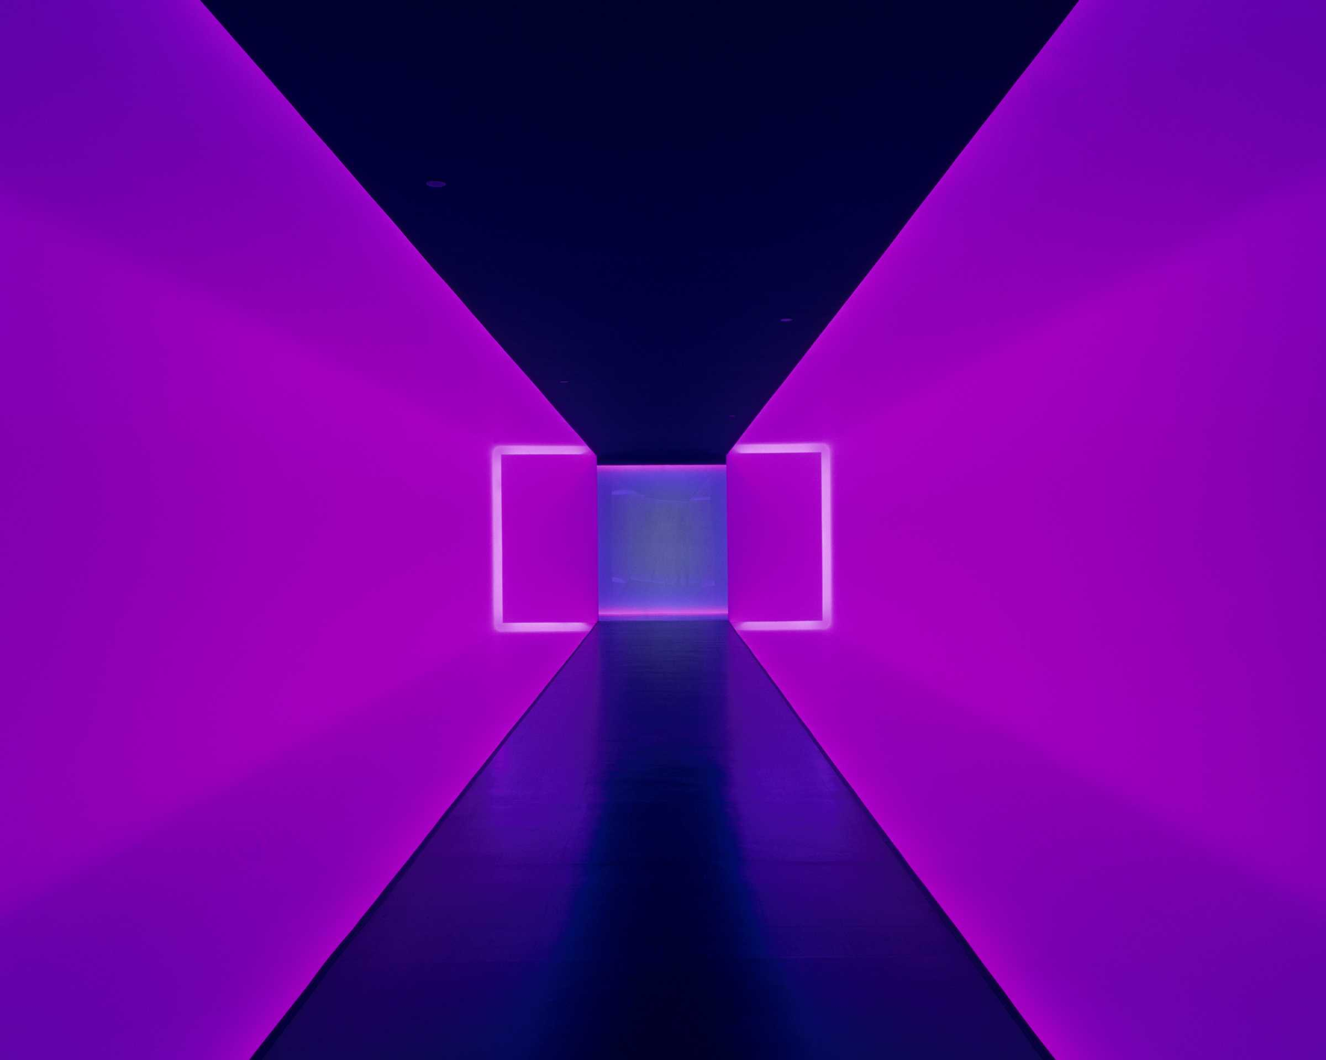
Why we chose him: Kevin
The reason I chose James Turrell is because of the unique type of artwork that he creates. I love artwork that involves the use of light and how one may connect to the light through his artwork in an optical, tangible and emotional manner. I also love how he distorts light by using color in his illustrations, this creates a great experience for me. I believe his idea of using light in new ways that inspire viewers, walks hand in hand in relation to examining New Media art.

Slide 8
What would we steal: Luis
I would like to steal the unique perspective that James Turrell has on the world. Because he was raised as a quaker, he approaches technology and the medium in which he works, differently. Being able to further obfuscate the way one works on their own artwork would be a really great skill when trying to determine how an audience would look at a piece. Then, as an artist, you can play right into the emotions and values of your intended viewer.

Slide 9
What would we steal: Kevin
The main idea that I would steal from James Turrell’s masterpieces would be the ability to use light in and of itself in the realm of art in order to inspire others. I just think it’s amazing how one may be awe-struck by just seeing light rays and being inspired by their tangible presence because of the light in and of itself.

