Slide 1
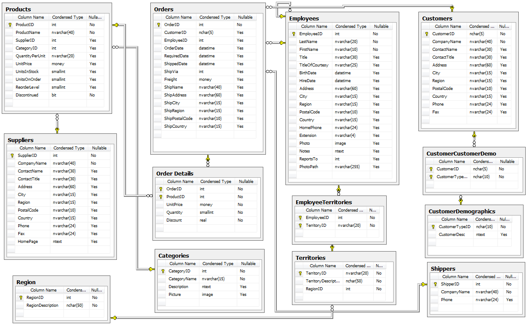
Synopsis of Dataset
"The Northwind database is a sample database used by Microsoft to demonstrate the features of some of its products, including SQL Server and Microsoft Access. The database contains the sales data for Northwind Traders, a fictitious specialty foods export/import company."

Slide 2
Do discounts have a statistically significant effect on the number of products customers order? If so, at what level(s) of discount?
Null Hypothesis The number of products customers order is not related to the level of discount
Alternative Hypothesis The number of products customers order is related to the level of discount.
Effect Size Numbers of products ordered at the 5%, 10%, 15%, 20%, 25% levels of discount.
Variables We Are Interested in Determining the Relationship Between Number of products ordered and percent discount

Slide 3
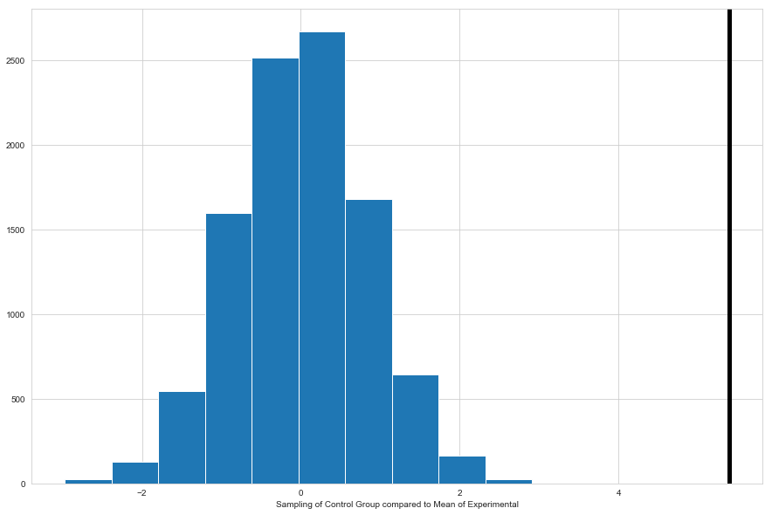
The mean value of discount applied the experimental group is about 5.4 Compared to a sampling of our Control Group Shows that there is a significant difference and this is reflected in our p value that is so low most tests show it as 0.

Slide 4
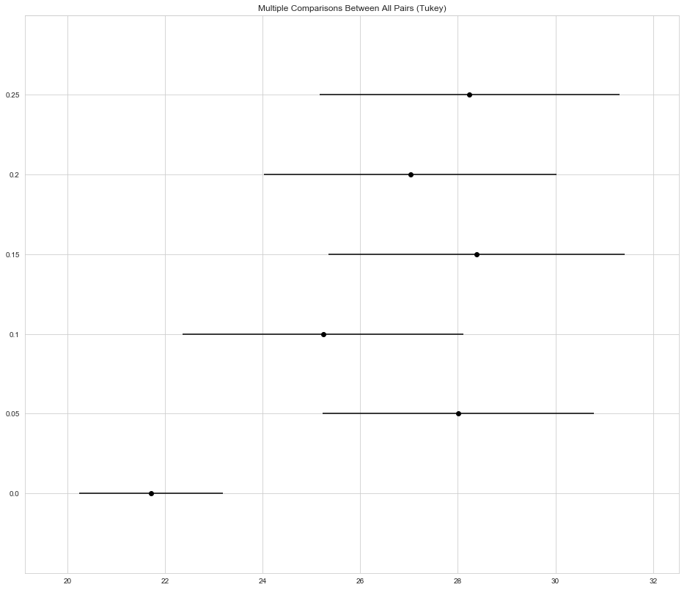
Number of Orders Sold at Different Discount Levels

Slide 5
Conclusions
We can reject the Null Hypothesis: The number of products customers order is not related to the level of discount
Our Alternative Hypothesis has more validity: The number of products customers order is related to the level of discount.

Slide 6
Is the company spending more on shipping each year?
Null Hypothesis An order is just as likely to cost the same regardless of year
Alternative Hypothesis The cost of the shipment is related to the year in which it is shipped
Effect Size The USA inflation rate was 0.8% for 2014, so I am interested in any change over that effect size.
Variables We Are Interested in Determining the Relationship Between The Year the order was shipped and the Cost of shipping the order.

Slide 7
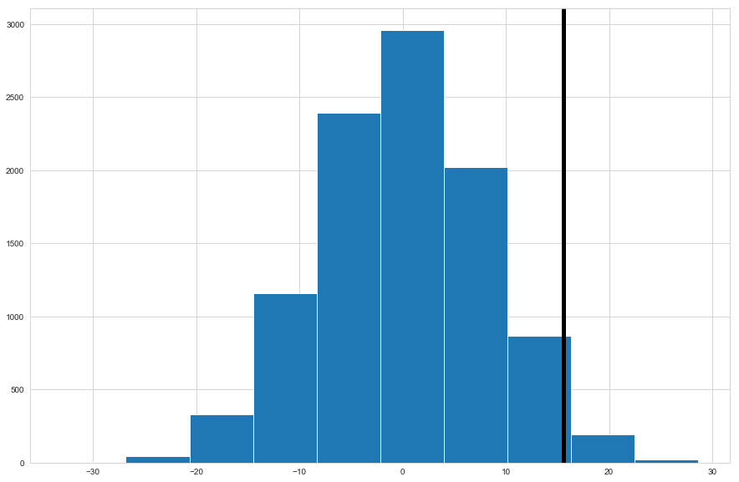
Is the company spending more on shipping each year?
pvalue=0.15099124016465792

