Slide 1

David Burton
Former Teacher
Current Student with Flatiron (Data Science Bootcamp)
10+ years Teaching Experience
Master’s Degree Elementary Education (Indiana University)
Third Grade Teacher at El Alsson International School (Cairo,Egypt)
Second Grade Teacher at Slaughter Elementary (Louisville, Kentucky)
Math Teacher at Neval Thomas Elementary (Washington D.C)
English Teacher at Fushing private school (Taipei, Taiwan)

Slide 2
Student Outcome Predictor
There were two schools in Portugal that took a census of their students and tried to use this to predict what grades they would achieve.
This presentation will show what we can learn from this type of study.

Slide 3
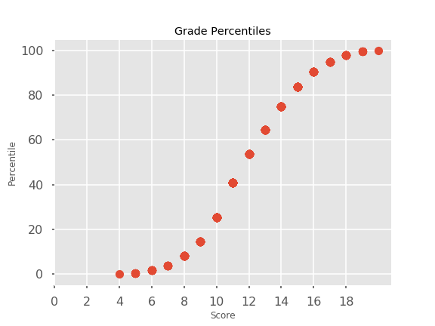
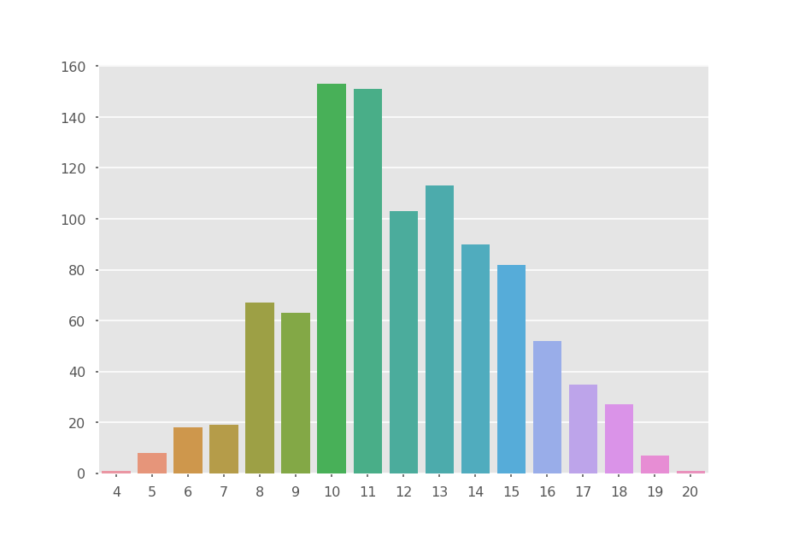
Predicting Students Final Grade

Slide 4

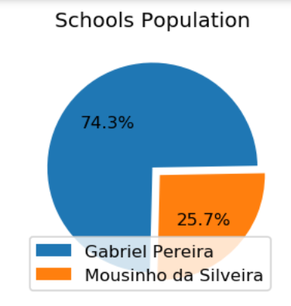
What Data Was collected?
Students were surveyed on their lifestyle, family and academic background
2 classes at 2 high schools completed the survey

Slide 5
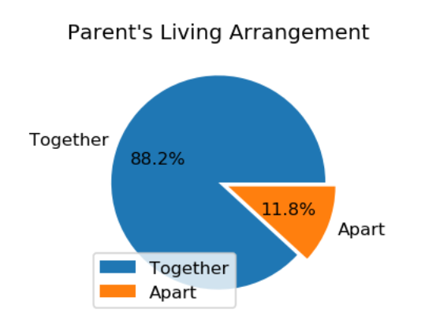
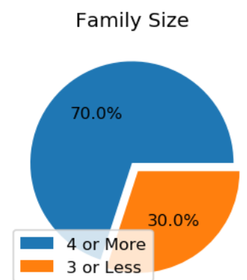
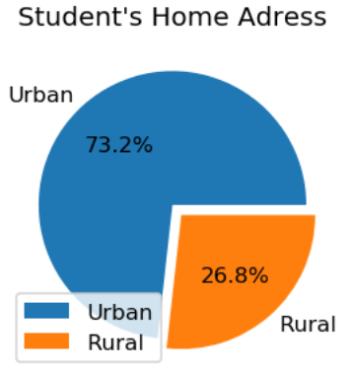
Home Life
Majority of Students have larger families
Within city
And live with both parents

Slide 6

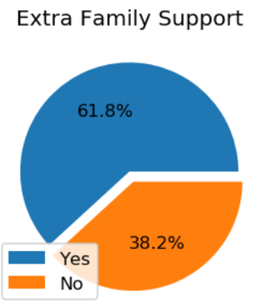
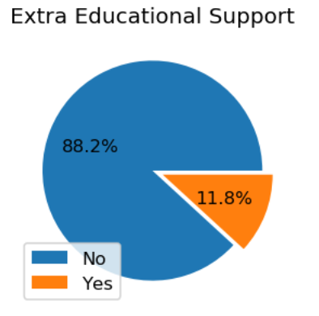
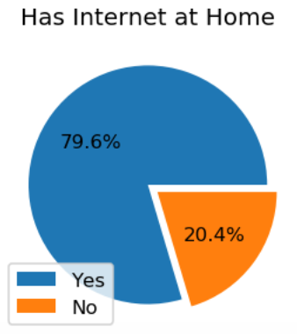
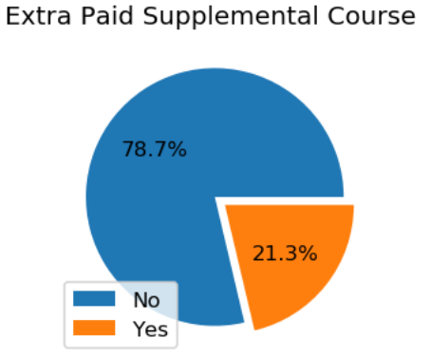
Supplemental Learning

Slide 7

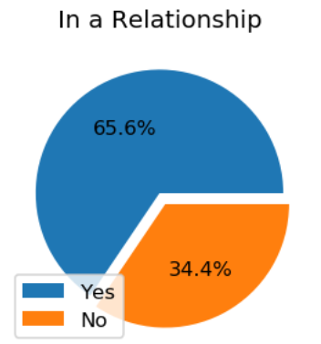
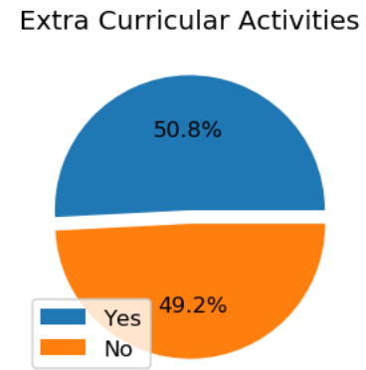
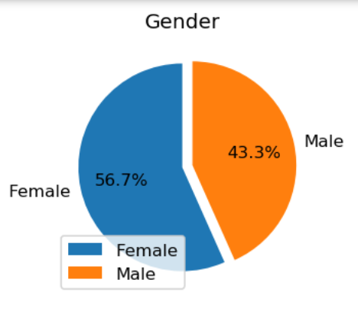
Other Features
Distribution of some other features

Slide 8
Distribution of Final Grades

Slide 9
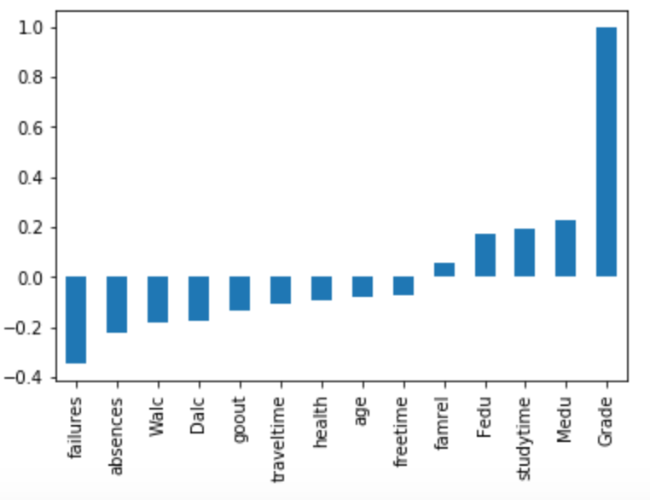
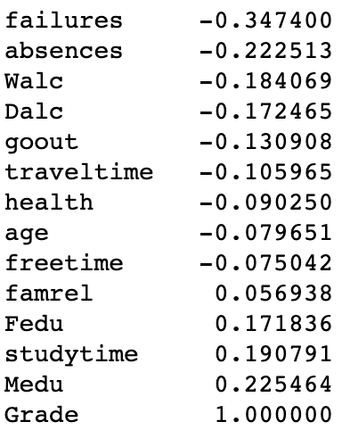
Correlation of Features to Final Grade

Slide 10
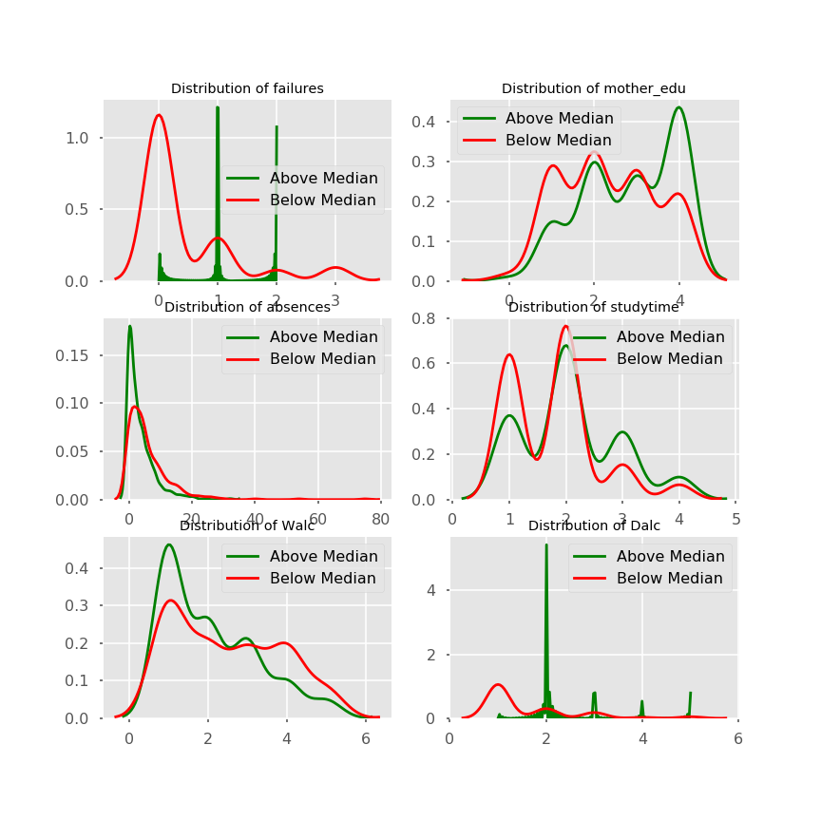
Exploratory Data Analysis

Slide 11
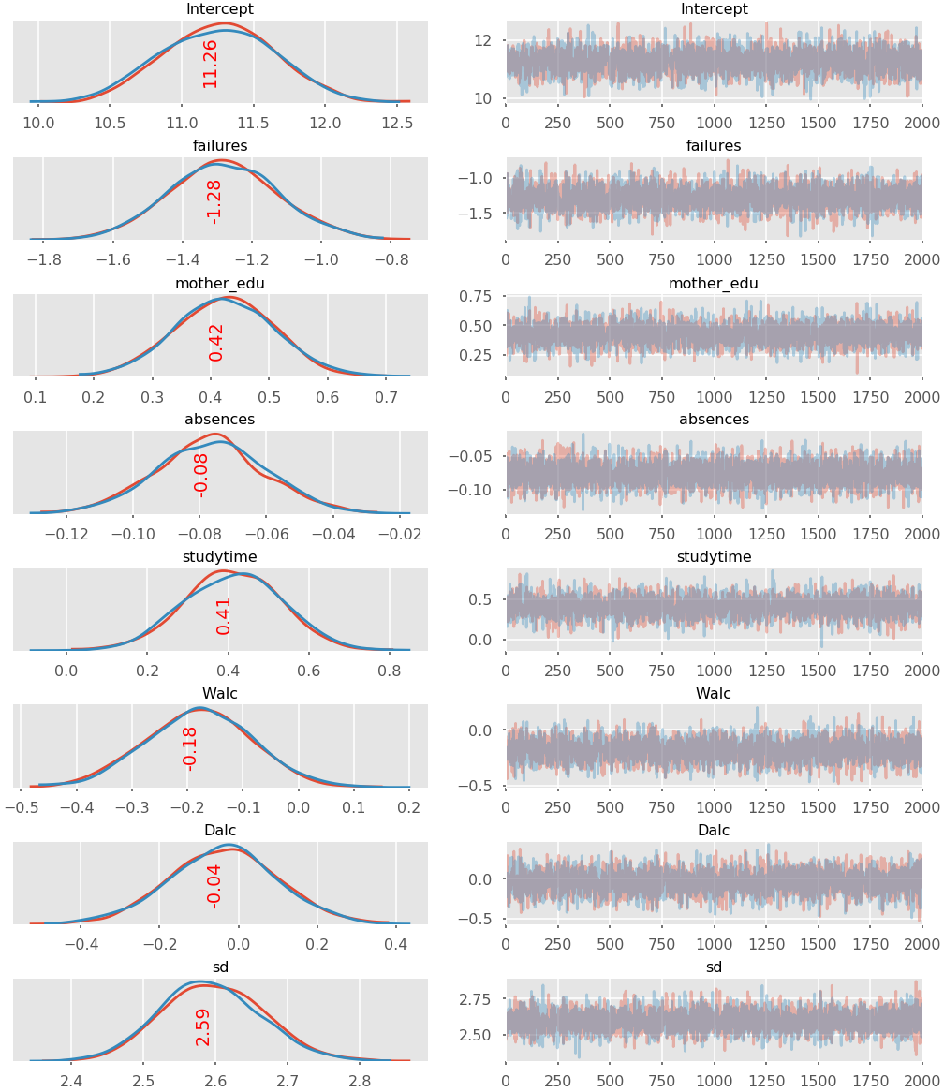
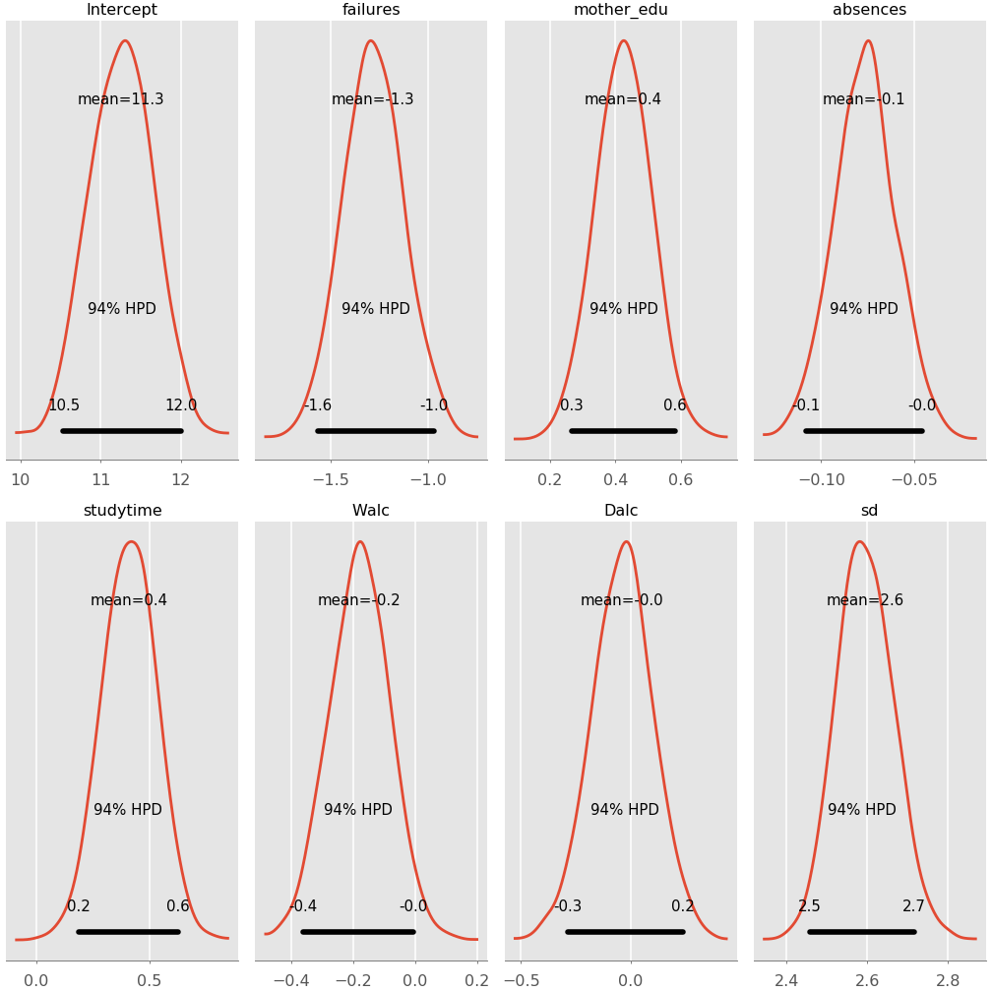
Bayesian Probability Statistics

Slide 12
Conclusions
Parents’ education
Absences
Studytime

