Slide 1
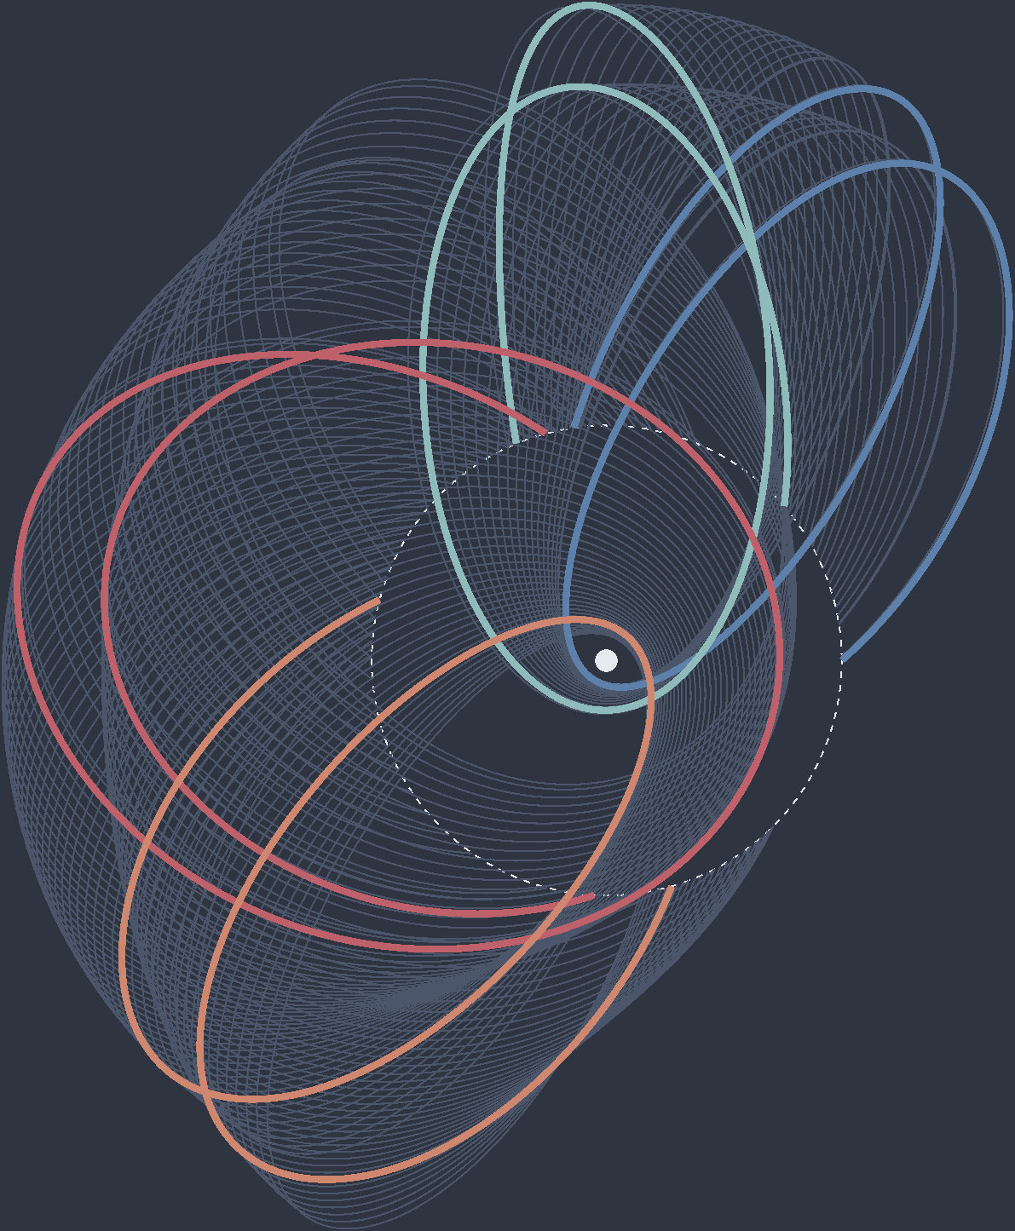

Multi-Revolution Extension of Solar-Perturbed Moon-To-Moon Transfer Families
AAS 21-581
Burton Yale (burton.yale@austin.utexas.edu)
Graduate Student at University of Texas at Austin
Gregory Lantoine (gregory.lantoine@jpl.nasa.gov)
Mission Design Engineer at Jet Propulsion Laboratory

Slide 2


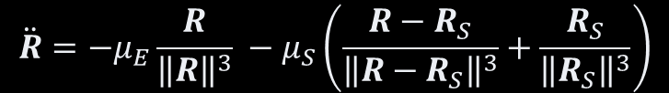

Parameters of a Moon-To-Moon Transfer (1/2)
Earth-Moon System Parameters
θ: Solar Phase Angle
TOF: Transfer time of flight
$$\hat{y}$$
Moon
θ₀
Sun
$$\hat{x}$$
Earth
Equations of Motion
$$ω_{S}$$
$$\ddot{R}=−μ_{E}\frac{R}{{\left\|R\right\|}^{3}} −μ_{S}\left(\frac{R−R_{S}}{{\left\|R−R_{S}\right\|}^{3}}+\frac{R_{S}}{{\left\|R_{S}\right\|}^{3}}\right)$$

Slide 3

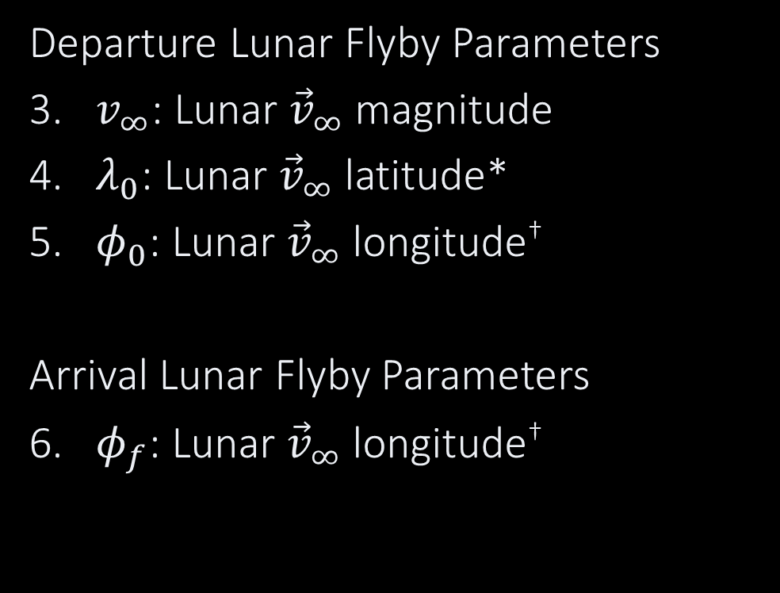



Parameters of a Moon-To-Moon Transfer (2/2)
Departure Lunar Flyby Parameters
​$v_{∞}$: Lunar ${\vec{v}}_{∞}$ magnitude
​$λ_{0}$: Lunar ${\vec{v}}_{∞}$ latitude*
​$φ_{0}$: Lunar ${\vec{v}}_{∞}$ longitude†
Arrival Lunar Flyby Parameters
​$φ_{f}$: Lunar ${\vec{v}}_{∞}$ longitude†
$${{\hat{R}}_{M}×\hat{v}}_{M}$$
ϕ₀
Towards Earth
$${\hat{v}}_{M}$$
$${\hat{R}}_{M}$$
λ₀
$$v_{∞}$$
*: Continuous [-90°, 90°]
† : Discrete {-90°, 90°}

Slide 4
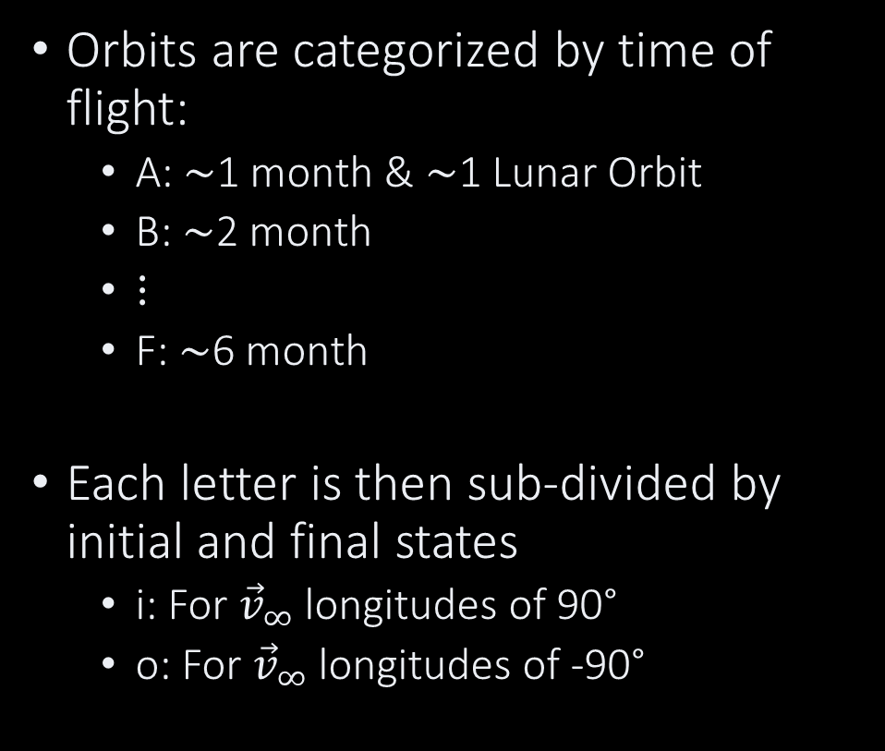
Transfer Nomenclature
Departure
Orbits are categorized by time of flight:
A: ∼1 month & ∼1 Lunar Orbit
B: ∼2 month
⋮
F: ∼6 month
Each letter is then sub-divided by initial and final states
i: For ${\vec{v}}_{∞}$ longitudes of 90°
o: For ${\vec{v}}_{∞}$ longitudes of -90°
Inward (i)
Outward (o)
Arrival
Inward (i)
Outward (o)

Slide 5
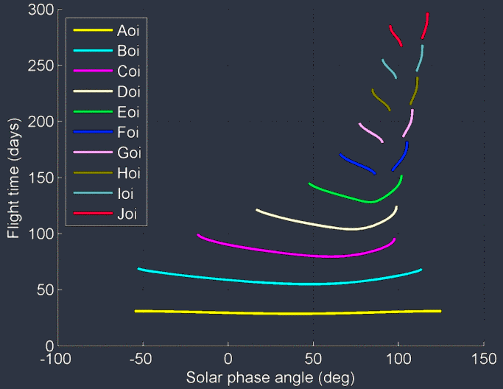
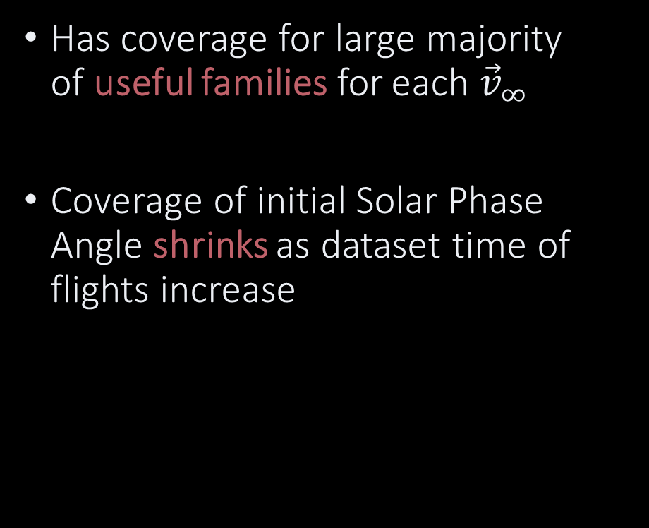
Overview of Current Dataset
Has coverage for large majority of useful families for each ${\vec{v}}_{∞}$
Coverage of initial Solar Phase Angle shrinks as dataset time of flights increase
Dataset Shrinking
Dataset Shrinking
Credit: Lantoine

Slide 6


Methodology of Building Multi-Rev Datasets
Select Lunar ${\vec{v}}_{∞}$ Mag
Search ${\vec{v}}_{∞}$ Latitudes
Optimize Solution
Continue Results for 180° Range

Slide 7
Methodology of Building Multi-Rev Datasets
Select Lunar ${\vec{v}}_{∞}$ Mag
Search ${\vec{v}}_{∞}$ Latitudes
Optimize Solution
0-Rev
Continue Results for 180° Range
1-Rev
2-Rev

Slide 8
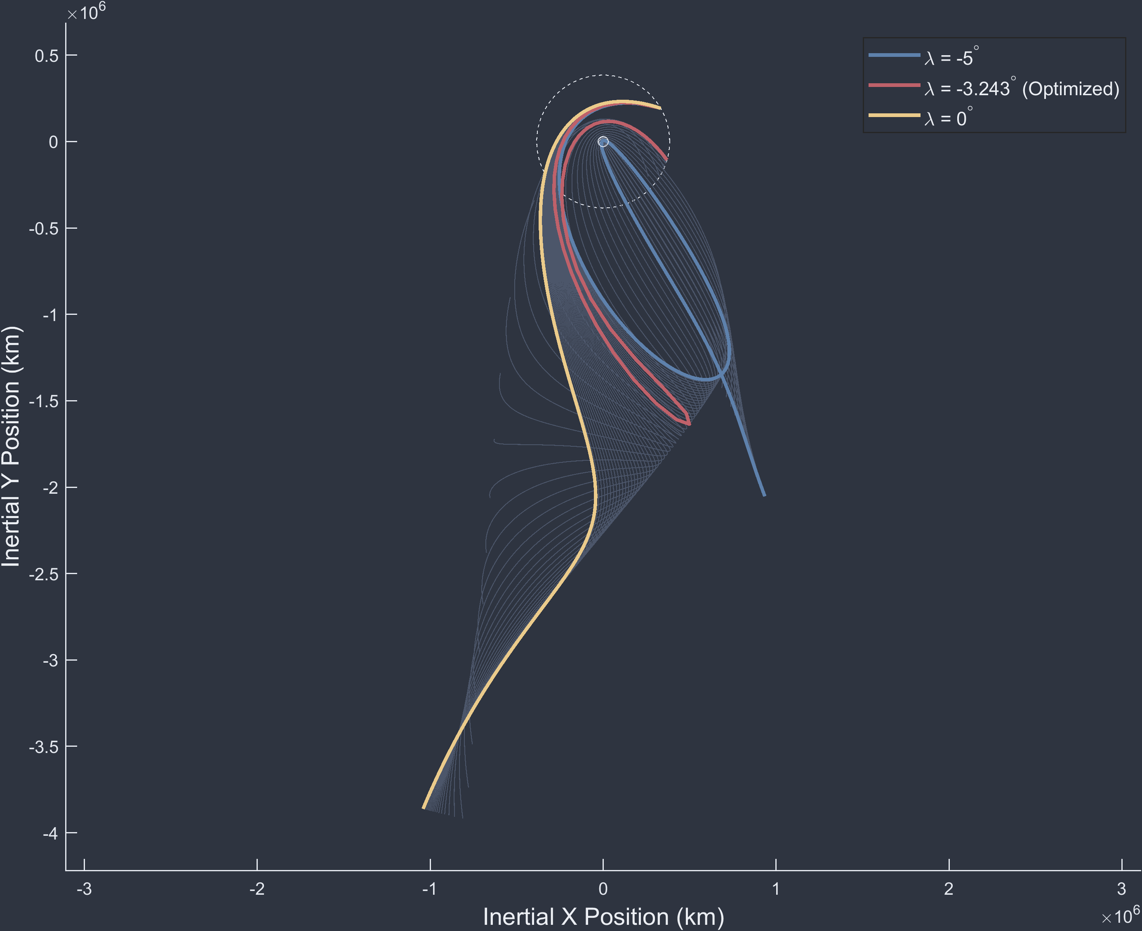
Methodology of Building Multi-Rev Datasets
Select Lunar ${\vec{v}}_{∞}$ Mag
Search ${\vec{v}}_{∞}$ Latitudes
Optimize Solution
Continue Results for 180° Range

Slide 9
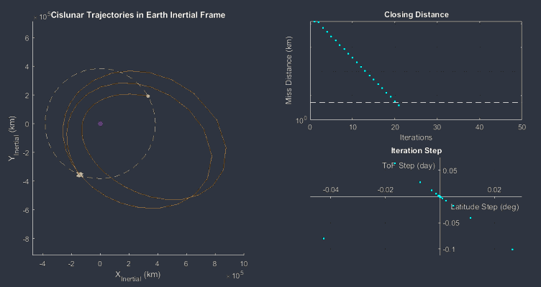

Methodology of Building Multi-Rev Datasets
Select Lunar ${\vec{v}}_{∞}$ Mag
Search ${\vec{v}}_{∞}$ Latitudes
Optimize Solution
Continue Results for 180° Range

Slide 10
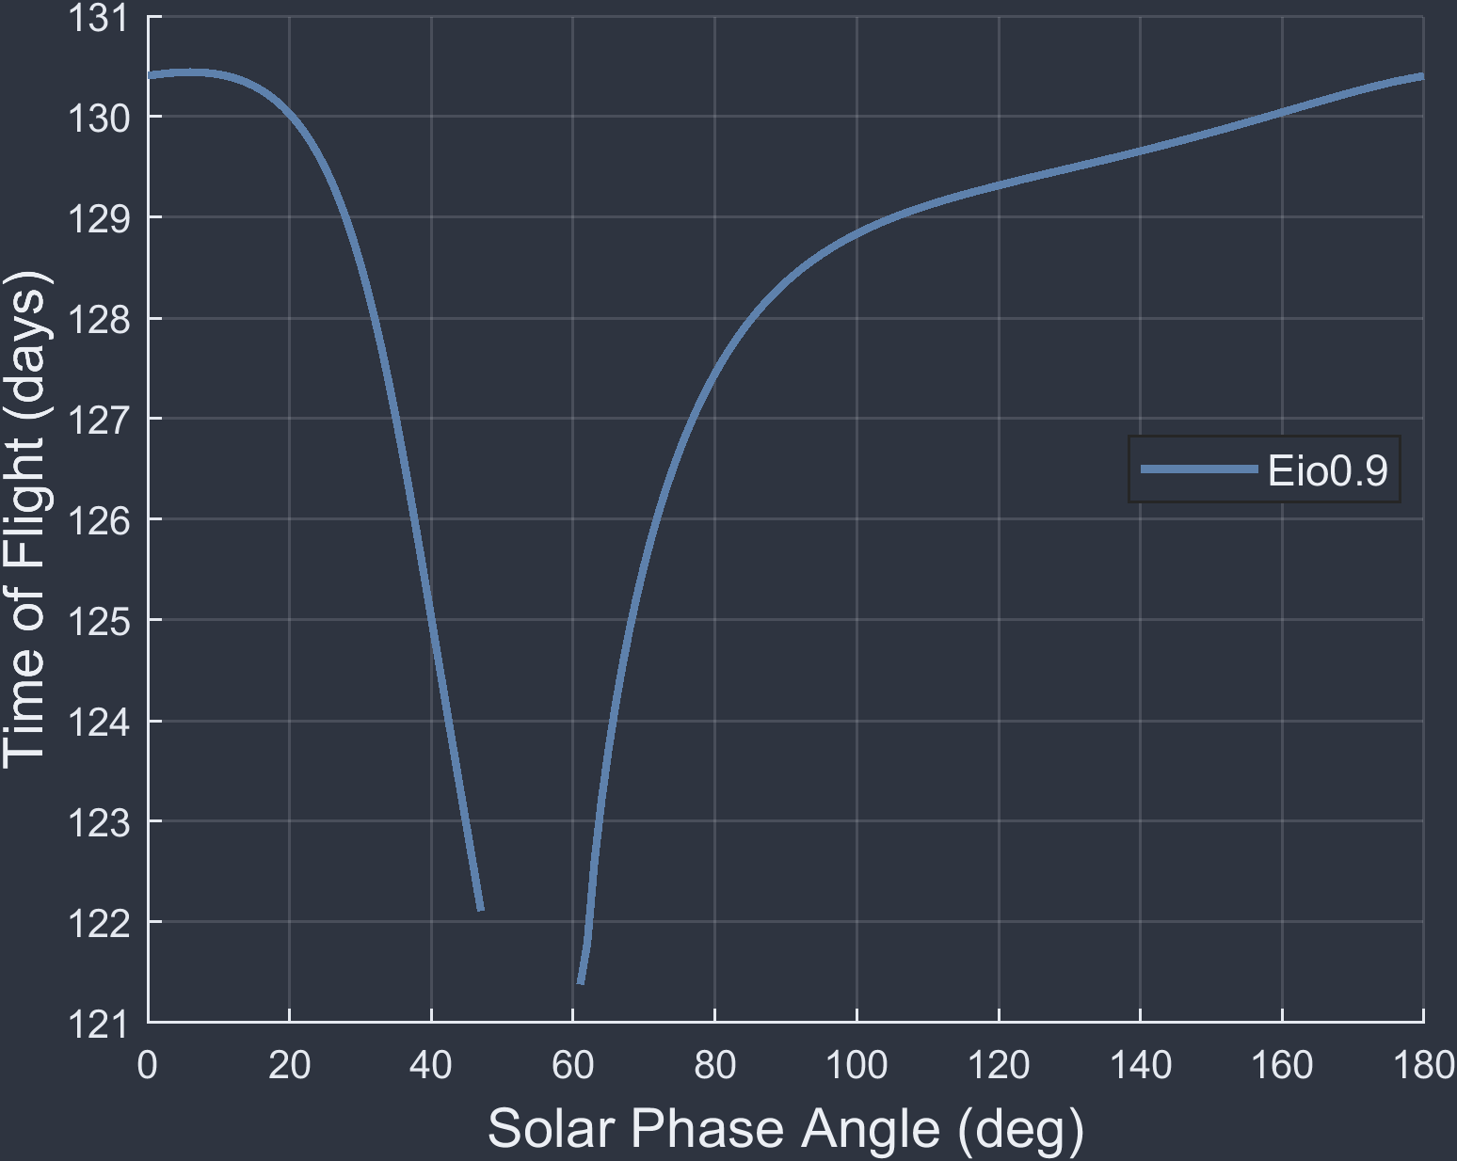

Methodology of Building Multi-Rev Datasets
Select Lunar ${\vec{v}}_{∞}$ Mag
Initial Seed Point
Search ${\vec{v}}_{∞}$ Longitudes
Optimize Solution
Continue Results for 180° Range

Slide 11
Methodology of Building Multi-Rev Datasets
Select Lunar ${\vec{v}}_{∞}$ Mag
Search ${\vec{v}}_{∞}$ Longitudes
Optimize Solution
New Seed Point
Continue Results for 180° Range
Terminated due to infeasibility

Slide 12
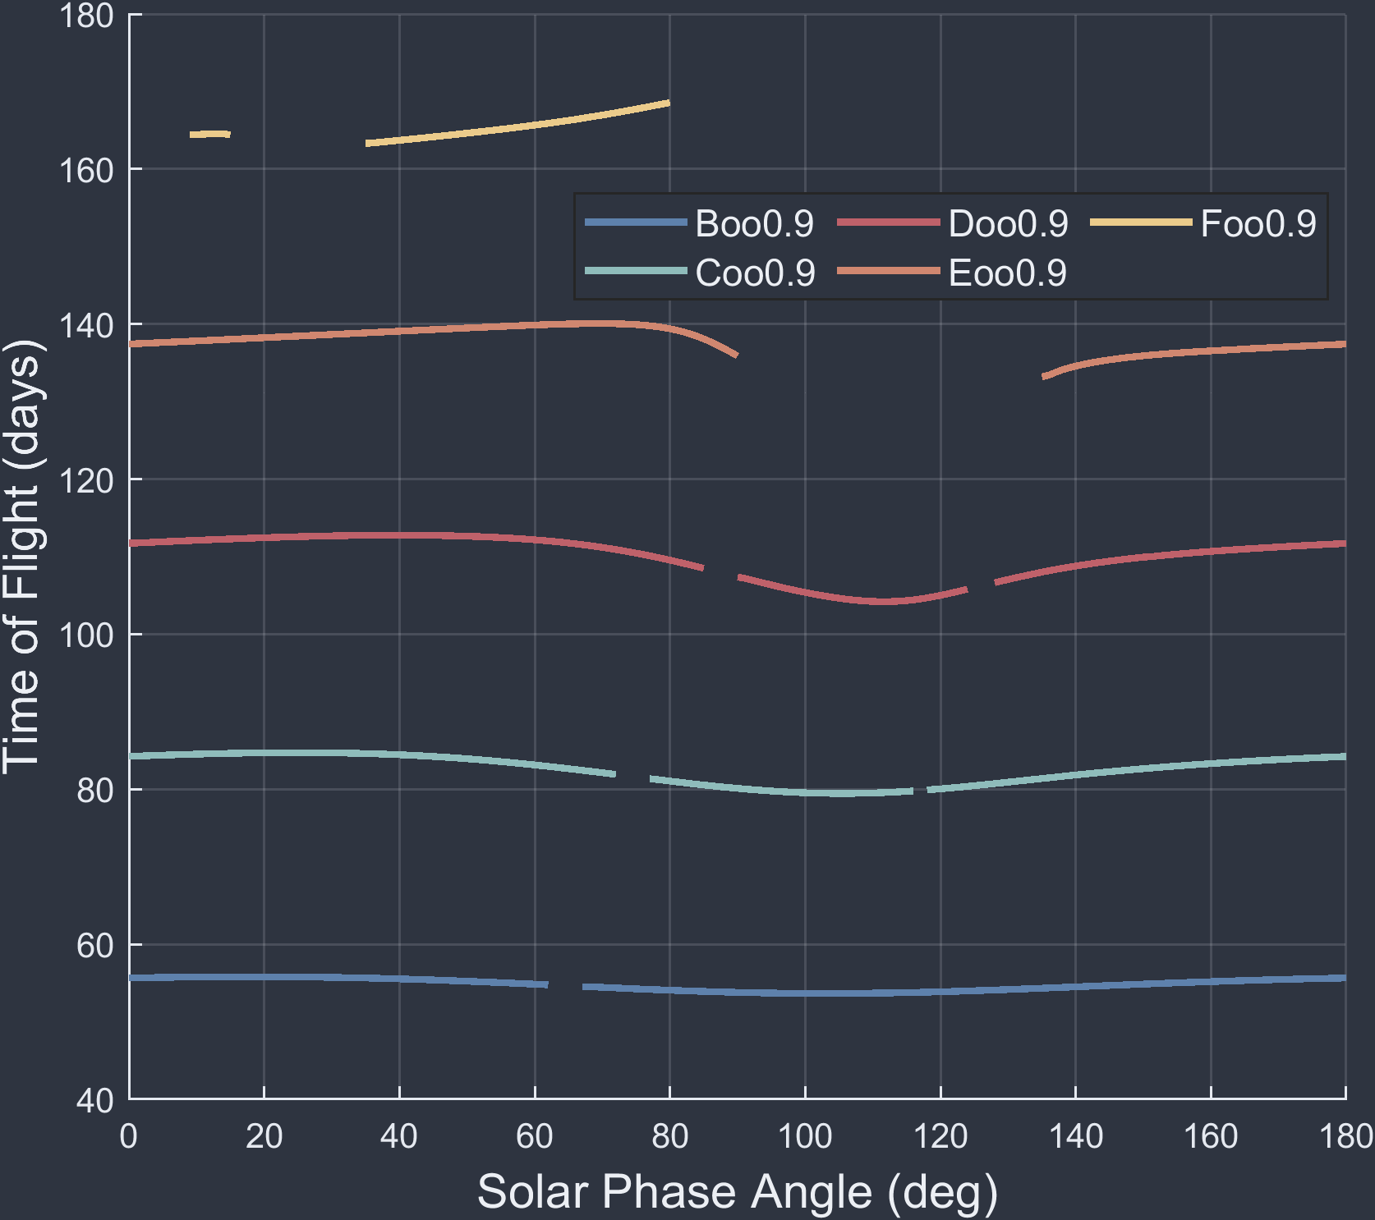
Classifying Multi-Revolution Transfers
Solutions are first categorized by their total time of flight across all revolutions
Each discontinuous group is then subdivided into their multi-rev families

Slide 13
Classifying Multi-Revolution Transfers
Each time of flight lettering (A:F), signifies the time to complete each revolution
Lower time of flight families see little variation in their classifications
DBoo
DBoo
CBoo
CBoo
BCoo
BBoo
AAoo

Slide 14

Same Families at Different ${\vec{v}}_{∞}$
3-Month (C) “io”

Slide 15
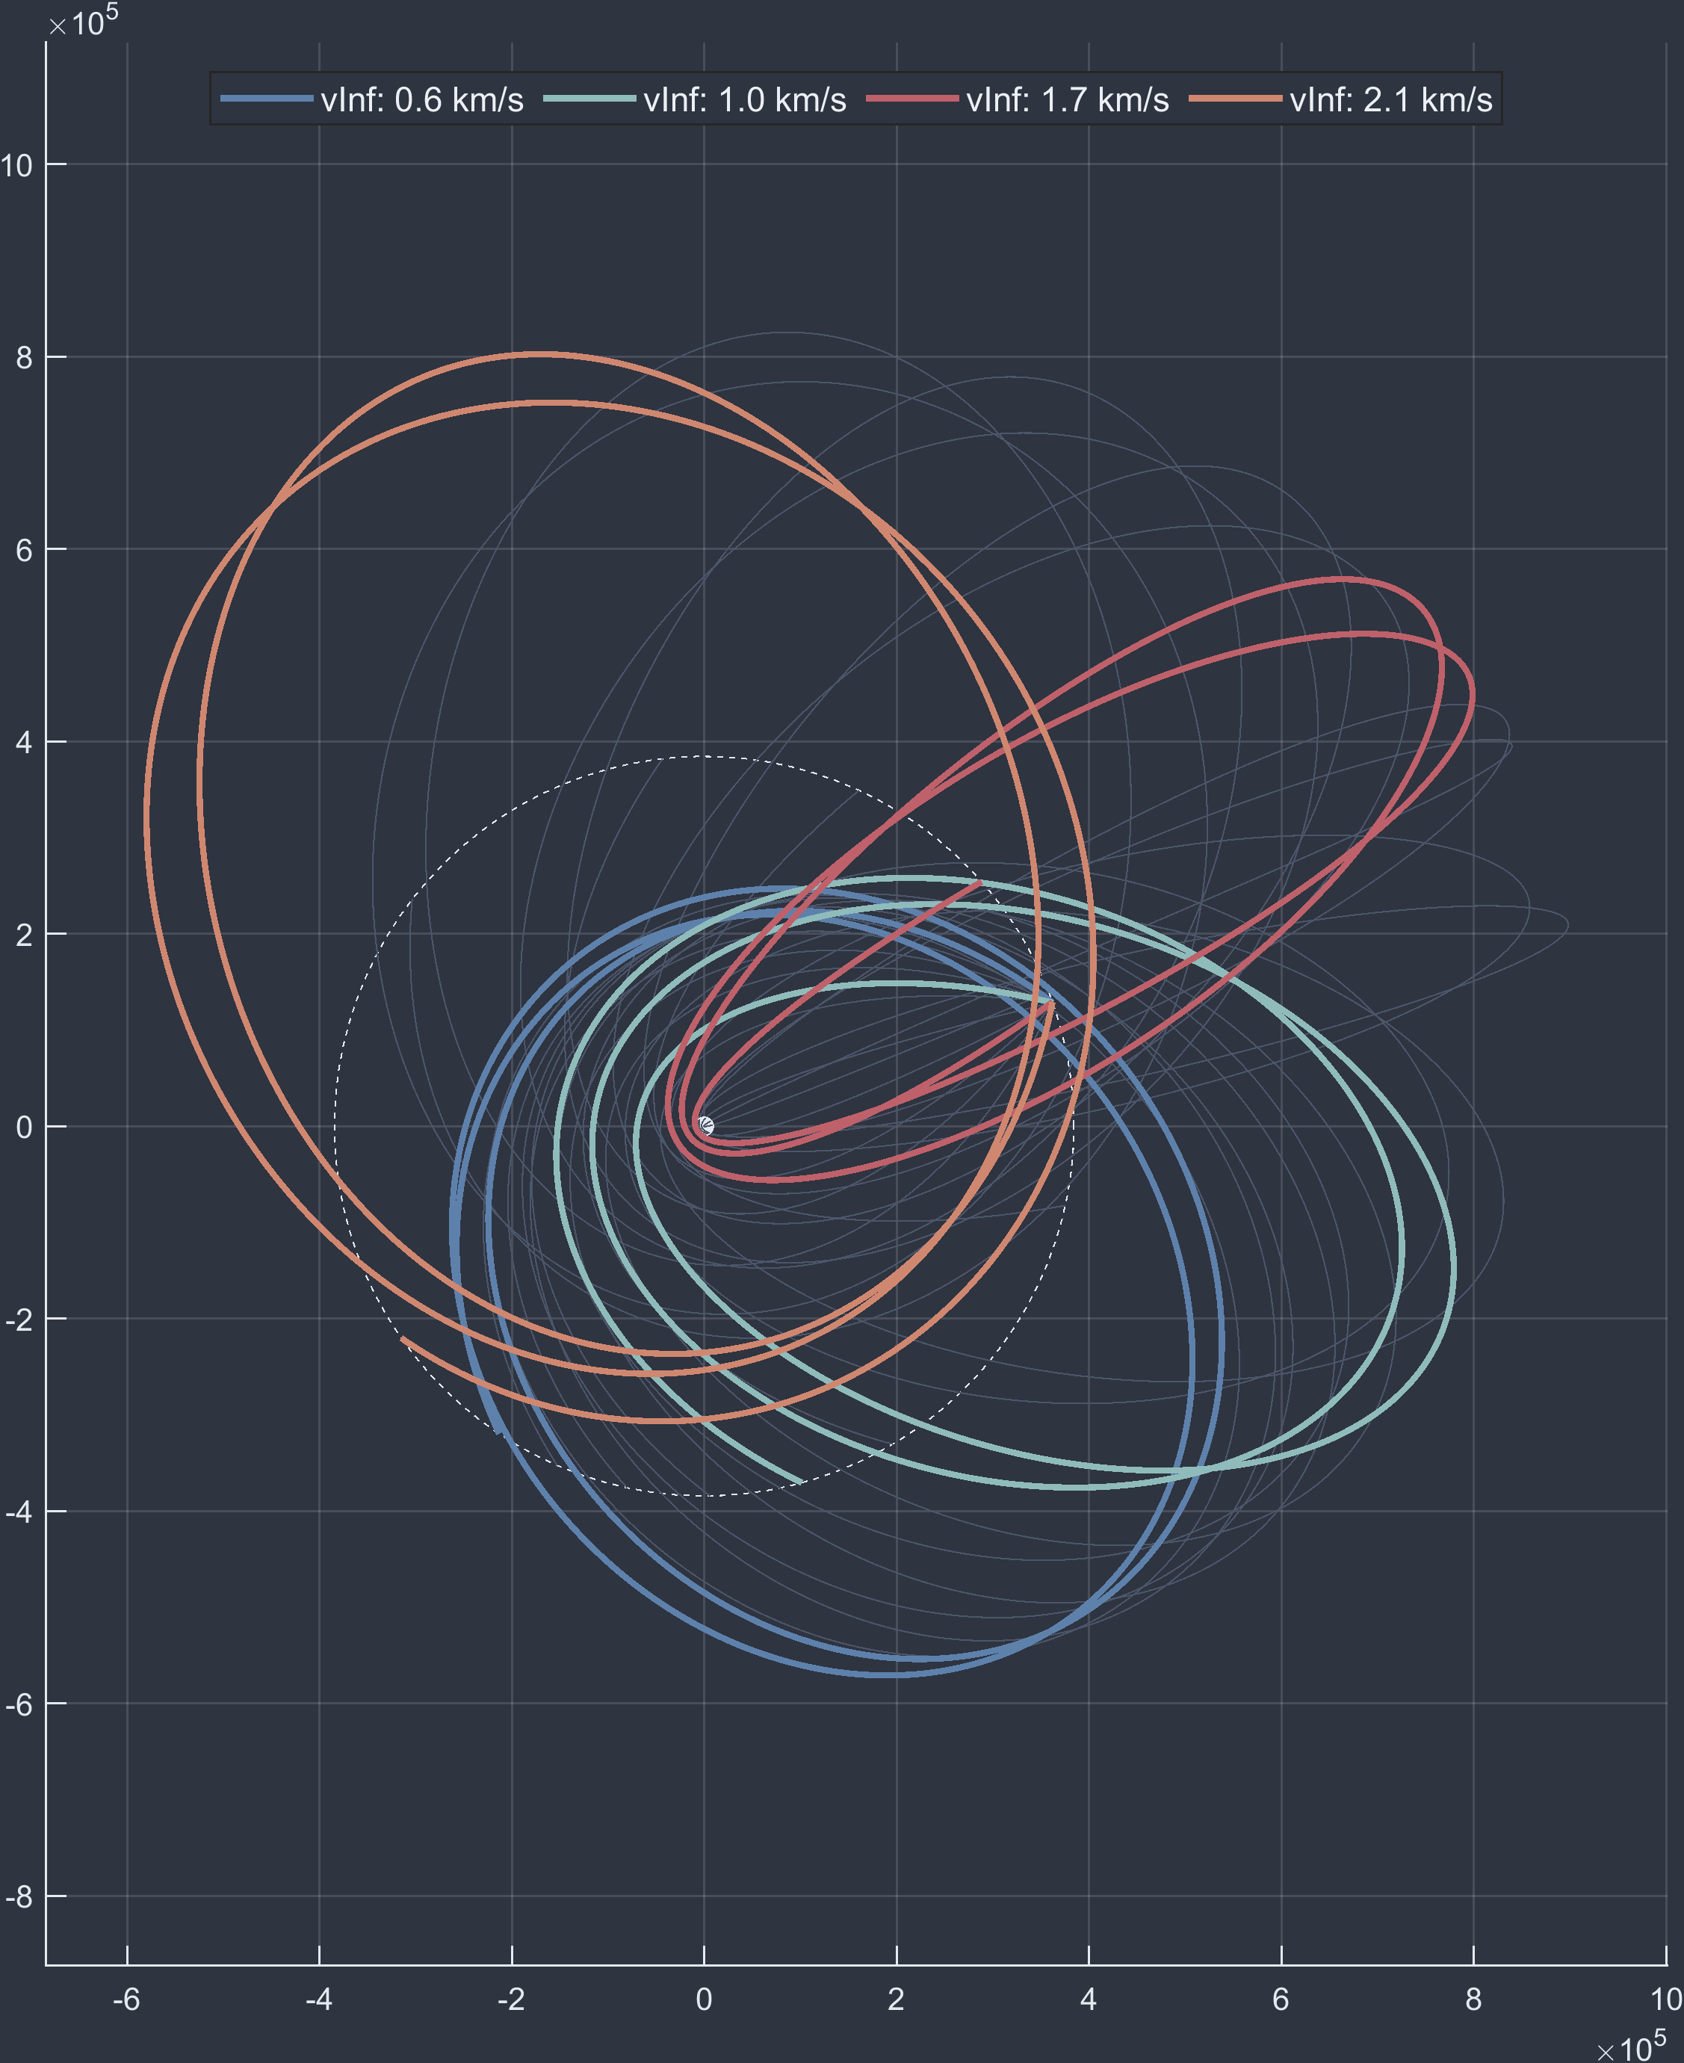
Same Families at Different ${\vec{v}}_{∞}$
3-Month (C) “io”

Slide 16
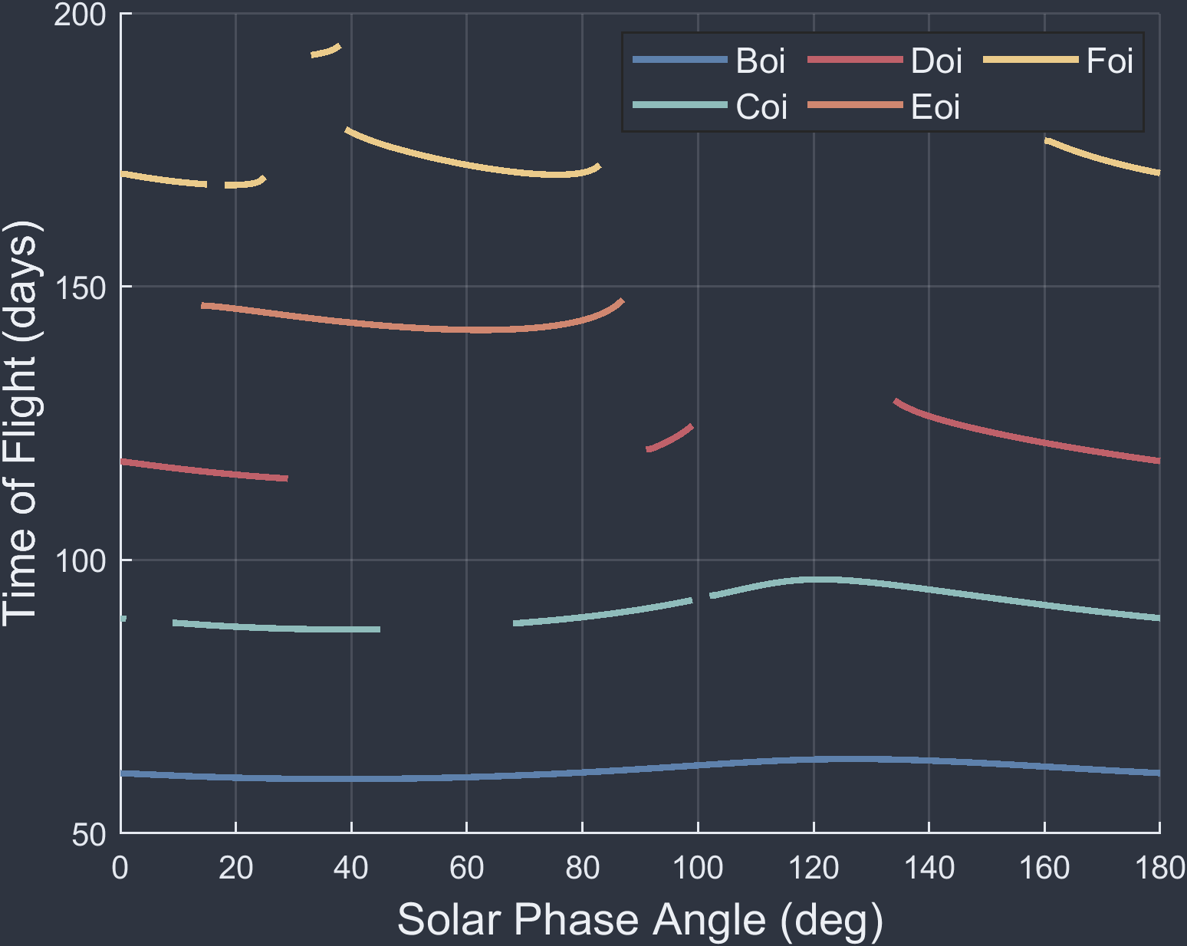

Combining 0 & 1 Rev Solution Spans
“oi” Families @ ${\vec{v}}_{∞}$ = 1.2 ^{km}/_{s}
Foi 0-Rev
Eoi 0-Rev
Doi 0-Rev
Coi 0-Rev
Coi 0-Rev
*Dotted lines indicate only phase angle span and not ToF

Slide 17
Per-Function Speed Improvements
Shorter functions/Cislunar transfers see larger gains from switching over to a referential database
Roughly 8-10x speed reduction
Overall time has also been made more consistent for each call
Longer functions benefit less due to spending more computation time on in-between calculations, such as flybys and eclipses
Roughly 5-7x speed reductions

Slide 18
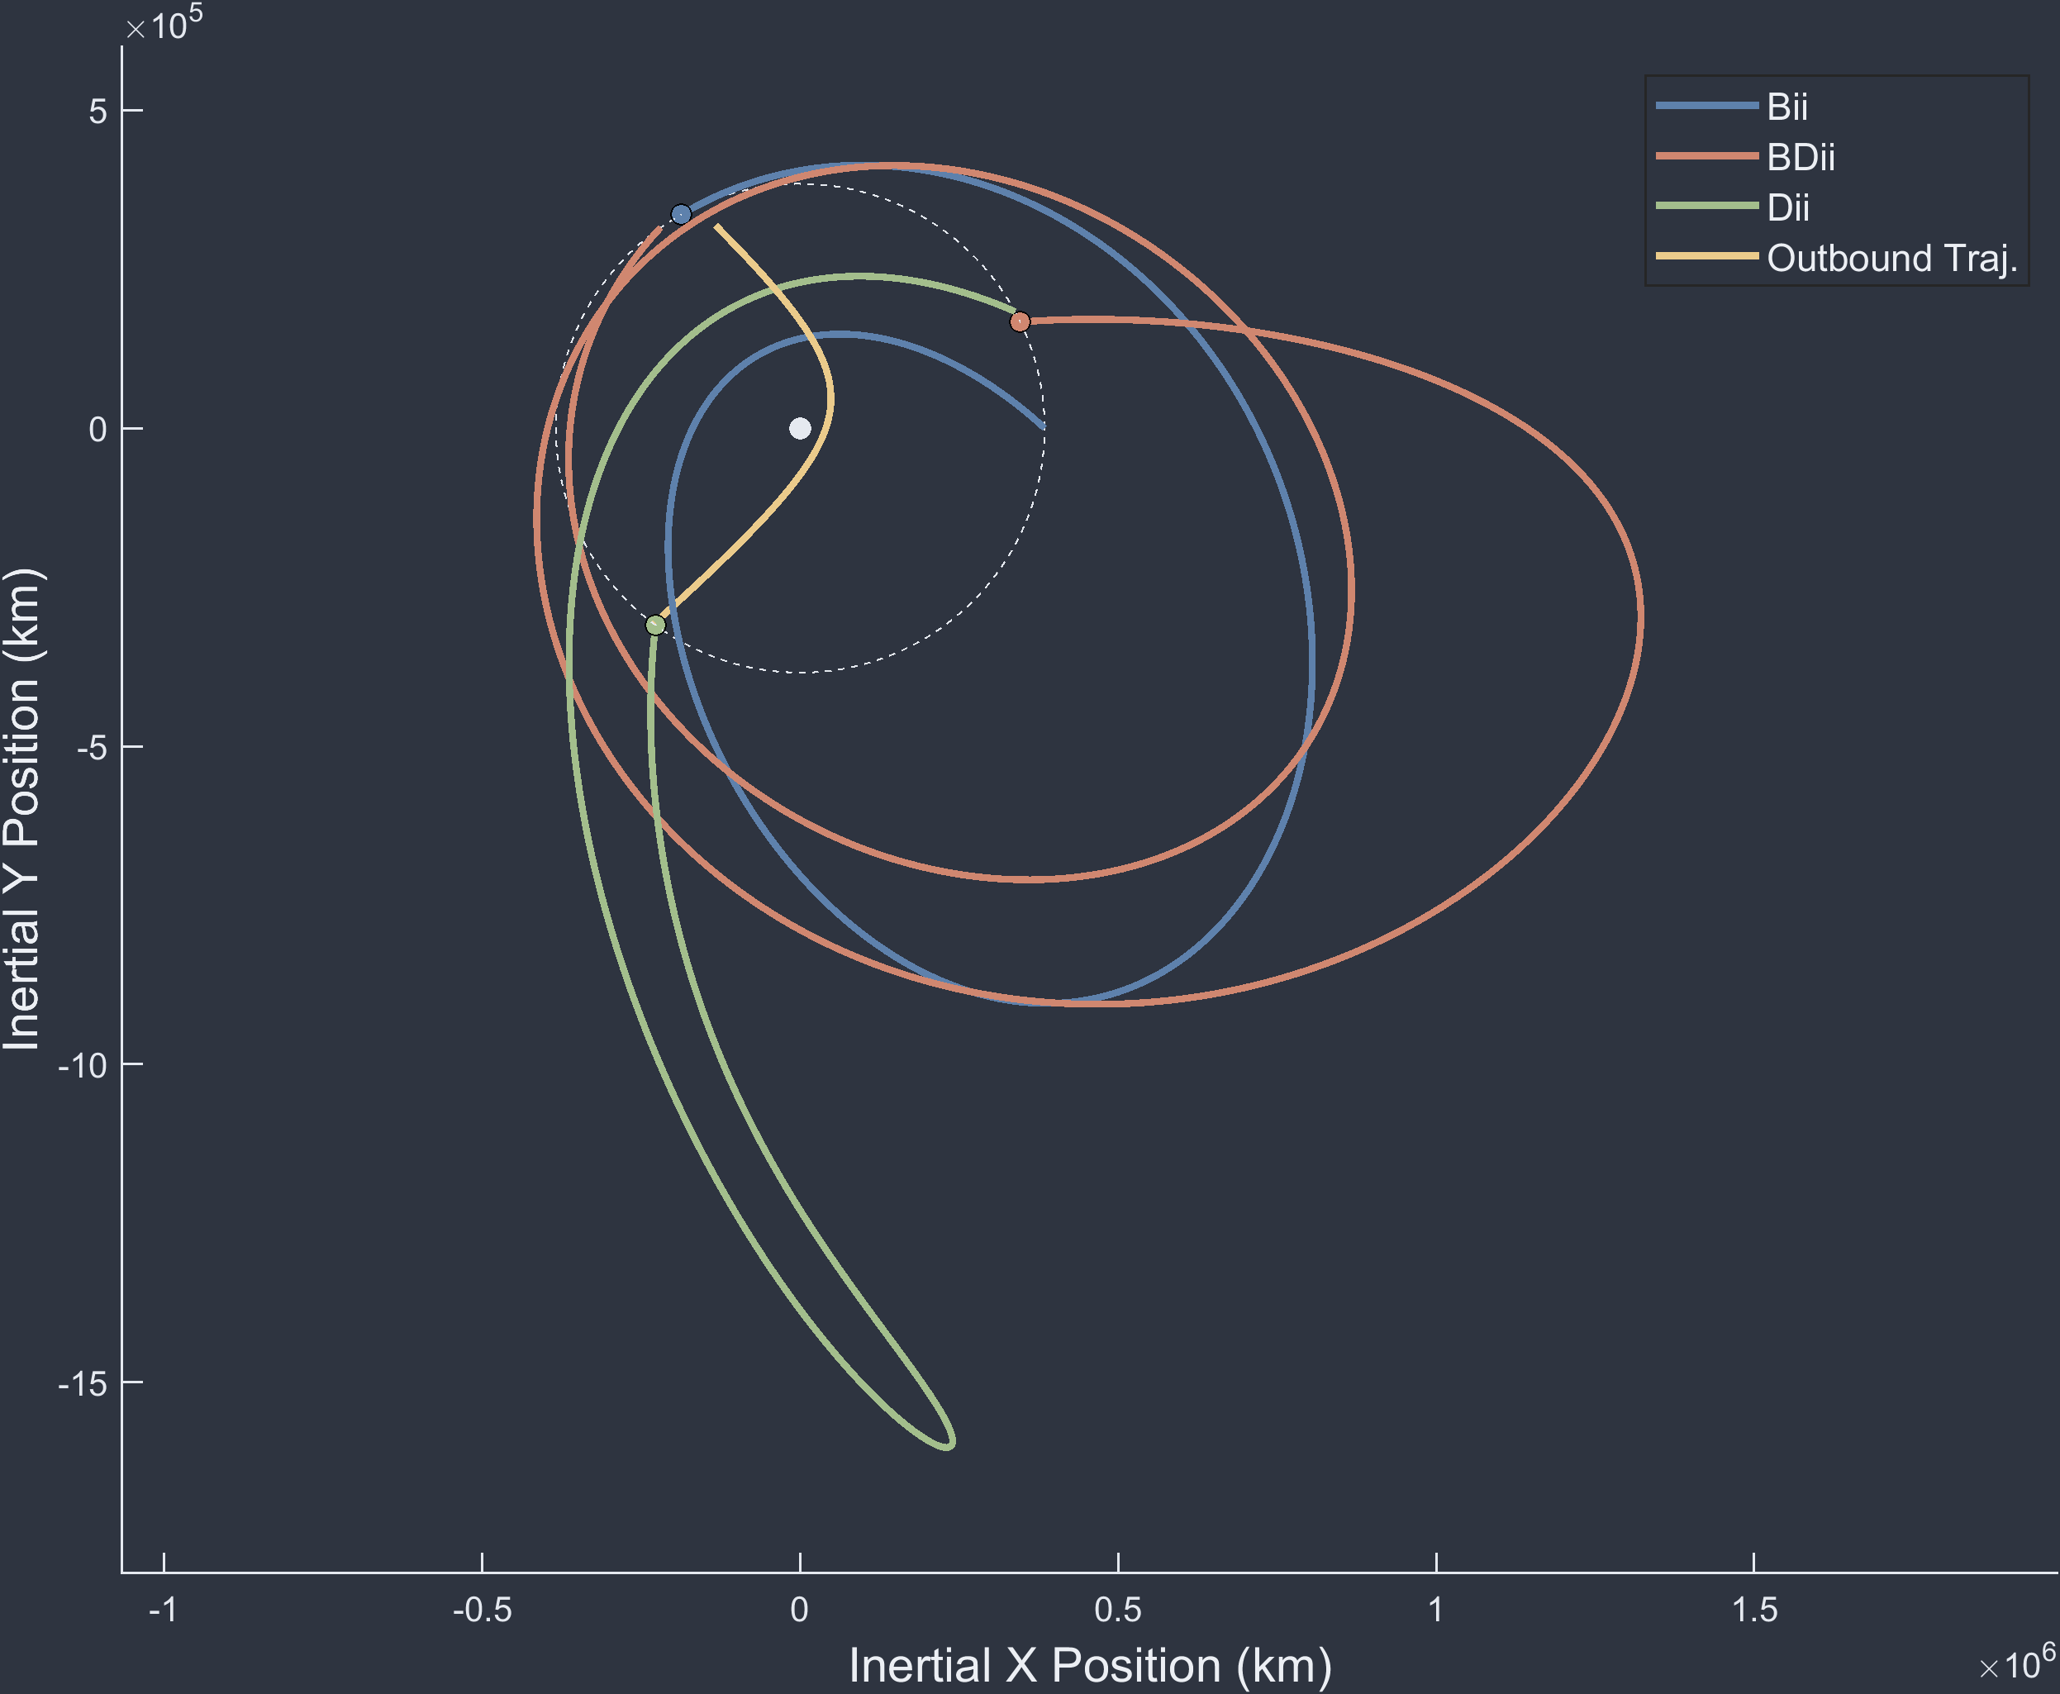

Multi-Revolution Results from Broad Search
Seq: BiiBDiiDii
Departure and Arrival*:
Dep: Oct 03, 2021
Arr: Jan 01, 2024
*At asteroid 2020GE

Slide 19
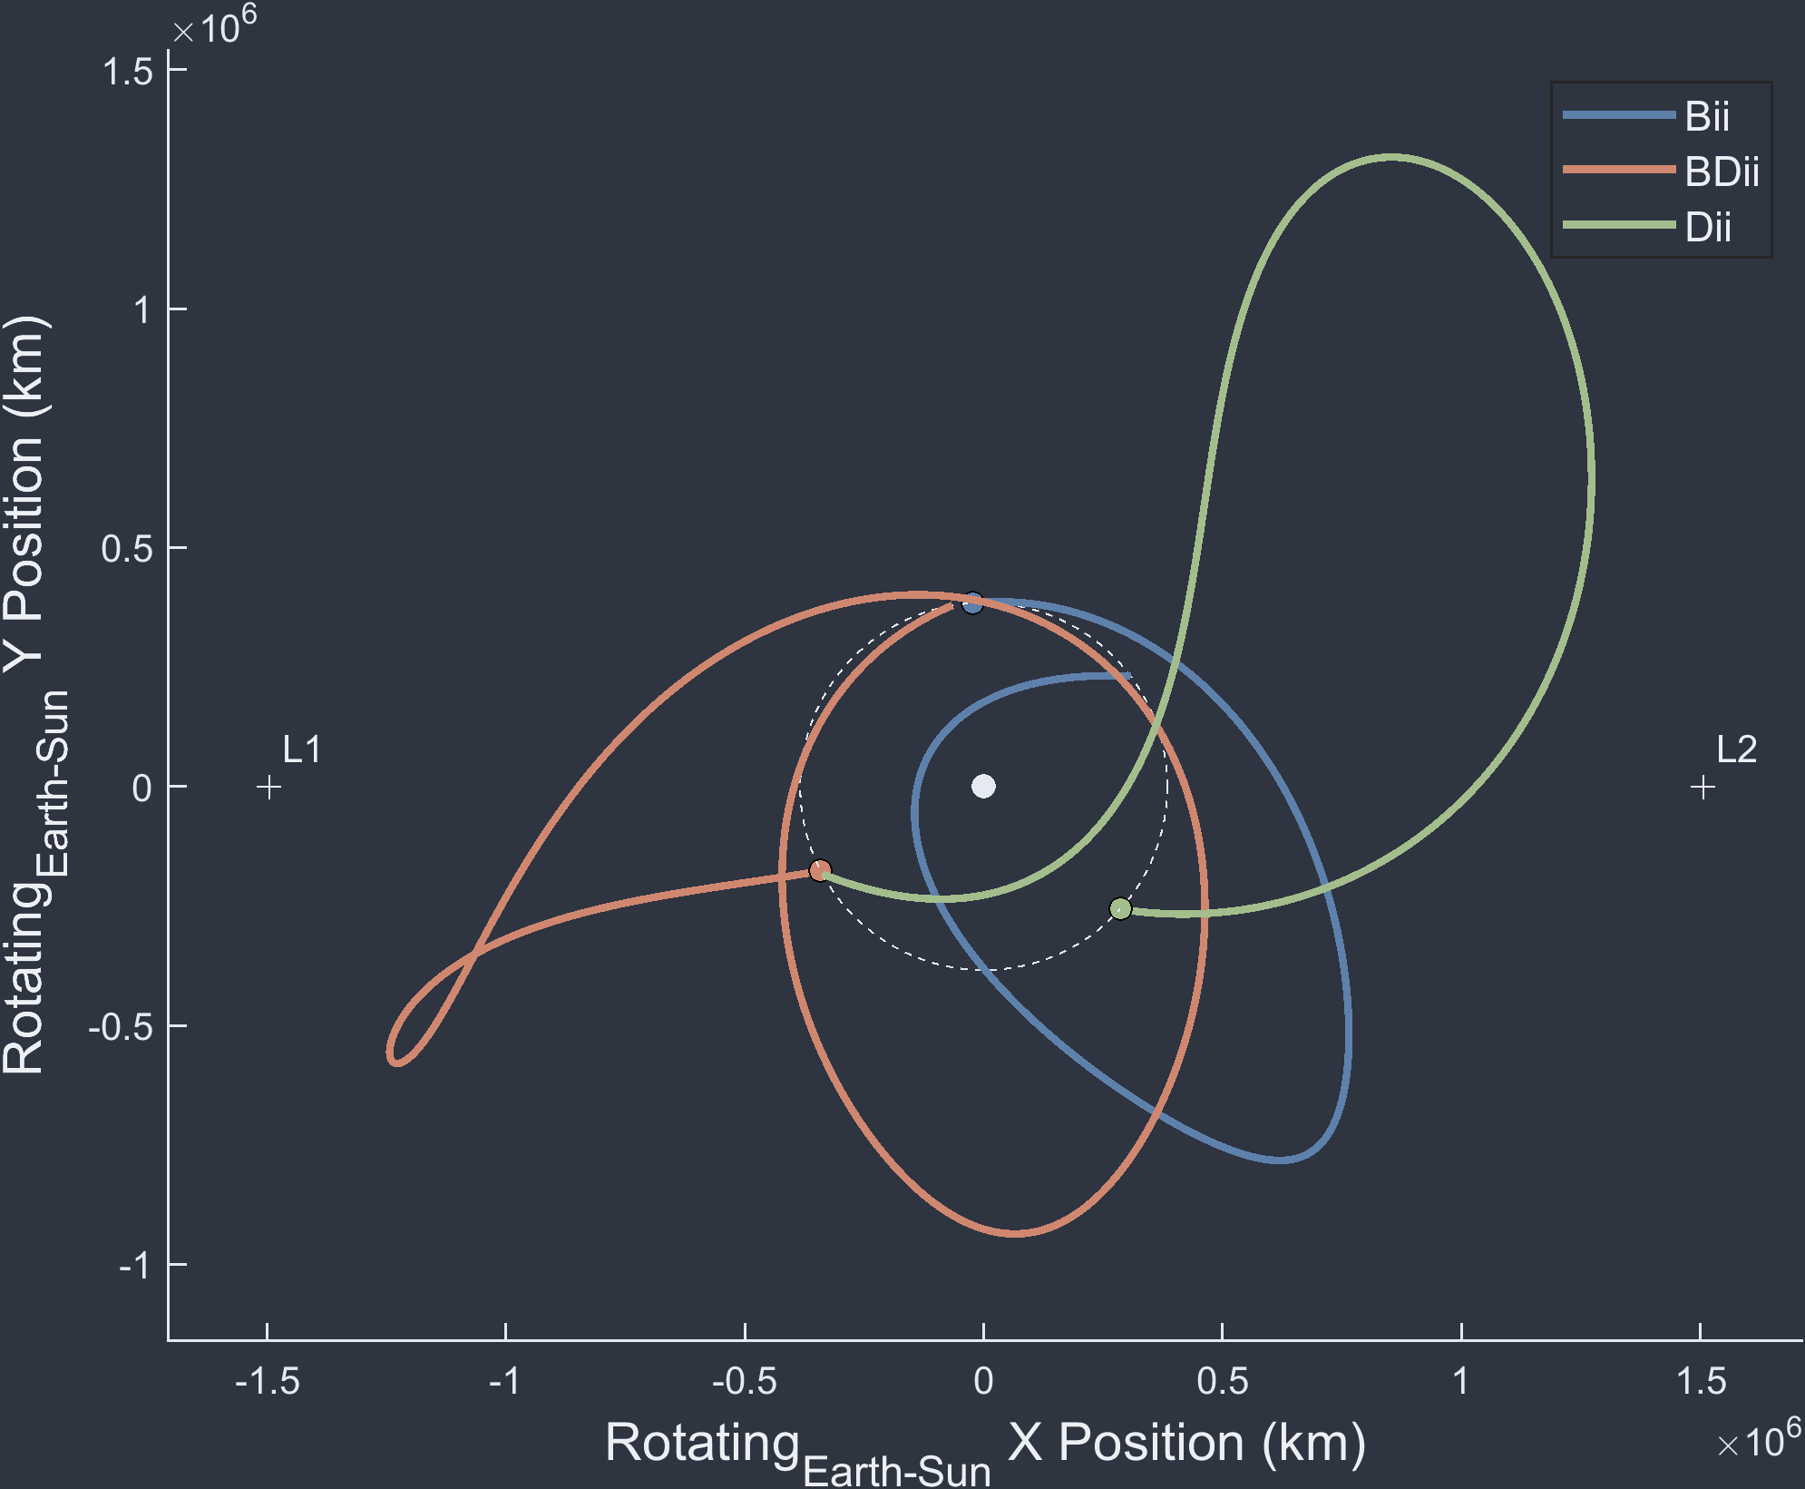
Closing Remarks
Defined methodology for initializing, building, and categorizing Moon-To-Moon trajectory families
Developed naming convention to illustrate overarching structures in multi-revolution datasets
Demonstrated speed boost in broad search contexts
Applied multi-revolution results to find novel solutions to future space missions such as NEA Scout

Slide 20
For any questions regarding the paper Please join Virtual Room Trajectory Design and Optimization XX on August XX, 2021 at XX:XX AM EST Thank you

Slide 21
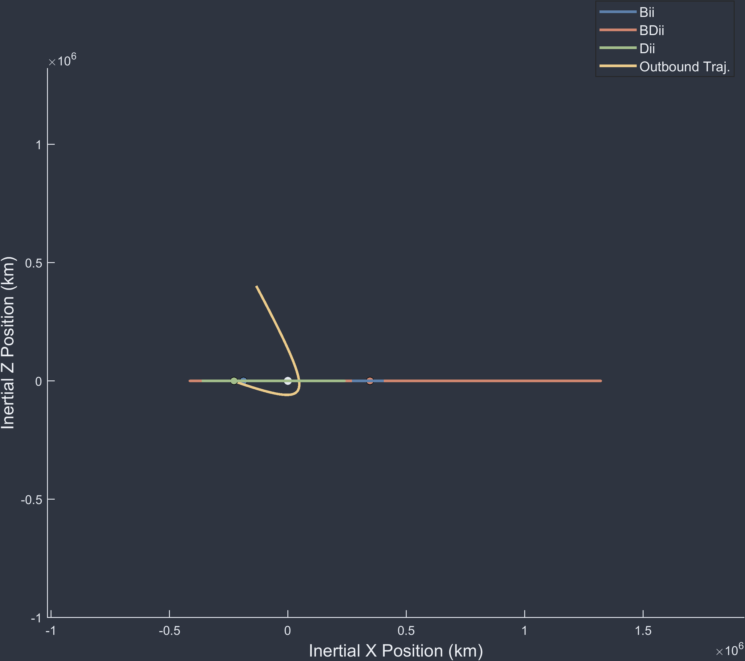
BiiBDiiDii Continued

Slide 22
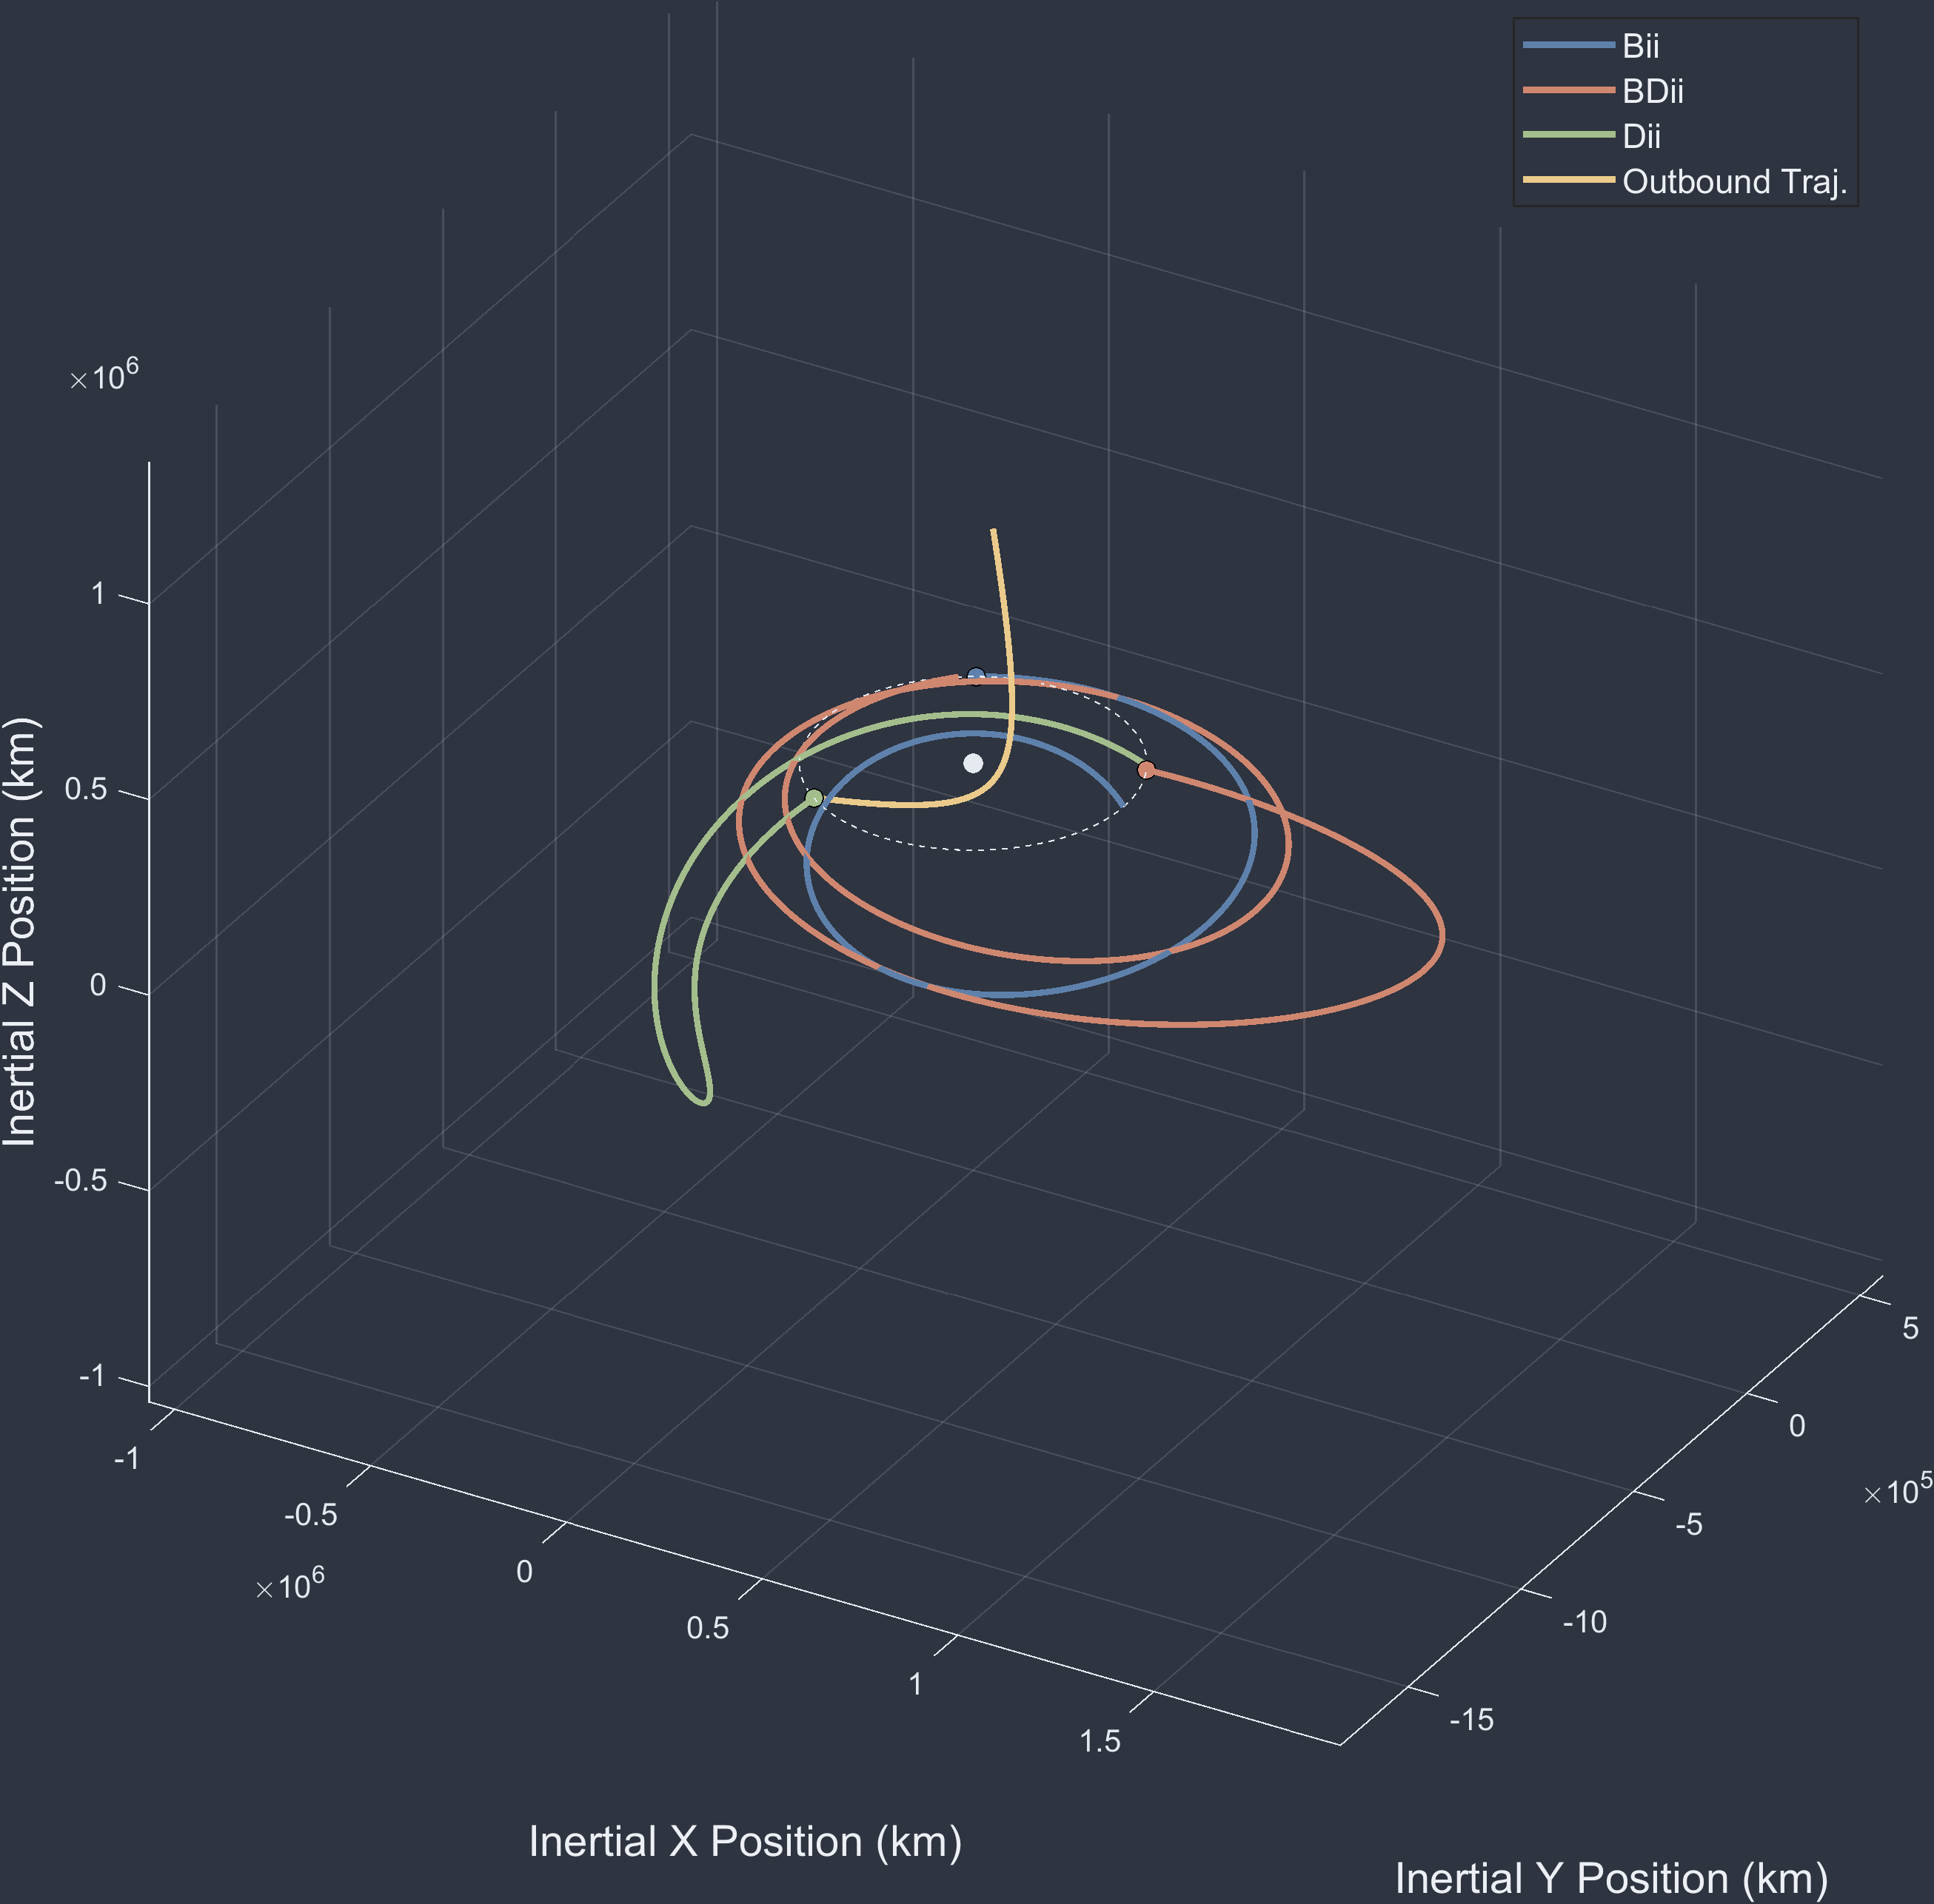
BiiBDiiDii Continued

Slide 23
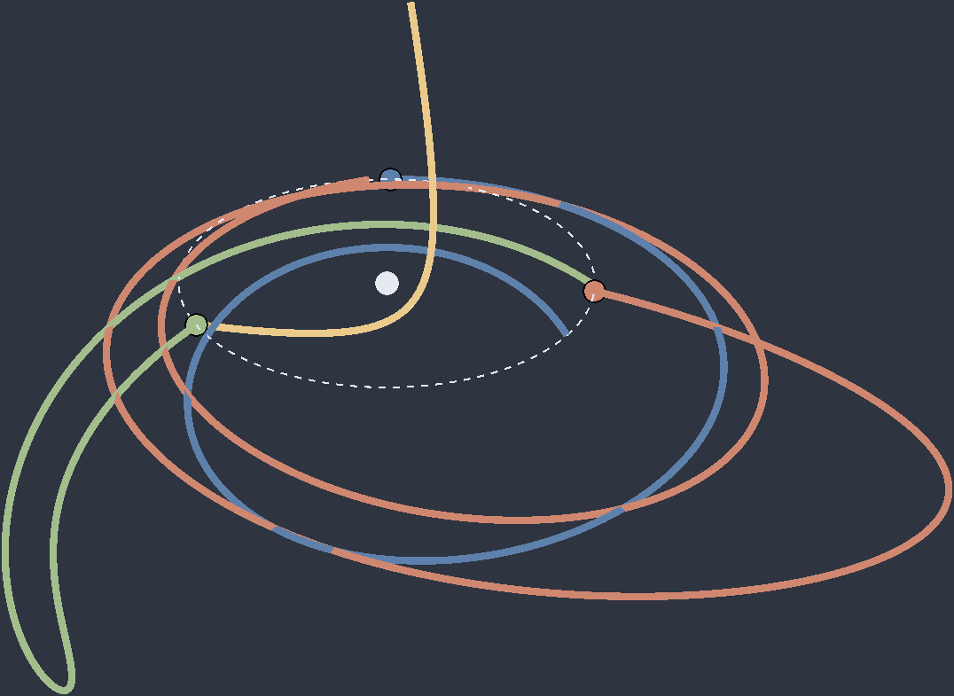
BiiBDiiDii Continued

Slide 24
BiiBDiiDii Rotating Frame

Slide 25

1-Rev vs 0-Rev Families
4-Month (D) “ii” Family @ ${\vec{v}}_{∞}$ 1.4 ^{km}/_{s}

Slide 26
1-Rev vs 0-Rev Families
4-Month (D) “ii” Family @ ${\vec{v}}_{∞}$ 1.4 ^{km}/_{s}
One of two orbits trends towards singularity

