Slide 1




$${{\hat{R}}_{M}×\hat{v}}_{M}$$
ϕ₀
Towards Earth
$${\hat{v}}_{M}$$
$${\hat{R}}_{M}$$
λ₀
$$v_{∞}$$

Slide 2



$$\hat{y}$$
Moon
Sun
θ₀
$$\hat{x}$$
Earth
$$ω_{S}$$

Slide 3
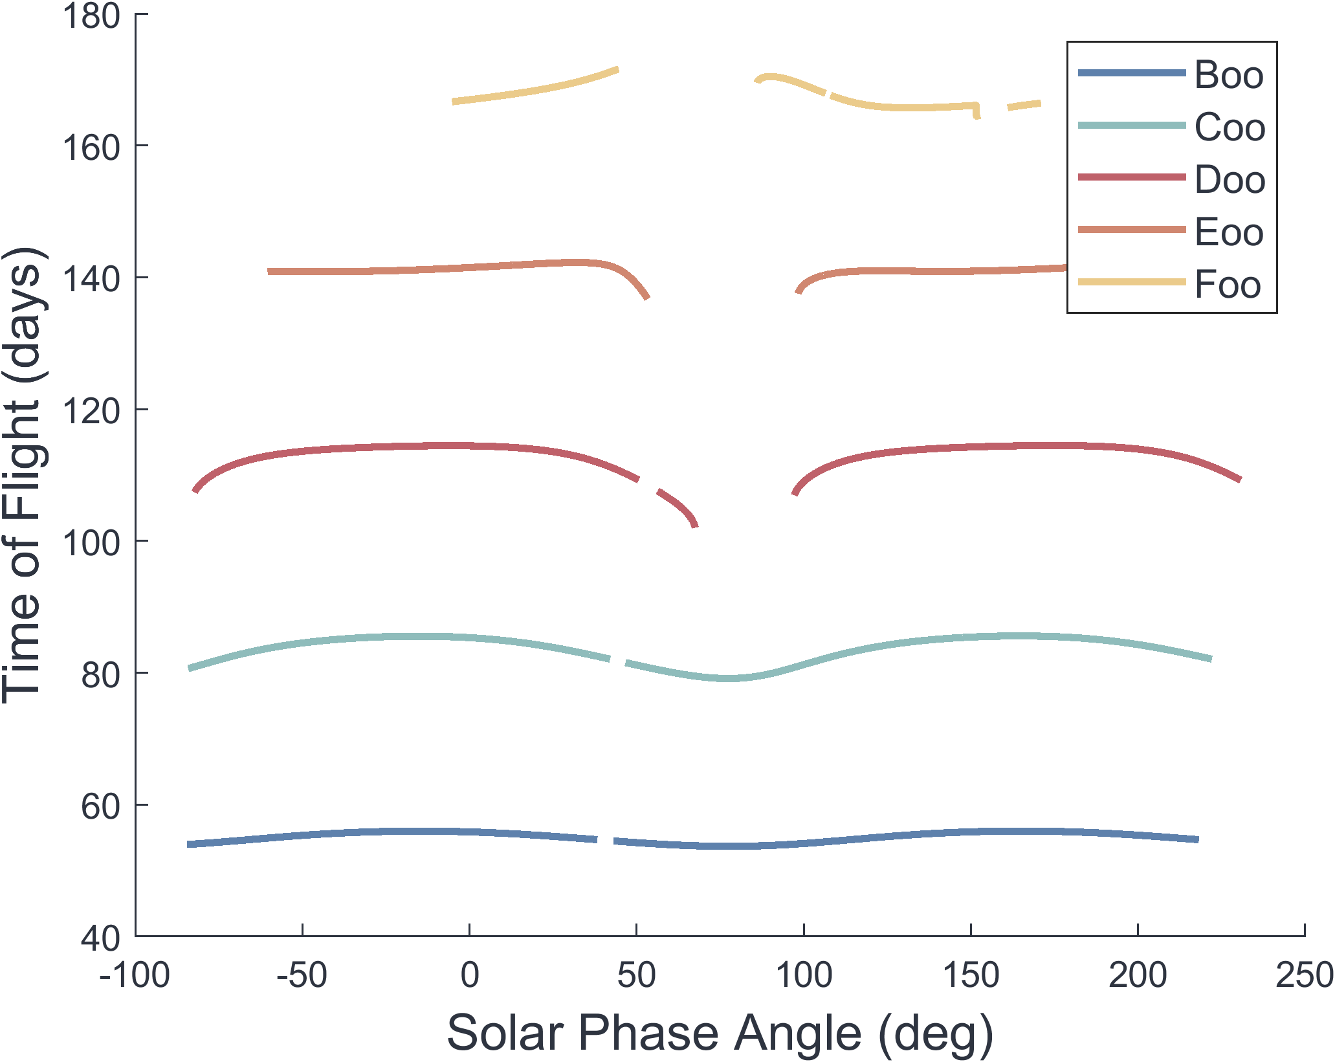
BDoo
BDoo
BCoo
BCoo
BBoo
BBoo
ABoo
ABoo
AAoo

Slide 4
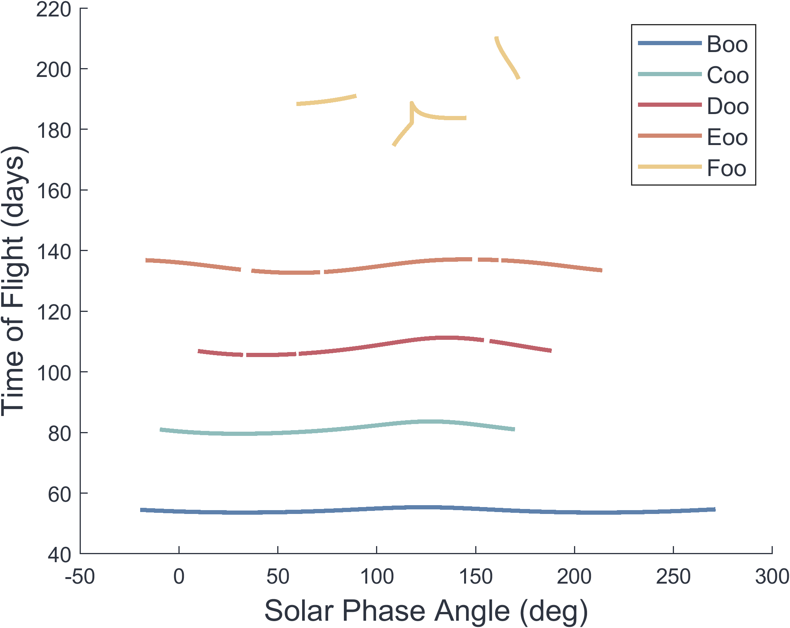
BDoo
CCoo
DBoo
BCoo
BBoo
BAoo
AAoo

Slide 5
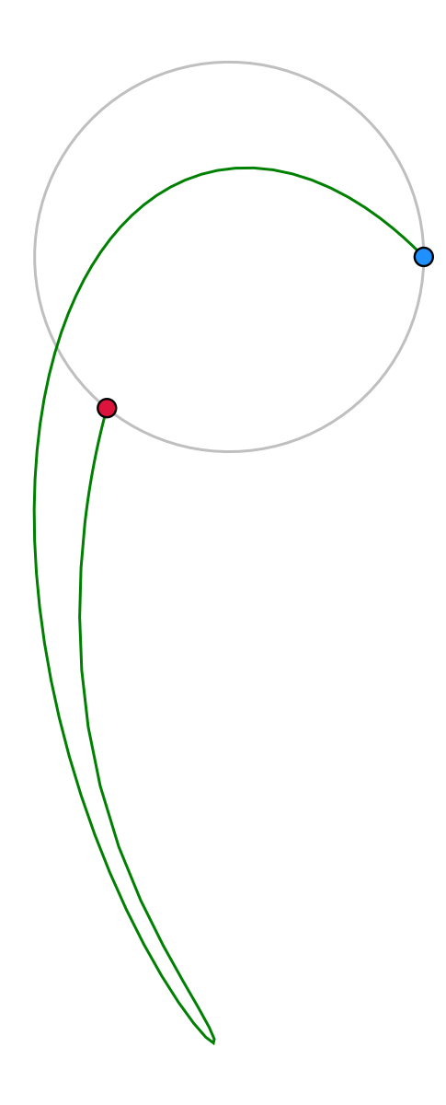
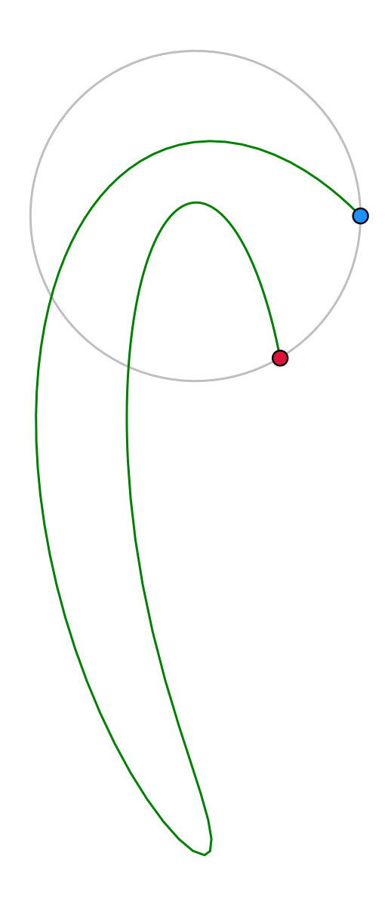
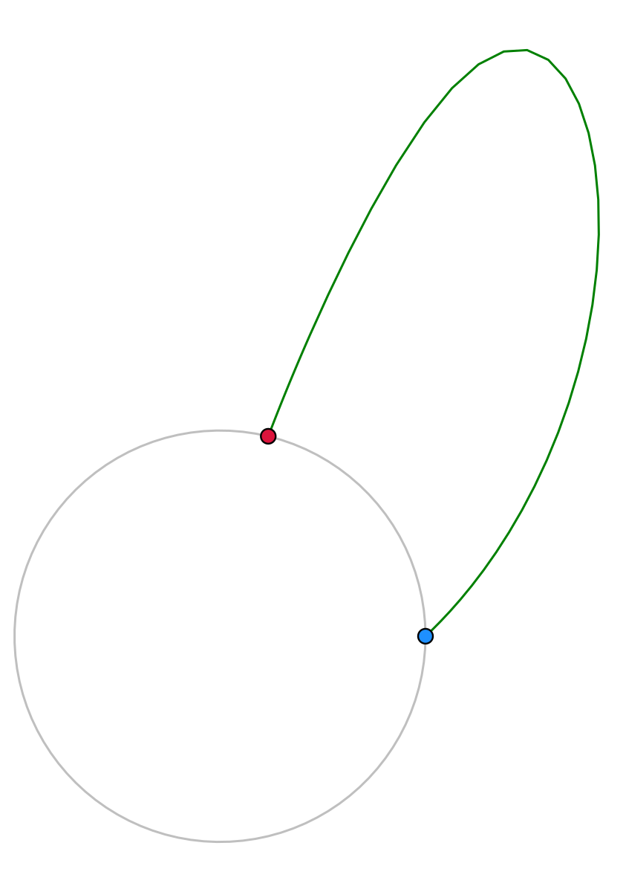
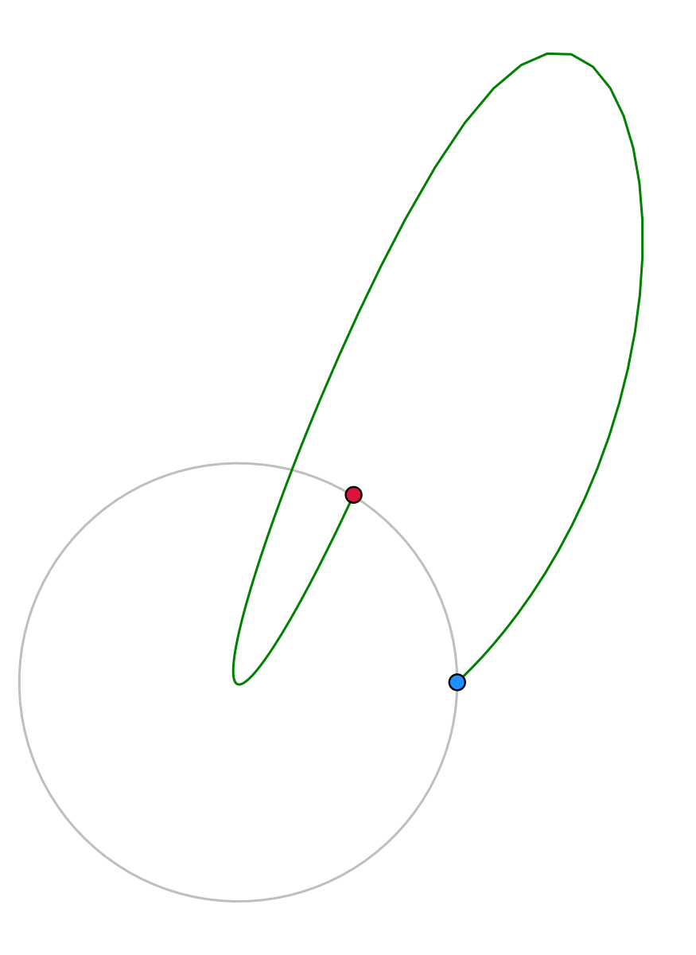
ii
io
oi
oo

Slide 6
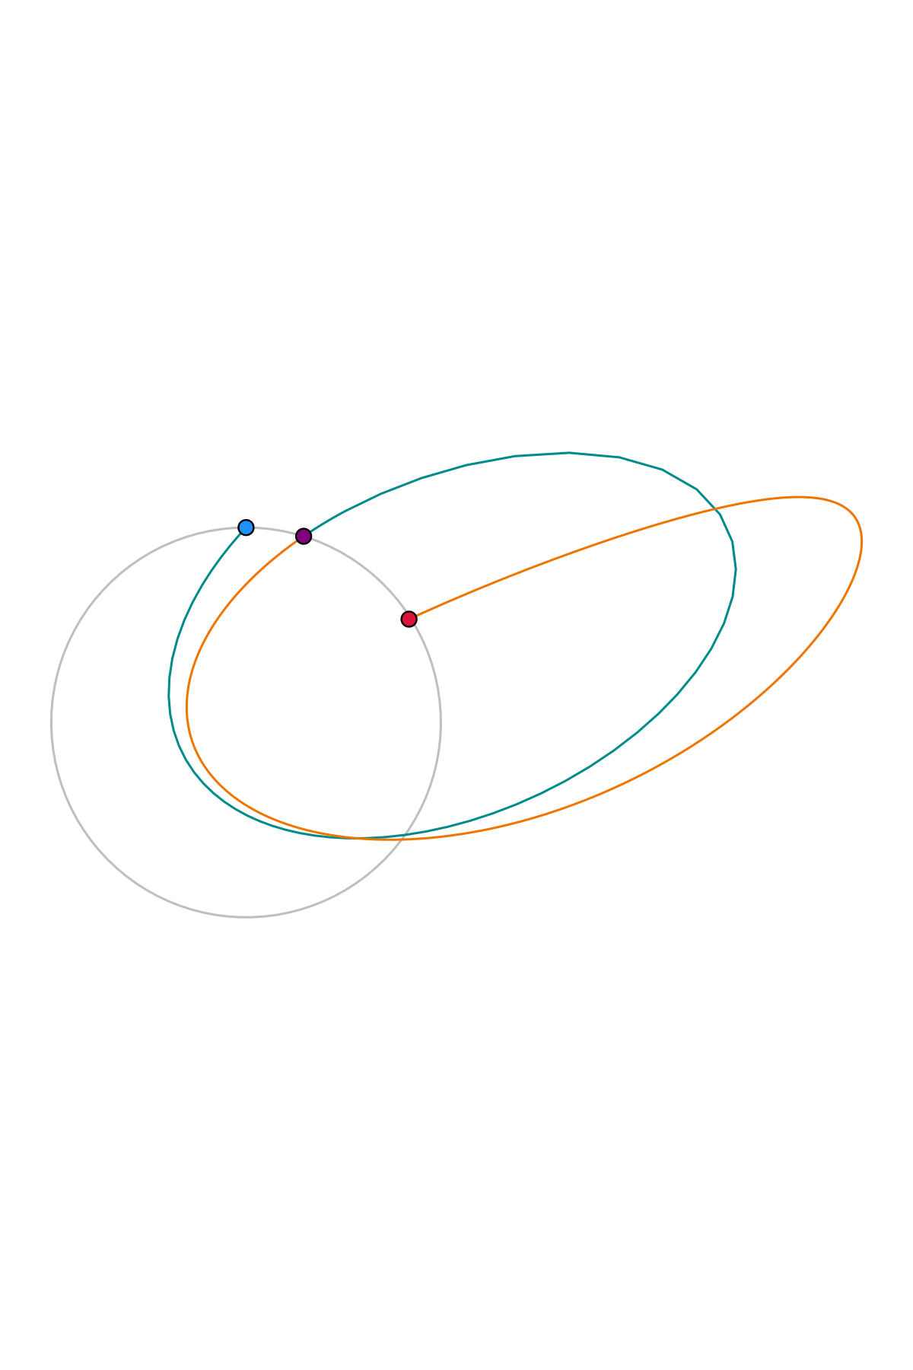
Crossing Point
Lunar Arrival
2nd Revolution
C-Type (72 days)
Lunar Departure
1st Revolution
B-Type (41 days)

Slide 7


If Fails To Converge
Select Lunar $v_{∞}$ & Family
Select Solar Phase Angle
Search ${\vec{v}}_{∞}$ Latitudes
Optimize Solution
Continue Results for 180° Range

