Slide 1
Product Roulette
A user enters her email and persona (developer, salesperson, marketing, hr, engineering manager, etc.), and the program immediately starts showing interesting B2B products that she may or may not like to adopt at her company. Depending on the feedback (we can play around with what we seek as feedback but it needs to be unobtrusive and non-lengthy), the program gets progressively smarter and gets the user's stack interest profile. This Interest/Taste graph can also be used for the next user, creating a network effect.
Like a Tinder/Netflix for Software Products.

Slide 2
RECOMMENDER SYSTEM [ML]

Slide 3
Objective
Discover content based on human’s unique needs and Preferences.[Customization]
Major industries with RM
Ecommerce
Amazon
Social
Google News
JOB
Linked in
Entertainment
Netflix
Tinder
YouTube
eBay

Slide 4
How is it done
New product Recommendation
White Spaces in any webpage --Advertisement
Email Campaigns --you added this to your cart
Loyalty Programs -- Points Redemption
USER
USER
SEARCH
Search engines [Pull mode]
Recommend
Recommendation system [Push mode]

Slide 5
RECOMMENDER SYSTEM
Candidate Generation
Scoring
Reranking
Collaborative filtering
Candidate Generation
Given a query, the system generates a set of relevant candidates.
Candidate Generation
Content Based Filtering
Hybrid

Slide 6
Recommender systems ---- Filtering Systems
Scoring
A model scores and ranks the candidates in order to select the set of items (on the order of 10) to display to the user. The system can use a more precise model relying on additional queries.
Re-ranking
Finally, the system must take into account additional constraints for the final ranking. For example, the system removes items that the user explicitly disliked or boosts the score of fresher content. Diversity, freshness, and fairness.

Slide 7
Why Not Let the Candidate Generator Score?
Since candidate generators compute a score (such as the similarity measure in the embedding space), you might be tempted to use them to do ranking as well. However, you should avoid this practice for the following reasons:
Some systems rely on multiple candidate generators. The scores of these different generators might not be comparable.
With a smaller pool of candidates, the system can afford to use more features and a more complex model that may better capture context

Slide 8
Content based filtering
Just focus on item rather than person opinion [item similarity]
Recommend based on his Past Search i.e based on content of item irrespective of other users opinions
The user profile is represented with the same terms and built up by analysing the content of items which have been seen by the user.
Relevance feedback, genetic algorithms, neural networks, and the Bayesian classifier are among the learning techniques for learning a user profile.

Slide 9
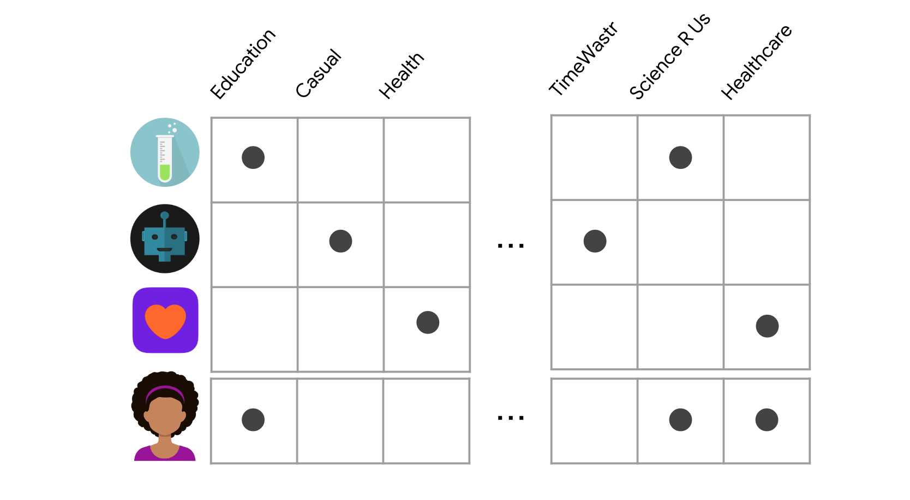

Slide 10
Initialization
User Profile
Binary Classifier [user interest profile]
DOC Source
Accepted docs by User
Accumulated
data
learning
feedback

Slide 11
ADV
The model doesn't need any data about other users, since the recommendations are specific to this user. This makes it easier to scale to a large number of users.
The model can capture the specific interests of a user, and can recommend niche items that very few other users are interested in
DISADV
Since the feature representation of the items are hand-engineered to some extent, this technique requires a lot of domain knowledge. Therefore, the model can only be as good as the hand-engineered features.
The model can only make recommendations based on existing interests of the user. In other words, the model has limited ability to expand on the users' existing interests.

Slide 12
Collaborative filtering
User Based – Large number of Users with similar interests have similar preferences
har liked popcorn. jot liked popcorn
har liked coke.
lets recommend coke to “jot” even though system has no idea on jot liking the coke.
ADV
No item features needed
DISADV
New user/item cold start issue
Large number of Users
Hard to include side features for query/item[but side features will increase the efficiency of model]

Slide 13
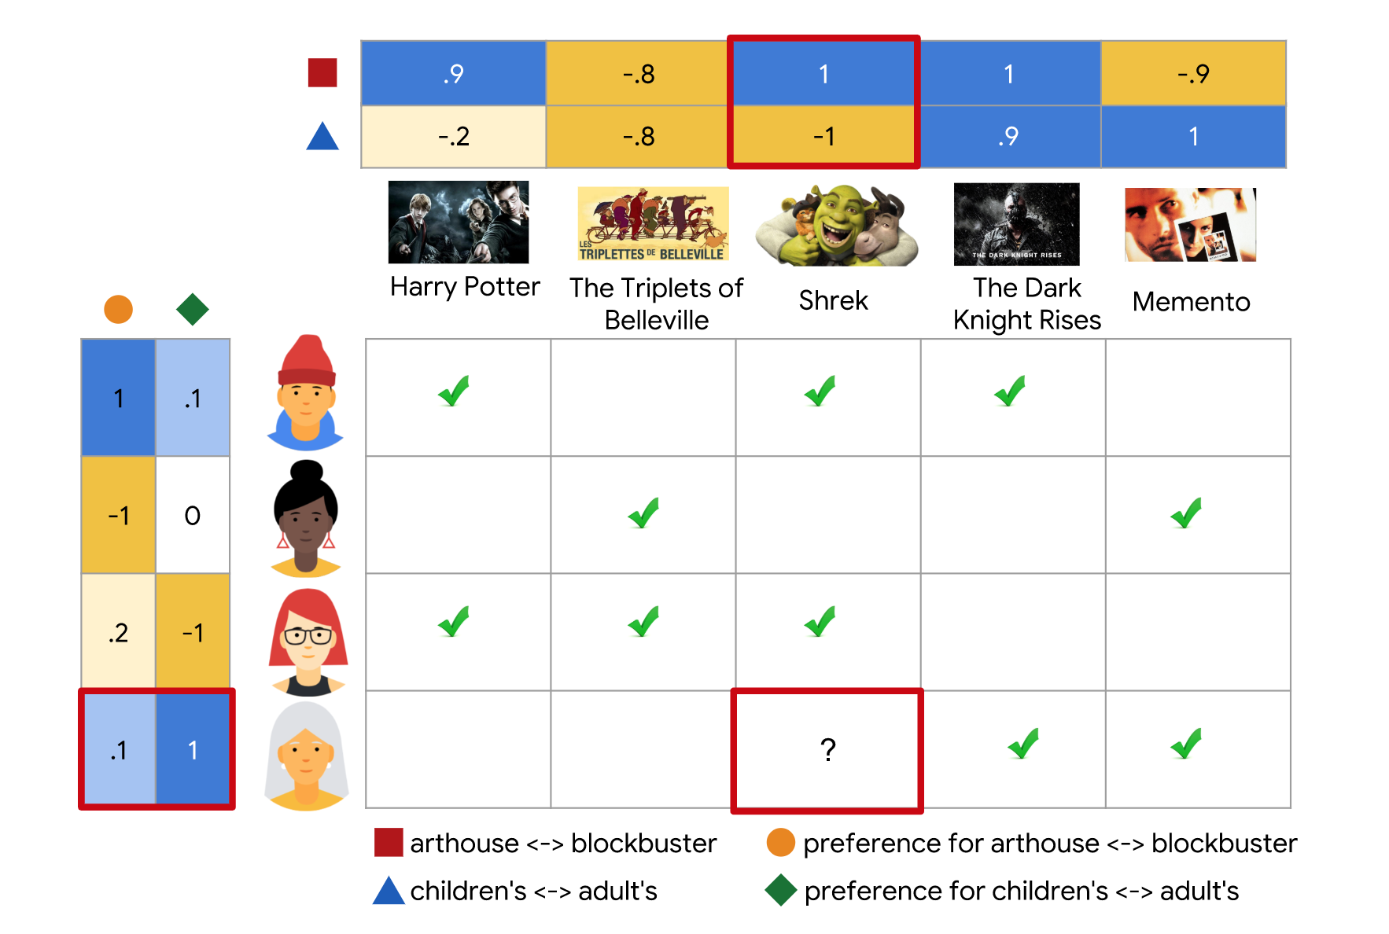

Slide 14
Collaborative filtering
Item Based
har bought iPhone and case. jot bought iPhone and case
recommend iPhone and case together to “all” who search for iphone-- Frequently bought together
ADV
No features details needed
Correlation between Limited items than large users
DISADV
New user/item cold start issue

Slide 15
Application | Before | After
Tinder | ELO score [rank- high with high, number of chats] | Collaborative filtering [from 2019 March] – near location , online at same time. [ based solely on the ways users select many of the same profiles as other users who are similar to them, and the way one user’s behaviour can predict another’s, without ranking people in an explicitly competitive way. --used by Hinge –tinder parent MATCH acquired it]
Linked in [2014] Feature Companies you want to follow | Term frequency-inverse document frequency. Matching job seeker’s resume to job description. | Hybrid Collaborative -- feature --company is similar to the ones a user already followed. Content -- feature -- industry, location match between the user and the company.

Slide 16
Application | Before | After
Netflix | Location and Past data [content based] | Collaborative filtering [SVD]
YouTube [2016] |  | Hybrid Collaborative -- search queries and videos watched Content --gender, location, etc
Airbnb [2018] Feature Person books flight after viewing few listings |  | Collaborative filtering [deep learning embeddings]
Linked in [2014] Feature Job seeker will apply to job |  | Content Based filtering

Slide 17
Product Roulette
A user enters her email and persona (developer, salesperson, marketing, hr, engineering manager, etc.), and the program immediately starts showing interesting B2B products that she may or may not like to adopt at her company. Depending on the feedback (we can play around with what we seek as feedback but it needs to be unobtrusive and non-lengthy), the program gets progressively smarter and gets the user's stack interest profile. This Interest/Taste graph can also be used for the next user, creating a network effect.
Like a Tinder/Netflix for Software Products.

Slide 18
Algorithm used (follows Hybrid)
Taking users (u1,u2,u3---) and softwares(s1, s2 ,s3--) and final original vector being the persona (dev, test ,hr ----)
Y will be approximately [x 0 0 ] if user is a developer on assuming only 3 features for software as dev feature, test feature, hr feature
Choose random values for user vector(U) and software vector(S) and we will find the cost function as difference between half of squares of (U^T)S and Y
Minimise the cost function w.r.t both U and S using Gradient descent algorithm , so that we get approximate correct U and S instead of our random choice.
So now for a user persona multiply with all LEARNED software vectors and will recommend the software with highest product value

Slide 19
Thank you.

