Slide 1
Movie Rating System
Requirement and Design Presentation

Slide 2
Team Six
Jakhongir Raimbekov
Teklemichael Buruk

Slide 3
Introduction
This presentation is designed to show all the steps and processes involved in requirement analysis and design for the project Movie Rating System

Slide 4
Presentation Scope
This presentation will first focus on Requirement Analysis such as Use-case model that includes Use-case diagram and Use-case description document.
Secondly focuses on Architectural analysis.

Slide 5
Content Outline
I. Requirement Analysis
Use Case Model
Use-diagram
Use-case descriptions
Supplementary Specifications
Glossary
II. Architectural Analysis

Slide 6
I. Requirement Analysis

Slide 7
Use-case Model
Use-case diagram
Use-case descriptions

Slide 8
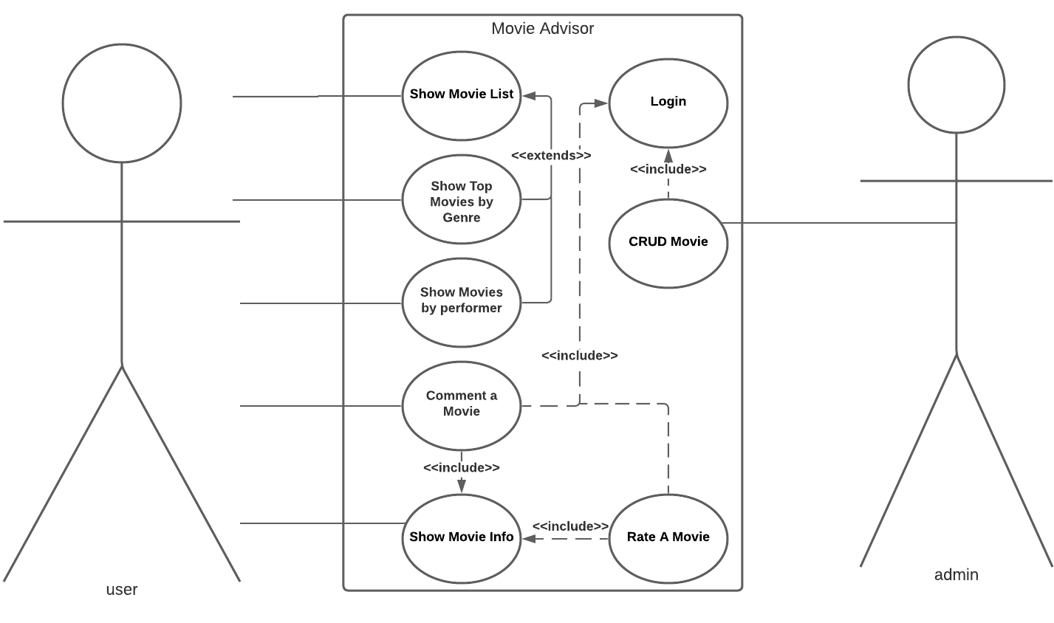
Use-Case Diagram

Slide 9
Use cases
Show movie List
Show top Movies By Genre
Show movie by performer
Comment a Movie
Rate a Movie
Show movie Info

Slide 10
Use-case description
Purpose
To describe all the use cases,flow of events, conditions after and before each use case and the system response in our project.

Slide 11
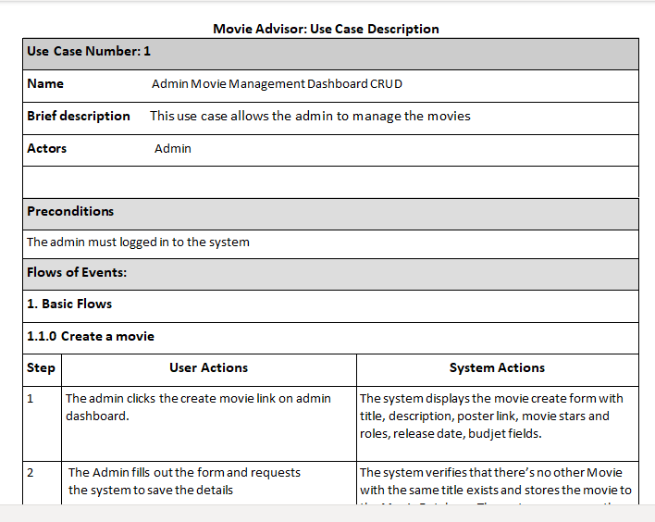
Use-case descriptions

Slide 12
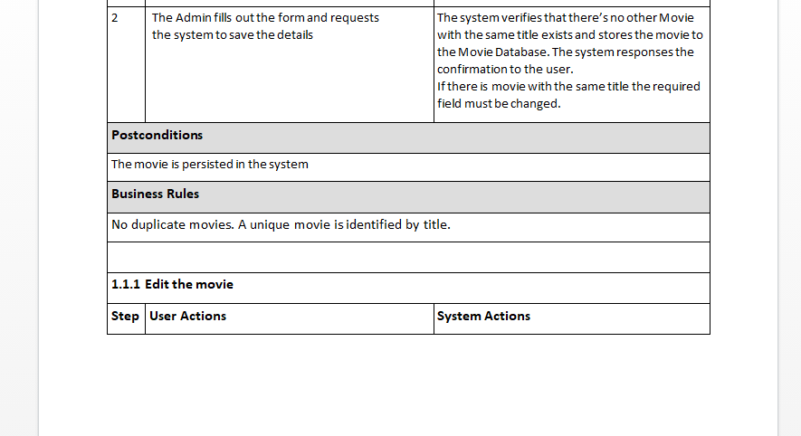
Use-case description

Slide 13
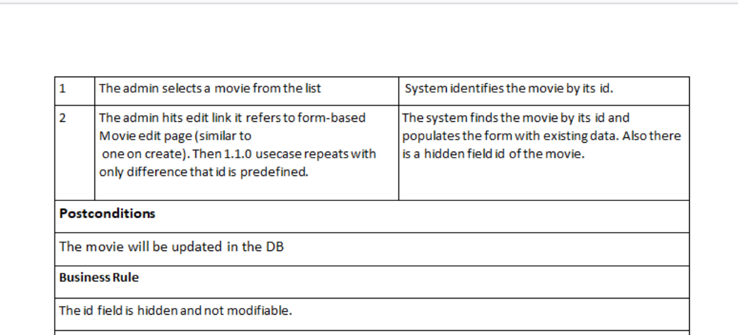
Use-case descriptions

Slide 14
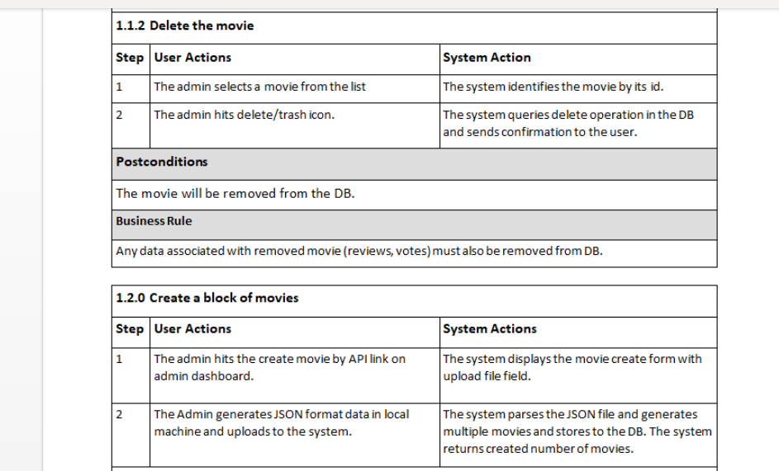
Use-case descriptions

Slide 15
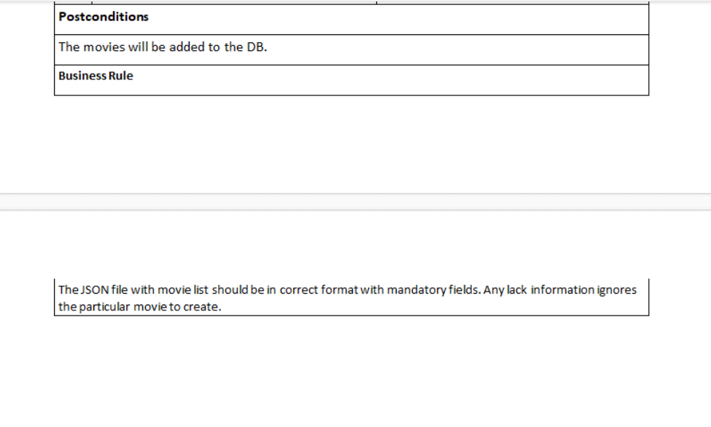
Use-case descriptions

Slide 16
Supplementary Specification
The purpose of this document is to define non-functional requirements of the Online Movie Rating System.
This Supplementary Specification lists the requirements that are not readily captured in the use cases of the use-case model.
The Supplementary Specifications and the use-case model together capture a complete set of requirements on the system.

Slide 17
Supplementary Specification
Scope
This Supplementary Specification applies to the Online Movie Rating System.
This specification defines the non-functional requirements of the system; such as reliability, usability, performance, and supportability as well as functional requirements that are common across a number of use cases.
(The functional requirements are defined in the Use Case Specifications.).

Slide 18
Glossary
Definition
1.1 Performer
An actor or actresss
1.2 Rate a Movie
To give ranking or evaluate a movie through one to ten rating scale.

