Slide 1
System programming Lecture 10
Threads in Windows

Slide 2
Thread Overview
A thread is an independent unit of execution within a process.
Single-threaded processes have several disadvantages:
It is expensive and time consuming for the OS to switch running processes.
Except in the case of shared memory, processes are not tightly coupled, and it is difficult to share resources, such as open files.
It is difficult and inefficient for single-threaded processes to manage several concurrent and interacting tasks, such as waiting for and processing user input, waiting for file or network input, and performing computation.
The Windows executive will schedule independent threads on separate processors of a multiprocessor1 computer.

Slide 3
Issues
Threads share storage and other resources within a process, so one thread can accidentally modify another thread’s data, leading to defects such as race conditions and deadlocks.
In certain circumstances, concurrency can drastically degrade, rather than improve, performance.

Slide 4
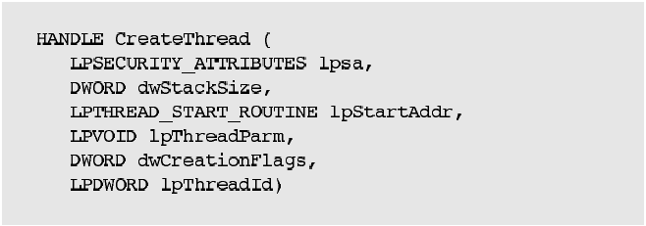
CreateThread

Slide 5

Parameters
dwStackSize is the size of the new thread’s stack. Use 0 to default to the primary thread’s stack size.
lpStartAddr points to the thread function (within the calling process) to be executed. This function accepts a single pointer argument and returns a 32-bit DWORD exit code.
The thread function signature, then, is as follows:

Slide 6
Parameters
lpThreadParm is the pointer passed as the thread argument and is interpreted by the thread and its parent, normally as a pointer to an argument structure.
The calling process can pass an argument, usually a pointer, to a thread at creation time. This argument is actually on the thread’s stack.
dwCreationFlags, if 0, means that the thread is ready to run immediately. If it is CREATE_SUSPENDED, the new thread will be in the suspended state, requiring a ResumeThread function call to move the thread to the ready state.
lpThreadId points to a DWORD that receives the new thread’s identifier.

Slide 7
CreateRemoteThread
The CreateRemoteThread function allows a thread to be created in another process. Compared with CreateThread, there is an additional parameter for the process handle, and the function addresses must be in the target process’s address space.
CreateRemoteThread is one of several interesting, and potentially dangerous, ways for one process to affect another directly, and it might be useful in writing, for example, a debugger. There is no way to call this function usefully and safely in normal applications.

Slide 8

ExitThread
A common alternative, however, is for a thread to return from the thread function using the exit code as the return value.
When the last thread in a process exits, the process itself terminates.

Slide 9
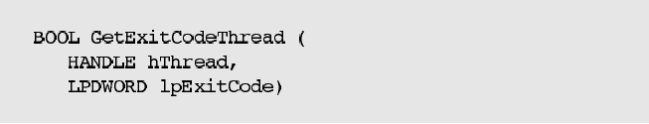
GetExitCodeThread
A terminated thread (again, a thread normally should terminate itself) will continue to exist until the last handle to it is closed using CloseHandle. Any other thread, perhaps one waiting for some other thread to terminate, can retrieve the exit code.

Slide 10
Thread Identity
You can obtain thread IDs and handles using functions that are similar to those used with processes.
GetCurrentThread returns a noninheritable pseudohandle to the calling thread.
GetCurrentThreadId obtains the thread ID rather than the handle.
GetThreadId obtains a thread’s ID from its handle.
OpenThread creates a thread handle from a thread ID.

Slide 11

Suspending and Resuming Threads
Every thread has a suspend count, and a thread can execute only if this count is 0.
One thread can increment or decrement the suspend count of another thread using SuspendThread and ResumeThread.
Both functions, if successful, return the previous suspend count.
0xFFFFFFFF indicates failure.

Slide 12
Waiting for Threads to Terminate
One thread can wait for another thread to terminate in the same way that threads wait for process termination. Use a wait function (WaitForSingleObject or WaitForMultipleObjects) using thread handles instead of process handles.
Note that the handles in the array passed to WaitForMultipleObjects do not all need to be of the same type; for example, thread, process, and other handle types can be mixed in a single call.

Slide 13
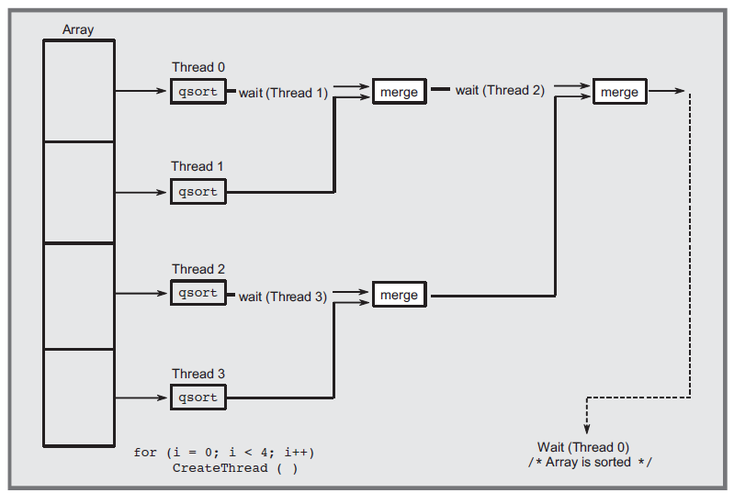
Merge-Sort—Exploiting Multiple Processors

Slide 14
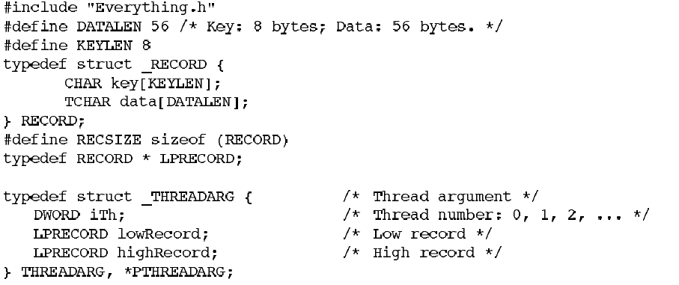

Slide 15
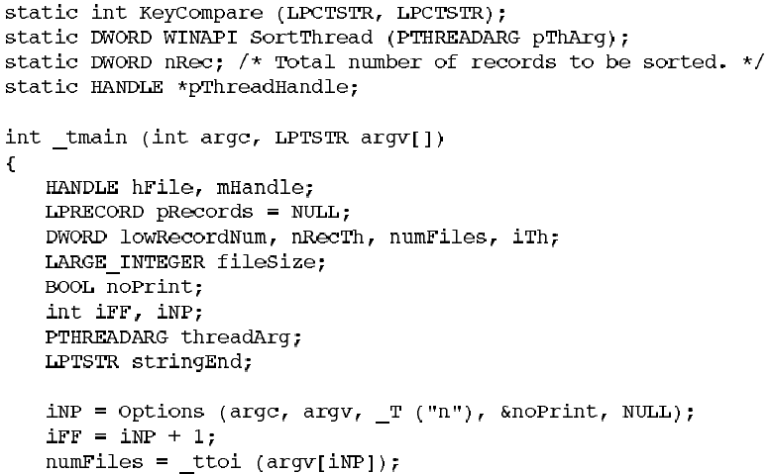

Slide 16
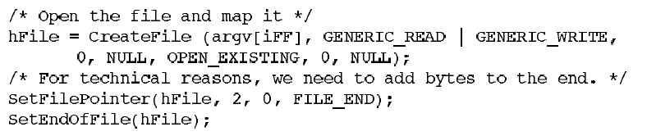
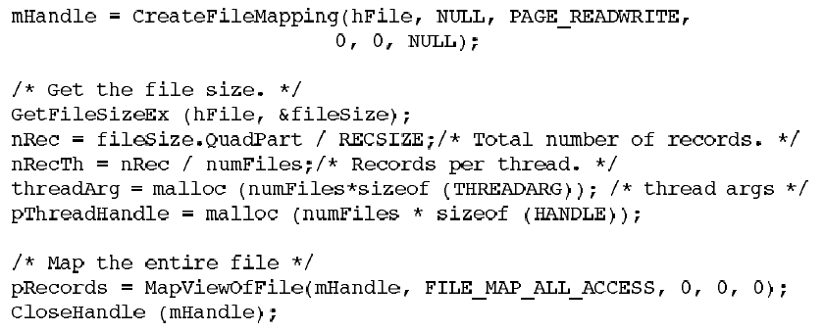

Slide 17
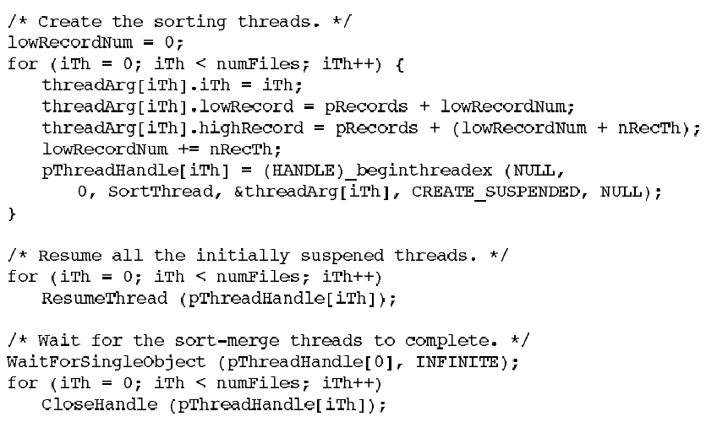

Slide 18
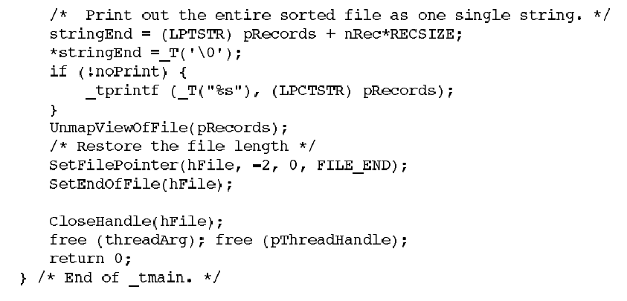

Slide 19
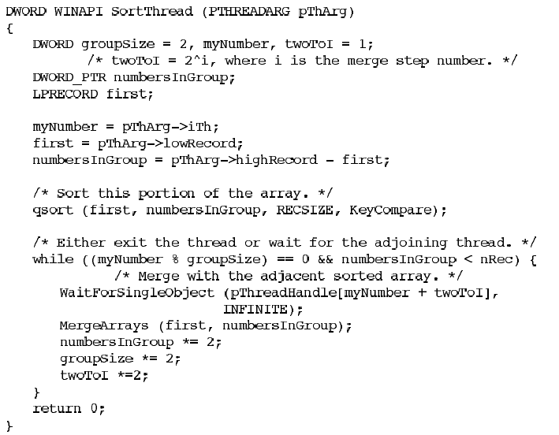

Slide 20
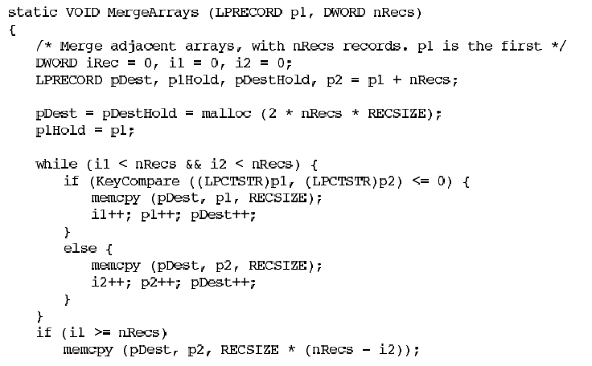
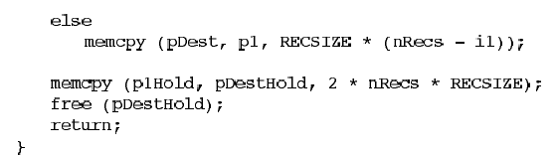

Slide 21
Properties that enable parallelism
There are separate worker subtasks that can run independently, without any interaction between them.
As subtasks complete, a master program can combine, or “reduce,” the results of several subtasks into a single result.
The programs are “lock-free” and do not need to use mutual exclusion locks. The only synchronization required is for the boss thread to wait for the worker threads to complete.
The worker subtasks run as individual threads, potentially running on separate processors.
Program performance scales automatically, up to some limit, as you run on systems with more processors.

Slide 22
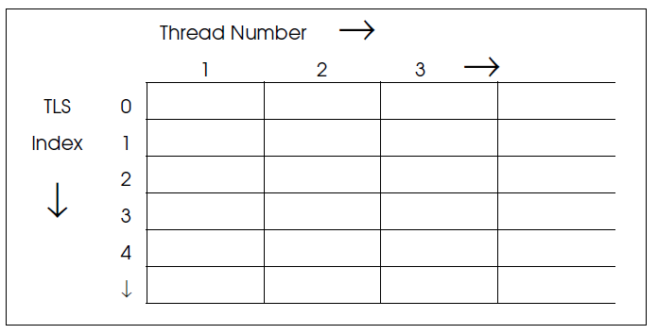
Thread Local Storage
TLS provides a convenient mechanism for storage that is global within a thread but unavailable to other threads.

Slide 23

TlsAlloc and TlsFree
TlsAlloc returns the allocated index (≥ 0), with –1 if no index is available.
An individual thread can get and set its values (void pointers) from its slot using a TLS index.

Slide 24
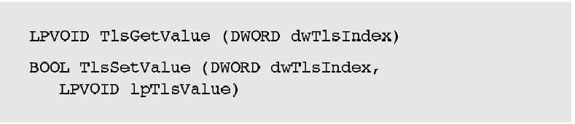
TlsGetValue and TlsSetValue
An individual thread can get and set its values (void pointers) from its slot using a TLS index.

Slide 25
Process and Thread Priority and Scheduling
Threads receive priority relative to their process priority classes.
Process priority classes are set initially by CreateProcess, and each has a base priority, with values including:
IDLE_PRIORITY_CLASS, for threads that will run only when the system is idle.
NORMAL_PRIORITY_CLASS, indicating no special scheduling requirements.
HIGH_PRIORITY_CLASS, indicating time-critical tasks that should be executed immediately.
REALTIME_PRIORITY_CLASS, the highest possible priority.
Additional values:
ABOVE_NORMAL_PRIORITY_CLASS
BELOW_NORMAL_PRIORITY_CLASS
PROCESS_MODE_BACKGROUND_BEGIN, which lowers the priority of the process and its threads for background work without affecting the responsiveness of foreground processes and threads
PROCESS_MODE_BACKGROUND_END, which restores the process priority to the value before it was set with PROCESS_MODE_BACKGROUND_BEGIN

Slide 26
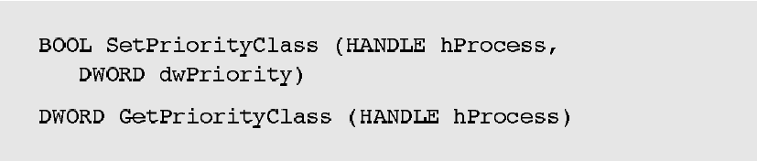
Setting and getting the priority class

Slide 27
Thread priority
THREAD_PRIORITY_LOWEST
THREAD_PRIORITY_BELOW_NORMAL
THREAD_PRIORITY_NORMAL
THREAD_PRIORITY_ABOVE_NORMAL
THREAD_PRIORITY_HIGHEST
THREAD_PRIORITY_TIME_CRITICA Lis 15, or 31 if the process class is REALTIME_PRIORITY_CLASS
THREAD_PRIORITY_IDLE is 1, or 16 for REALTIME_PRIORITY_CLASS processes
THREAD_MODE_BACKGROUND_BEGIN
THREAD_MODE_BACKGROUND_END

Slide 28
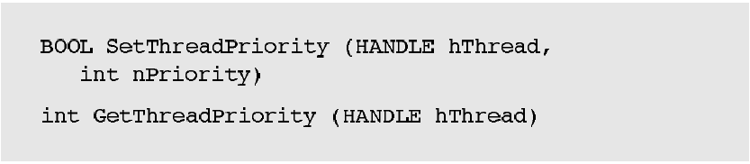
Setting and reading a thread’s relative priority

Slide 29
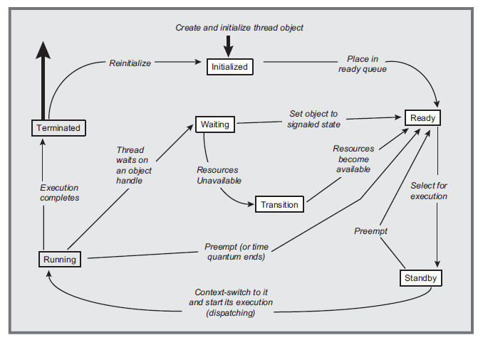
Thread States and Transitions

Slide 30
Pitfalls and Common Mistakes
Make no assumptions about the order in which the parent and child threads execute.
Be certain that each distinct child has its own data structure passed through the thread function’s parameter.
Any thread, at any time, can be preempted, and any thread, at any time, may resume execution.
Do not use thread priority as a substitute for explicit synchronization.
Threads should be used only as appropriate. Thus, if there are activities that are naturally concurrent, each such activity can be represented by a thread. If, on the other hand, the activities are naturally sequential, threads only add complexity and performance overhead.
If you use a large number of threads, be careful, as the numerous stacks will consume virtual memory space and thread context switching may become expensive.

Slide 31

Timed Waits
Function Sleep , allows a thread to give up the processor and move from the running to the wait state for a specified period of time. A thread can, for example, perform a task periodically by sleeping after carrying out the task.
Once the time period is over, the scheduler moves the thread back to the ready state.

Slide 32
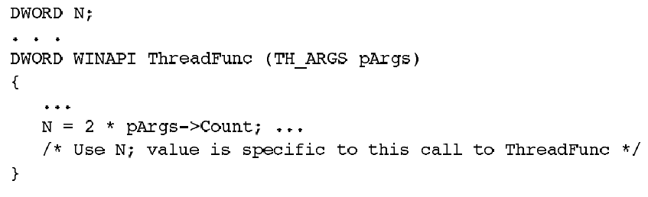
Problems in converting a legacy single-threaded program to multithreaded

Slide 33
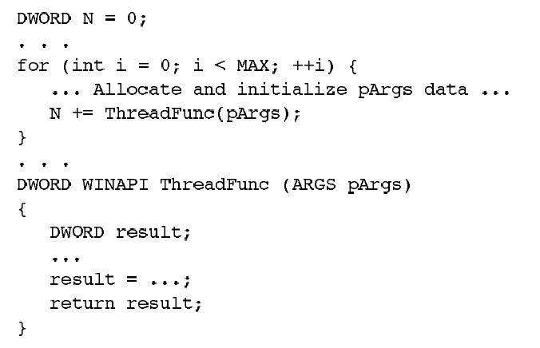

Slide 34
Thread-Safe Code
Variables that are local to the thread should not be global and should be on the thread’s stack or in a data structure or TLS that only the individual thread can access directly.
If a function is called by several threads and a thread-specific state value, such as a counter, is to persist from one function call to the next, do not store it in a global variable or structure. Instead, store the state value in TLS or in a data structure dedicated to that thread, such as the data structure passed to the thread when it is created.

Slide 35
Thread-Safe Code
3. Threads should not, in general, change the process environment because that would affect all threads. Thus, a thread should not set the standard input or output handles or change environment variables.
4. Variables shared by all threads should be static or in global storage and protected with the synchronization or interlocked mechanisms.

Slide 36
Thread Synchronization Objects
A thread can wait for another process to terminate by waiting on the process handle with WaitForSingleObject or WaitForMultipleObjects.
Mutexes
Semaphores
Events
CRITICAL_SECTION objects

Slide 37
CRITICAL_SECTION objects
A critical code region, as described earlier, is a code region that only one thread can execute at a time; more than one thread executing the critical code region concurrently can result in unpredictable and incorrect results.
Windows provides the CRITICAL_SECTION object as a simple “lock” mechanism for implementing and enforcing the critical code region concept.
CS objects are initialized and deleted but do not have handles and are not shared with other processes.

Slide 38
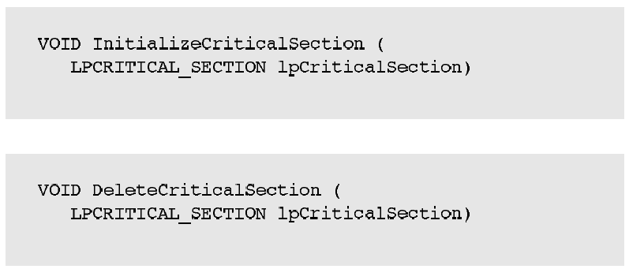
Initializing and deleting a CS variable

Slide 39
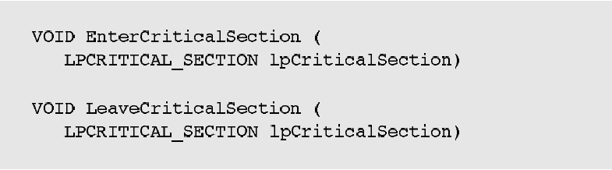
Entering and leaving a CS
EnterCriticalSection blocks a thread if another thread is in the section, and multiple threads can wait simultaneously on the same CS. One waiting thread unblocks when another thread executes LeaveCriticalSection; you cannot predict which waiting thread will unblock.

Slide 40
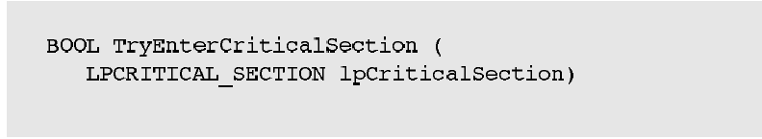
Testing whether another thread owns a CS
A TRUE return value from the function indicates that the calling thread now owns the CS. A FALSE return indicates that some other thread already owns the CS, and it is not safe to execute the critical code region.
CRITICAL_SECTIONs have the advantage of not being kernel objects and are maintained in user space. This almost always provides performance improvements compared to using a Windows mutex kernel object.

Slide 41

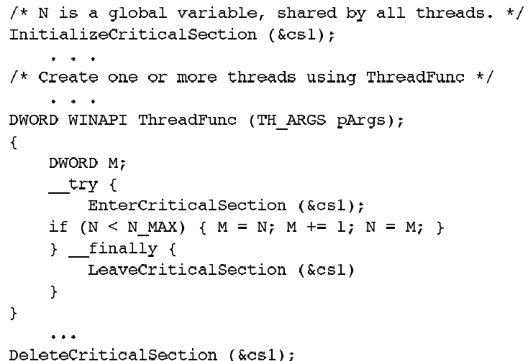

Slide 42
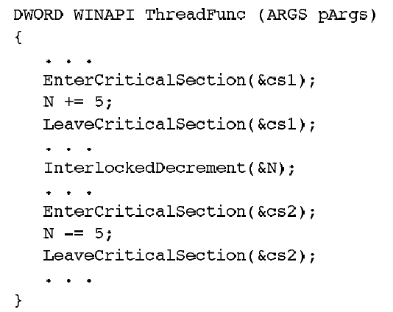
Protect a Variable with a Single Synchronization Object

Slide 43
Mutexes
Because mutexes can be named and have handles, they can also be used for interprocess synchronization between threads in separate processes.
For example, two processes that share memory by means of memory-mapped files can use mutexes to synchronize access to the shared memory.

Slide 44
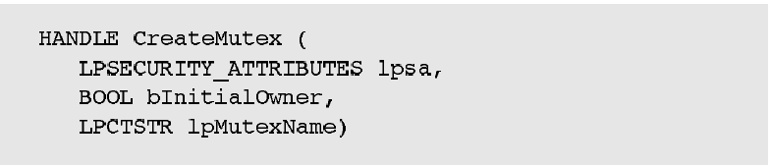
CreateMutex
The bInitialOwner flag, if TRUE, gives the calling thread immediate ownership of the new mutex.

Slide 45

ReleaseMutex

Slide 46
Mutexes vs CSs
Mutexes, when abandoned by a terminated thread, are signaled so that other threads are not blocked forever. This allows the application to continue execution, but an abandoned mutex almost certainly indicates a serious program bug or failure.
Mutex waits can time out, whereas you can only poll a CS.
Mutexes can be named and are sharable by threads in different processes.
CSs are almost always considerably faster than mutexes.

Slide 47
Semaphores
Semaphores, the second of the three kernel synchronization objects, maintain a count, and the semaphore object is in the signaled state when the count is greater than 0. The semaphore is unsignaled when the count is 0.

Slide 48

CreateSemaphore
lSemMax, which must be 1 or greater, is the maximum value for the semaphore
lSemInitial, with 0 <= lSemInitial <= lSemMax, is the initial value, and the semaphore value is never allowed to go outside of this range.

Slide 49
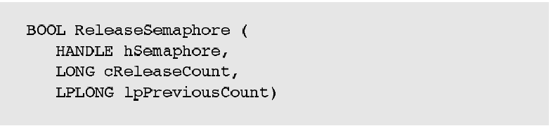
ReleaseSemaphore

Slide 50
Mutexes vs semaphores
While it is tempting to think of a mutex as a special case of a semaphore with a maximum value of 1, this would be misleading because there is no semaphore ownership.
Any thread can release a semaphore, not just the one that performed the wait.

Slide 51
Events
Events are the kernel synchronization objects.
Events can signal other threads to indicate that some condition, such as a message being available, now holds.
The important additional capability offered by events is that multiple threads can be released from a wait simultaneously when a single event is signaled.
A manual-reset event can signal several threads waiting on the event simultaneously and can be reset.
An auto-reset event signals a single thread waiting on the event, and the event is reset automatically.

Slide 52
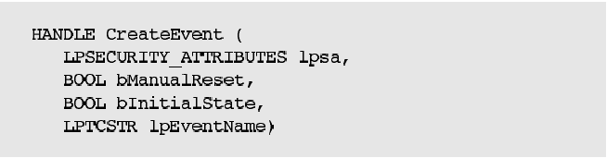
CreateEvent
Specify a manual-reset event by setting bManualReset to TRUE. Similarly, the event is initially set to the signaled state if bInitialState is TRUE .

Slide 53
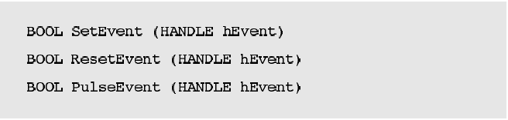
Controlling events

Slide 54
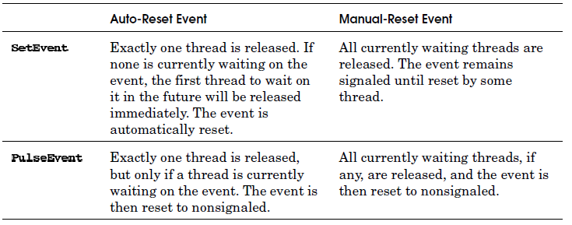

Slide 55
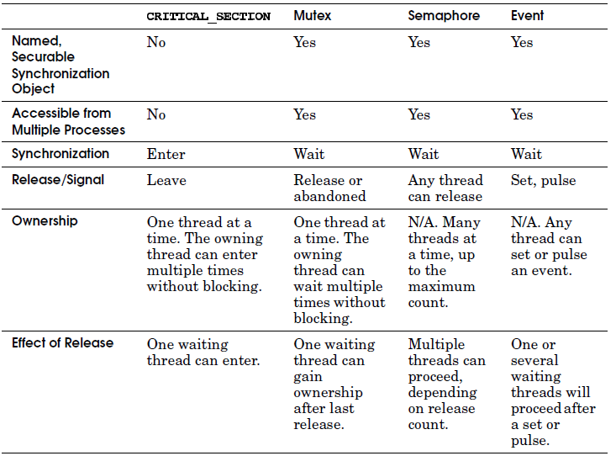
Comparison of Windows Synchronization Objects

