Slide 1
System programming Lecture 3 Processes Part 1

Slide 2
Process
A process is an instance of an executing program.

Slide 3
Program
A program is a file containing a range of information that describes how to construct a process at run time.

Slide 4
Structure of a program file
Machine-language instructions
Program entry-point address
Data
Symbol and relocation tables
Shared-library and dynamic-linking information
etc.

Slide 5
Structure of a process
A process consists of :
user-space memory containing program code and variables,
and a range of kernel data structures that maintain information about the state of the process
Ids
Virtual memory tables
Table of open file descriptors
Information relating to signal handling
Process resource usages and limits
etc.

Slide 6
Process ID (PID)
a positive integer that uniquely identifies the process on the system

Slide 7
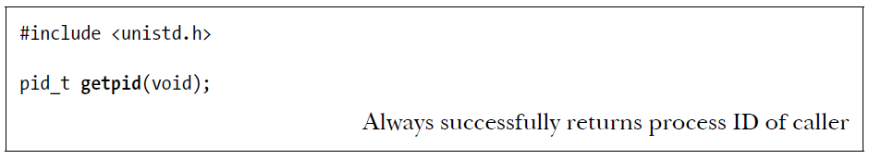
getpid() system call

Slide 8
Parent process
Each process has a parent—the process that created it.

Slide 9
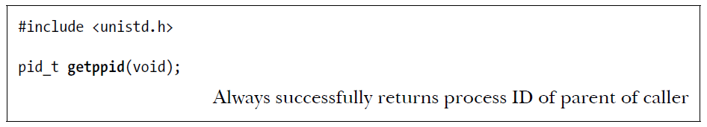
getppid() system call

Slide 10
init
the ancestor of all processes.
If a child process becomes orphaned because its “birth” parent terminates, then the child is adopted by the init process, and subsequent calls to getppid() in the child return 1.

Slide 11
Memory Layout of a Process
text segment (machine-language instructions of the program)
initialized data segment (global and static variables that are explicitly initialized)
uninitialized data segment (global and static variables that are not explicitly initialized)
stack (stack frames, one for each currently called function)
heap (area from which memory can be dynamically allocated at run time)

Slide 12
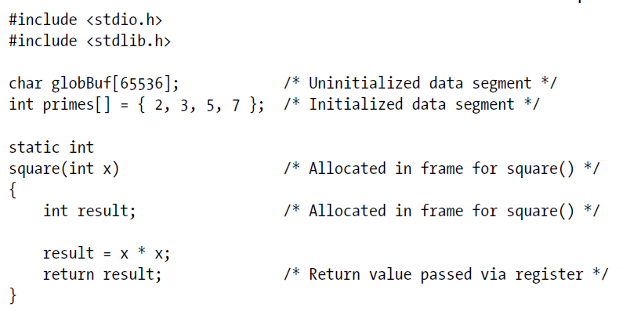
Mapping between C variables and the segments of a process

Slide 13
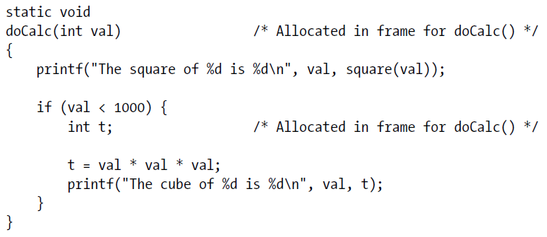

Slide 14
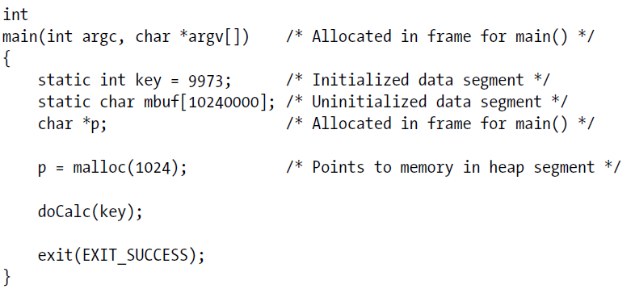

Slide 15
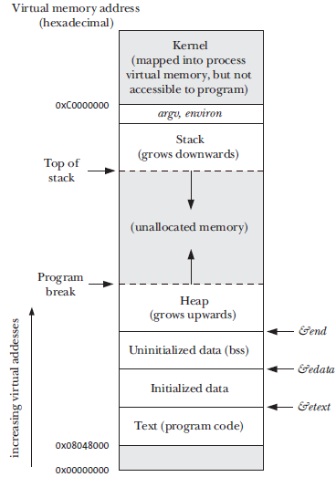
Memory layout of a process on Linux x86-32 architecture

Slide 16
Locality of reference
Spatial locality is the tendency of a program to reference memory addresses that are near those that were recently accessed (because of sequential processing of instructions, and, sometimes, sequential processing of data structures).
Temporal locality is the tendency of a program to access the same memory addresses in the near future that it accessed in the recent past (e.g., because of loops).

Slide 17
Virtual Memory
The term virtual memory refers to a combination of hardware and operating system software that solves several computing problems. It receives a single name because it is a single mechanism, but it meets several goals:
To simplify memory management and program loading by providing virtual addresses.
To allow multiple large programs to be run without the need for large amounts of RAM, by providing virtual storage.

Slide 18
Virtual memory management
The aim of the virtual memory management technique is to make efficient use of both the CPU and RAM (physical memory) by exploiting a locality of reference.

Slide 19
Pages and frames
A virtual memory scheme splits the memory used by each program into small, fixed-size units called pages.
Correspondingly, RAM is divided into a series of page frames of the same size.

Slide 20
Resident set
At any one time, only some of the pages of a program need to be resident in physical memory page frames; these pages form the so-called resident set.

Slide 21
Swap area
Copies of the unused pages of a program are maintained in the swap area—a reserved area of disk space loaded into physical memory only as required.

Slide 22
Page fault
When a process references a page that is not currently resident in physical memory, a page fault occurs, at which point the kernel suspends execution of the process while the page is loaded from disk into memory.

Slide 23
Page table
The page table describes the location of each page in the process’s virtual address space.
Each entry in the page table either indicates the location of a virtual page in RAM or indicates that it currently resides on disk.

Slide 24
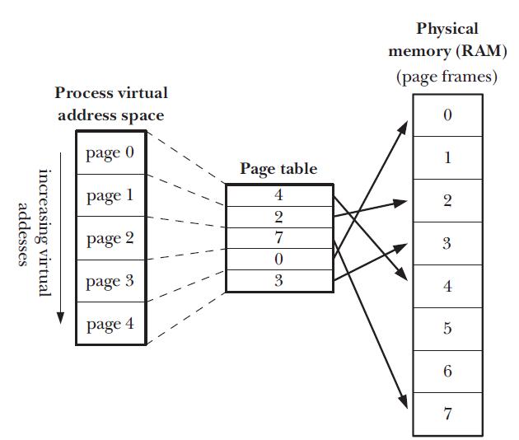
Virtual memory

Slide 25
Paged memory management unit (PMMU)
The PMMU translates each virtual memory address reference into the corresponding physical memory address and advises the kernel of a page fault when a particular virtual memory address corresponds to a page that is not resident in RAM.

Slide 26
Advantages of using VM
Processes are isolated from one another and from the kernel, so that one process can’t read or modify the memory of another process or the kernel.
Where appropriate, two or more processes can share memory. The kernel makes this possible by having page-table entries in different processes refer to the same pages of RAM.

Slide 27
Advantages of using VM
Programmers, and tools such as the compiler and linker, don’t need to be concerned with the physical layout of the program in RAM.
Because only a part of a program needs to reside in memory, the program loads and runs faster.
Since each process uses less RAM, more processes can simultaneously be held in RAM.

Slide 28
Stack
The stack grows and shrinks as functions are called and return.
Stack holds parameter values, local variables, and the address of calling function.
For Linux on the x86-32 architecture, the stack resides at the high end of memory and grows downward.
A special-purpose register, the stack pointer, tracks the current top of the stack.
Each time a function is called, an additional stack frame (or activation record) is allocated on the stack, and this frame is removed when the function returns.

Slide 29
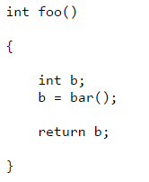
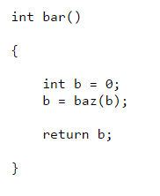
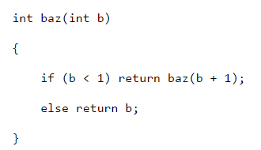
Example: Simple functions

Slide 30
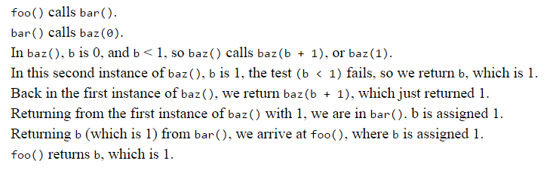
A call to foo()

Slide 31
Problems
variables in different functions can have the same name but still represent different variables;
each instance of a recursive function can have its own set of private variables;
recursive functions can create arbitrarily many instances of functions

Slide 32
Stack frame (activation record)
The information for one function is called an activation record or stack frame.
Function arguments and local variables
Call linkage information
When the function returns, the activation record will be removed

Slide 33
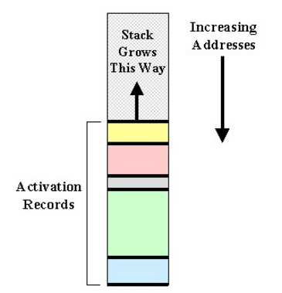
Stack Frame

Slide 34
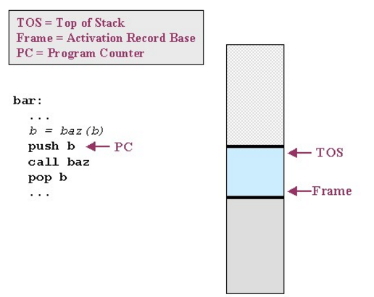
Call stack: push b

Slide 35
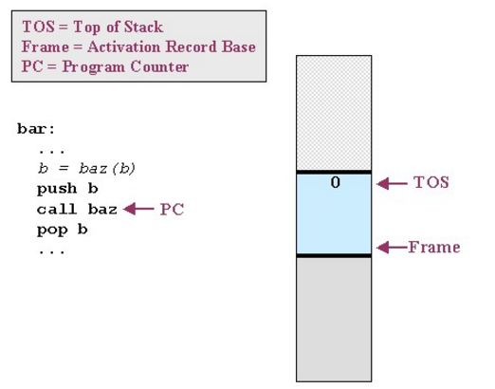
Call stack: call baz

Slide 36
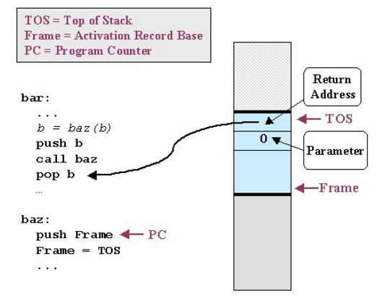
Call stack: save state of bar

Slide 37
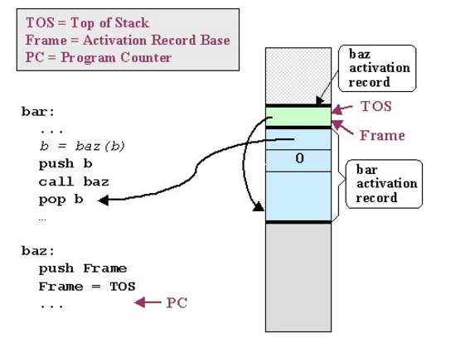
Call stack: execute baz

Slide 38
Notice that baz() will access its parameter b from the stack by using an offset of eight bytes from the Frame register. (The pointer to the caller's activation record takes four bytes, and the return address takes another four bytes; the parameter is the next location in memory.)

Slide 39
Returning From a Function Call
TOS = Frame // restore top of stack from Frame base pointer
pop Frame // pop the top of stack (previous Frame base) into Frame
return // pop the PC from the top of the stack

Slide 40
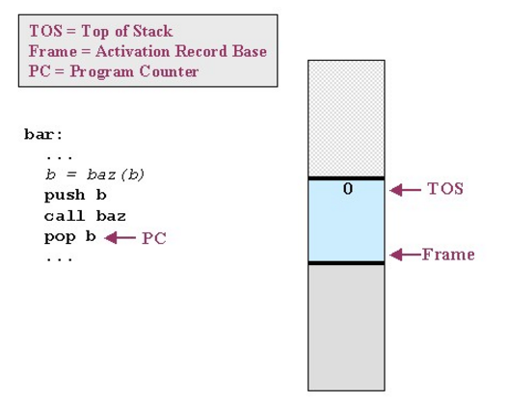
Call stack: pop b

Slide 41
Activation record
In general, an activation record may contain:
Parameters. For example, the parameter 0 passed by bar() to baz()
The return address. The address used to restore the PC. (Again, this is shown in bar()'s activation record.)
A pointer to the caller's activation record. The pointer used to restore the Frame pointer.
Saved machine registers. In addition to saving the Frame pointer, the callee may need to save and restore other machine registers, allowing them to be used as fast, intermediate storage while executing instructions in the callee.
Local variables. Any variables declared within the function are allocated on the stack.

Slide 42
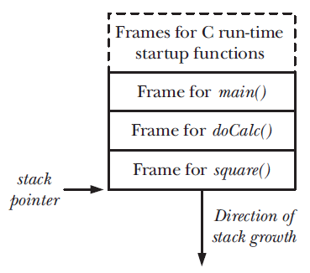
Example of a process stack

