Slide 1
System programming Lecture 3 Processes Part 2

Slide 2
Main system calls
fork()
wait()
exit() (library function layered on top of _exit() system call)
execve()

Slide 3
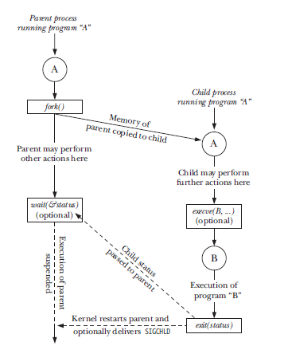

Slide 4
Process creation

Slide 5
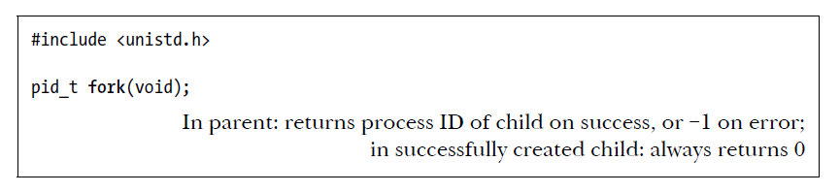
Creating a New Process: fork()
The two processes are executing the same program text, but they have separate copies of the stack, data, and heap segments.

Slide 6
How to distinguish two processes?
For the parent, fork() returns the process ID of the newly created child. This is useful because the parent may create, and thus need to track, several children (via wait() or one of its relatives).
For the child, fork() returns 0.

Slide 7
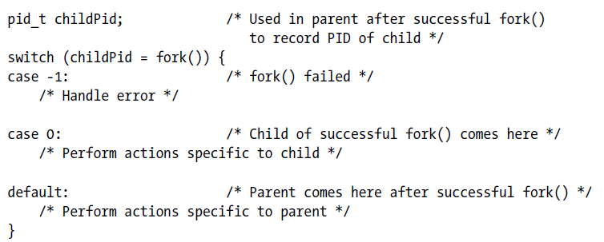
General structure

Slide 8
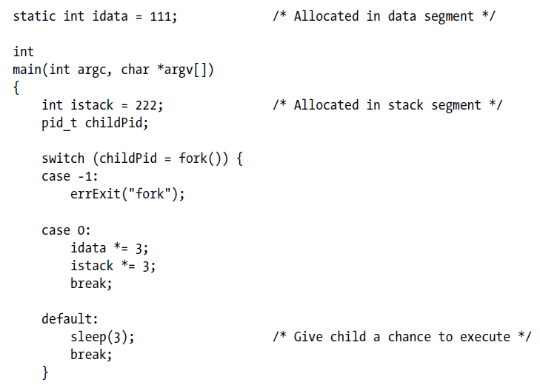
Using fork()

Slide 9
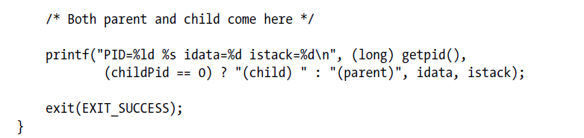

Output

Slide 10
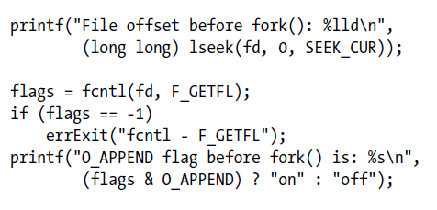
File sharing between parent and child (sharing of file offset and open file status flags )

Slide 11
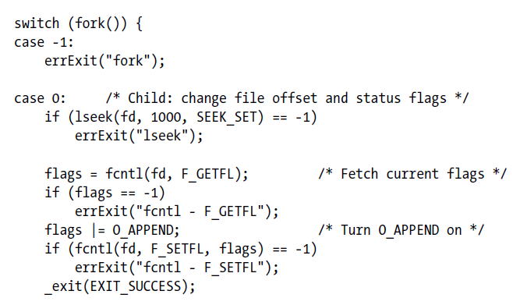

Slide 12
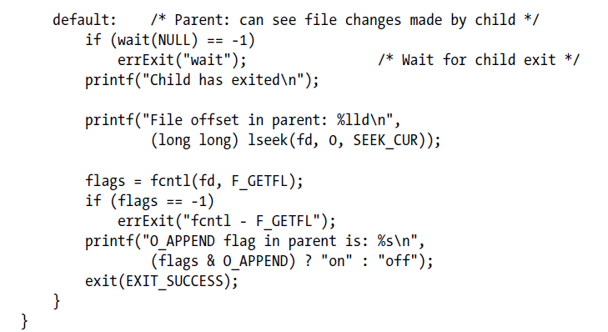

Slide 13
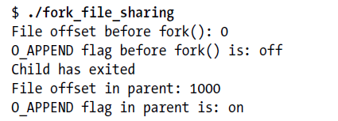
Output
Main result
attributes are shared by the parent and child after a fork()

Slide 14
Memory Semantics of fork()
The kernel marks the text segment of each process as read-only, so that a process can’t modify its own code.
For the pages in the data, heap, and stack segments of the parent process, the kernel employs a technique known as copy-on-write.

Slide 15
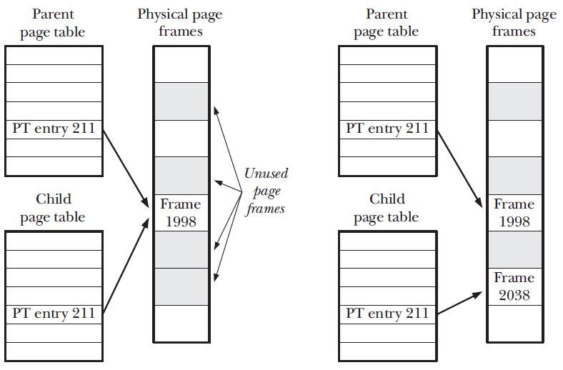
Copy-on-write technique

Slide 16
Process’s memory footprint
The process’s memory footprint is the range of virtual memory pages used by the process.

Slide 17
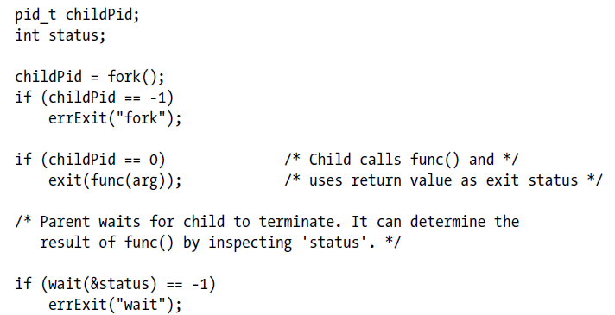
Calling a function without changing the parent process’s memory footprint

Slide 18
Main idea
If we know that func() causes memory leaks or excessive fragmentation of the heap, this technique eliminates the problem.

Slide 19
Race conditions after fork()
After a fork(), it is indeterminate which process—the parent or the child—next has access to the CPU.

Slide 20
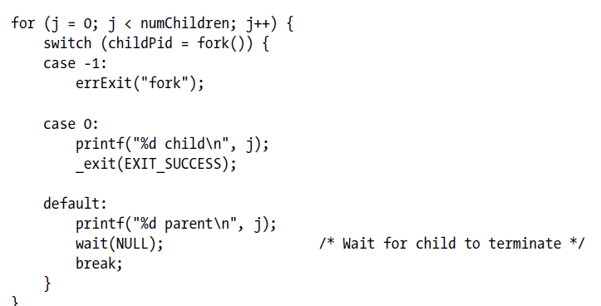
Parent and child race to write a message after fork()

Slide 21
Main idea
We can’t assume a particular order of execution for the parent and child after a fork().
If we need to guarantee a particular order, we must use some kind of synchronization technique.

Slide 22
Process termination

Slide 23
Two ways of process termination
Abnormal (delivery of a signal whose default action is to terminate the process)
Normal (using the _exit() system call)

Slide 24
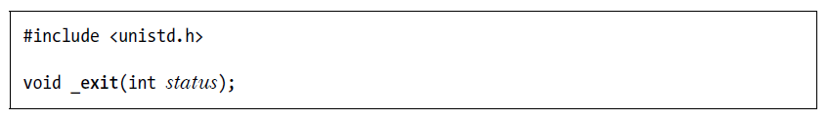
_exit() system call

Slide 25
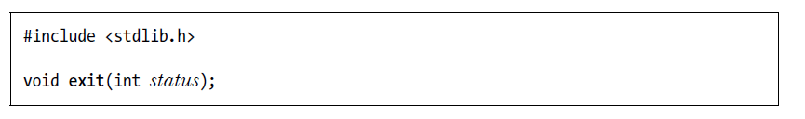
exit() library function
Actions are performed by exit():
Exit handlers are called.
The stdio stream buffers are flushed.
The _exit() system call is invoked, using the value supplied in status.

Slide 26
Details of Process Termination
Open file descriptors are closed.
Any file locks held by this process are released.
Any POSIX named semaphores that are open in the calling process are closed.
Any POSIX message queues that are open in the calling process are closed.
Any memory locks established by this process are removed.
Any memory mappings established by this process are unmapped.
etc.

Slide 27
Exit Handlers
An exit handler is a programmer-supplied function that is registered at some point during the life of the process and is then automatically called during normal process termination via exit().
Exit handlers are not called if a program calls _exit() directly or if the process is terminated abnormally by a signal.

Slide 28
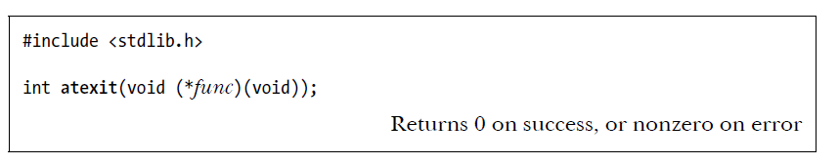
Registering exit handlers with atexit()
The atexit() function adds func to a list of functions that are called when the process terminates.
It is possible to register multiple exit handlers.
When the program invokes exit(), these functions are called in reverse order of registration.
A child process created via fork() inherits a copy of its parent’s exit handler registrations. When a process performs an exec(), all exit handler registrations are removed.

Slide 29
Limitations of atexit()
when called, an exit handler doesn’t know what status was passed to exit();
we can’t specify an argument to the exit handler when it is called

Slide 30
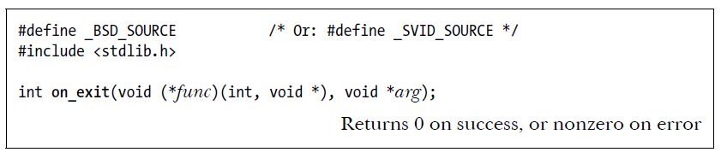
Registering exit handlers with on_exit()

Slide 31
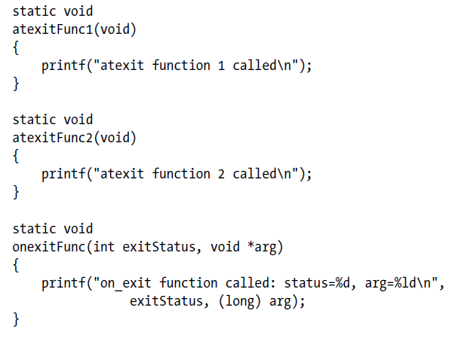
Using exit handlers

Slide 32
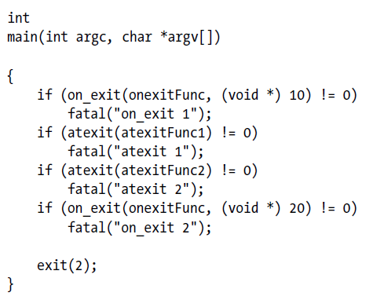

Slide 33
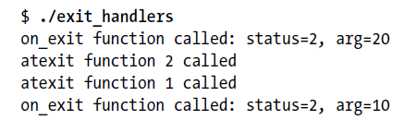
Output

Slide 34
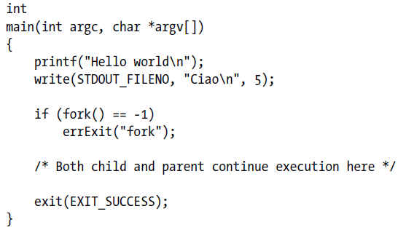
Interaction of fork() and stdio buffering

Slide 35
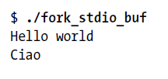
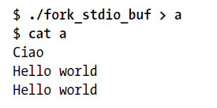
Standard output to the terminal
Standard output to a file

Slide 36
Results
The stdio buffers are maintained in a process’s user-space memory. Therefore, these buffers are duplicated in the child by fork().
When standard output is directed to a terminal, it is line-buffered by default, with the result that the newline-terminated string written by printf() appears immediately.
When standard output is directed to a file, it is block-buffered by default.
The output of the write() doesn’t appear twice, because write() transfers data directly to a kernel buffer, and this buffer is not duplicated during a fork().

Slide 37
Possible solutions
We can use fflush() to flush the stdio buffer prior to a fork() call.
Alternatively, we can use setvbuf() or setbuf() to disable buffering on the stdio stream.
Instead of calling exit(), the child can call _exit(), so that it doesn’t flush stdio buffers.

Slide 38
CHILD Processes

Slide 39
Two techniques used to monitor child processes
wait() system call (and its variants)
SIGCHLD signal (will be discussed later)

Slide 40
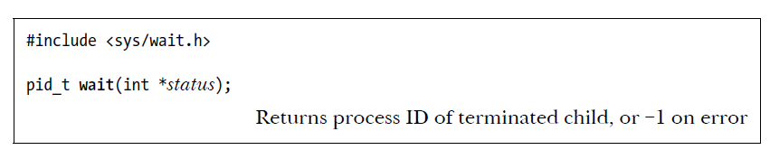
wait() system call
The wait() system call waits for one of the children of the calling process to terminate
and returns the termination status of that child in the buffer pointed to by status.

Slide 41
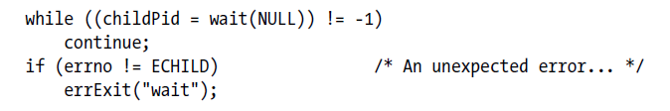
Possible error
One possible error is that the calling process has no (previously unwaited-for) children, which is indicated by the errno value ECHILD.

Slide 42
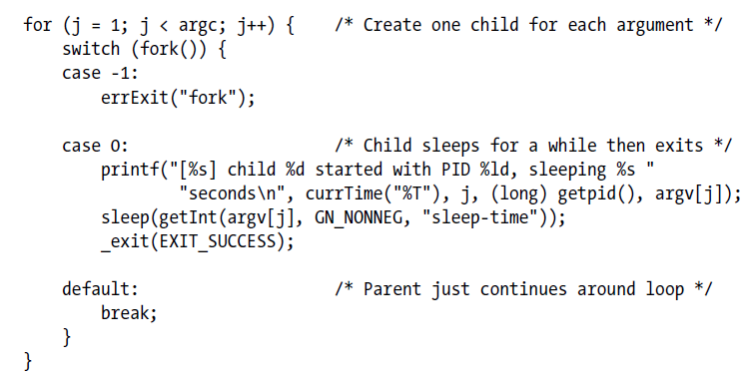
Creating and waiting for multiple children

Slide 43
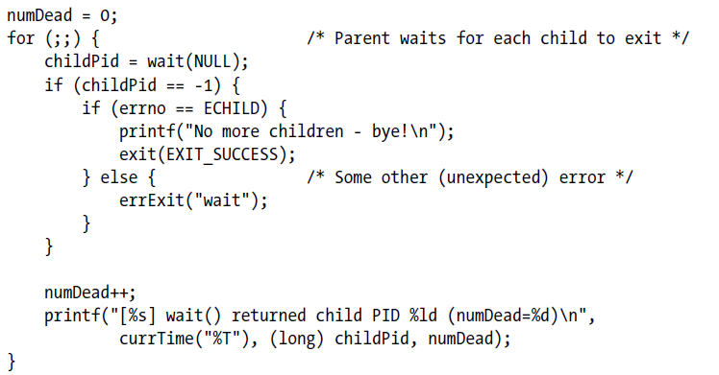

Slide 44
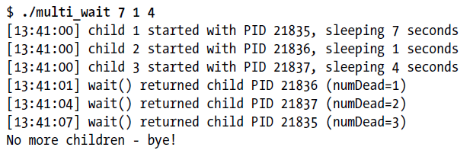
Output

Slide 45
Limitations of wait()
If a parent process has created multiple children, it is not possible to wait() for the completion of a specific child; we can only wait for the next child that terminates.
If no child has yet terminated, wait() always blocks. Sometimes, it would be preferable to perform a nonblocking wait so that if no child has yet terminated, we obtain an immediate indication of this fact.
Using wait(), we can find out only about children that have terminated. It is not possible to be notified when a child is stopped by a signal (such as SIGSTOP or SIGTTIN) or when a stopped child is resumed by delivery of a SIGCONT signal.

Slide 46
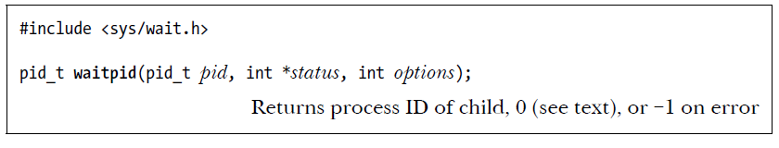
waitpid() system call
If pid is greater than 0, wait for the child whose process ID equals pid.
If pid equals 0, wait for any child in the same process group as the caller (parent).
If pid is less than –1, wait for any child whose process group identifier equals the absolute value of pid.
If pid equals –1, wait for any child. The call wait(&status) is equivalent to the call waitpid(–1, &status, 0).

Slide 47
options argument
WUNTRACED - In addition to returning information about terminated children, also return information when a child is stopped by a signal.
WCONTINUED - Also return status information about stopped children that have been resumed by delivery of a SIGCONT signal.
WNOHANG - If no child specified by pid has yet changed state, then return immediately, instead of blocking

Slide 48
status value
The child terminated by calling _exit() (or exit()), specifying an integer exit status.
The child was terminated by the delivery of an unhandled signal.
The child was stopped by a signal, and waitpid() was called with the WUNTRACED flag.
The child was resumed by a SIGCONT signal, and waitpid() was called with the WCONTINUED flag.

Slide 49
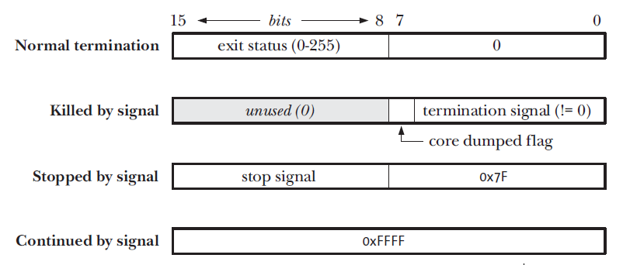
Value returned in the status argument of wait() and waitpid()

Slide 50
Set of macros for status value
WIFEXITED(status) - This macro returns true if the child process exited normally. In this case, the macro WEXITSTATUS(status) returns the exit status of the child process.
WIFSIGNALED(status) - This macro returns true if the child process was killed by a signal.
WIFSTOPPED(status) - This macro returns true if the child process was stopped by a signal.
WIFCONTINUED(status) - This macro returns true if the child was resumed by delivery of SIGCONT.

Slide 51
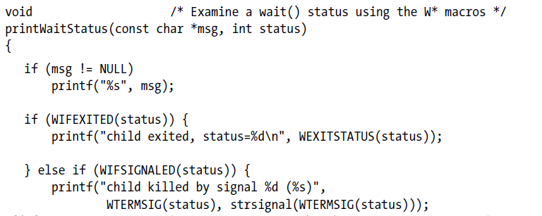
Displaying the status value returned by wait()

Slide 52
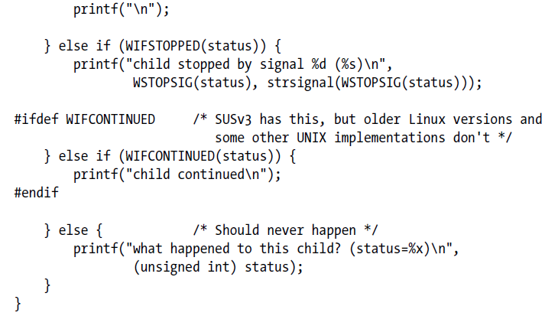

Slide 53
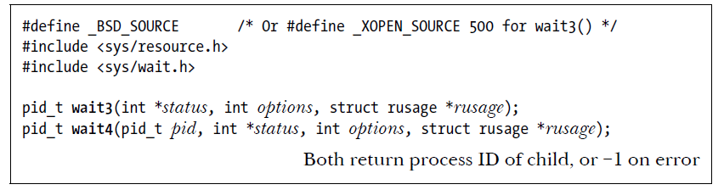
wait3() and wait4() system calls
Return resource usage information about the terminated child in the structure pointed to by the rusage argument.
This information includes the amount of CPU time used by the process and memory management statistics.

Slide 54


wait3(), wait4(), and waitpid()
wait3() is equivalent to the following
waitpid() call:
wait4() is equivalent to the following:

Slide 55
Orphans
Who becomes the parent of an orphaned child? The orphaned child is adopted by init, the ancestor of all processes, whose process ID is 1. In other words, after a child’s parent terminates, a call to getppid() will return the value 1.

Slide 56
Zombies
What happens to a child that terminates before its parent has had a chance to perform a wait()?
The point here is that, although the child has finished its work, the parent should still be permitted to perform a wait() at some later time to determine how the child terminated. The kernel deals with this situation by turning the child into a zombie.
This means that most of the resources held by the child are released back to the system to be reused by other processes.
The only part of the process that remains is an entry in the kernel’s process table recording (among other things) the child’s process ID, termination status, and resource usage statistics

Slide 57
A zombie process can’t be killed by a signal, not even the (silver bullet) SIGKILL. This ensures that the parent can always eventually perform a wait().
When the parent does perform a wait(), the kernel removes the zombie.
If the parent terminates without doing a wait(), then the init process adopts the child and automatically performs a wait(), thus removing the zombie process from the system.
If a parent creates a child, but fails to perform a wait(), then an entry for the zombie child will be maintained indefinitely in the kernel’s process table.
If a large number of such zombie children are created, they will eventually fill the kernel process table, preventing the creation of new processes.

Slide 58
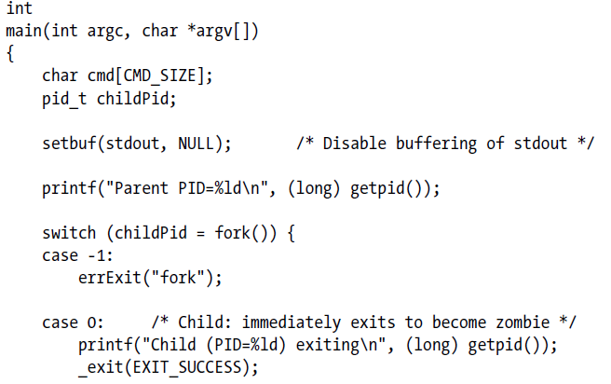
Creating a zombie child process

Slide 59
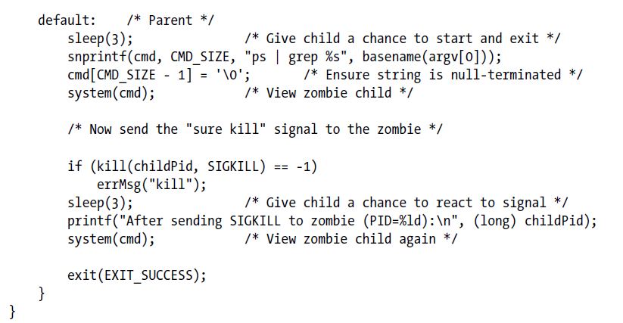

Slide 60
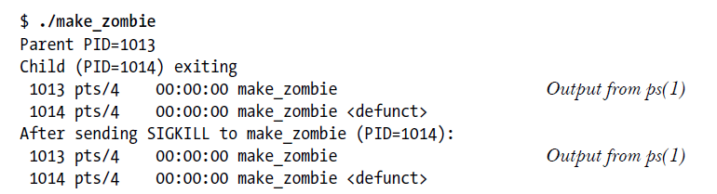
Output

