Slide 1
System programming Lecture 4 POSIX Threads

Slide 2
Overview
Threads are a mechanism that permits an application to perform multiple tasks concurrently.

Slide 3
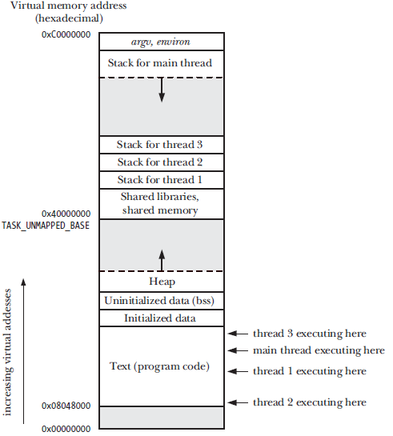
Single process with multiple threads

Slide 4
Limitations of processes
It is difficult to share information between processes. Since the parent and child don’t share memory (other than the read-only text segment), we must use some form of interprocess communication in order to exchange information between processes.
Process creation with fork() is relatively expensive. The need to duplicate various process attributes such as page tables and file descriptor tables means that a fork() call is still time-consuming.

Slide 5
How threads solve these problems
Sharing information between threads is easy and fast. It is just a matter of copying data into shared (global or heap) variables. In order to avoid the problems that can occur when multiple threads try to update the same information, we must employ the synchronization techniques
Thread creation is faster because many of the attributes that must be duplicated in a child created by fork() are instead shared between threads. In particular, copy-on-write duplication of pages of memory is not required, nor is duplication of page tables.

Slide 6
Threads share a number of attributes
process ID and parent process ID;
process credentials (user and group IDs);
open file descriptors;
record locks created using fcntl();
signal dispositions;
etc.

Slide 7
Threads do not share
thread ID;
signal mask;
thread-specific data;
the errno variable;
stack (local variables and function call linkage information);
etc.

Slide 8
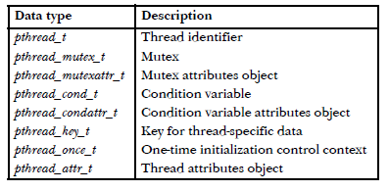
Pthreads data types

Slide 9
Return value from Pthreads functions
All Pthreads functions return 0 on success or a positive value on failure.
The failure value is one of the same values that can be placed in errno by traditional UNIX system calls.

Slide 10
Compiling Pthreads programs
On Linux, programs that use the Pthreads API must be compiled with the cc –pthread option.

Slide 11
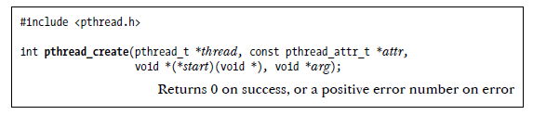
Thread Creation: pthread_create()
The new thread commences execution by calling the function identified by start with the argument arg (i.e., start(arg)).
The thread that calls pthread_create() continues execution with the next statement that follows the call.
The thread argument points to a buffer of type pthread_t into which the unique identifier for this thread is copied before pthread_create() returns. This identifier can be used in later Pthreads calls to refer to the thread.
The attr argument is a pointer to a pthread_attr_t object that specifies various attributes for the new thread.

Slide 12

Thread Termination: pthread_exit()
The thread’s start function performs a return specifying a return value for the thread.
The thread calls pthread_exit().
The thread is canceled using pthread_cancel().
Any of the threads calls exit(), or the main thread performs a return (in the main() function), which causes all threads in the process to terminate immediately.
The retval argument specifies the return value for the thread.

Slide 13
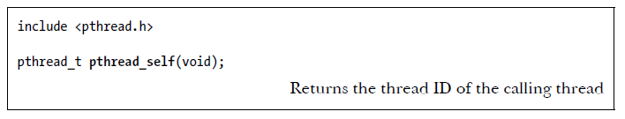
Thread IDs
Each thread within a process is uniquely identified by a thread ID. This ID is returned to the caller of pthread_create(), and a thread can obtain its own ID using pthread_self().

Slide 14
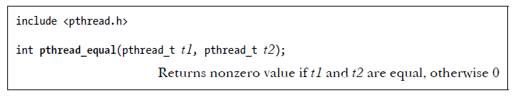
pthread_equal()
The pthread_equal() function allows us check whether two thread IDs are the same.

Slide 15
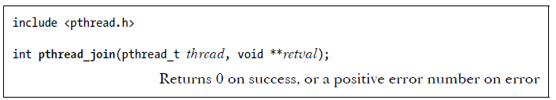
Joining with a terminated thread
The pthread_join() function waits for the thread identified by thread to terminate.

Slide 16
pthread_join() for threads and waitpid() for processes
Threads are peers. Any thread in a process can use pthread_join() to join with any other thread in the process.
For example, if thread A creates thread B, which creates thread C, then it is possible for thread A to join with thread C, or vice versa.
This differs from the hierarchical relationship between processes. When a parent process creates a child using fork(), it is the only process that can wait() on that child.

Slide 17
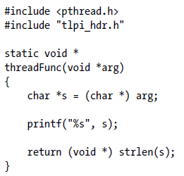
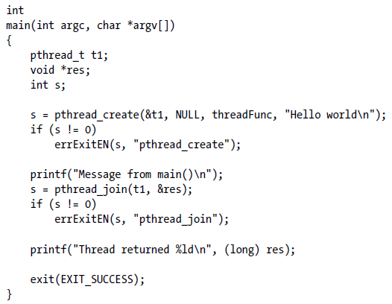
A simple program using Pthreads

Slide 18

Output

Slide 19
Detaching a thread
By default, a thread is joinable, meaning that when it terminates, another thread can obtain its return status using pthread_join().
Sometimes, we don’t care about the thread’s return status; we simply want the system to automatically clean up and remove the thread when it terminates.
In this case, we can mark the thread as detached, by making a call to pthread_detach() specifying the thread’s identifier in thread.

Slide 20
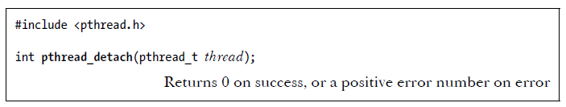
pthread_detach()
Once a thread has been detached, it is no longer possible to use pthread_join() to obtain its return status, and the thread can’t be made joinable again.

Slide 21
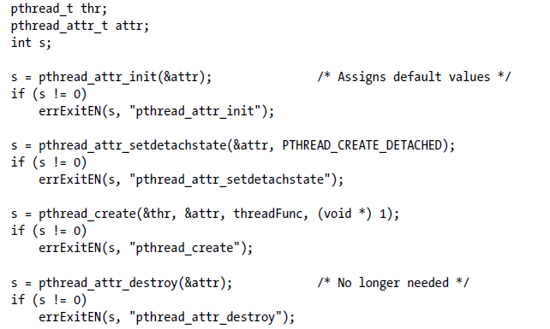
Creating a thread with the detached attribute

Slide 22
Threads vs. Processes
Sharing data between threads is easy. By contrast, sharing data between processes requires more work (e.g., creating a shared memory segment or using a pipe).
Thread creation is faster than process creation; context-switch time may be lower for threads than for processes.

Slide 23
Threads vs. Processes
When programming with threads, we need to ensure that the functions we call are thread-safe or are called in a thread-safe manner.
A bug in one thread (e.g., modifying memory via an incorrect pointer) can damage all of the threads in the process, since they share the same address space and other attributes. By contrast, processes are more isolated from one another.
Each thread is competing for use of the finite virtual address space of the host process. In particular, each thread’s stack and thread-specific data (or thread local storage) consumes a part of the process virtual address space, which is consequently unavailable for other threads.

