Slide 1
System programming Lecture 4 Thread synchronization

Slide 2
Critical section
The term critical section is used to refer to a section of code that accesses a shared resource and whose execution should be atomic;
that is, its execution should not be interrupted by another thread that simultaneously accesses the same shared resource.

Slide 3
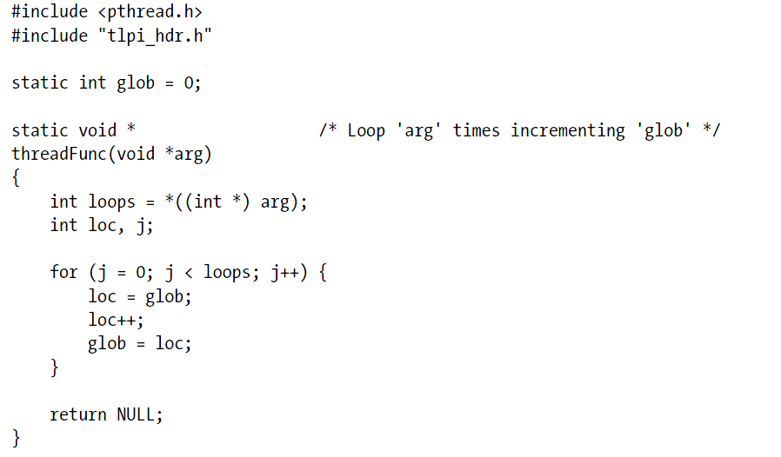
Incorrectly incrementing a global variable from two threads

Slide 4
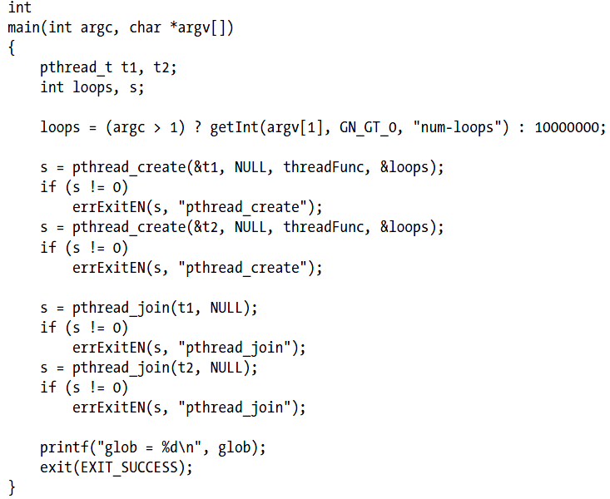

Slide 5
Some comments
This program creates two threads, each of which executes the same function.
The function executes a loop that repeatedly increments a global variable, glob, by copying glob into the local variable loc, incrementing loc, and copying loc back to glob.
Since loc is an automatic variable allocated on the per-thread stack, each thread has its own copy of this variable.

Slide 6
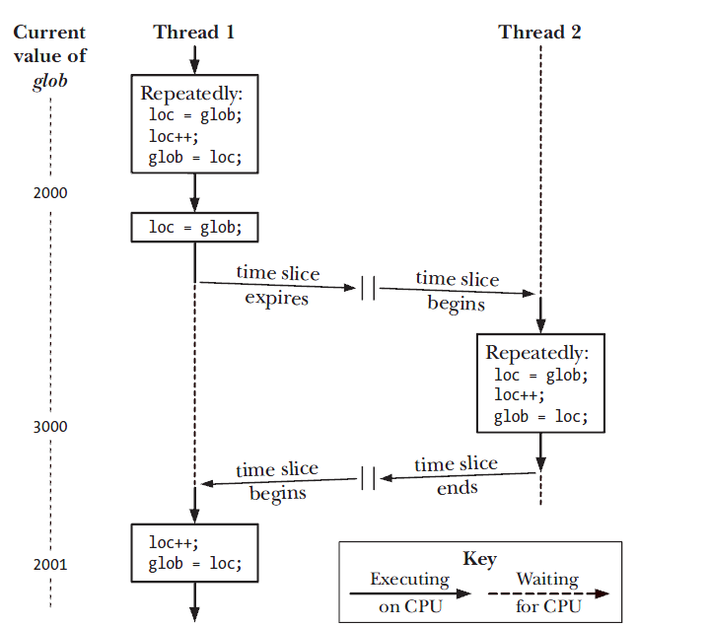
Two threads incrementing a global variable without synchronization

Slide 7
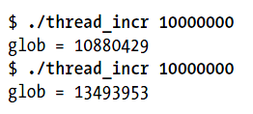
Nondeterministic behavior

Slide 8
Mutex
Mutexes can be used to ensure atomic access to any shared resource, but protecting shared variables is the most common use.
A mutex has two states: locked and unlocked. At any moment, at most one thread may hold the lock on a mutex.
When a thread locks a mutex, it becomes the owner of that mutex. Only the mutex owner can unlock the mutex.

Slide 9
Protocol for accessing a resource
lock the mutex for the shared resource;
access the shared resource;
unlock the mutex.

Slide 10
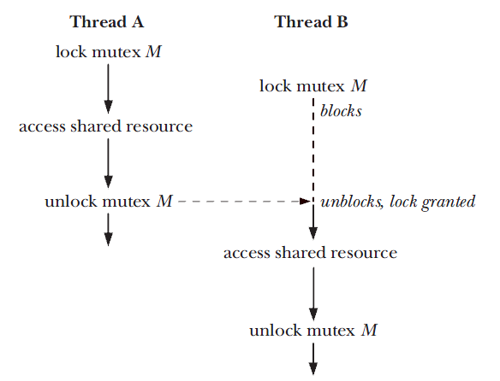
Using a mutex to protect a critical section

Slide 11
Statically allocated mutexes
A mutex is a variable of the type pthread_mutex_t.
pthread_mutex_t mtx = PTHREAD_MUTEX_INITIALIZER;

Slide 12
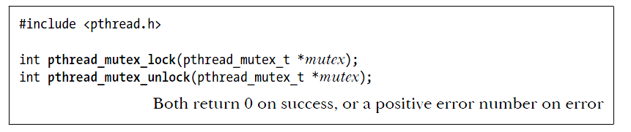
Locking and unlocking a mutex
If the mutex is currently unlocked, this call locks the mutex and returns immediately.
If the mutex is currently locked by another thread, then pthread_mutex_lock() blocks until the mutex is unlocked, at which point it locks the mutex and returns.
The pthread_mutex_unlock() function unlocks a mutex previously locked by the calling thread. It is an error to unlock a mutex that is not currently locked, or to unlock a mutex that is locked by another thread.

Slide 13
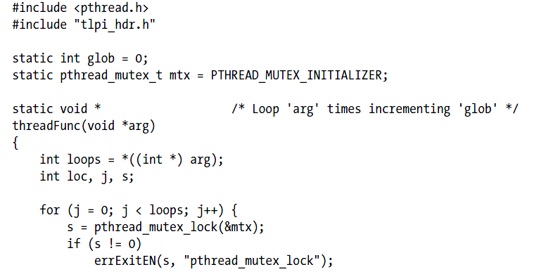
Using a mutex to protect access to a global variable

Slide 14
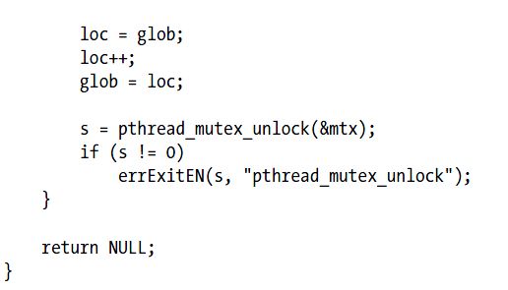

Slide 15
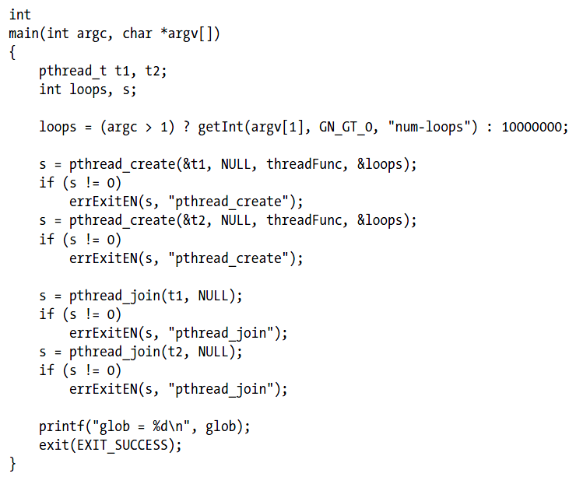

Slide 16
pthread_mutex_trylock()
The pthread_mutex_trylock() function is the same as pthread_mutex_lock(), except that if the mutex is currently locked, pthread_mutex_trylock() fails, returning the error EBUSY.

Slide 17
pthread_mutex_timedlock()
The pthread_mutex_timedlock() function is the same as pthread_mutex_lock(), except that the caller can specify an additional argument, abstime, that places a limit on the time that the thread will sleep while waiting to acquire the mutex.
If the time interval specified by its abstime argument expires without the caller becoming the owner of the mutex, pthread_mutex_timedlock() returns the error ETIMEDOUT.

Slide 18
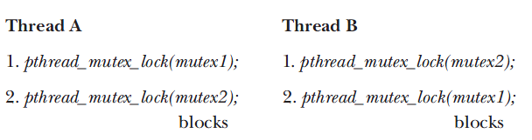
A deadlock when two threads lock two mutexes

Slide 19
Signaling changes of state: condition variables
A condition variable allows one thread to inform other threads about changes in the state of a shared resource and allows the other threads to wait (block) for such notification.

Slide 20

Example: Producer-Consumer (without condition variables)

Slide 21
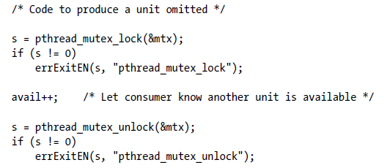
Producer

Slide 22
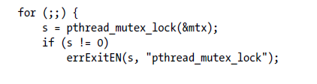
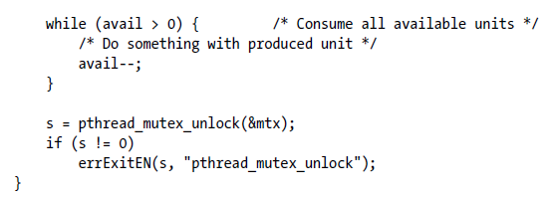
Consumer

Slide 23
Some comments
This code works, but it wastes CPU time, because the main thread continually loops, checking the state of the variable avail.
Condition variable allows a thread to sleep (wait) until another thread notifies (signals) it that it must do something.

Slide 24
Condition variable and mutex
A condition variable is always used in conjunction with a mutex.
The mutex provides mutual exclusion for accessing the shared variable, while the condition variable is used to signal changes in the variable’s state.

Slide 25
Statically allocated condition variables: pthread_cond_t

Slide 26
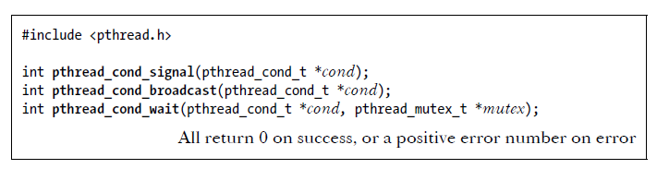
Signaling and waiting on condition variables

Slide 27

Using a condition variable in the producer-consumer example

Slide 28
pthread_cond_signal() and pthread_cond_broadcast()
The pthread_cond_signal() and pthread_cond_broadcast() functions both signal the condition variable specified by cond.

Slide 29
pthread_cond_wait()
The pthread_cond_wait() function blocks a thread until the condition variable cond is signaled.
pthread_cond_wait() performs the following steps:
unlock the mutex specified by mutex;
block the calling thread until another thread signals the condition variable cond; and
relock mutex.

Slide 30
Main idea
The thread locks the mutex in preparation for checking the state of the shared variable.
The state of the shared variable is checked.
If the shared variable is not in the desired state, then the thread must unlock the mutex (so that other threads can access the shared variable) before it goes to sleep on the condition variable.
When the thread is reawakened because the condition variable has been signaled, the mutex must once more be locked, since, typically, the thread then immediately accesses the shared variable.

Slide 31
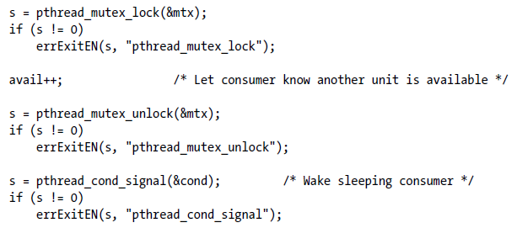
Producer (with cond. var.)

Slide 32
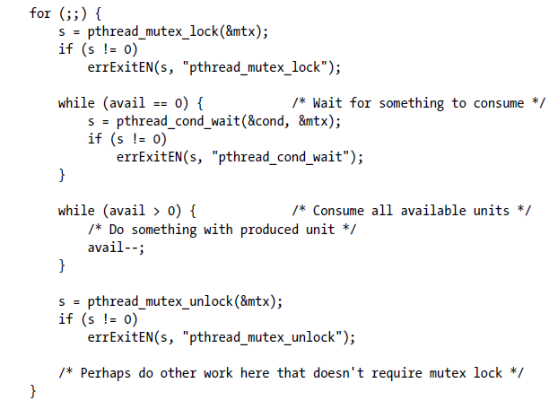
Consumer (with cond. var.)

