Slide 1
System programming Lecture 5 Signals

Slide 2
Signal
A signal is a notification to a process that an event has occurred.
Kernel Process
Process Process

Slide 3
Examples of events
Hardware exception:
executing a malformed machine-language instruction,
dividing by 0,
referencing a part of memory that is inaccessible,
etc.
Terminal special characters:
interrupt character (usually Control-C)
suspend character (usually Control-Z)
etc.
Software event:
input became available on a file descriptor,
the terminal window was resized,
a timer went off,
the process’s CPU time limit was exceeded,
a child of this process terminated
etc.

Slide 4
Categories of signals
Standard (are used by the kernel to notify processes and events, 1-31)
Realtime

Slide 5
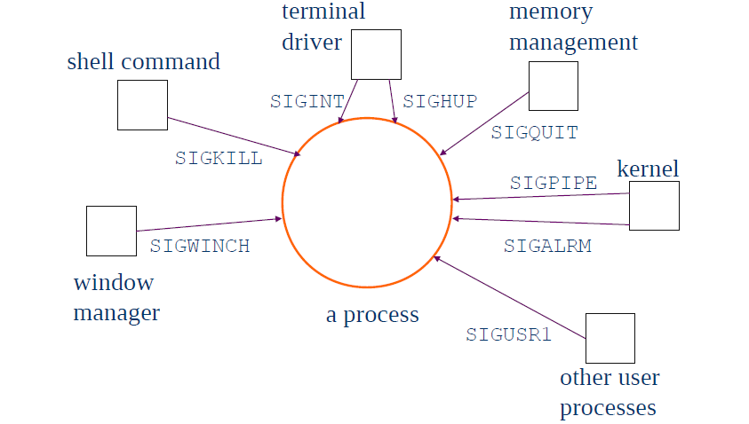
Signal sources

Slide 6
POSIX predefined signals
• SIGALRM: Alarm timer time-out. Generated by alarm( ) API.
• SIGABRT: Abort process execution. Generated by abort( ) API.
• SIGFPE: Illegal mathematical operation.
• SIGHUP: Controlling terminal hang-up.
• SIGILL: Execution of an illegal machine instruction.
• SIGINT: Process interruption. Can be generated by <Delete> or
<ctrl_C> keys.
• SIGKILL: Sure kill a process. Can be generated by
– “kill -9 <process_id>“ command.
• SIGPIPE: Illegal write to a pipe.
• SIGQUIT: Process quit. Generated by <crtl_\> keys.
• SIGSEGV: Segmentation fault. generated by de-referencing a NULL
pointer.

Slide 7
POSIX predefined signals
• SIGTERM: process termination. Can be generated by
– “kill <process_id>” command.
• SIGUSR1: Reserved to be defined by user.
• SIGUSR2: Reserved to be defined by user.
• SIGCHLD: Sent to a parent process when its child process has
terminated.
• SIGCONT: Resume execution of a stopped process.
• SIGSTOP: Stop a process execution.
• SIGTTIN: Stop a background process when it tries to read from from its
controlling terminal.
• SIGTSTP: Stop a process execution by the control_Z keys.
• SIGTTOUT: Stop a background process when it tries to write to its
controlling terminal.

Slide 8
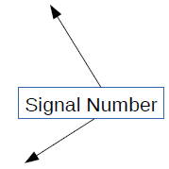
Example of signals
User types Ctrl-c
– Event gains attention of OS
– OS stops the application process immediately, sending it a 2/SIGINT
signal
– Signal handler for 2/SIGINT signal executes to completion
– Default signal handler for 2/SIGINT signal exits process
• Process makes illegal memory reference
– Event gains attention of OS
– OS stops application process immediately, sending it a 11/SIGSEGV
signal
– Signal handler for 11/SIGSEGV signal executes to completion
– Default signal handler for 11/SIGSEGV signal prints “segmentation
fault” and exits process

Slide 9
Send signals via commands
kill Command
–kill signal
pid
• Send a signal of type signal to the process with id pid
• Can specify either signal type name (-SIGINT) or number (-2)
–No signal type name or number specified => sends 15/SIGTERM
signal
• Default 15/SIGTERM handler exits process
– Better command name would be sendsig
• Examples
–kill –2 1234
–kill SIGINT
1234
• Same as pressing Ctrl-c if process 1234 is running in foreground

Slide 10
Demonstration
#include<stdio.h>
int main()
{
while(1)
printf("Hello World...\n");
return 0;
}

Slide 11
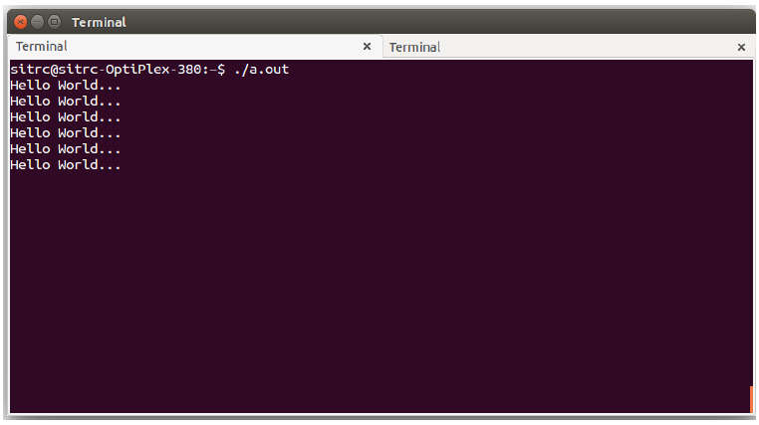
Output

Slide 12
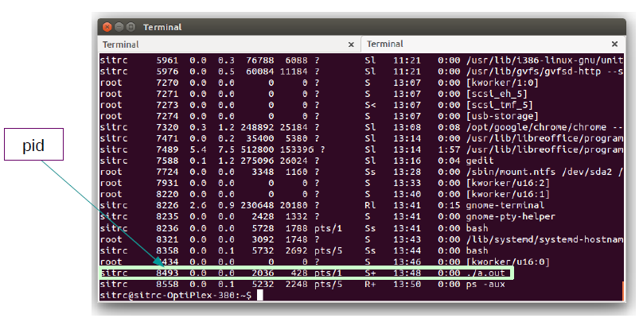
Output
Go to new terminal and check the process list (ps -aux)

Slide 13
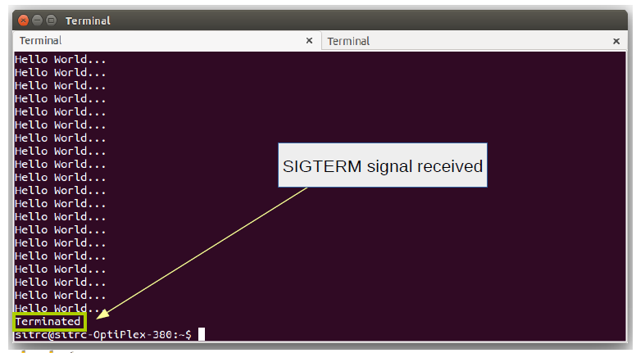
Kill the process
kill 8493

Slide 14
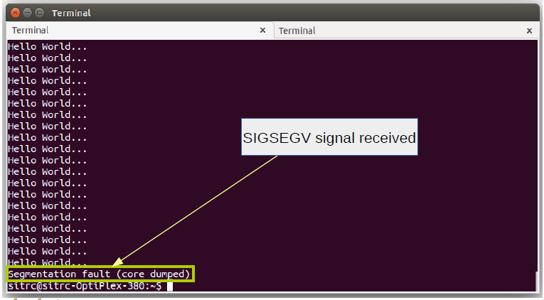
Killing process by different signals
kill -SIGSEGV 8493

Slide 15
Signal concepts
Signals are defined in <signal.h>
• man 7 signal for complete list of signals
and their numeric values.
• kill –l for full list of signals on a system.
• 64 signals. The first 32 are traditional
signals, the rest are for real time
applications

Slide 16
Some useful terms
A signal is said to be generated by some event.
Once generated, a signal is later delivered to a process, which then takes some action in response to the signal.
Between the time it is generated and the time it is delivered, a signal is said to be pending.

Slide 17
Signal mask
Sometimes we need to ensure that a segment of code is not interrupted by the delivery of a signal.
To do this, we can add a signal to the process’s signal mask—a set of signals whose delivery is currently blocked.

Slide 18
Different (default) actions can be taken upon delivery of a signal
The signal is ignored and has no effect on the process.
The process is terminated (killed). (Abnormal termination)
A core dump file is generated, and the process is terminated. (For debugging purposes)
The process is stopped—execution of the process is suspended.
Execution of the process is resumed after previously being stopped.

Slide 19
Disposition
Changing the action that occurs when the signal is delivered instead of accepting the default for a particular signal.

Slide 20
Dispositions
The default action should occur.
The signal is ignored.
A signal handler is executed.

Slide 21
Signal handler
A signal handler is a function, written by the programmer, that performs appropriate tasks in response to the delivery of a signal.

Slide 22
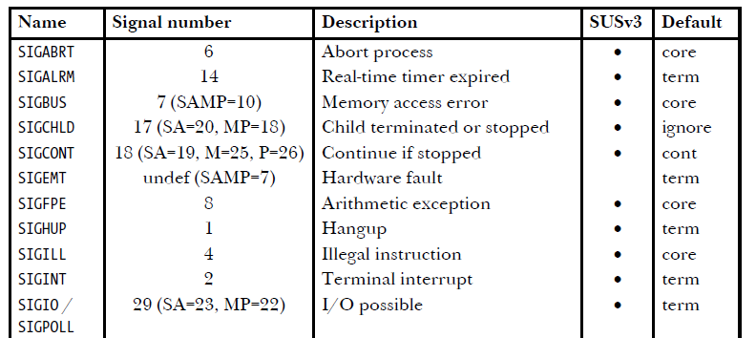
Linux signals

Slide 23
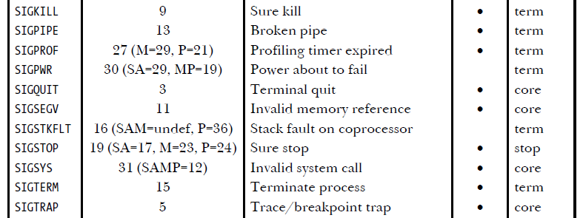
Linux signals

Slide 24
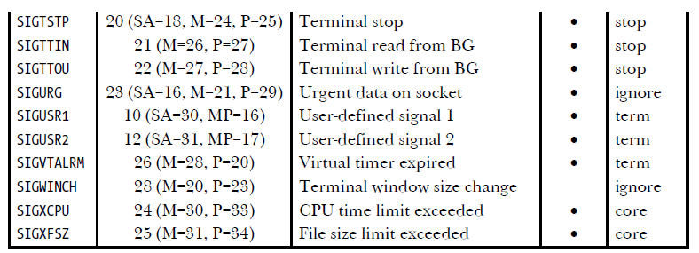
Linux signals

Slide 25
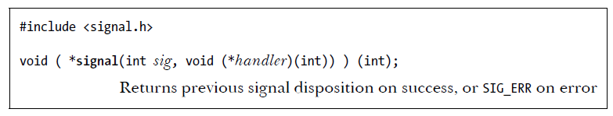
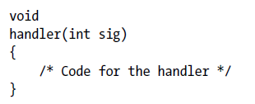
Changing Signal Dispositions: signal()

Slide 26
signal()
The first argument, sig, identifies the signal whose disposition we wish to change.
The second argument, handler, is the address of the function that should be called when this signal is delivered.
The return value of signal() is the previous disposition of the signal.

Slide 27
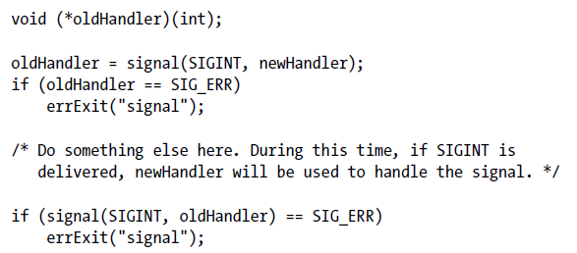
Establishing a handler for a signal, and resetting the disposition of the signal to whatever it was previously

Slide 28
SIG_DFL and SIG_IGN
SIG_DFL - Reset the disposition of the signal to its default.
SIG_IGN - Ignore the signal.

Slide 29
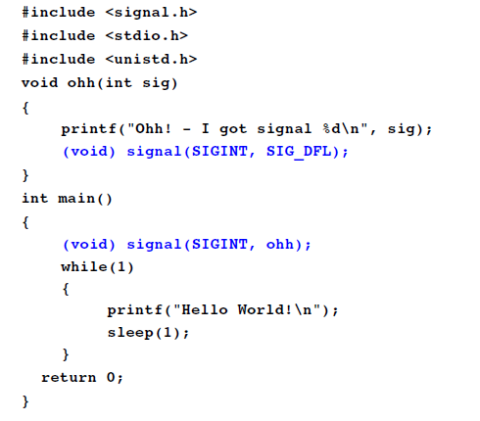
Example 1

Slide 30
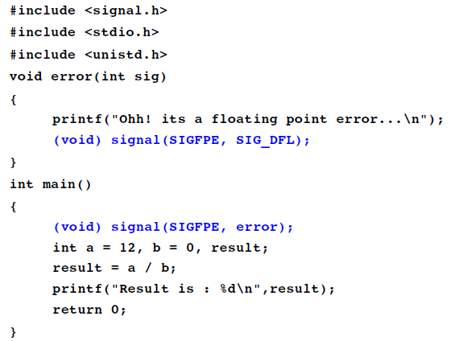
Example 2

Slide 31
Signal handlers
A signal handler is a function that is called when a specified signal is delivered to a process.

Slide 32
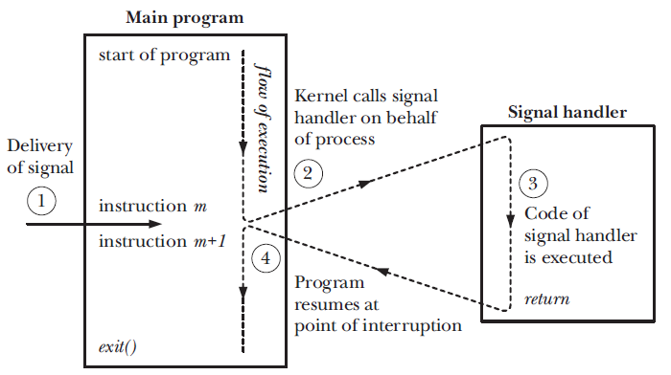
Signal delivery and handler execution

Slide 33
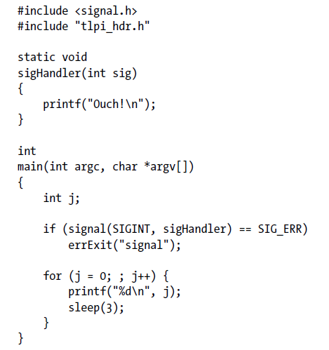
Installing a handler for SIGINT (example)

Slide 34
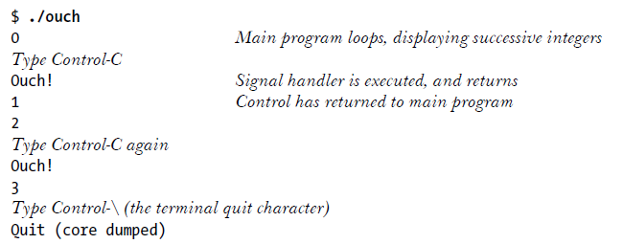
Output

Slide 35
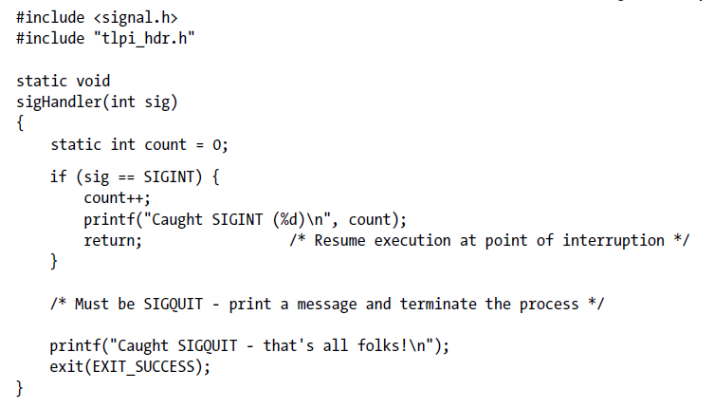
Establishing the same handler for two different signals (example)

Slide 36
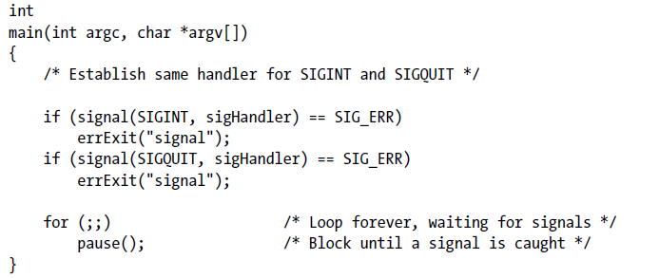

Slide 37
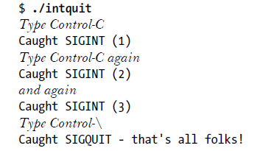
Output

Slide 38
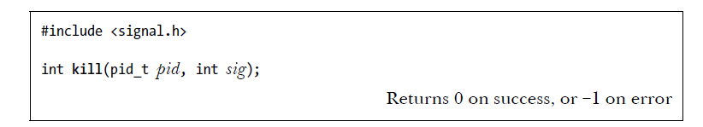
Sending signals: kill()

Slide 39
pid
If pid is greater than 0, the signal is sent to the process with the process ID specified by pid.
If pid equals 0, the signal is sent to every process in the same process group as the calling process, including the calling process itself.
If pid is less than –1, the signal is sent to all of the processes in the process group whose ID equals the absolute value of pid.
If pid equals –1, the signal is sent to every process for which the calling process has permission to send a signal, except init (process ID 1) and the calling process.

Slide 40
Process permissions
A privileged (CAP_KILL) process may send a signal to any process.
The init process (process ID 1), which runs with user and group of root, is a special case. It can be sent only signals for which it has a handler installed.

Slide 41
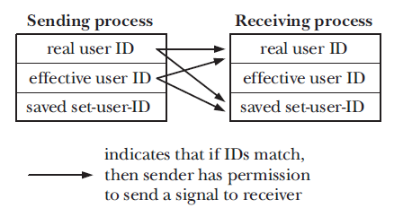
Process permissions
An unprivileged process can send a signal to another process if the real or effective user ID of the sending process matches the real user ID or saved setuser-ID of the receiving process
The SIGCONT signal is treated specially. An unprivileged process may send this signal to any other process in the same session, regardless of user ID checks.

Slide 42
Checking for the Existence of a Process
If the sig argument is specified as 0 (the so-called null signal), then no signal is sent.
Instead, kill() performs error checking to see if the process can be signaled.
If sending a null signal fails with the error ESRCH, then we know the process doesn’t exist.
If the call fails with the error EPERM (meaning the process exists, but we don’t have permission to send a signal to it) or succeeds (meaning we do have permission to send a signal to the process), then we know that the process exists.

Slide 43
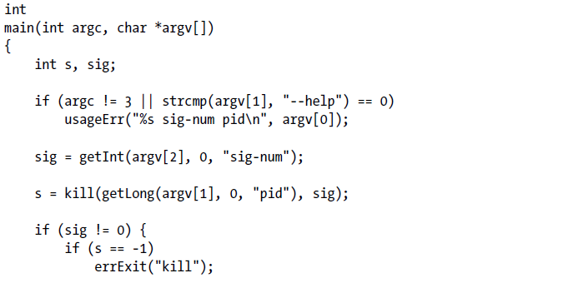
Using the kill() system call (example)

Slide 44
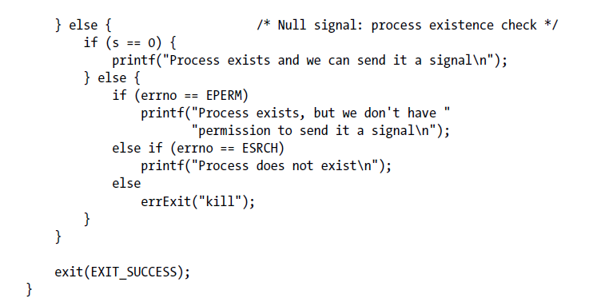

Slide 45
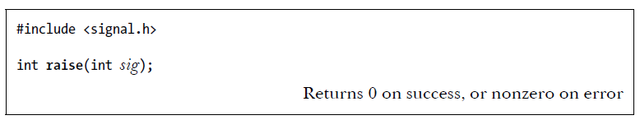
Sending a signal to itself: raise()
In a single-threaded program, a call to raise() is equivalent to the following call to kill():
kill(getpid(), sig);
On a system that supports threads, raise(sig) is implemented as:
pthread_kill(pthread_self(), sig)

Slide 46
Displaying Signal Descriptions
char *strsignal(int sig);
void psignal(int sig, const char *msg);

Slide 47
Signal Sets
Multiple signals are represented using a data structure called a signal set, provided by the system data type sigset_t.

Slide 48
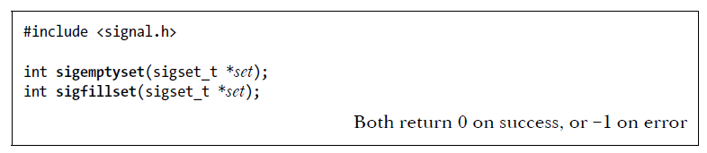
sigemptyset() and sigfillset() functions
The sigemptyset() function initializes a signal set to contain no members.
The sigfillset() function initializes a set to contain all signals (including all realtime signals).

Slide 49
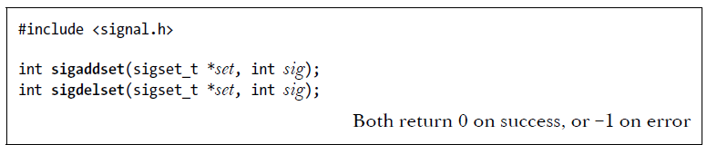
sigaddset() and sigdelset() functions
After initialization, individual signals can be added to a set using sigaddset() and removed using sigdelset().

Slide 50
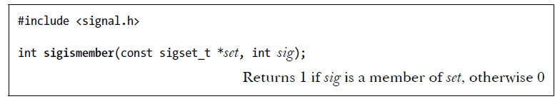
sigismember() function
The sigismember() function is used to test for membership of a set.

Slide 51
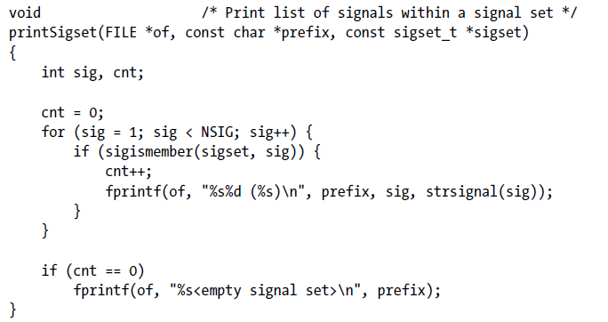
Print list of signals within a signal set

Slide 52
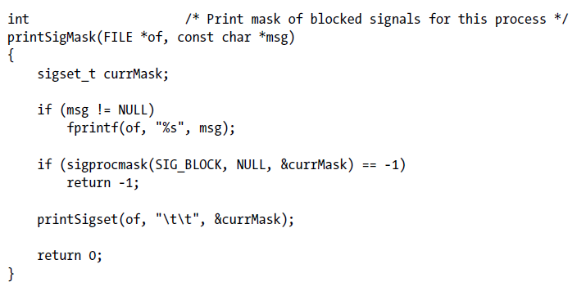
Print mask of blocked signals for this process

Slide 53
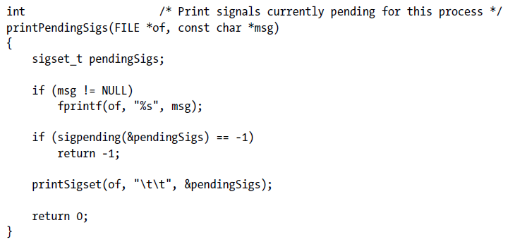
Print signals currently pending for this process

Slide 54
The Signal Mask
For each process, the kernel maintains a signal mask—a set of signals whose delivery to the process is currently blocked.
If a signal that is blocked is sent to a process, delivery of that signal is delayed until it is unblocked by being removed from the process signal mask.

Slide 55
Adding a signal to the signal mask
When a signal handler is invoked, the signal that caused its invocation can be automatically added to the signal mask.
When a signal handler is established with sigaction(), it is possible to specify an additional set of signals that are to be blocked when the handler is invoked.
The sigprocmask() system call can be used at any time to explicitly add signals to, and remove signals from, the signal mask.

Slide 56
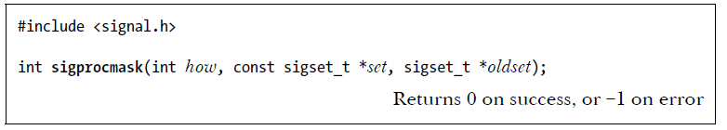
sigprocmask()
The how argument determines the changes that sigprocmask() makes to the signal mask:
SIG_BLOCK - The signals specified in the signal set pointed to by set are added to the signal mask.
SIG_UNBLOCK - The signals in the signal set pointed to by set are removed from the signal mask.
SIG_SETMASK - The signal set pointed to by set is assigned to the signal mask.

Slide 57
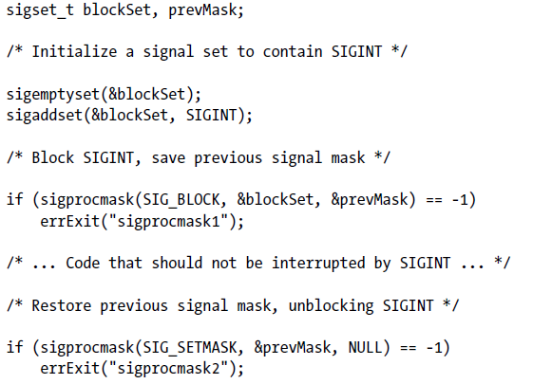
Temporarily blocking delivery of a signal

Slide 58
Pending Signals
If a process receives a signal that it is currently blocking, that signal is added to the process’s set of pending signals.
When (and if) the signal is later unblocked, it is then delivered to the process.

Slide 59
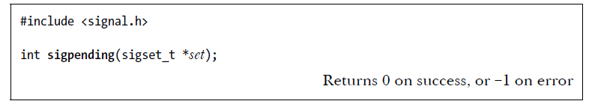
sigpending()
To determine which signals are pending for a process, we can call sigpending().

Slide 60
Changing disposition of a pending signal
If we change the disposition of a pending signal, then, when the signal is later unblocked, it is handled according to its new disposition.

Slide 61
Signals are not queued
If the same signal is generated multiple times while it is blocked, then it is recorded in the set of pending signals, and later delivered, just once.

Slide 62
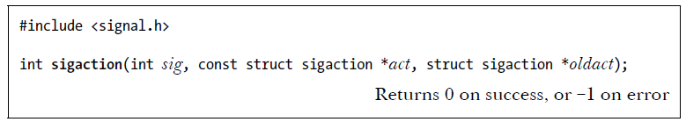
Changing signal dispositions: sigaction()
The sig argument identifies the signal whose disposition we want to retrieve or change. This argument can be any signal except SIGKILL or SIGSTOP.
The act argument is a pointer to a structure specifying a new disposition for the signal.
The oldact argument is a pointer to a structure of the same type, and is used to return information about the signal’s previous disposition.

Slide 63
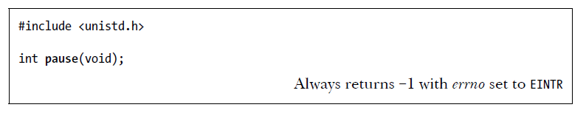
Waiting for a signal: pause()
Calling pause() suspends execution of the process until the call is interrupted by a signal handler (or until an unhandled signal terminates the process).

