Slide 1
System programming Lecture 6 Interprocess Communication (IPC) Pipes

Slide 2
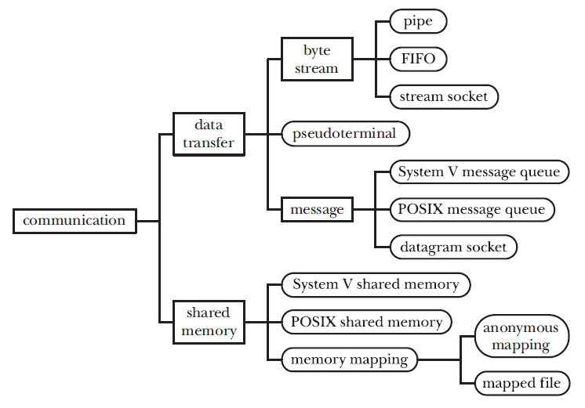
UNIX IPC facilities

Slide 3
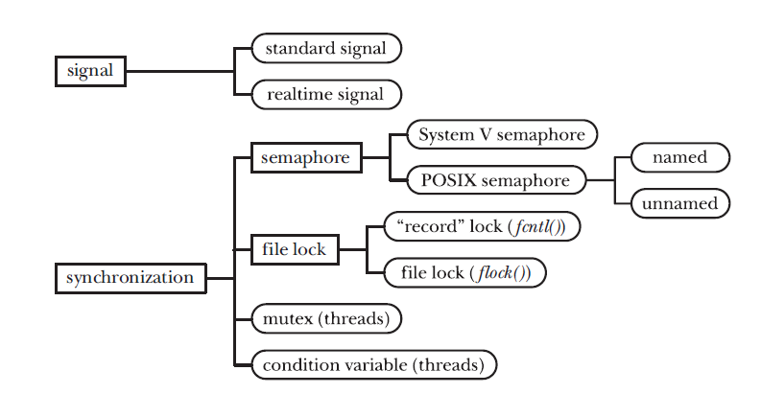
UNIX IPC facilities

Slide 4
Categories of IPC facilities
Communication: These facilities are concerned with exchanging data between processes.
Synchronization: These facilities are concerned with synchronizing the actions of processes or threads.
Signals: They can be used as a synchronization technique in certain circumstances.

Slide 5
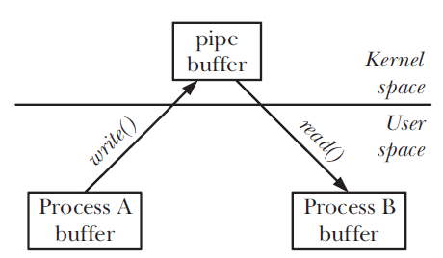
Communication facilities (1)
Data-transfer facilities: In order to communicate, one process writes data to the IPC facility, and another process reads the data.

Slide 6
Communication facilities (2)
Shared memory: Shared memory allows processes to exchange information by placing it in a region of memory that is shared between the processes.
Because communication doesn’t require system calls or data transfer between user memory and kernel memory, shared memory can provide very fast communication.

Slide 7
Data transfer
Byte stream: The data exchanged via pipes, FIFOs, and datagram sockets is an undelimited byte stream. Each read operation may read an arbitrary number of bytes from the IPC facility, regardless of the size of blocks written by the writer.
Message: The data exchanged message queues and datagram sockets takes the form of delimited messages.

Slide 8
Data-transfer vs. shared memory
Although a data-transfer facility may have multiple readers, reads are destructive. A read operation consumes data, and that data is not available to any other process.
Synchronization between the reader and writer processes is automatic. If a reader attempts to fetch data from a data-transfer facility that currently has no data, then (by default) the read operation will block until some process writes data to the facility.

Slide 9
Shared memory
Although shared memory provides fast communication, this speed advantage is offset by the need to synchronize operations on the shared memory.
Data placed in shared memory is visible to all of the processes that share that memory.

Slide 10
Synchronization Facilities
Semaphores: A semaphore is a kernel-maintained integer whose value is never permitted to fall below 0. A process can decrease or increase the value of a semaphore.
File locks: File locks are a synchronization method explicitly designed to coordinate the actions of multiple processes operating on the same file.
Mutexes: These synchronization facilities are normally used with POSIX threads.

Slide 11
Pipes
Pipes are the oldest method of IPC on the UNIX system, having appeared in Third Edition UNIX in the early 1970s.
Pipes provide an elegant solution to a frequent requirement: having created two processes to run different programs (commands), how can the shell allow the output produced by one process to be used as the input to the other process?

Slide 12
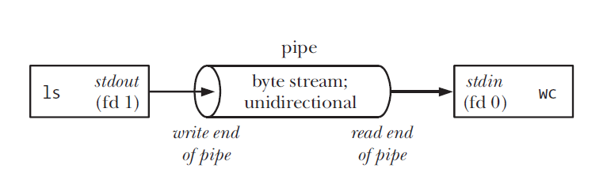
Example: using a pipe to connect two processes
$ ls | wc -l

Slide 13
Characteristics of a pipe (1)
The process reading from a pipe can read blocks of data of any size, regardless of the size of blocks written by the writing process.
The data passes through the pipe sequentially — bytes are read from a pipe in exactly the order they were written.
Attempts to read from a pipe that is currently empty block until at least one byte has been written to the pipe.
Data can travel only in one direction through a pipe. One end of the pipe is used for writing, and the other end is used for reading.

Slide 14
Characteristics of a pipe (2)
If multiple processes are writing to a single pipe, then it is guaranteed that their data won’t be intermingled if they write no more than PIPE_BUF bytes at a time.
A pipe is simply a buffer maintained in kernel memory. This buffer has a limited capacity. Once a pipe is full, further writes to the pipe block until the reader removes some data from the pipe.

Slide 15
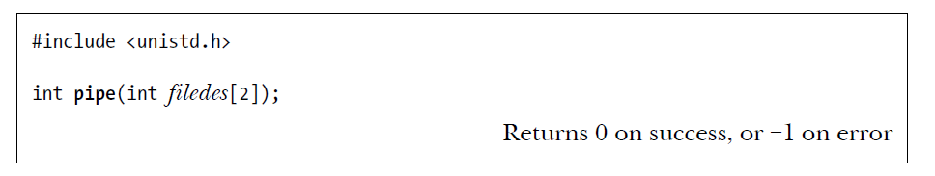
Creating and Using Pipes
A successful call to pipe() returns two open file descriptors in the array filedes: one for the read end of the pipe (filedes[0]) and one for the write end (filedes[1]).
As with any file descriptor, we can use the read() and write() system calls to perform I/O on the pipe. Once written to the write end of a pipe, data is immediately available to be read from the read end.
A read() from a pipe obtains the lesser of the number of bytes requested and the number of bytes currently available in the pipe (but blocks if the pipe is empty).

Slide 16
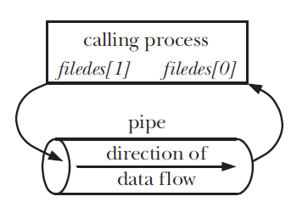
Process file descriptors after creating a pipe

Slide 17
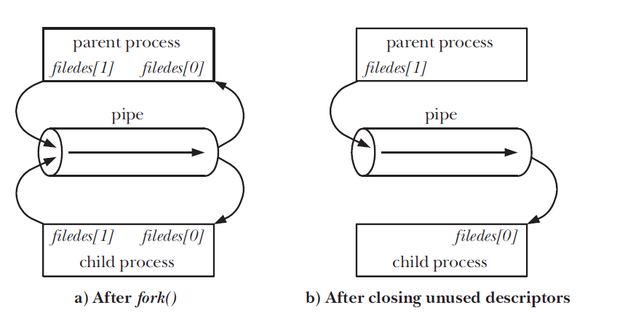
Setting up a pipe to transfer data from a parent to a child

Slide 18
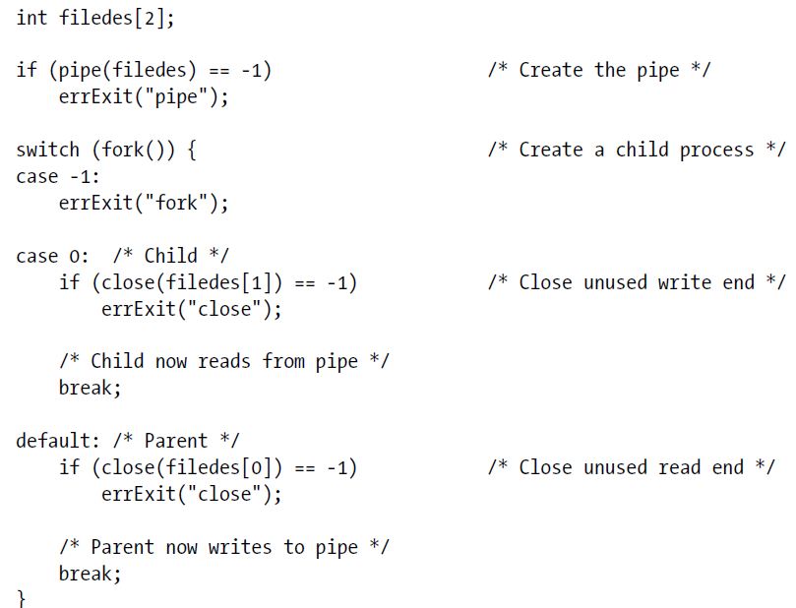
Creating a pipe to transfer data from a parent to a child

Slide 19
Pipes allow communication between related processes
The first process creates the pipe, and then forks a child that in turn forks to yield the grandchild.
A common scenario is that a pipe is used for communication between two siblings—their parent creates the pipe, and then creates the two children. This is what the shell does when building a pipeline.

Slide 20
Closing unused pipe file descriptors (1)
The process reading from the pipe closes its write descriptor for the pipe, so that, when the other process completes its output and closes its write descriptor, the reader sees end-of-file (once it has read any outstanding data in the pipe).
If the reading process doesn’t close the write end of the pipe, then, after the other process closes its write descriptor, the reader won’t see end-of-file, even after it has read all data from the pipe.
Instead, a read() would block waiting for data, because the kernel knows that there is still at least one write descriptor open for the pipe.

Slide 21
Closing unused pipe file descriptors (2)
The writing process closes its read descriptor for the pipe for a different reason.
When a process tries to write to a pipe for which no process has an open read descriptor, the kernel sends the SIGPIPE signal to the writing process.
By default, this signal kills a process. A process can instead arrange to catch or ignore this signal, in which case the write() on the pipe fails with the error EPIPE (broken pipe).
Receiving the SIGPIPE signal or getting the EPIPE error is a useful indication about the status of the pipe, and this is why unused read descriptors for the pipe should be closed.
If the writing process doesn’t close the read end of the pipe, then, even after the other process closes the read end of the pipe, the writing process will still be able to write to the pipe.

Slide 22
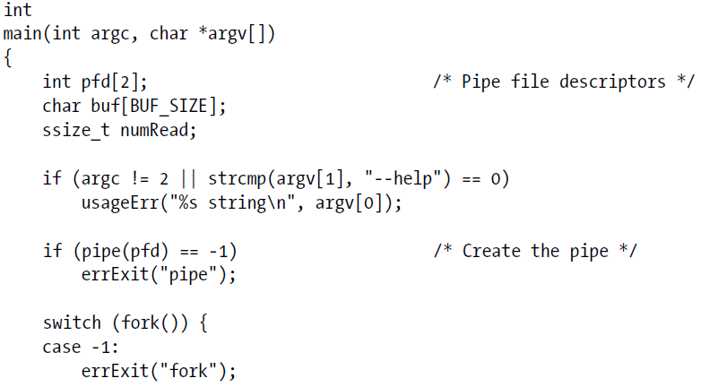
Using a pipe to communicate between a parent and child process

Slide 23
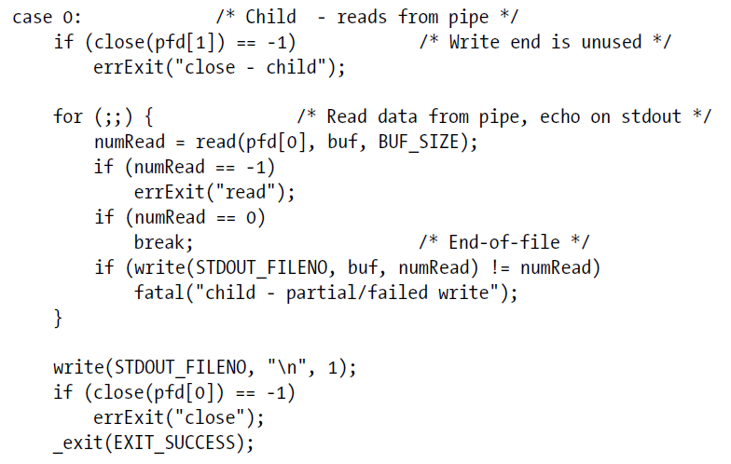

Slide 24
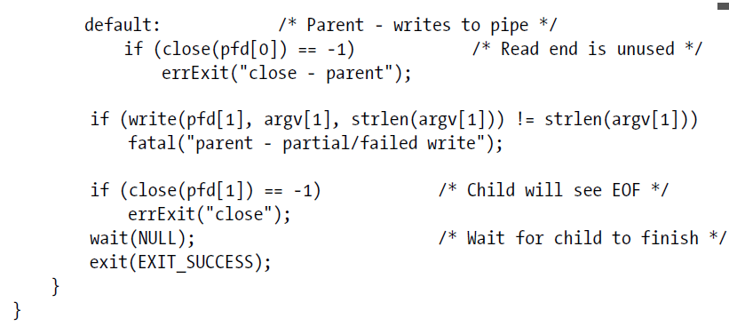

Slide 25
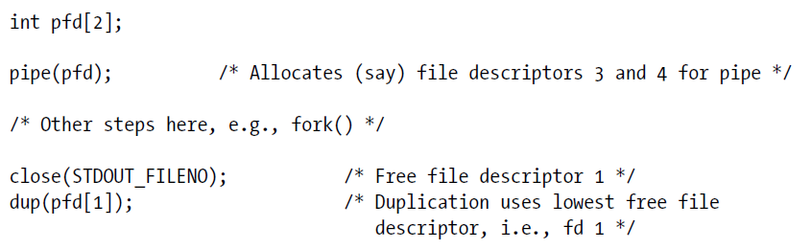
Using Pipes to Connect Filters
The process’s standard output is bound to the write end of the pipe.
Note that these steps depend on the assumption that file descriptors 0, 1, and 2 for a process are already open.
dup2(pfd[1], STDOUT_FILENO);

Slide 26
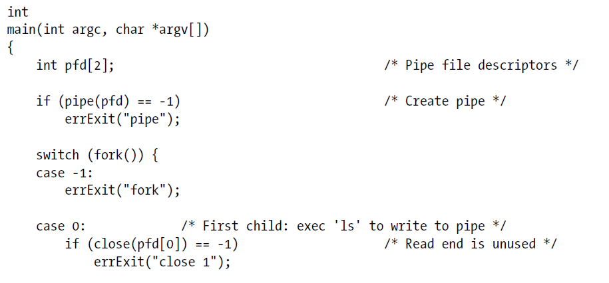
Using a pipe to connect ls and wc

Slide 27
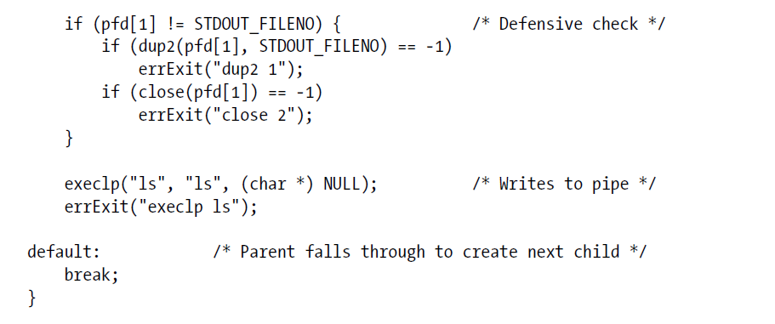

Slide 28
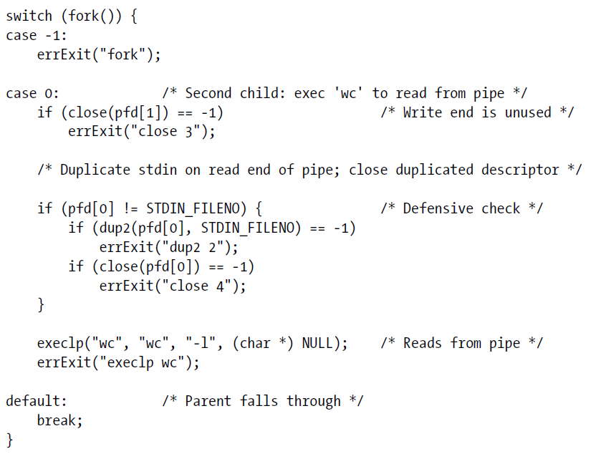

Slide 29
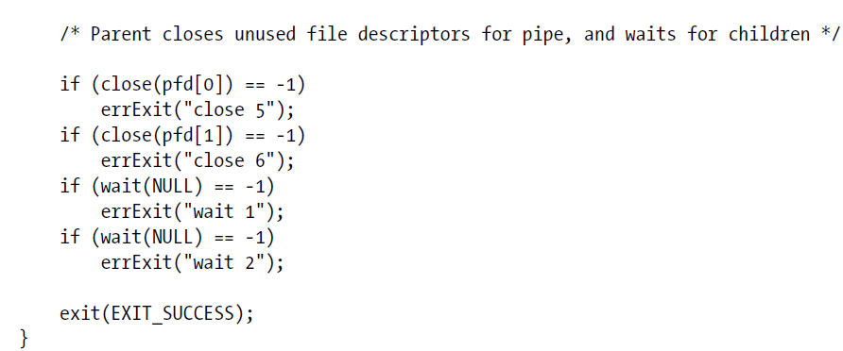

Slide 30
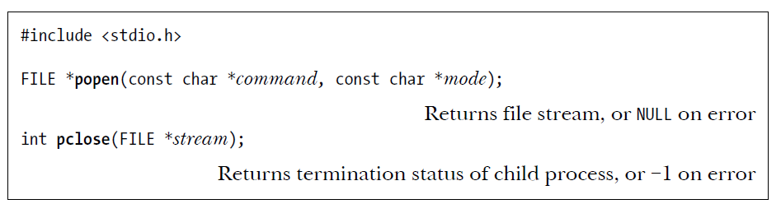
Talking to a Shell Command via a Pipe: popen()
The popen() function creates a pipe, and then forks a child process that execs a shell, which in turn creates a child process to execute the string given in command.
The mode argument is a string that determines whether the calling process will read from the pipe (mode is r) or write to it (mode is w).

Slide 31
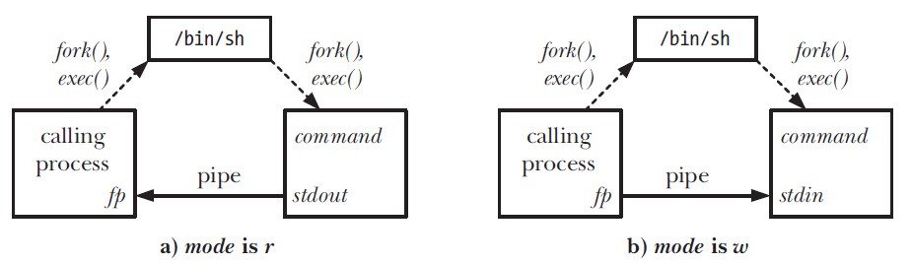
Process relationships and pipe usage for popen()
Once I/O is complete, the pclose() function is used to close the pipe and wait for the child shell to terminate.

Slide 32
FIFOs (named pipes)
Semantically, a FIFO is similar to a pipe.
The principal difference is that a FIFO has a name within the file system and is opened in the same way as a regular file.
This allows a FIFO to be used for communication between unrelated processes (e.g., a client and server).

