Slide 1
System programming Lecture 8
Windows File System and Character I/O

Slide 2
The Windows File Systems
The NT file system (NTFS) is Microsoft’s modern file system that supports long file names, security, fault tolerance, encryption, compression, extended attributes, and very large files and volumes.
The File Allocation Table (FAT and FAT32) file systems are rare on current systems and descend from the original MS-DOS and Windows 3.1 FAT (or FAT16) file systems. FAT does not support Windows security, among other limitations.
The CD-ROM file system (CDFS) is for accessing information provided on CD-ROMs.
The Universal Disk Format (UDF), an industry standard, supports DVD drives.

Slide 3
Client and server support for distributed file systems
Networked File System (NFS)
Common Internet File System (CIFS)
Windows Server 2003 and 2008 provide extensive support for storage area networks (SANs) and emerging storage technologies.

Slide 4
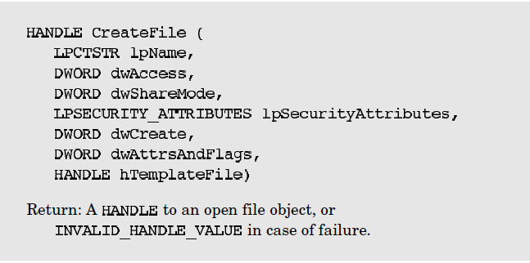
CreateFile

Slide 5
Parameters
The prefix dw describes DWORD (32 bits, unsigned) options containing flags or numerical values.
lpsz (long pointer to a zero-terminated string), or, more simply, lp, is for pathnames and other strings,

Slide 6
dwAccess
dwAccess specifies the read and write access, using GENERIC_READ and GENERIC_WRITE.
We can combine these values with a bit-wise “|” operator to open a file for read and write:
GENERIC_READ | GENERIC_WRITE

Slide 7
dwShareMode
0 – file cannot be shared (not even this process can open a second HANDLE on this file)
FILE_SHARE_READ - Other processes, including the one making this call, can open this file for concurrent read access.
FILE_SHARE_WRITE - This allows concurrent writing to the file.

Slide 8
lpSecurityAttributes
lpSecurityAttributes points to a SECURITY_ATTRIBUTES structure. Use NULL values with and all other functions for now.

Slide 9
dwCreate
CREATE_NEW- Create a new file. Fail if the specified file already exists.
CREATE_ALWAYS - Create a new file, or overwrite the file if it already exists.
OPEN_EXISTING - Open an existing file or fail if the file does not exist.
OPEN_ALWAYS - Open the file, creating it if it does not exist.
TRUNCATE_EXISTING - Set the file length to zero.

Slide 10
dwAttrsAndFlags
There are 32 flags and attributes.
FILE_ATTRIBUTE_NORMAL - This attribute can be used only when no other attributes are set (flags can be set, however).
FILE_ATTRIBUTE_READONLY - Applications can neither write to nor delete the file.
FILE_FLAG_DELETE_ON_CLOSE - This is useful for temporary files. Windows deletes the file when the last open HANDLE is closed.
FILE_FLAG_OVERLAPPED - This attribute flag is important for asynchronous I/O

Slide 11
hTemplateFile
hTemplateFile is the HANDLE of an open GENERIC_READ file that specifies extended attributes to apply to a newly created file, ignoring dwAttrsAndFlags. Normally, this parameter is NULL.

Slide 12
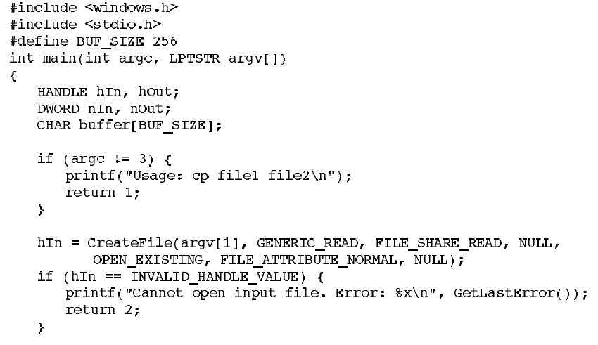
File Copying with Windows

Slide 13
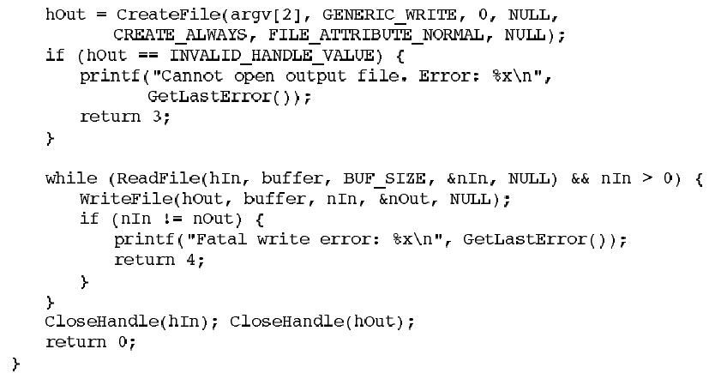

Slide 14

Closing Files

Slide 15
UNIX vs Windows
There is no UNIX equivalent to dwShareMode. UNIX files are always shareable.
Both systems use security information when creating a new file. In UNIX, the mode argument specifies the familiar user, group, and other file permissions.

Slide 16
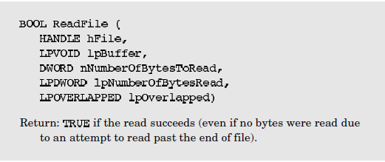
Reading Files

Slide 17
Parameters
hFile is a file handle with FILE_READ_DATA access
lpBuffer points to the memory buffer to receive the input data
nNumberOfBytesToRead is the number of bytes to read from the file
lpNumberOfBytesRead points to the actual number of bytes read by the ReadFile call

Slide 18
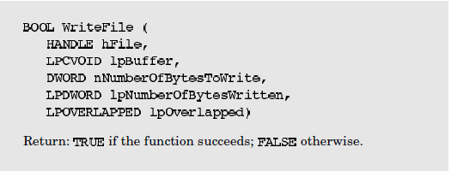
Writing Files

Slide 19
Notice
Notice that a successful write does not ensure that the data actually is written through to the disk unless FILE_FLAG_WRITE_THROUGH is specified with CreateFile.
If the HANDLE position plus the write byte count exceed the current file length, Windows will extend the file length.

Slide 20
Unicode and Generic Characters
Windows supports standard 8-bit characters (type char or CHAR) and wide 16-bit characters (WCHAR, which is defined to be the C wchar_t type).
The wide character support that Windows provides using the Unicode UTF-16 encoding is capable of representing symbols and letters in all major languages, including English, French, Spanish, German, Japanese, and Chinese.

Slide 21
Steps for writing a generic Windows application that can be built to use either Unicode or 8-bit ASCII characters
Define all characters and strings using the generic types TCHAR, LPTSTR, and LPCTSTR.
Include the definitions #define UNICODE and #define _UNICODE in all source modules to get Unicode wide characters (ANSI C wchar_t). The definition must precede the #include <windows.h> statement.
Byte buffer lengths—as used, for example, in ReadFile—can be calculated using sizeof (TCHAR).

Slide 22

4. Use the collection of generic C library string and character I/O functions in tchar.h. See MSDN for a complete and extensive list.
5. Constant strings should be in one of three forms:
6. Include tchar.h after windows.h to get required definitions for text macros and generic C library functions.

Slide 23
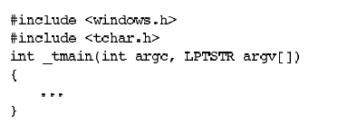
The Generic Main Function

Slide 24
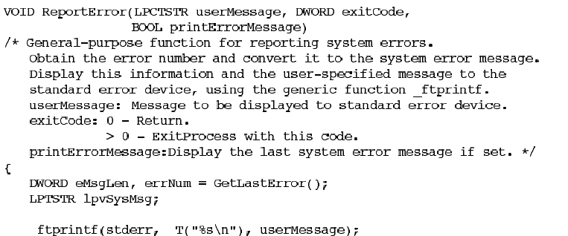
Reporting System Call Errors

Slide 25
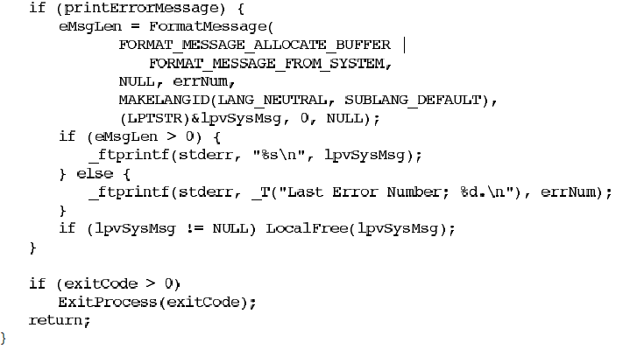

Slide 26
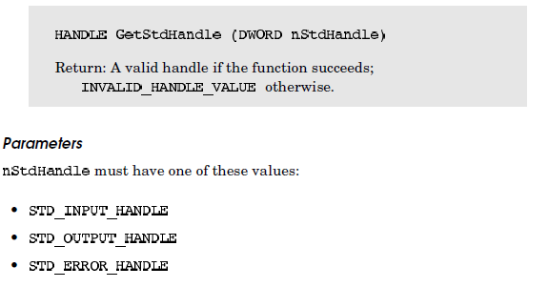
Standard Devices

Slide 27

File Deletion

Slide 28
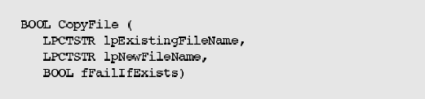
Copying a File

Slide 29
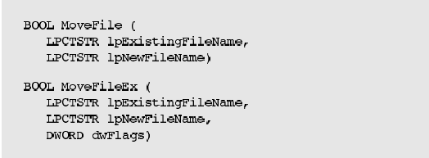
Renaming and Moving Files

