Slide 1
System programming Lecture 9
Process Management in Windows

Slide 2
Components of a process
One or more threads.
A virtual address space that is distinct from other processes’ address spaces.
One or more code segments, including code in DLLs.
One or more data segments containing global variables.
Environment strings with environment variable information, such as the current search path.
The process heap.
Resources such as open handles.

Slide 3
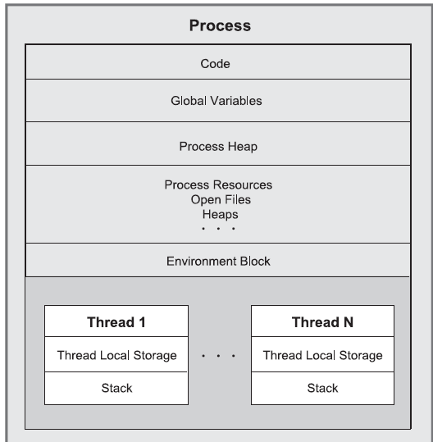
Process and its threads
Each thread in a process shares code, global variables, environment strings, and resources.

Slide 4
Components of a thread
A stack for procedure calls, interrupts, exception handlers, and automatic storage.
Thread Local Storage (TLS)—An array like collection of pointers giving each thread the ability to allocate storage to create its own unique data environment.
An argument on the stack, from the creating thread, which is usually unique for each thread.
A context structure, maintained by the kernel, with machine register values.

Slide 5
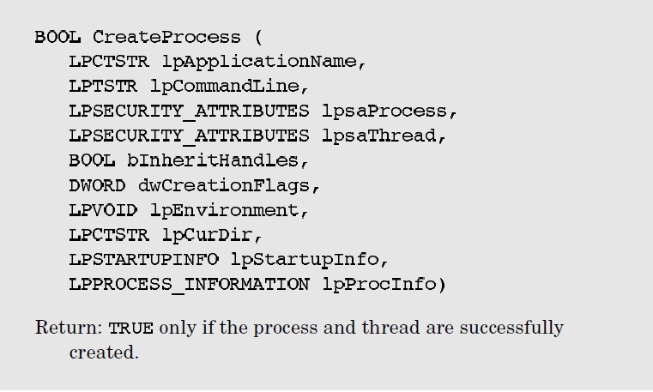
Process Creation

Slide 6
Parameters
lpApplicationName and lpCommandLine together specify the executable program and the command line arguments.
lpsaProcess and lpsaThread point to the process and thread security attribute structures. NULL values imply default security.
bInheritHandles indicates whether the new process inherits copies of the calling process’s inheritable open handles (files, mappings, and so on). Inherited handles have the same attributes as the originals.

Slide 7
dwCreationFlags
CREATE_SUSPENDED indicates that the primary thread is in a suspended state and will run only when the program calls ResumeThread.
DETACHED_PROCESS and CREATE_NEW_CONSOLE are mutually exclusive; don’t set both. The first flag creates a process without a console, and the second flag gives the new process a console of its own. If neither flag is set, the process inherits the parent’s console.
CREATE_UNICODE_ENVIRONMENT should be set if UNICODE is defined.
CREATE_NEW_PROCESS_GROUP specifies that the new process is the root of a new process group.

Slide 8
Other parameters
lpEnvironment points to an environment block for the new process. If NULL, the process uses the parent’s environment. The environment block contains name and value strings, such as the search path.
lpCurDir specifies the drive and directory for the new process. If , the parent’s working directory is used.
lpStartupInfo is complex and specifies the main window appearance and standard device handles for the new process.

Slide 9
Sequence of operations
Use the parent’s information, which is obtained from GetStartupInfo
First, clear the associated STARTUPINFO structure before calling CreateProcess, and then specify the standard input, output, and error handles by setting the STARTUPINFO standard handler fields.

Slide 10
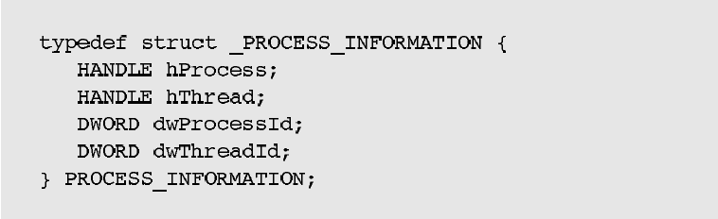
lpProcInfo
specifies the structure for containing the returned process, thread handles, and identification.

Slide 11
IDs and handles
The ID is unique to the object for its entire lifetime and in all processes, although the ID is invalid when the process or thread is destroyed and the ID may be reused.
On the other hand, a given process may have several handles, each having distinct attributes, such as security access.
For this reason, some process management functions require IDs, and others require handles.
Just as with file handles, process and thread handles should be closed when no longer required.

Slide 12
Specifying the Executable Image and the Command Line
If lpApplicationName is NULL, it specifies the executable module.
Specify the full path and file name, or use a partial name and the current drive and directory will be used; there is no additional searching. Include the file extension in the name.
If the lpApplicationName string is NULL, the first white-space-delimited token in lpCommandLine is the program name.

Slide 13
Inheritable Handles
Frequently, a child process requires access to an object referenced by a handle in the parent; if this handle is inheritable, the child can receive a copy of the parent’s open handle.

Slide 14
To make a handle inheritable
The bInheritHandles flag on the CreateProcess call determines whether the child process will inherit copies of the inheritable handles of open files, processes, and so on. The flag can be regarded as a master switch applying to all handles.
It is also necessary to make an individual handle inheritable, which is not the default. To create an inheritable handle, use a SECURITY_ATTRIBUTES structure at creation time or duplicate an existing handle.
The SECURITY_ATTRIBUTES structure has a flag, bInheritHandle, that should be set to TRUE.

Slide 15
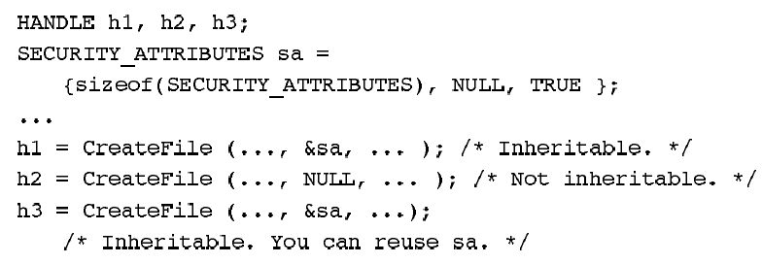
Example

Slide 16
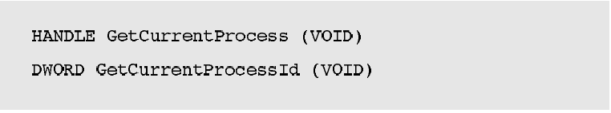
Process Identities
A process can obtain the identity and handle of a new child process from the PROCESS_INFORMATION structure. Closing the child handle does not, of course, destroy the child process; it destroys only the parent’s access to the child. A pair of functions obtain current process identification.

Slide 17
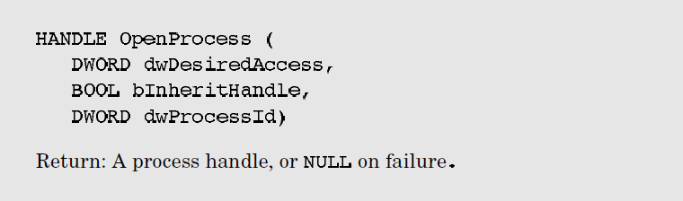
Creating a handle using process ID

Slide 18
dwDesiredAccess
determines the handle’s access to the process.
SYNCHRONIZE - This flag enables processes to wait for the process to terminate using the wait functions described later in this chapter.
PROCESS_ALL_ACCESS - All the access flags are set.
PROCESS_TERMINATE - It is possible to terminate the process with the TerminateProcess function.
PROCESS_QUERY_INFORMATION – The handle can be used by GetExitCodeProcess and GetPriorityClass to obtain process information.

Slide 19

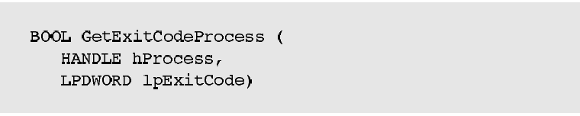
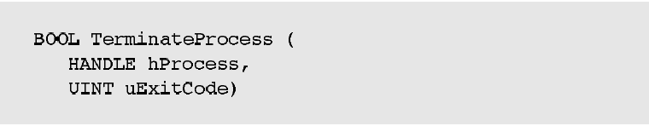
Exiting and Terminating a Process

Slide 20
Unix vs Windows processes
UNIX processes have a process ID, or pid, comparable to the Windows process ID.
getpid is similar to GetCurrentProcessId, but there are no Windows equivalents to getppid because Windows has no process parents.
Conversely, UNIX does not have process handles, so it has no functions comparable to GetCurrentProcess or OpenProcess.
Unix exit is similar to ExitProcess; to terminate another process, signal it with SIGKILL.

Slide 21
Waiting for a Process to Terminate
The simplest, and most limited, method to synchronize with another process is to wait for that process to complete.
The functions can wait for many different types of objects; process handles are just the first use of the wait functions.
The functions can wait for a single process, the first of several specified processes, or all processes in a collection to complete.
There is an optional time-out period.

Slide 22
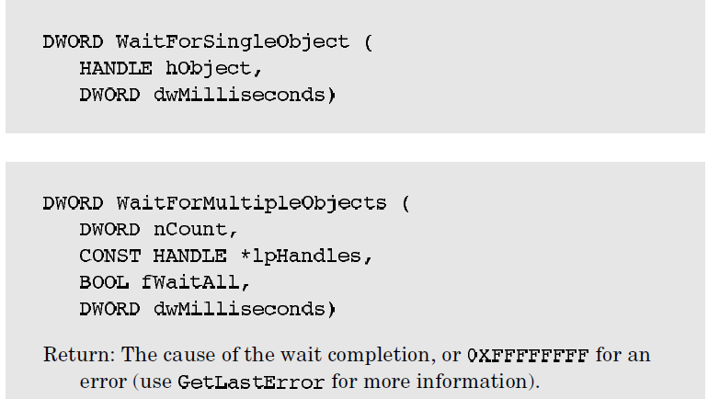
Wait functions
The two general-purpose wait functions wait for synchronization objects to become signaled.
The system sets a process handle, for example, to the signaled state when the process terminates or is terminated.

Slide 23
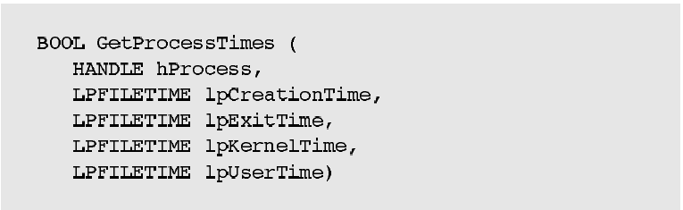
Process Execution Times

