Slide 1
System programming Lecture 11 Network Programming with Windows Sockets

Slide 2
Benefits of Winsock API
Porting code already written for Berkeley Sockets is straightforward.
Windows machines easily integrate into TCP/IP networks, both IPv4 and IPv6.
Sockets can be treated as file HANDLEs for use with ReadFile, WriteFile, and, with some limitations, other Windows functions, just as UNIX allows sockets to be used as file descriptors.
Sockets can support protocols other than TCP/IP.

Slide 3
Winsock initialization
The Winsock API is supported by a DLL (WS2_32.dll) that can be accessed by linking WS2_32.dll with your program.
The DLL needs to be initialized with a nonstandard, Winsock-specific function, WSAStartup, which must be the first Winsock function a program calls.
WSACleanup should be called when the program no longer needs to use Winsock functionality.

Slide 4
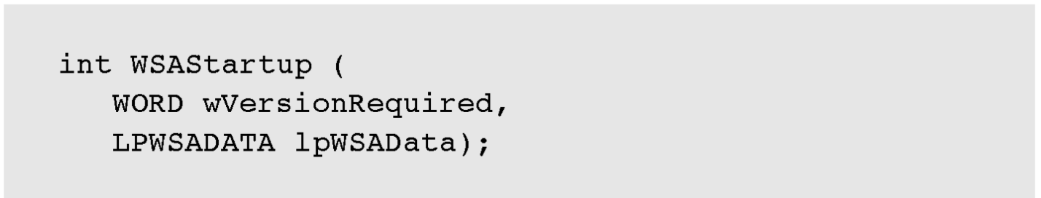
WSAStartup
wVersionRequired indicates the highest version of the Winsock DLL that you can use.
lpWSAData points to a WSADATA structure that returns information on the configuration of the DLL, including the highest version available.

Slide 5
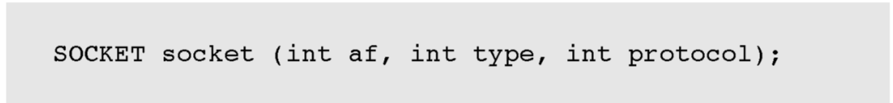
Creating a socket
A Windows SOCKET data type is analogous to the Windows HANDLE and can even be used with ReadFile and other Windows functions requiring a HANDLE.
af denotes the address family (e.g, AF_INET)
type specifies connection-oriented (SOCK_STREAM) or datagram communication (SOCK_DGRAM)
protocol is unnecessary when af is AF_INET; use 0.
socket return INVALID_SOCKET on failure

Slide 6
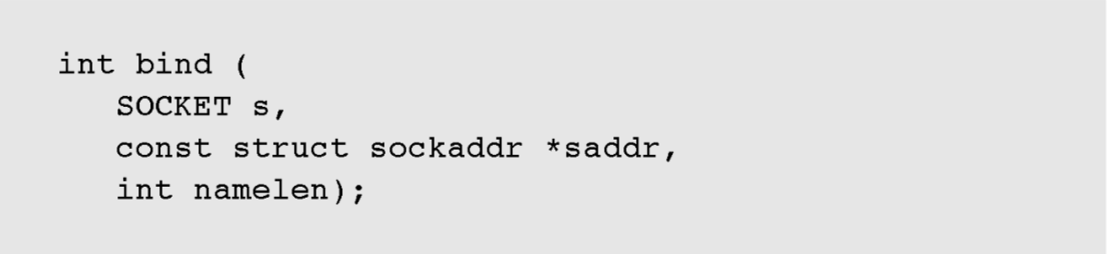
Binding a socket
s is an unbound SOCKET returned by socket
saddr specifies the protocol and protocol-specific information
namelen is sizeof(sockaddr)
The return value is normally 0 or SOCKET_ERROR in case of error.

Slide 7
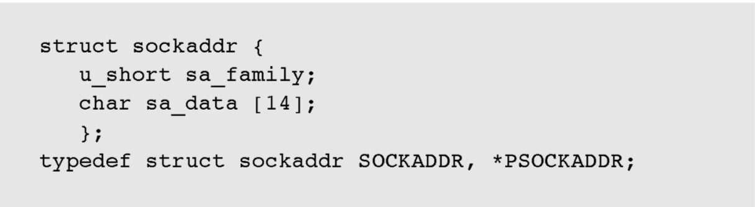
sockaddr structure
sa_family is the protocol
sa_data is protocol-specific

Slide 8
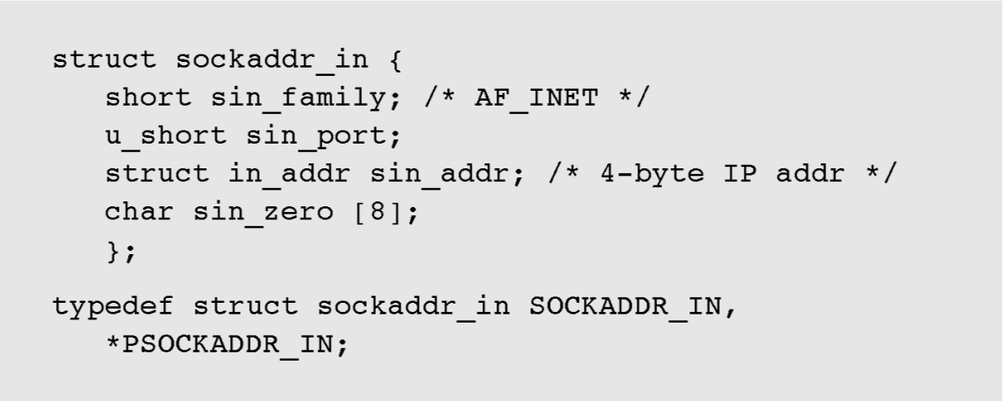
Internet version of sockaddr: sockaddr_in

Slide 9
inet_addr function
Use inet_addr function to convert a known IP address text string into the required form:

Slide 10
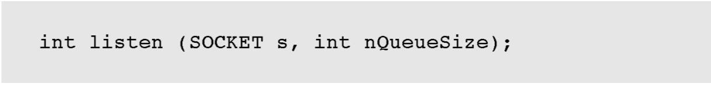
Putting a bound socket into the listening state
listen makes a server socket available for client connection
nQueueSize indicates the number of connection requests you are willing to have queued at the socket.

Slide 11
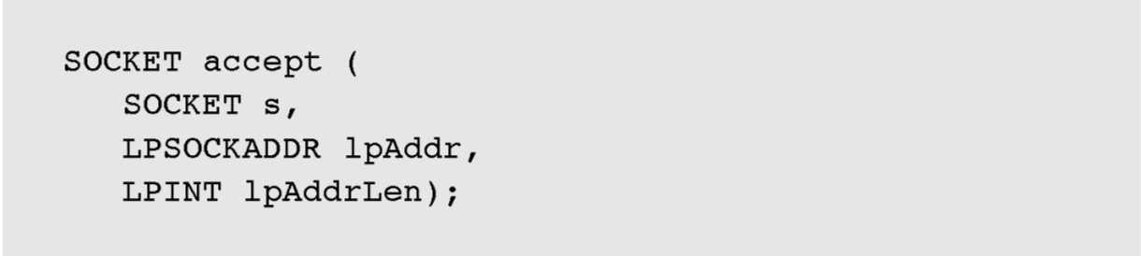
Accepting a client connection
accept function returns a new connected socket for use in the I/O operations
The original socket, now in the listening state, is used solely as an accept parameter and is not used directly for I/O
s is the listening socket
lpAddr points to a sockaddr_in structure that gives the address of the client machine
lpAddrLen points to a variable that will receive the length of the returned sockaddr_in structure = sizeof(sockaddr_in)

Slide 12


Disconnecting and closing sockets
Disconnect a socket using
where s is the value returned by accept. The how value indicates if you want to disconnect send operations (SD_SEND), receive operations (SD_RECEIVE), or both (SD_BOTH).
SD_SEND or SD_BOTH – subsequent send calls will fail and the sender will send a FIN (no more data from the sender)
SD_RECEIVE or SD_BOTH – subsequent recv calls will fail and the receiver will send a FIN (no more data from the receiver)
Once you are finished with a socket, you can close it with

Slide 13
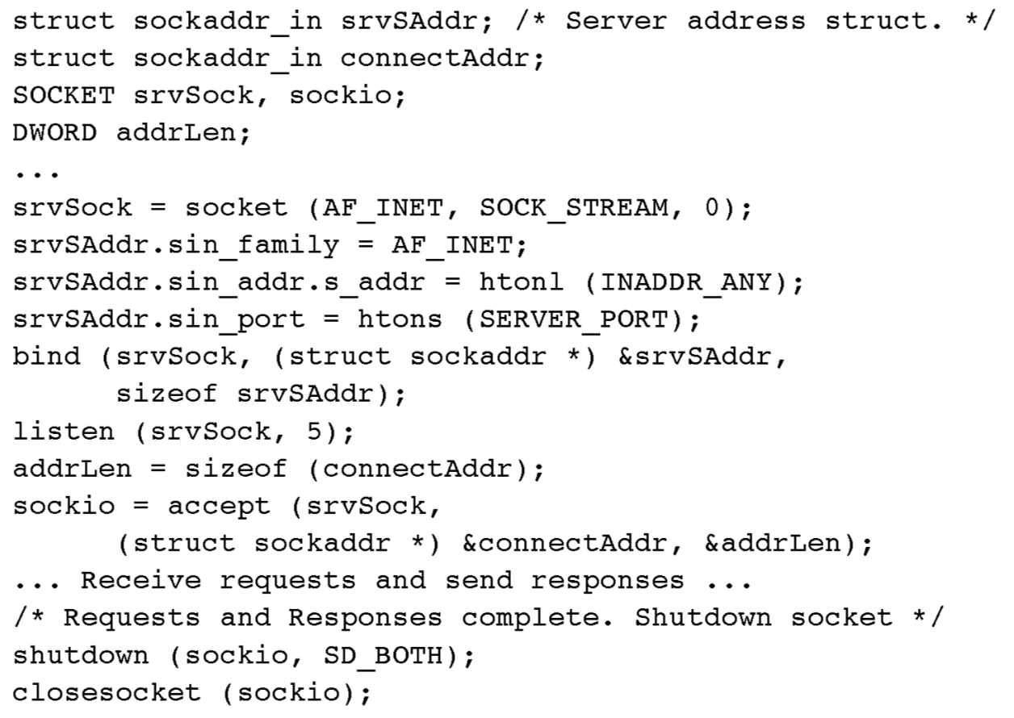
Example: preparing for and accepting a client connection

Slide 14
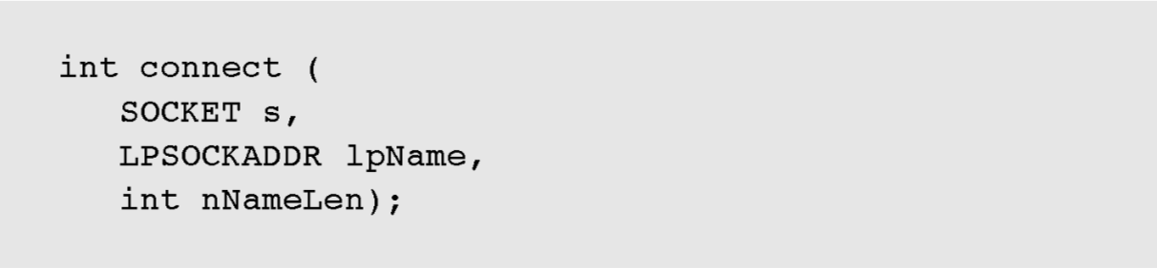
Connecting to a server
s is a socket created with the socket function
lpName points to a sockaddr_in structure that has been initialized with the port number and IP address of a machine with a socket, bound to the specified port, that is in listening mode
Initialize nNameLen with sizeof (sockaddr_in)
Return value of 0 indicates a successful connection, whereas SOCKET_ERROR indicates failure

Slide 15
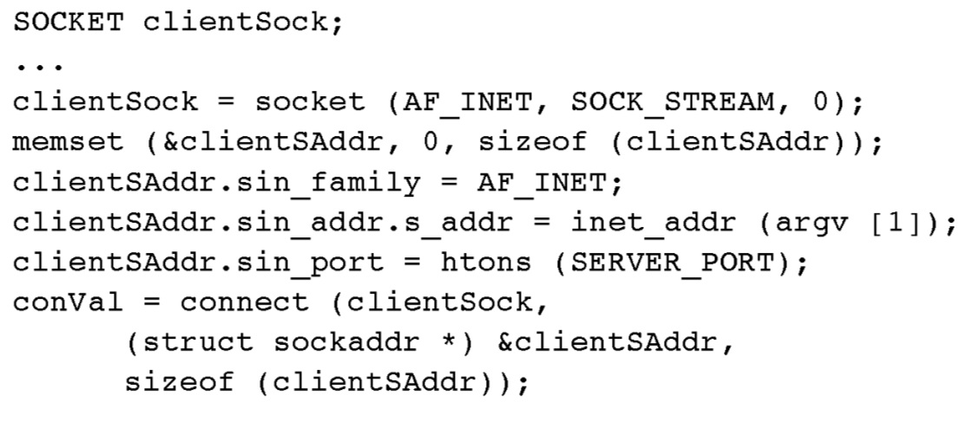
Example: client connecting to a server

Slide 16
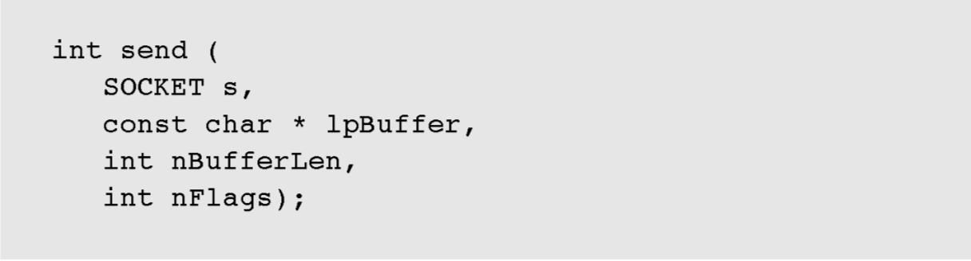
Sending and receiving data
The return value is the actual number of bytes transmitted. An error is indicated by the return value SOCKET_ERROR.
nFlags can be used to indicate urgency
send and recv are not atomic, and there is no assurance that all the requested data has been received or sent.

Slide 17
Example: a socket message receive function
It is frequently convenient to send and receive messages as a single unit.
Sockets, however, require that you provide a mechanism to specify and determine message boundaries.
One common method is to create a message header with a length field, followed by the message itself, and we’ll use message headers in the following examples.

Slide 18
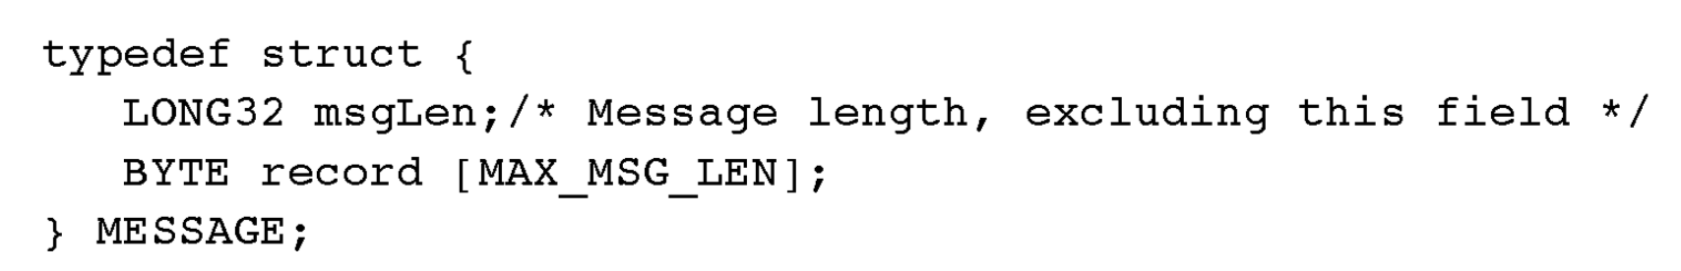
Message structure
The message is received in two parts: the header and the contents. The user-defined MESSAGE type with a 4-byte message length header is:
Even the 4-byte header requires repetitive recv calls to ensure that it is read in its entirety because recv is not atomic.

Slide 19
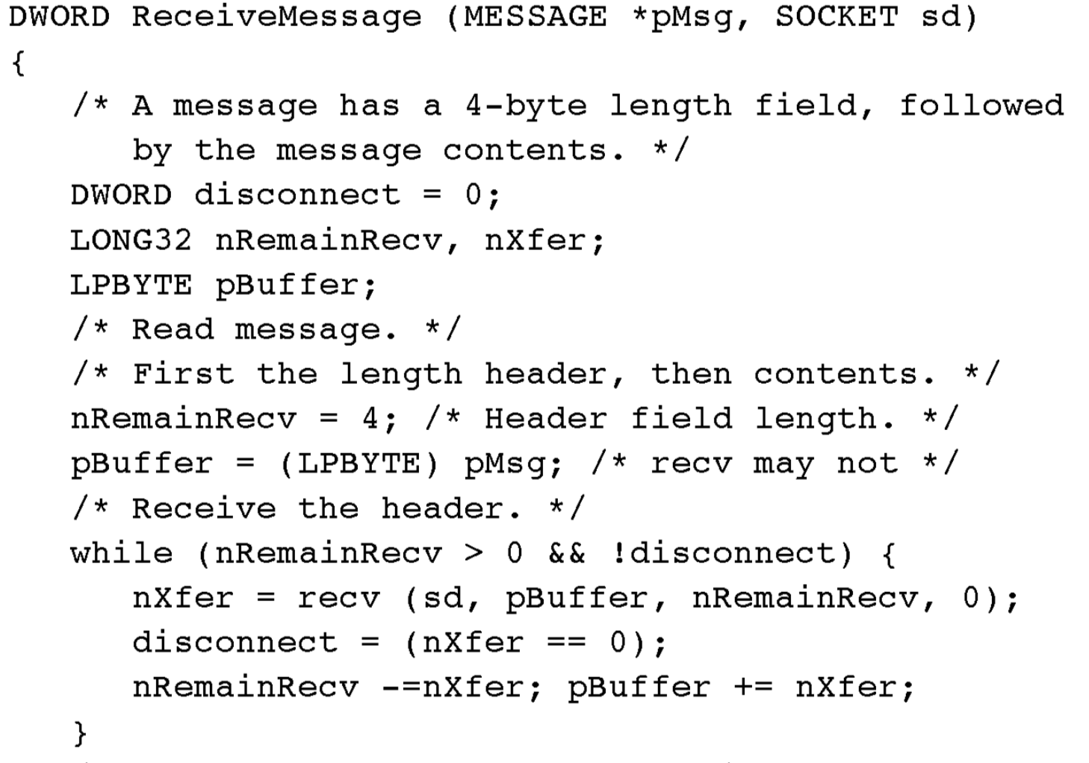

Slide 20
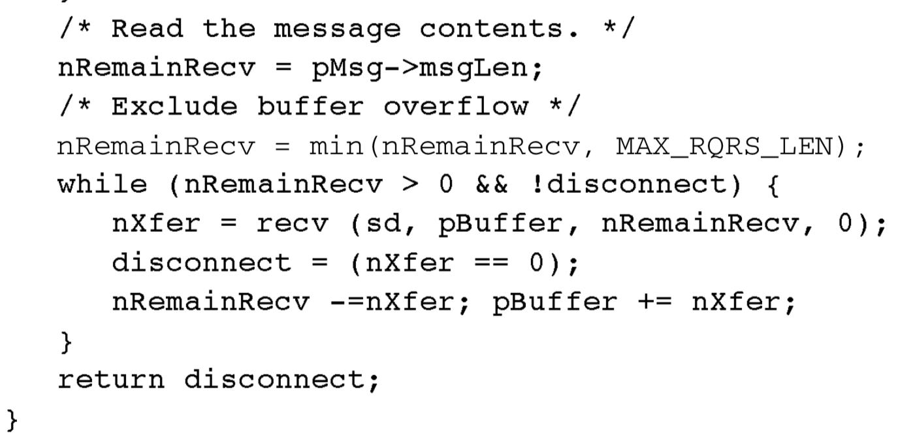

Slide 21
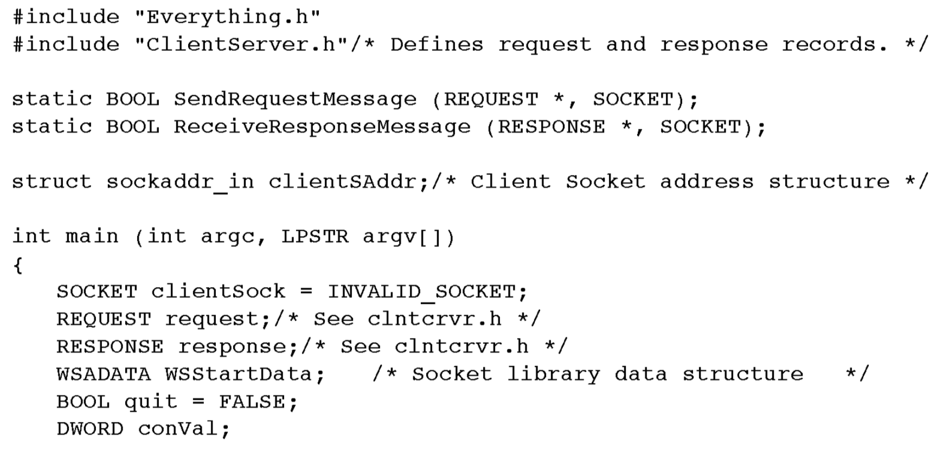
A socket-based client

Slide 22
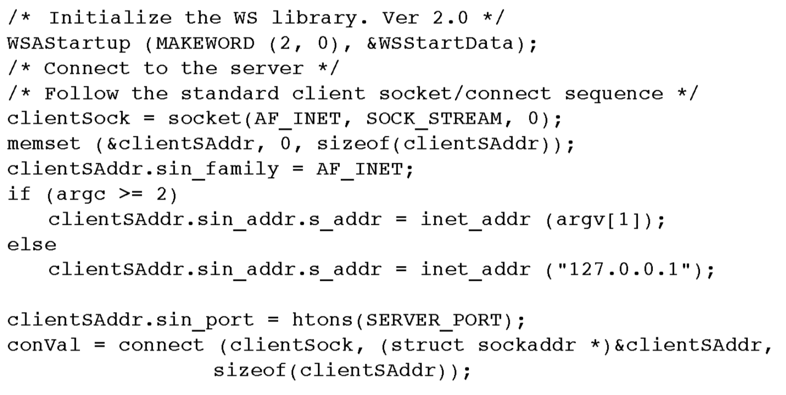

Slide 23
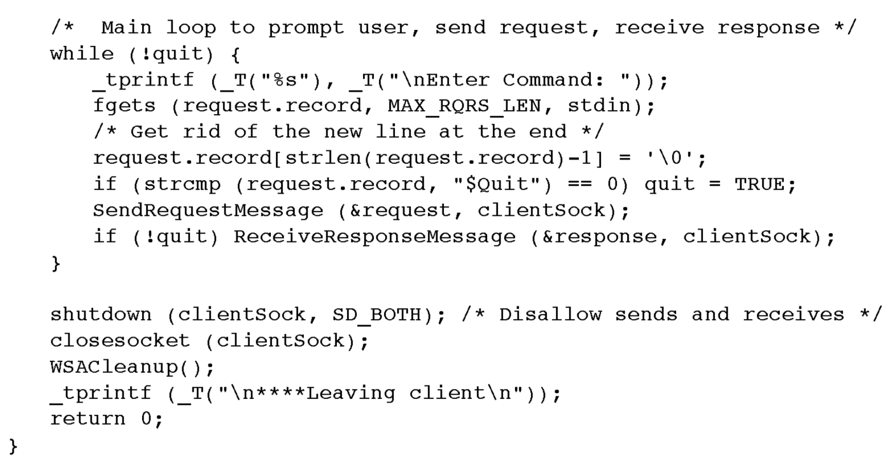

Slide 24
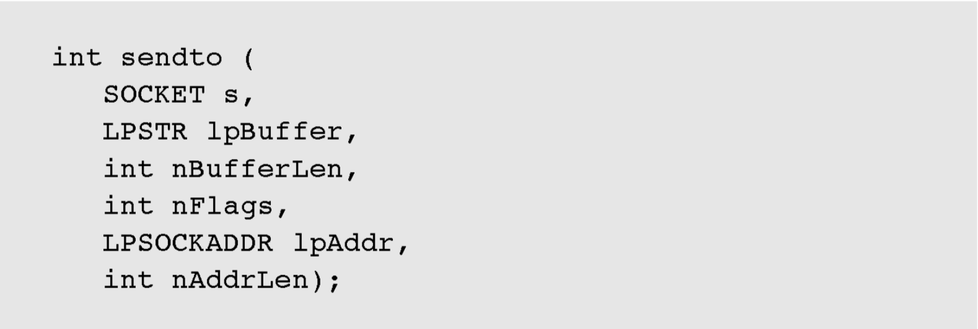
Datagrams
The first step in using datagrams is to specify SOCK_DGRAM in the type field when creating the socket with the socket function.
Use sendto and recvfrom.
lpAddr points to an sockaddr address structure where you can specify the name of a specific machine and port, or you can specify that the datagram is to be broadcast to multiple computers.

Slide 25
Datagram broadcasting
Set the SOCK_DGRAM socket options by calling setsockopt, specifying the SO_BROADCAST option. Also, set this option for sockets that are to receive broadcast messages.
Set the client’s lpAddr sin_addr_in.s value to INADDR_BROADCAST.
Set the port number.
The broadcasts will be sent to and received by all computer interfaces to that port.

Slide 26
Berkeley Sockets vs. Windows Sockets
Programs that use standard Berkeley Sockets calls will port to Windows Sockets, with the following important exceptions.
You must call WSAStartup to initialize the Winsock DLL.
You must use closesocket (which is not portable), rather than close, to close a socket.
You must call WSACleanup to shut down the DLL.

