Slide 1
System programming Lecture 7 Part 1 Sockets

Slide 2
Socket
Socket is a method of IPC that allow data to be exchanged between applications, either on the same host or on different hosts connected by a network.

Slide 3

Client-server communication
Each application creates a socket.
The server binds its socket to a well-known address (name) so that clients can locate it.
A socket is created using the socket() system call, which returns a file descriptor used to refer to the socket in subsequent system calls:

Slide 4
Communication domains
Communication domains determine:
The method of identifying a socket (“address”)
The range of communication (either between applications on the same host or between applications on different hosts connected via a network)

Slide 5
Communication domains
The UNIX (AX_UNIX) domain allows communication between applications on the same host.
The IPv4 (AF_INET) domain allows communication between applications running on hosts connected via IPv4 network.
The IPv6 (AF_INET6) domain allows communication between applications running on hosts connected via IPv6 network.

Slide 6
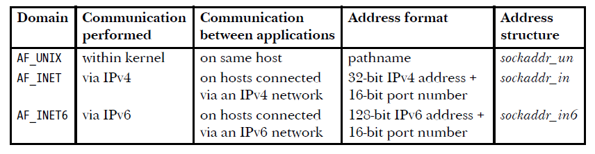
Socket domains (summary)

Slide 7
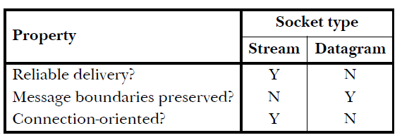
Socket types
Stream
Datagram

Slide 8
Stream sockets (SOCK_STREAM)
Provide a reliable, bidirectional, byte-stream communication channel.

Slide 9
Datagram sockets (SOCK_DGRAM)
Allow data to be exchanged in the form of messages called datagrams.

Slide 10
UDP and TCP
In the Internet domain, datagram sockets employ the UDP, and stream sockets employ the TCP.

Slide 11
Socket system calls
The socket() system call creates a new socket.
The bind() system call binds a socket to an address.
The listen() system call allows a stream socket to accept incoming connections from other sockets.
The accept() system call accepts a connection from a remote application on a listening stream socket, and optionally returns the address of the remote socket.
The connect() system call establishes a connection with another socket.

Slide 12
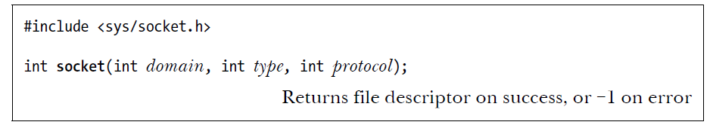
Creating a socket: socket()

Slide 13
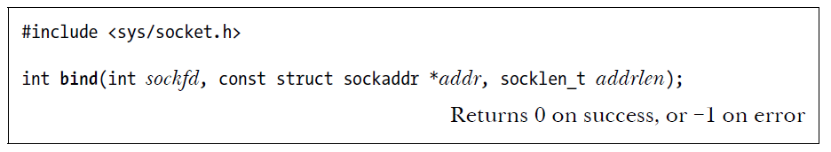
Binding a socket to an address: bind()
The sockfd argument is a file descriptor obtained from a previous call to socket().
The addr argument is a pointer to a structure specifying the address to which this socket is to be bound.
The addrlen argument specifies the size of the address structure.

Slide 14
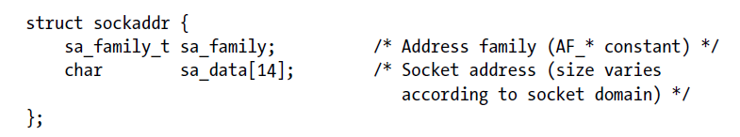
Socket address structure: struct sockaddr

Slide 15
Active and passive sockets
An active socket can be used in a connect() call to establish a connection to a passive socket. This is referred to as performing an active open.
A passive socket (also called a listening socket) is one that has been marked to allow incoming connections by calling listen(). Accepting an incoming connection is referred to as performing a passive open.

Slide 16
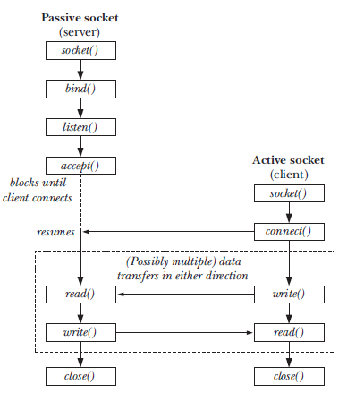
System calls used with stream sockets

Slide 17
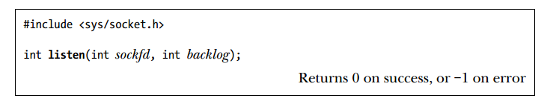
Listening for Incoming Connections: listen()
The kernel must record some information about each pending connection request so that a subsequent accept() can be processed. The backlog argument allows us to limit the number of such pending connections.

Slide 18
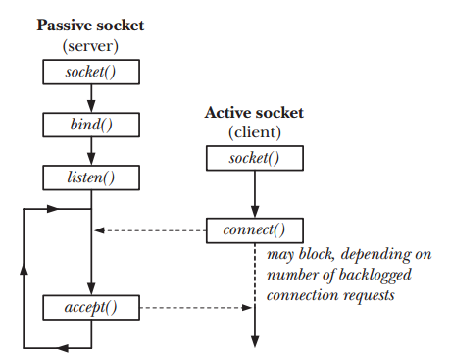
A pending socket connection

Slide 19
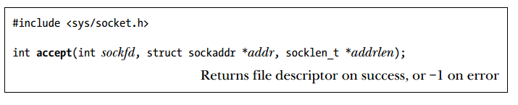
Accepting a Connection: accept()
The key point to understand about accept() is that it creates a new socket, and it is this new socket that is connected to the peer socket that performed the connect().
A file descriptor for the connected socket is returned as the function result of the accept() call. The listening socket (sockfd) remains open, and can be used to accept further connections.

Slide 20
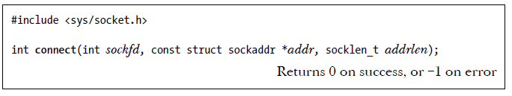
Connecting to a Peer Socket: connect()
The connect() system call connects the active socket referred to by the file descriptor sockfd to the listening socket whose address is specified by addr and addrlen.

Slide 21
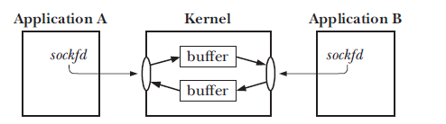
UNIX domain stream sockets provide a bidirectional communication channel

Slide 22
Connection Termination: close()
The usual way of terminating a stream socket connection is to call close().
If multiple file descriptors refer to the same socket, then the connection is terminated when all of the descriptors are closed.

Slide 23
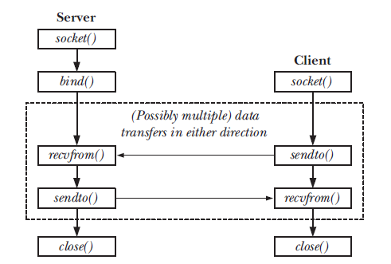
Overview of system calls used with datagram sockets

Slide 24
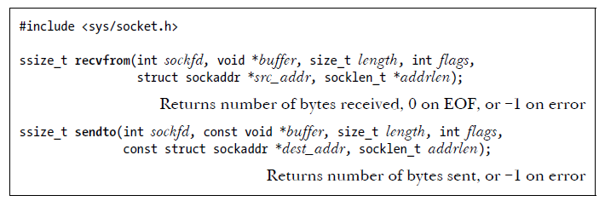
Exchanging Datagrams: recvfrom() and sendto()
The src_addr and addrlen arguments are used to obtain or specify the address of the peer socket with which we are communicating.

Slide 25

UNIX Domain Socket Addresses: struct sockaddr_un

Slide 26
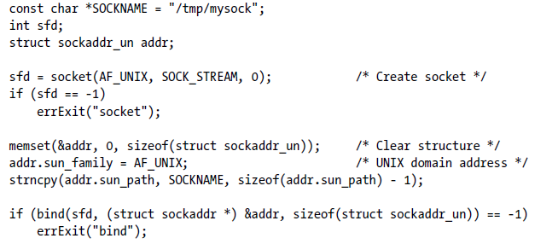
Binding a UNIX domain socket

Slide 27
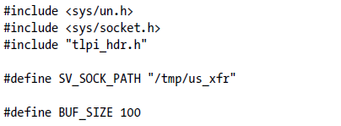
Header file for us_xfr_sv.c and us_xfr_cl.c

Slide 28
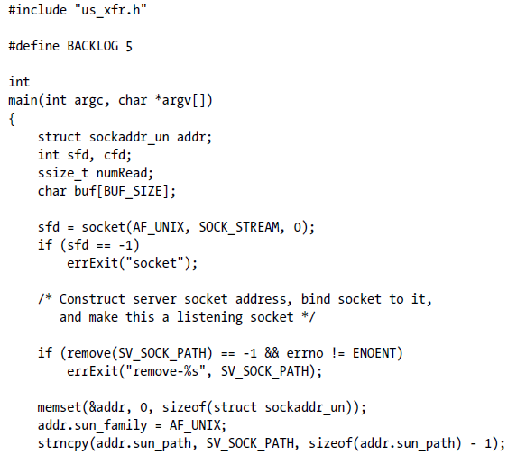
A simple UNIX domain stream socket server

Slide 29
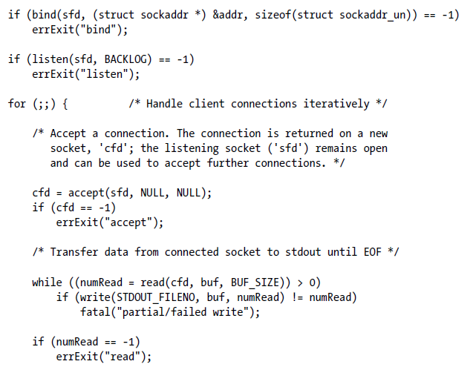
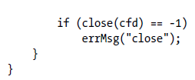

Slide 30
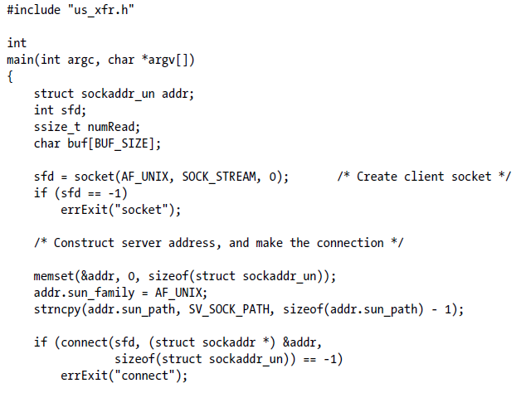
A simple UNIX domain stream socket client

Slide 31
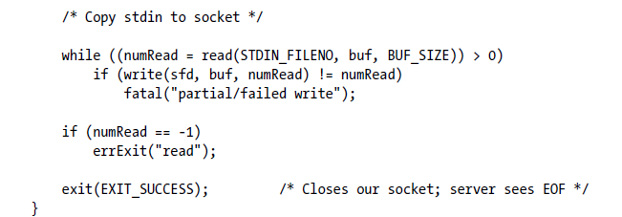

Slide 32
The server performs the following steps:
Create a socket.
Remove any existing file with the same pathname as that to which we want to bind the socket.
Construct an address structure for the server’s socket, bind the socket to that address, and mark the socket as a listening socket.

Slide 33
Execute an infinite loop to handle incoming client requests. Each loop iteration performs the following steps:
Accept a connection, obtaining a new socket, cfd, for the connection.
Read all of the data from the connected socket and write it to standard output.
Close the connected socket cfd.
The server must be terminated manually (e.g., by sending it a signal).

Slide 34
The client program performs the following steps:
Create a socket.
Construct the address structure for the server’s socket and connect to the socket at that address.
Execute a loop that copies its standard input to the socket connection. Upon encountering end-of-file in its standard input, the client terminates, with the result that its socket is closed and the server sees end-of-file when reading from the socket on the other end of the connection.

