Slide 1
System programming Lecture 7 Part2 Sockets: Internet Domains

Slide 2
Internet Domains
IPv4 (AF_INET)
IPv6 (AF_INET6)

Slide 3
Socket address
Socket address = IP address + port number

Slide 4
Internet domain stream sockets
Internet domain stream sockets are implemented on top of TCP.
They provide a reliable, bidirectional, byte-stream communication channel.

Slide 5
Internet domain datagram sockets
Internet domain datagram sockets are implemented on top of UDP.
UDP sockets are unreliable —datagrams may be lost, duplicated, or arrive in a different order from that in which they were sent.
If the incoming datagram would overflow the receiver’s queue, then the datagram is silently dropped.

Slide 6
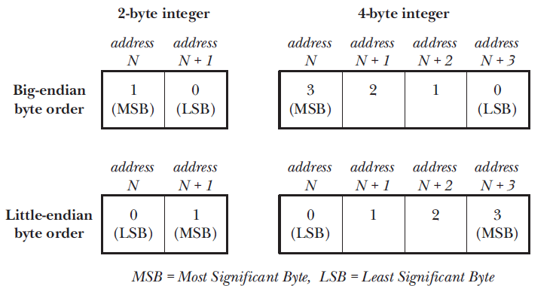
Big-endian and little-endian byte order for 2-byte and 4-byte integers

Slide 7
Network Byte Order
Since port numbers and IP addresses must be transmitted between, and understood by, all hosts on a network, a standard ordering must be used.
This ordering is called network byte order, and happens to be big endian.

Slide 8
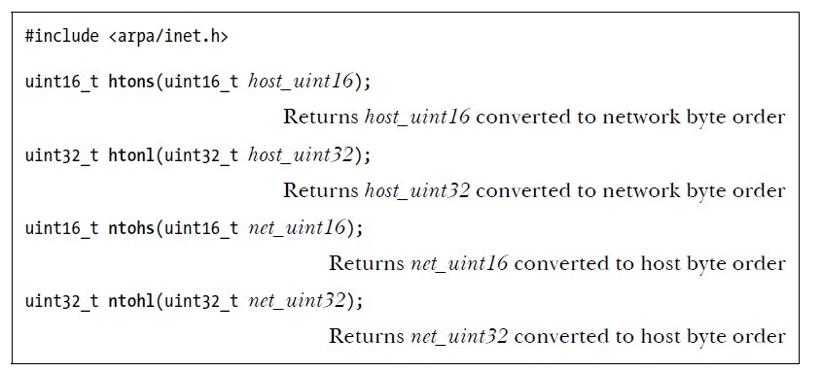
Converting integers (from host to network byte order and visa versa)
The use of these four functions is necessary only on systems where the host byte order differs from network byte order.

Slide 9
Data representation in heterogeneous systems
integer types can be stored in big-endian or little endian form;
C long data type may be 32 bits on some systems and 64 bits on others;
etc.
Because of these differences in data representation, applications that exchange data between heterogeneous systems over a network must adopt some common convention for encoding that data.

Slide 10
Marshalling
The sender must encode data according to this convention, while the receiver decodes following the same convention.
The process of putting data into a standard format for transmission across a network is referred to as marshalling.

Slide 11
Marshalling standards
XDR (External Data Representation, described in RFC 1014);
ASN.1-BER (Abstract Syntax Notation 1, http://www.asn1.org/),
CORBA,
and XML.

Slide 12
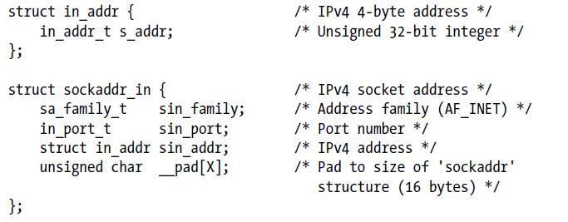
IPv4 socket addresses: struct sockaddr_in

Slide 13
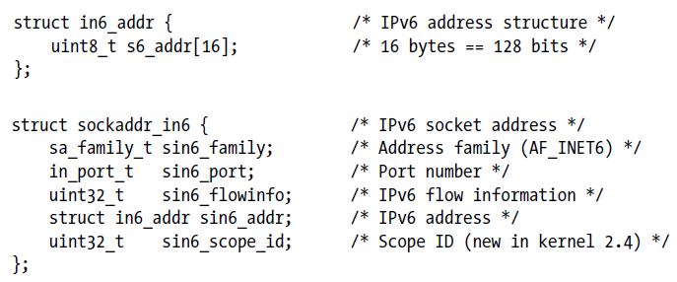
IPv6 socket addresses: struct sockaddr_in6

Slide 14
Symbolic names
Representing host addresses and ports:
A host address can be represented as a binary value, as a symbolic hostname, or in presentation format (dotted-decimal for IPv4 or hex-string for IPv6).
A port can be represented as a binary value or as a symbolic service name.

Slide 15
Converting IPv4 and IPv6 addresses between binary and human-readable forms
inet_pton() and inet_ntop() functions convert binary IPv4 and IPv6 addresses to and from presentation format—either dotted-decimal or hexstring notation.

Slide 16
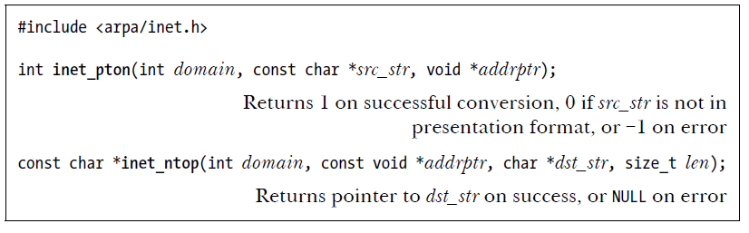
inet_pton() and inet_ntop() functions
The p in the names of these functions stands for “presentation,” and the n stands for “network.” The presentation form is a human-readable string, such as the following:
204.152.189.116 (IPv4 dotted-decimal address);
::1 (an IPv6 colon-separated hexadecimal address); or
::FFFF:204.152.189.116 (an IPv4-mapped IPv6 address).

Slide 17
Size of the buffer pointed to by dst_str

Slide 18
Client-Server Example (Datagram Sockets)

Slide 19
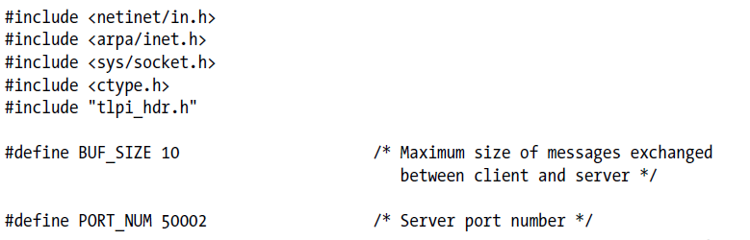
Header file

Slide 20
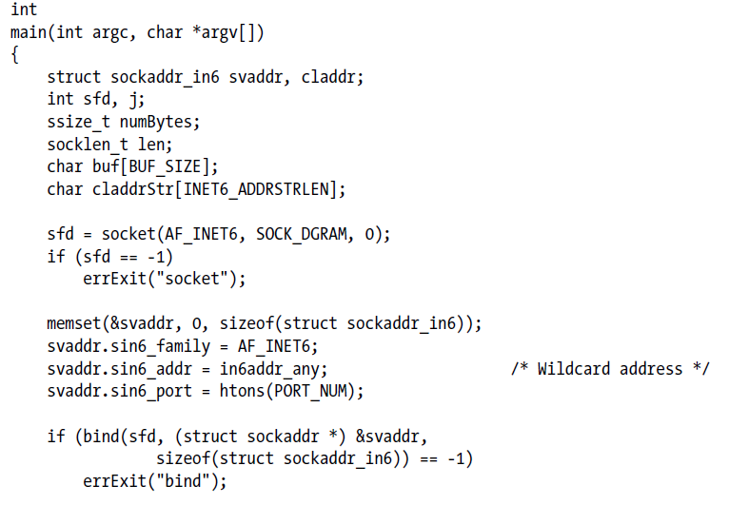
IPv6 case-conversion server using datagram sockets

Slide 21
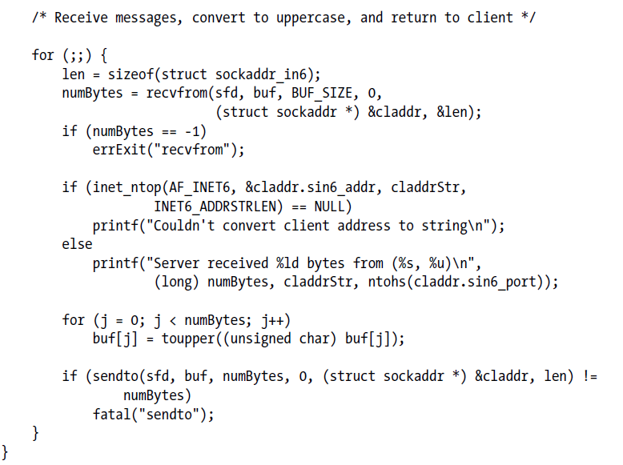

Slide 22
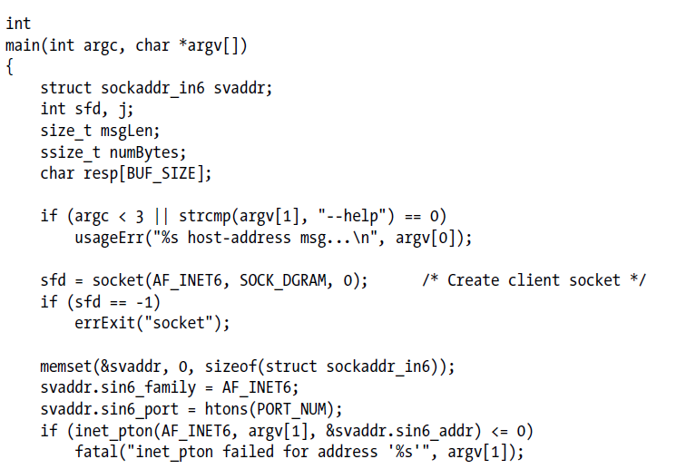
IPv6 case-conversion client using datagram sockets

Slide 23
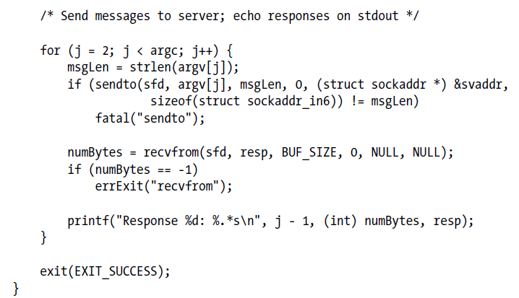

Slide 24
Client-Server Example (Stream Sockets)

Slide 25
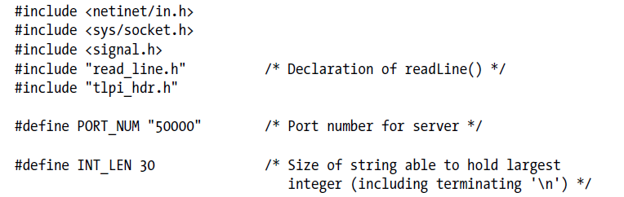
Header file

Slide 26
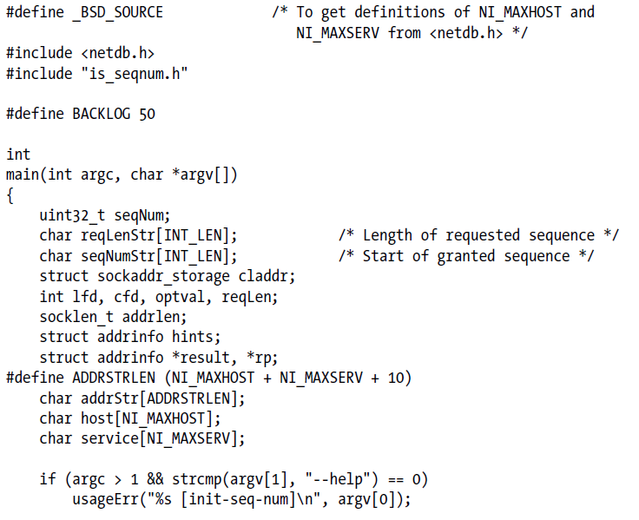
Server

Slide 27
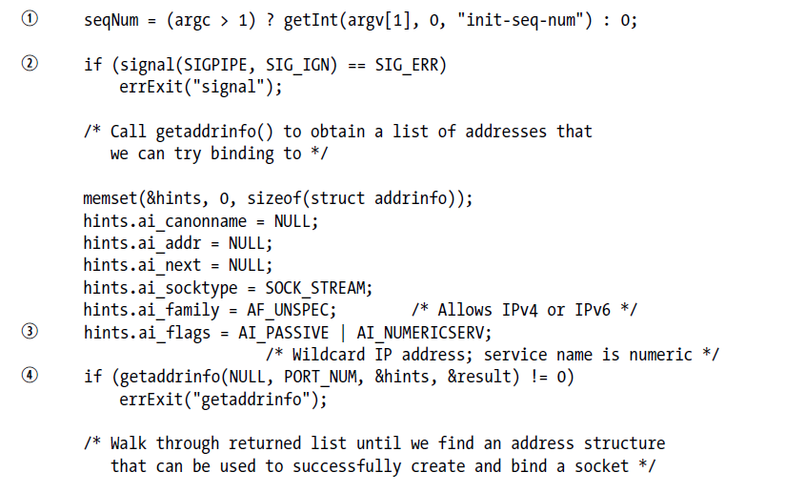

Slide 28
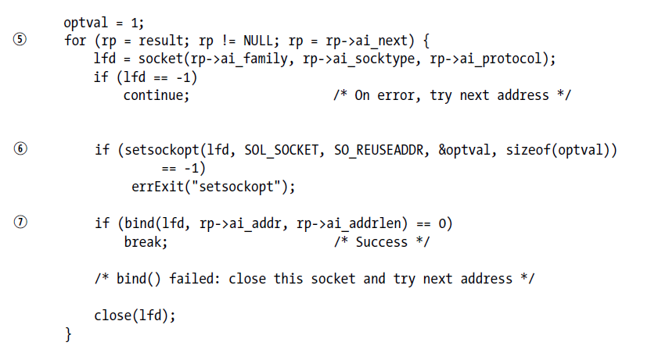


Slide 29
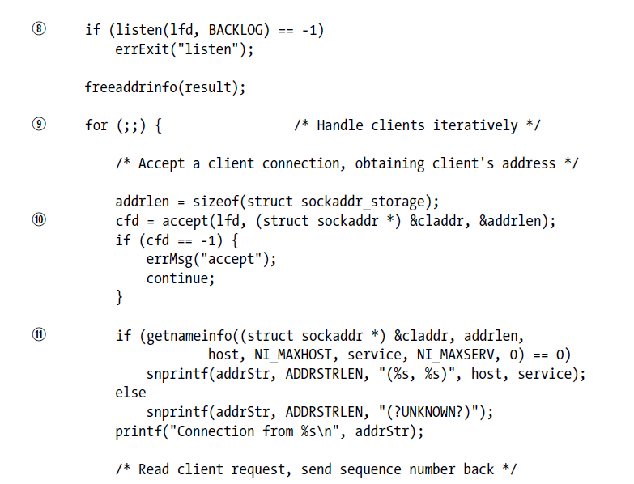

Slide 30
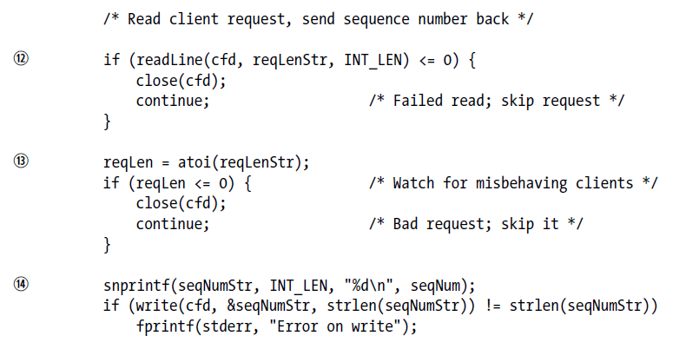
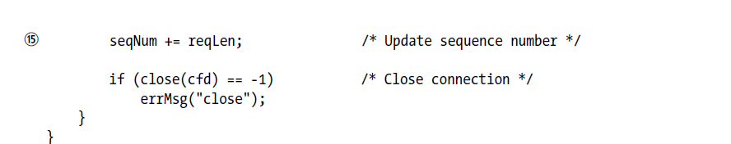

Slide 31
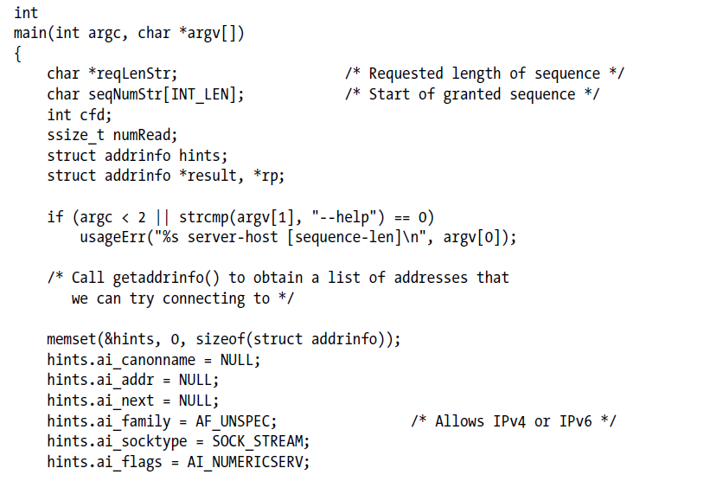
Client

Slide 32
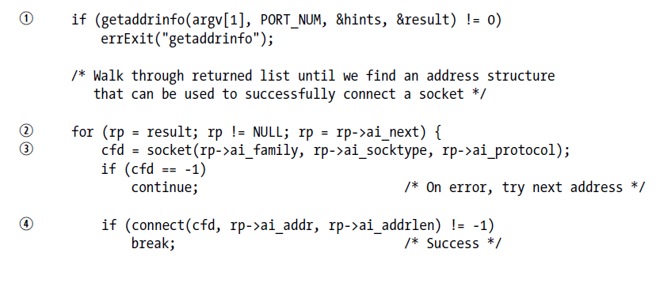
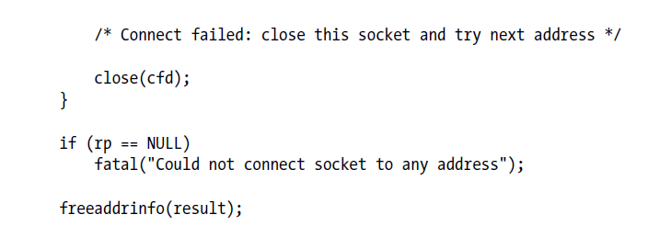

Slide 33
