Slide 1

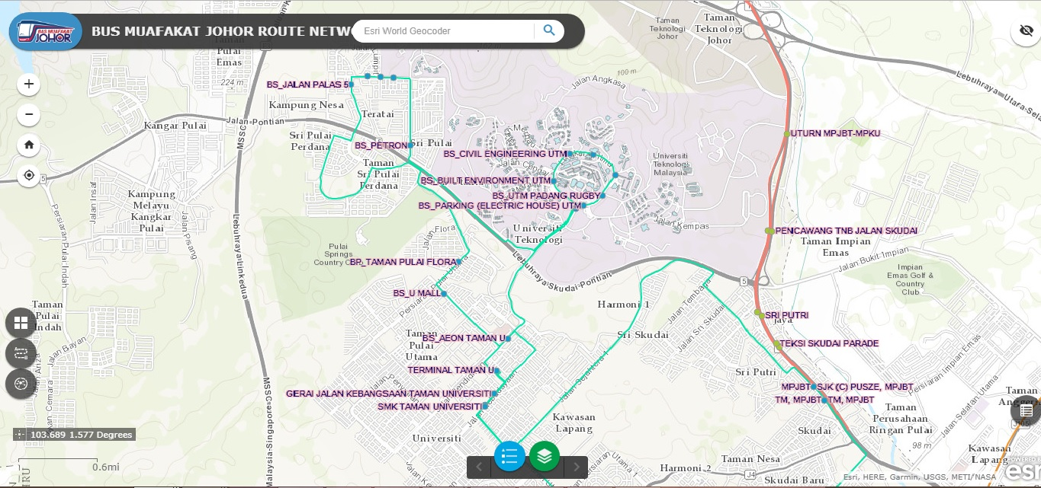
Zoom in and out button
Search widget
Bus Muafakat Johor Route Network System
Home button
Get location button
Attribute table button
Base map gallery button
Get direction and analysis button
Legend & Layer button

