Slide 1
AI cuts RF tolerance analysis from 277 days to 15 hours
Sub-topic 3 | A physics-checked AI model that stands in for the full-wave solver
Notes:
This project addresses Sub-topic 3: applying AI to the modelling of electromagnetic problems. One full-wave simulation of the supplied coupler takes about 30 minutes, while the two tasks the challenge evaluates, sensitivity analysis and design, require thousands to millions of simulations. We present a single surrogate model, built from about 60 simulations, that replaces the solver for both tasks, respects the S-parameter physics on every prediction, and is validated against boards it has never seen.

Slide 2
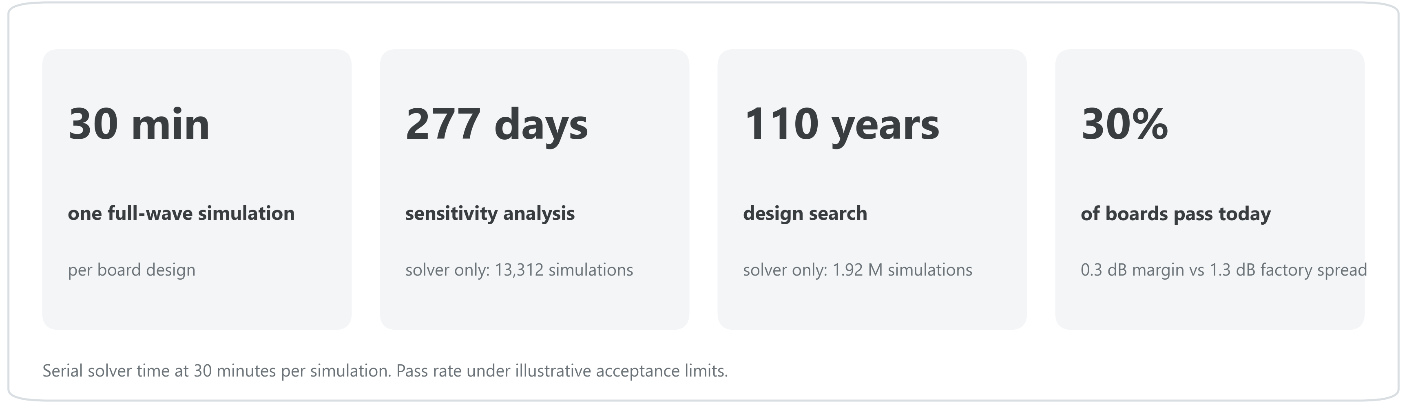
A tolerance study takes months to a century of solver time
Finding and fixing the causes with the solver alone is not affordable.
Notes:
The figures on this slide use only the solver cost confirmed by Huawei (30 minutes per run) and the supplied dataset. A standard Saltelli sensitivity analysis requires 13,312 runs, or 277 days of serial solver time; a design search over 961 candidate designs, each evaluated on 2,000 manufacturing realisations, would take about 110 years. The nominal design meets the illustrative limits, but its 0.25-0.40 dB margin is small compared with the 1.3 dB spread caused by manufacturing tolerances, so only about 30% of boards pass.

Slide 3
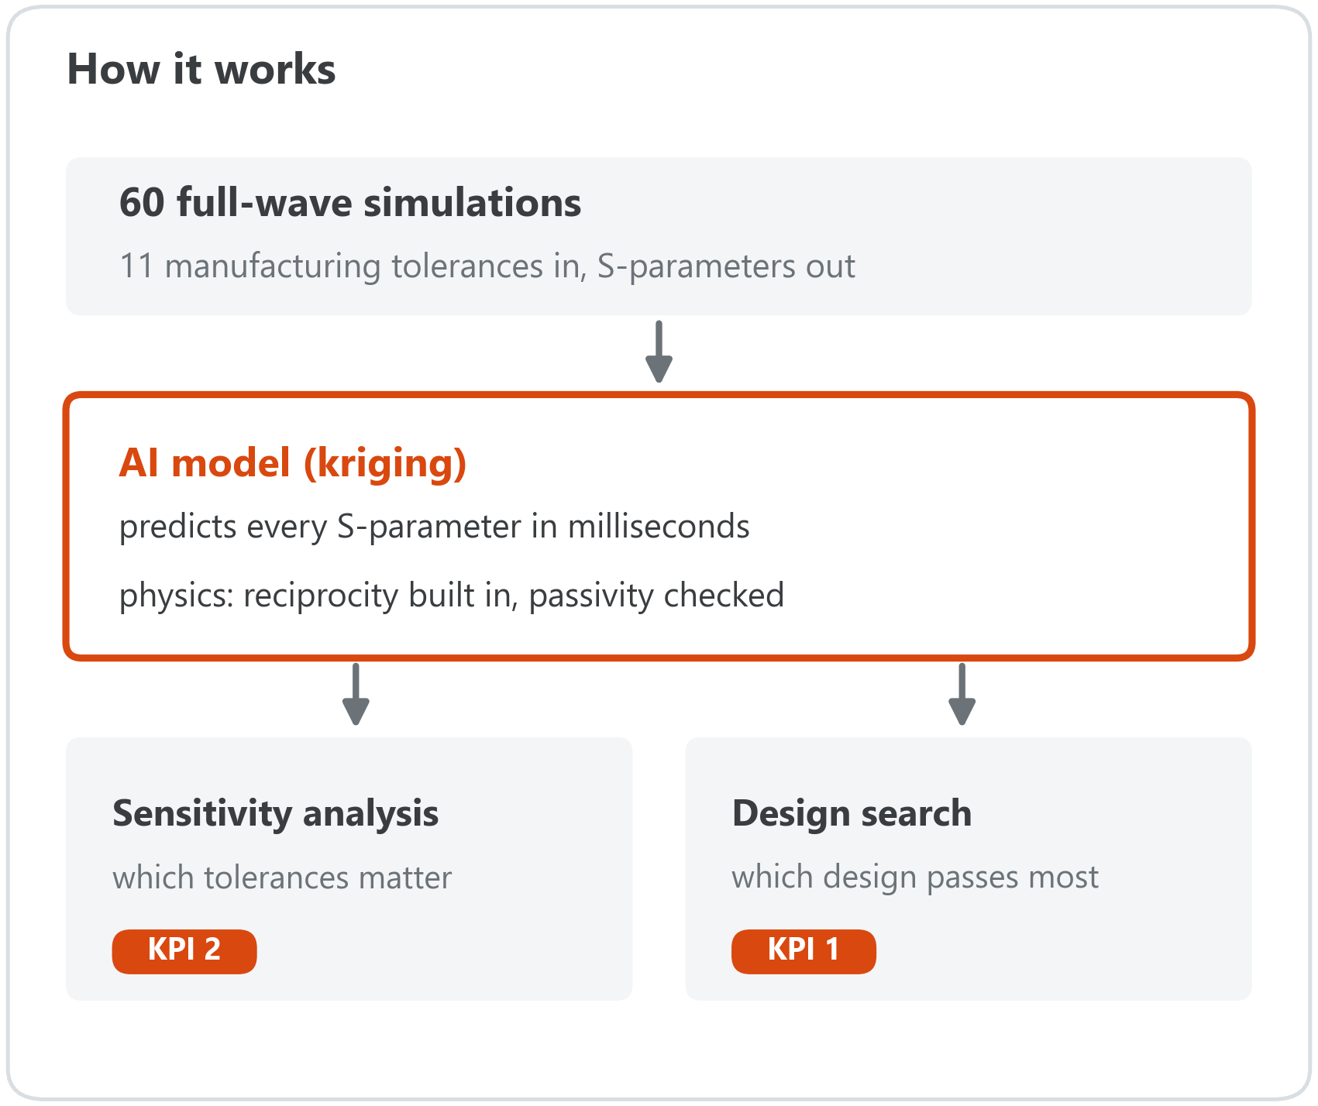
One AI model, trained on 60 simulations, replaces the solver
Learns how the 11 manufacturing tolerances shape the S-parameters.
Obeys the physics: reciprocity built in, passivity checked on every prediction.
60 simulations are enough: ten random 60-simulation models match the full-data results within about 3 points.
Notes:
The surrogate is a kriging (Gaussian-process) model of the 11 tolerance parameters. Reciprocity is imposed by construction, and passivity is verified on every predicted S-matrix; Huawei confirmed that enforcing these S-parameter laws qualifies as physics-informed for this challenge. The validation results use models trained on the 540 supplied designs, excluding the held-out boards. A separate test with ten random 60-run training sets reproduced the pass-rate results within 1.7 to 3.3 points and identified the same two leading tolerances in every case. Polynomial-chaos and neural-network surrogates agree with kriging within 2 points.

Slide 4
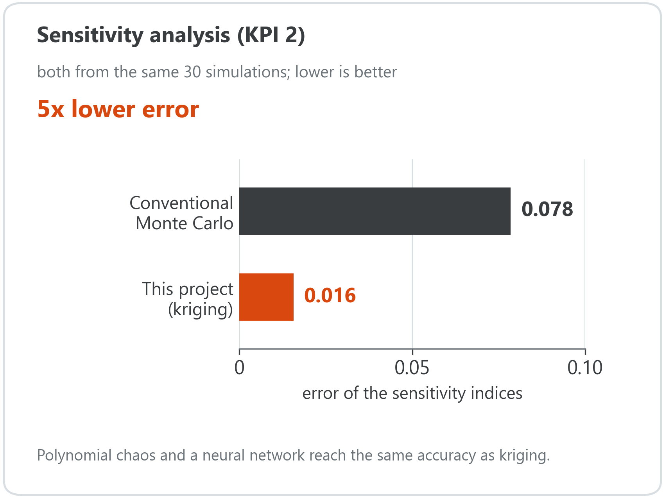
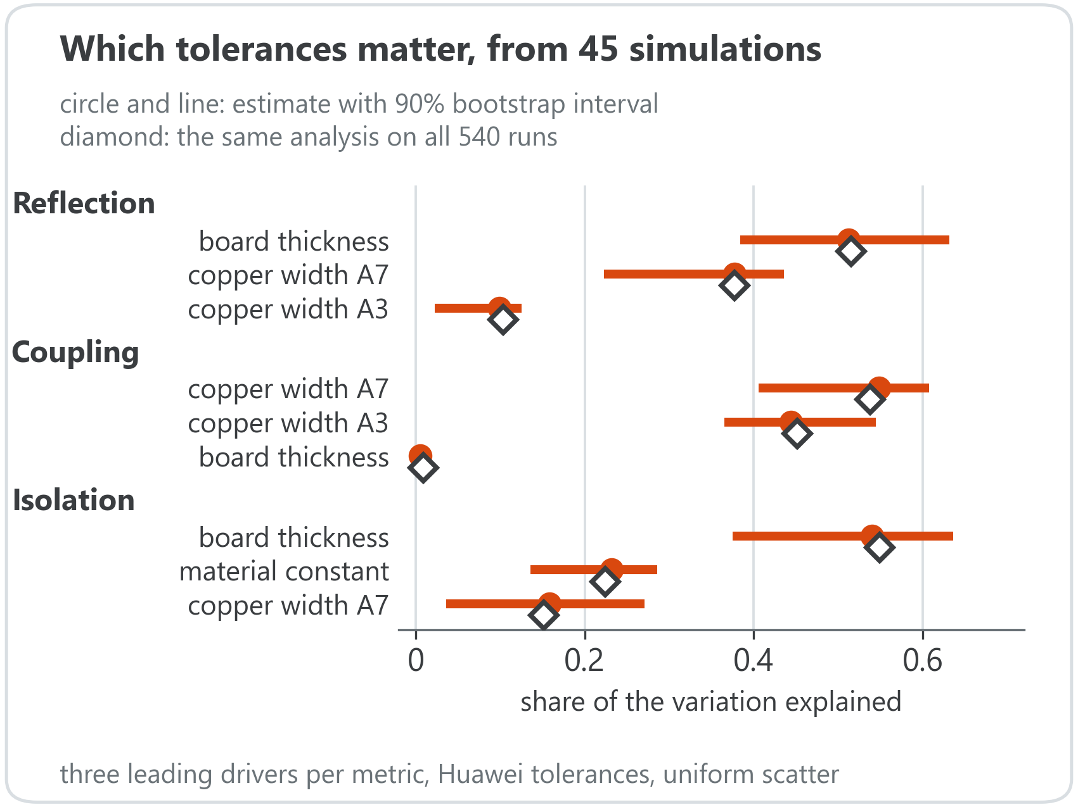
Thirty simulations find the tolerances that matter, with 5× lower error
Board thickness and copper widths A7 and A3 drive most of the variation: the tolerances worth tightening.
Notes:
Left: error of the sensitivity indices when both methods use the same 30 simulations, measured against a reference computed from all 540 simulations. Conventional Monte Carlo reaches 0.078, the kriging model 0.016, about five times lower; with 45 and 60 simulations the advantage is three to four times. Polynomial chaos and a neural network perform equivalently to kriging, so the gain is over the conventional approach named in the criterion. Right: the three leading tolerances per metric with 90% bootstrap intervals from 45 simulations. Board thickness and copper widths A7 and A3 dominate, and every interval contains the full-data value. These are the tolerances the design changes on slide 6 act on.

Slide 5
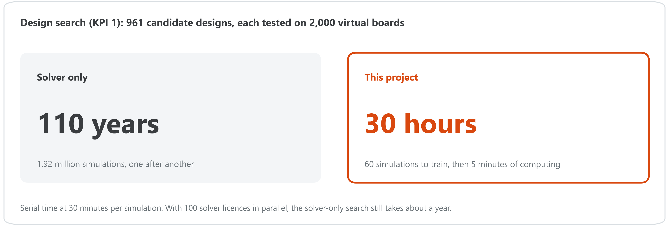
A 110-year design search now takes 30 hours
The same 60-simulation model also delivers the sensitivity analysis: no extra simulations needed.
Notes:
Serial solver time at 30 minutes per run, conventional workflow versus this pipeline. The design search evaluates 961 candidate designs, each on 2,000 simulated manufacturing realisations: 1.92 million surrogate evaluations, completed in about 5 minutes after the 60 training simulations. Even with 100 solver licences running in parallel, the conventional design search would still take about a year.

Slide 6
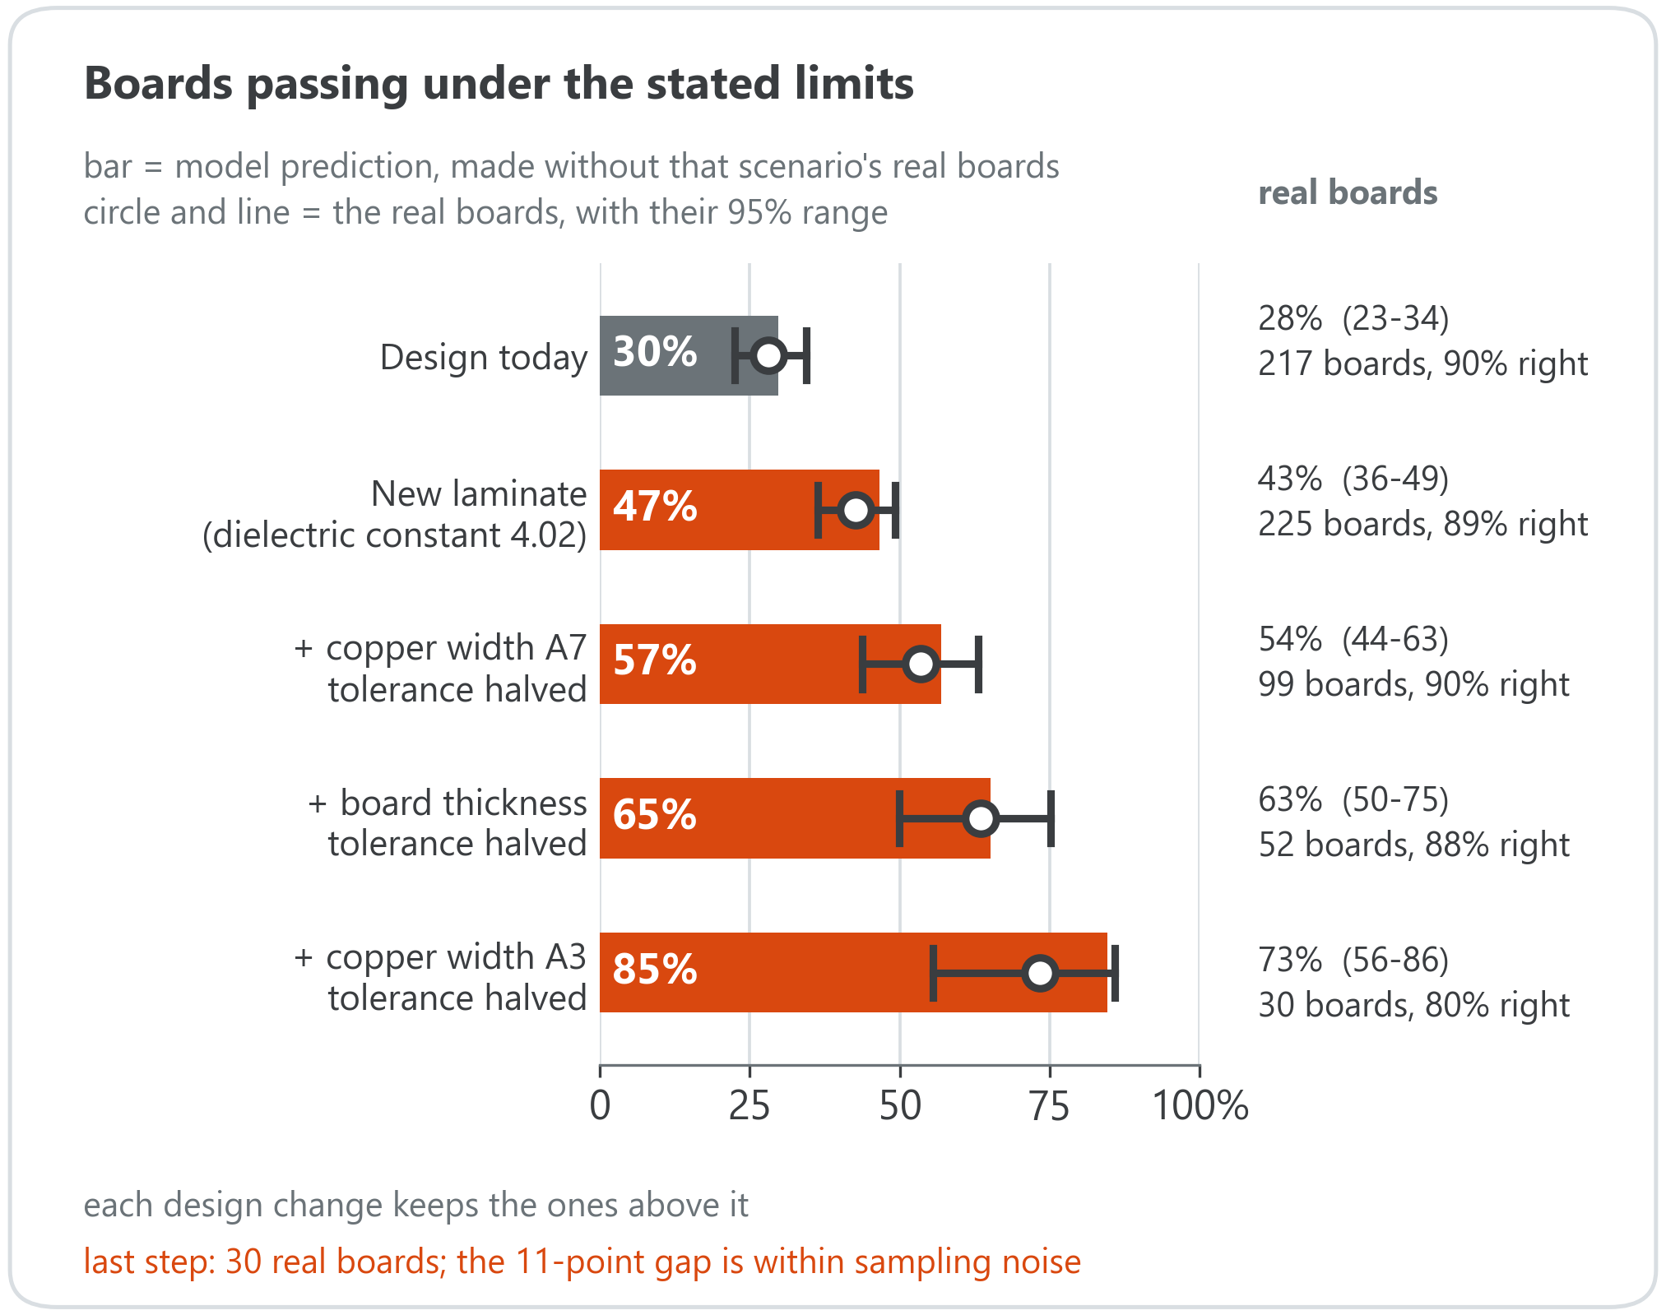
Four design changes lift the pass rate to 73–85%
Changes: higher laminate constant; tighter A7, board-thickness and A3 tolerances.
Each prediction was made without that scenario's real boards: 5 of 5 fall within the real range.
Holds when the illustrative limits are halved or tripled (92–97% agreement).
0 of 734 million predictions break the physics (passivity).
Notes:
The four changes act on the tolerances identified on slide 4: a laminate with a higher dielectric constant (4.02), then halved tolerances on copper width A7, board thickness and copper width A3. For each scenario, the real boards falling inside it were removed from training, the model was retrained, and its predicted pass rate was compared with those boards. All five predictions fall within the 95% range of the real boards. The final scenario rests on 30 boards: the model predicts 85%, the real boards show 73%, and the difference is within sampling uncertainty, hence the range 73-85%. The acceptance limits are illustrative, and pass/fail agreement remains 92-97% when they are halved or tripled. The full-curve model checked all 734 million predicted S-matrices across every study, and none violated passivity. Remaining limitations: model bias cannot be separated from sampling noise with the available boards, the stack-up is confidential, and no additional solver runs were available to confirm the proposed design.

Slide 7
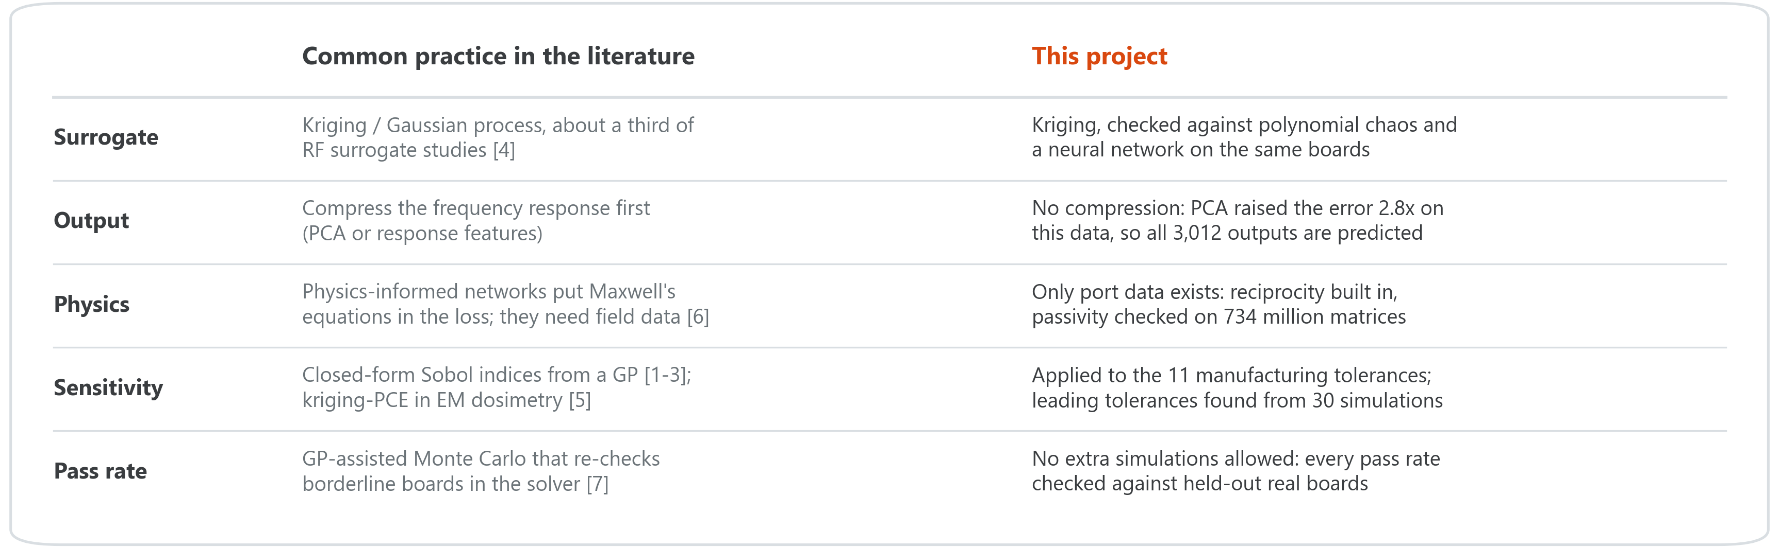
Established methods, applied with physics checks and real-board validation
[1] Oakley & O'Hagan (2004), J. R. Stat. Soc. B 66(3)
[2] Marrel et al. (2009), Reliab. Eng. Syst. Saf. 94(3)
[3] Le Gratiet, Cannamela & Iooss (2014), SIAM/ASA J. Uncertain. Quantif.
[4] Systematic review, surrogate-based EM design of RF components (2026), Sensors 26(8):2504
[5] Kersaudy et al. (2015), J. Comput. Phys. 286:103-117
[6] Khan & Lowther (2022), IEEE Trans. Magn. 58(9)
[7] Fuhrländer & Schöps (2020), J. Math. Ind. 10
Notes:
Kriging is well established for electromagnetic surrogate modelling, and closed-form Sobol indices from Gaussian processes are known in statistics. The contribution of this work lies in how these methods are applied and verified: physics is enforced at the port level because no field data were available, the literature's default compression (PCA) was tested and rejected on this data, and every result was validated against real boards held out from training rather than against additional simulations.

Slide 8

Project folder
Scan to open the full material
README: pipeline, evidence and limitations
Code that reproduces every number
Stored results of every study
github.com/BuseDuygun22/rf-tolerance-surrogates
Notes:
The repository contains the code that reproduces every figure and number in this presentation, the stored results of each study, and a README describing the pipeline, the validation and the limitations. The Huawei dataset is not included.

Slide 9
THANK YOU
From 277 days of solver time to 15 hours – with the physics checked on every prediction.
60 simulations · exact sensitivity analysis · pass rates checked on held-out real boards
Notes:
In summary: 277 days of solver time are reduced to 15 hours, the 110-year design search to about 30 hours, and every one of 734 million predicted S-matrices satisfies the physical constraints.

