Slide 1
HUAWEI TECH ARENA 2026 SUB-TOPIC 3
The physics behind the project
What the device does, what your data measures, and why a fast model of it answers the two things the competition marks.

Slide 2
PART 1
What the device actually is

Slide 3
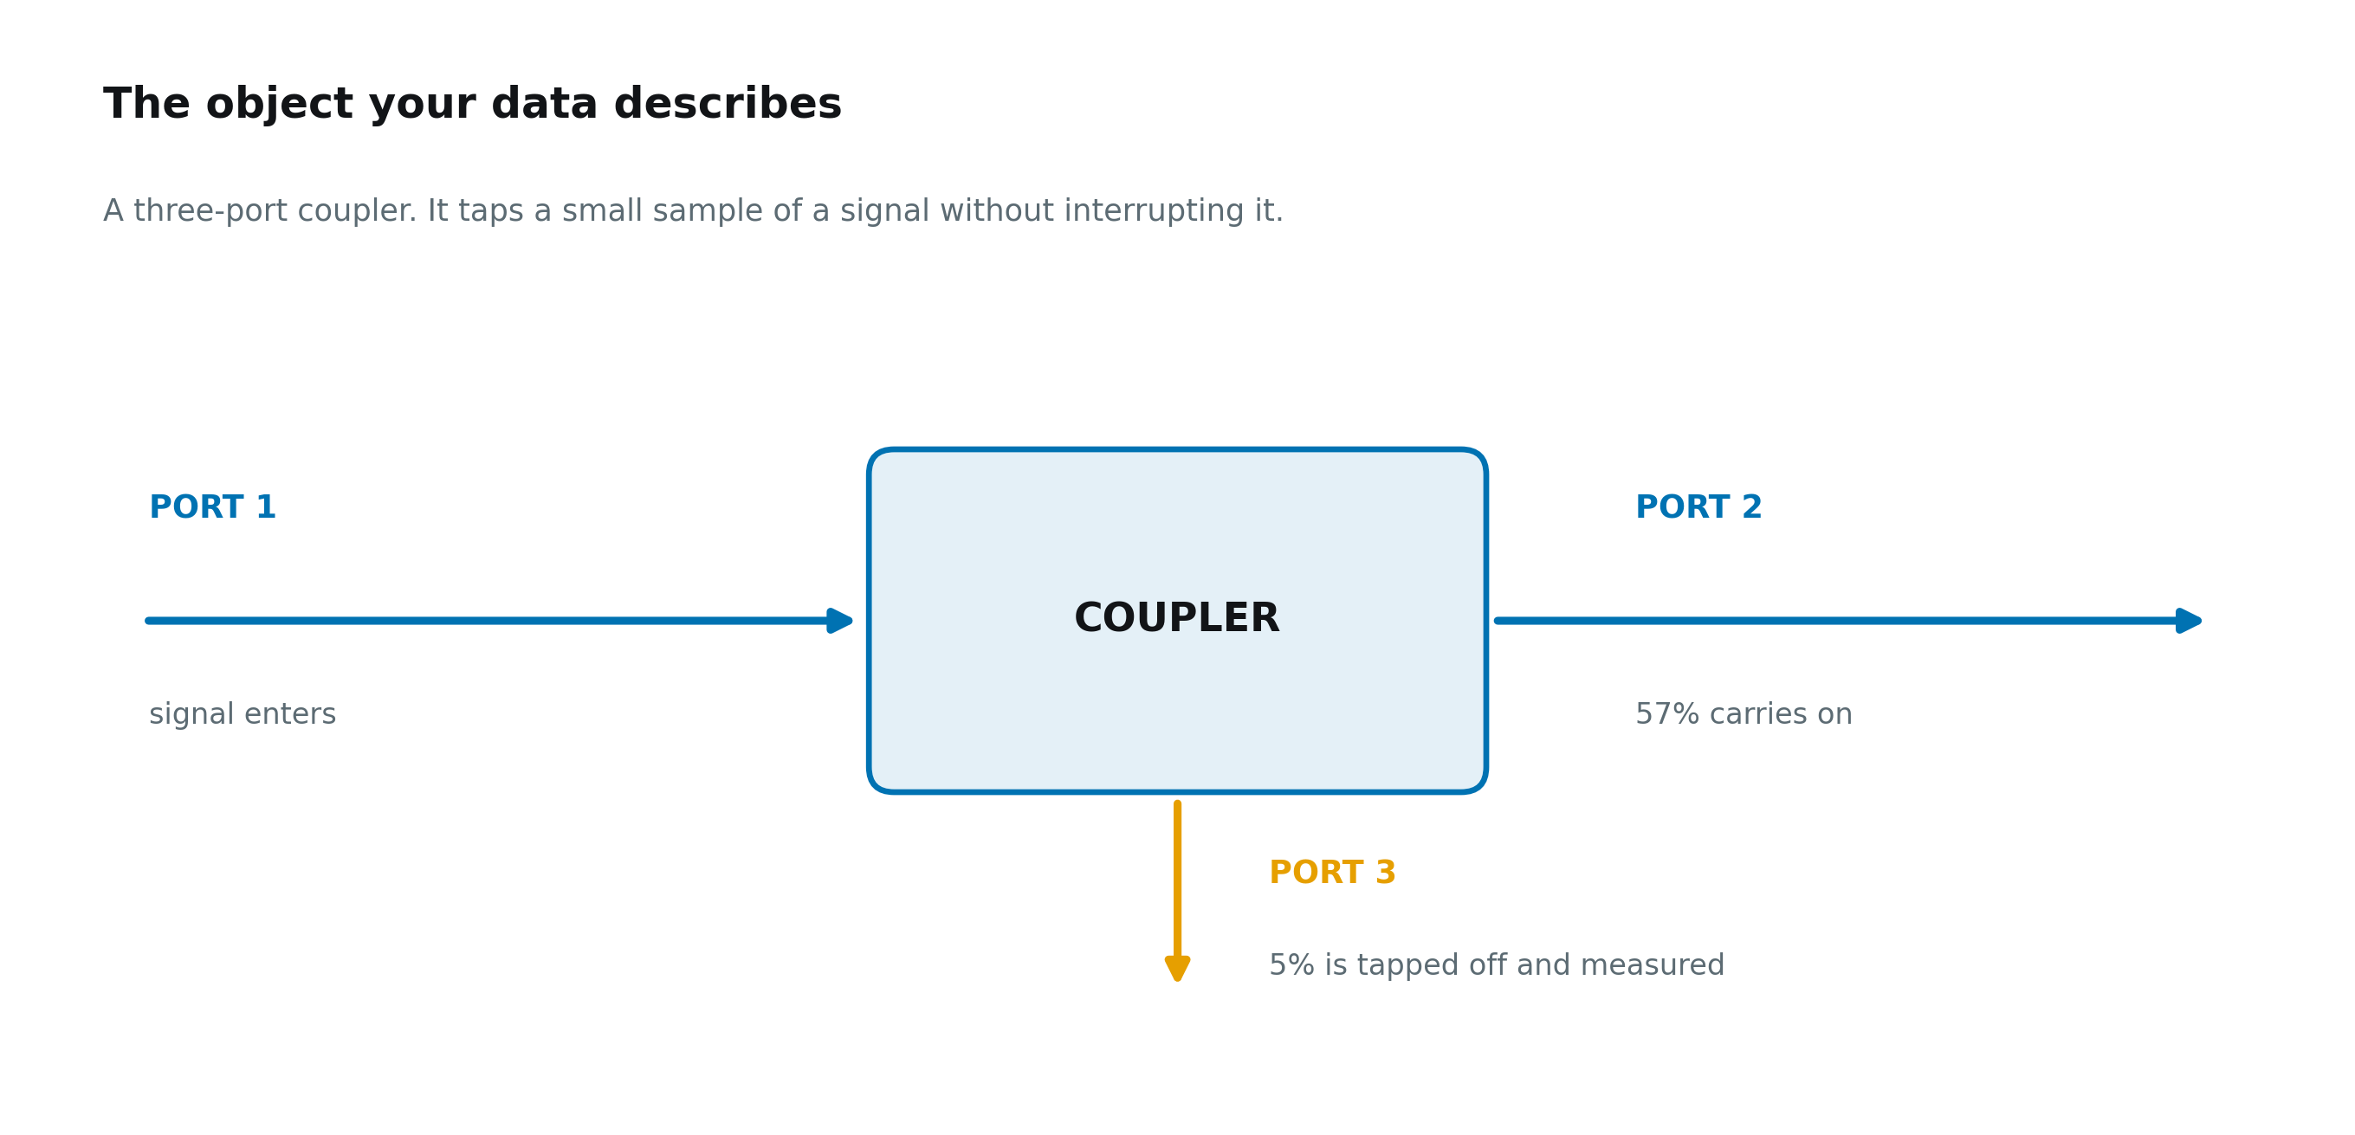
A three-port coupler
Signal enters port 1. Most of it carries on to port 2. A small, known fraction is tapped off at port 3, so equipment can monitor the signal without interrupting it.
Notes:
Signal enters port 1. Most of it carries on to port 2. A small, known fraction is tapped off at port 3, so equipment can monitor the signal without interrupting it.

Slide 4
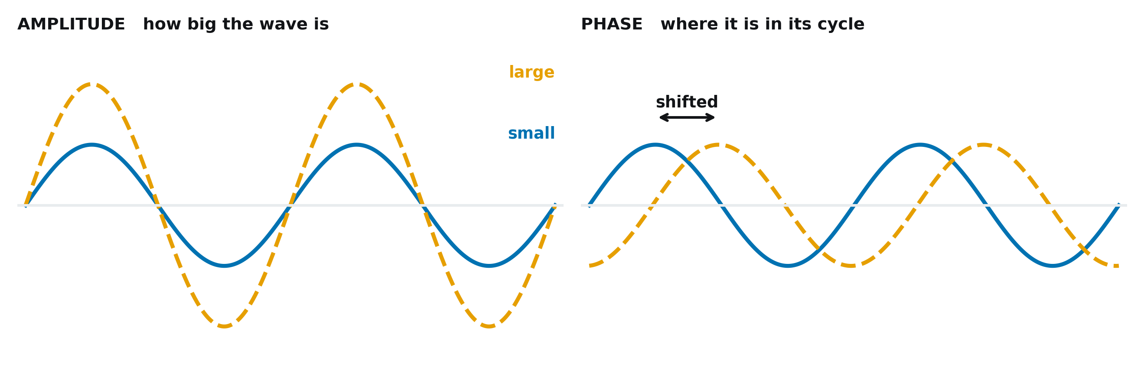
A radio signal is a wave
Only two properties matter. How big the wave is, and where it sits in its cycle. Everything your file records is one of those two.
Notes:
Only two properties matter. How big the wave is, and where it sits in its cycle. Everything your file records is one of those two.

Slide 5
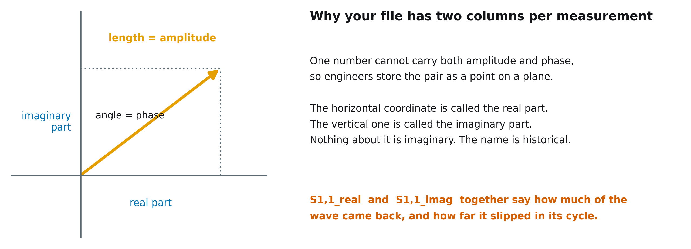
Why every measurement has two columns
One number cannot carry both amplitude and phase, so the pair is stored as a point on a plane. The names real and imaginary are historical, not physical.
Notes:
One number cannot carry both amplitude and phase, so the pair is stored as a point on a plane. The names real and imaginary are historical, not physical.

Slide 6
PART 2
What your file measures

Slide 7
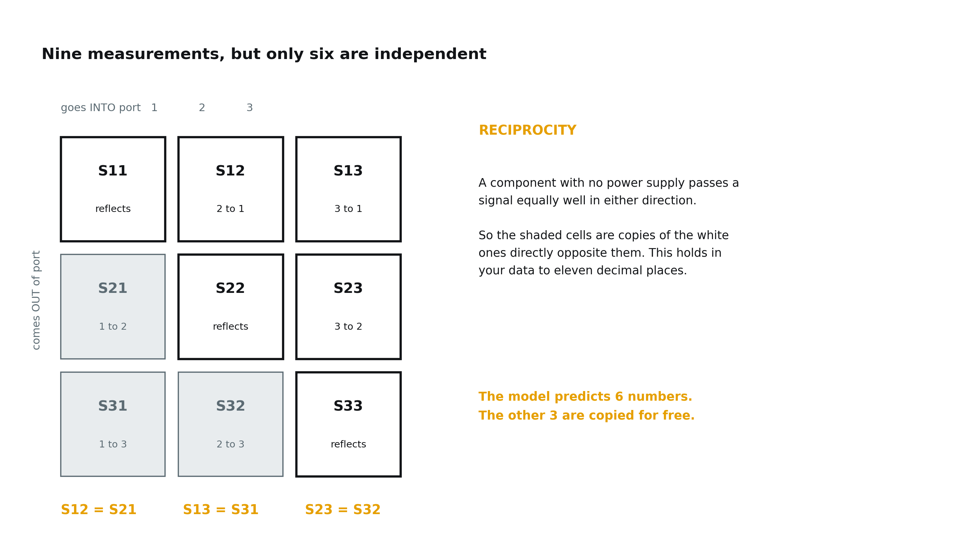
Nine measurements, six of them independent
S followed by two digits. The second digit is the port the signal went into, the first is the port it came out of. Reciprocity makes three of the nine free.
Notes:
S followed by two digits. The second digit is the port the signal went into, the first is the port it came out of. Reciprocity makes three of the nine free.

Slide 8
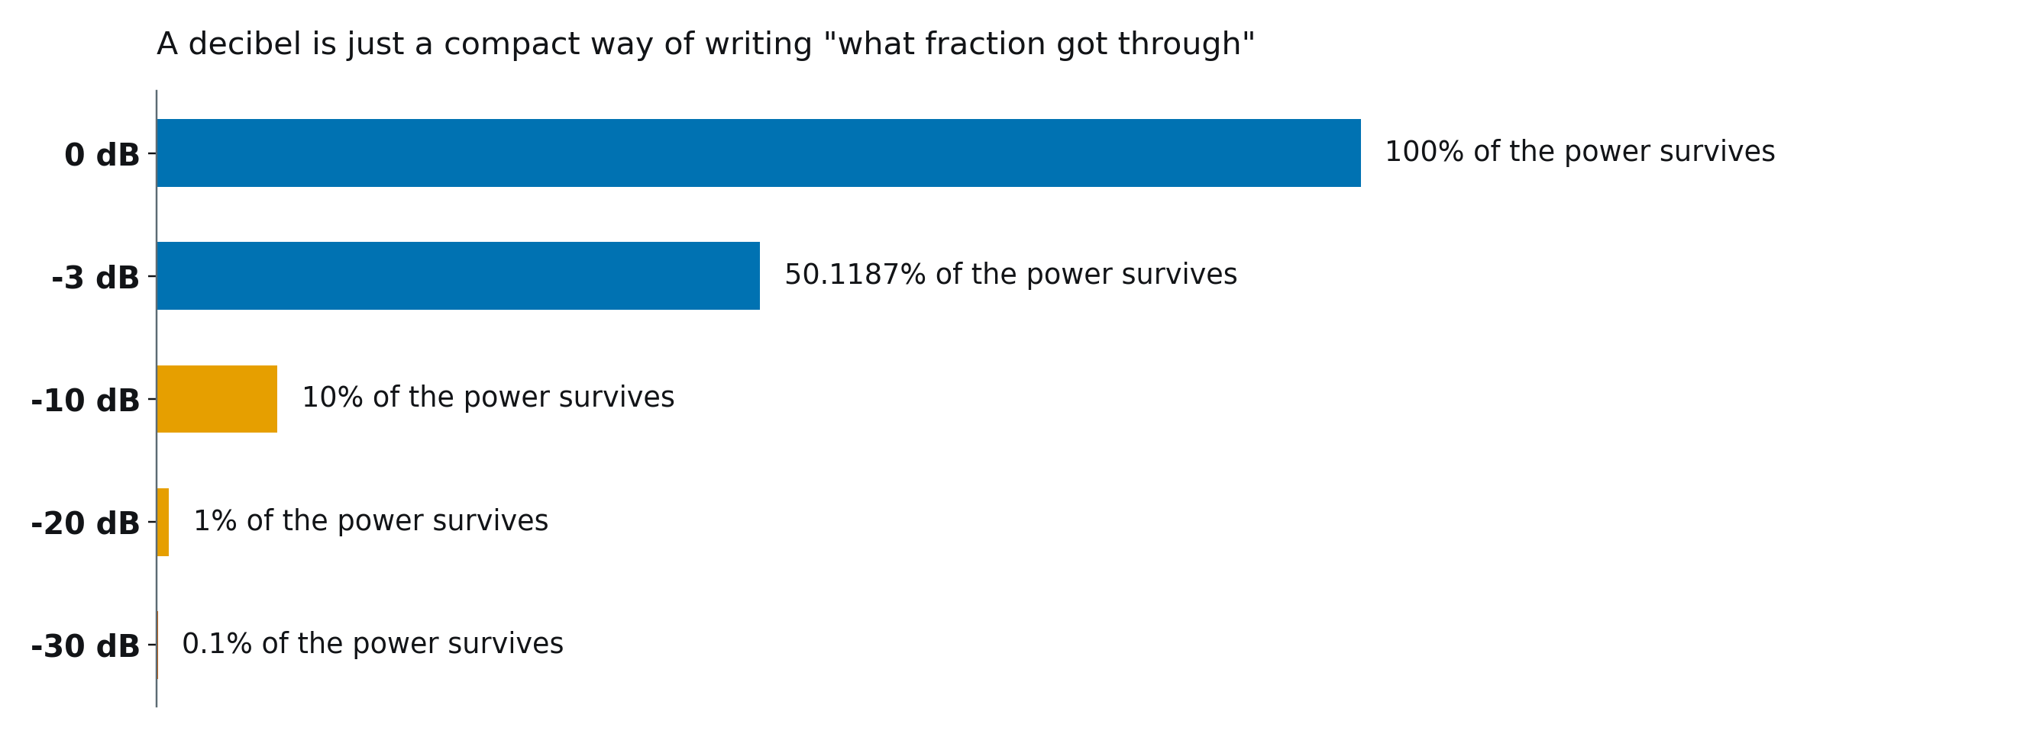
Decibels
A compact way of writing what fraction of the power survived. Always negative for a component with no power supply, because you never get out more than you put in.
Notes:
A compact way of writing what fraction of the power survived. Always negative for a component with no power supply, because you never get out more than you put in.

Slide 9
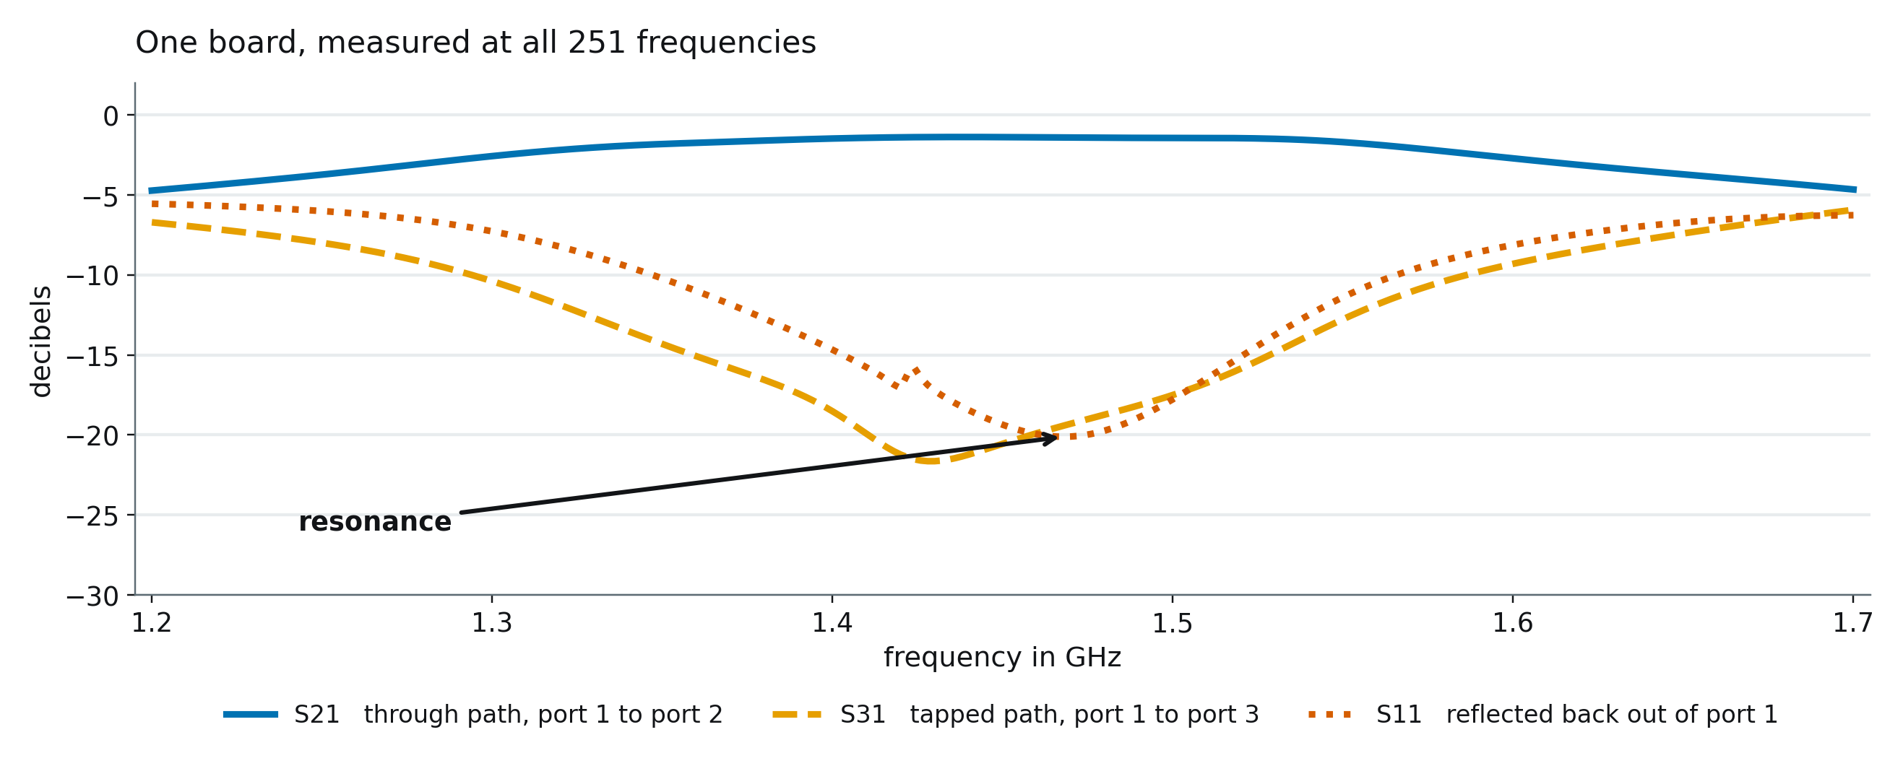
One board, swept across frequency
The device behaves differently at every frequency, so each design is measured at 251 of them. The dip is the resonance the design is tuned around.
Notes:
The device behaves differently at every frequency, so each design is measured at 251 of them. The dip is the resonance the design is tuned around.

Slide 10
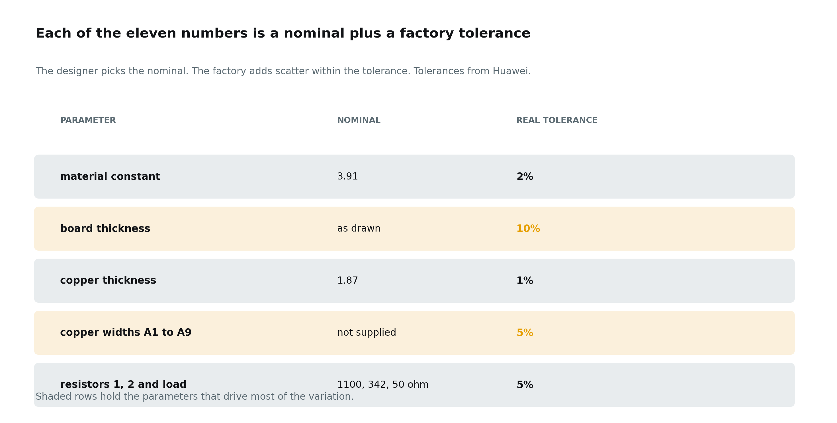
The eleven numbers that describe one board
Each is a nominal the designer picks plus a tolerance the factory adds. Huawei supplied the real tolerances, and every study now uses them.
Notes:
Each is a nominal the designer picks plus a tolerance the factory adds. Huawei supplied the real tolerances, and every study now uses them.

Slide 11
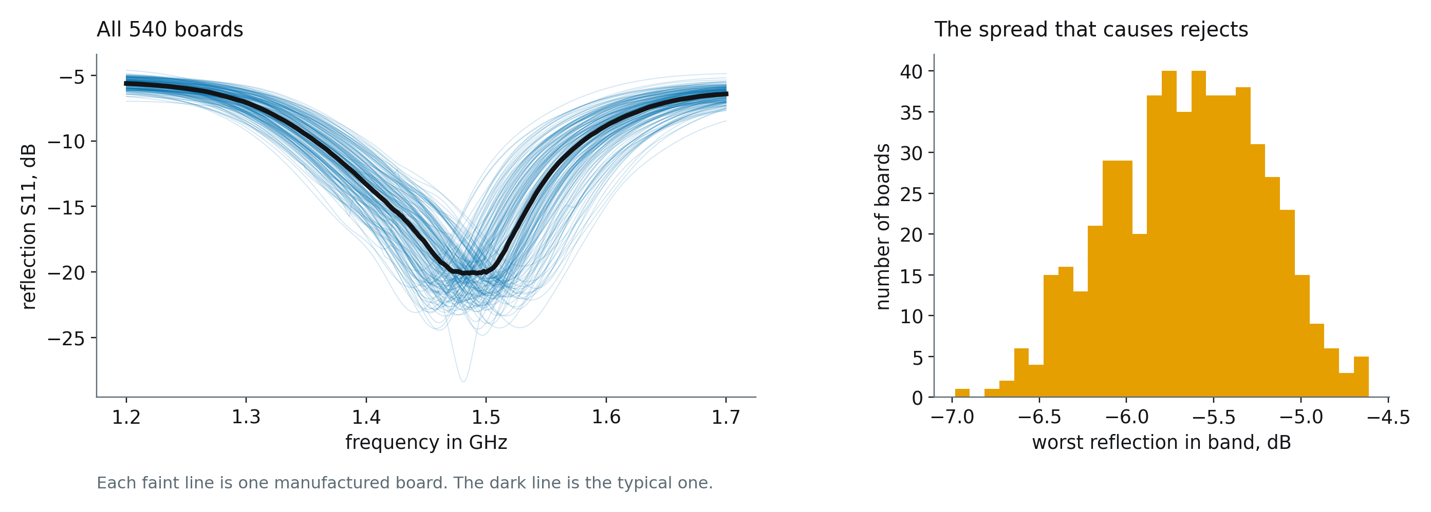
Why manufacturing tolerance matters
Identical drawings, 540 different boards. Etching, thickness and material all vary, and some of the resulting boards will fail specification.
Notes:
Identical drawings, 540 different boards. Etching, thickness and material all vary, and some of the resulting boards will fail specification.

Slide 12
PART 3
The physics we can exploit

Slide 13
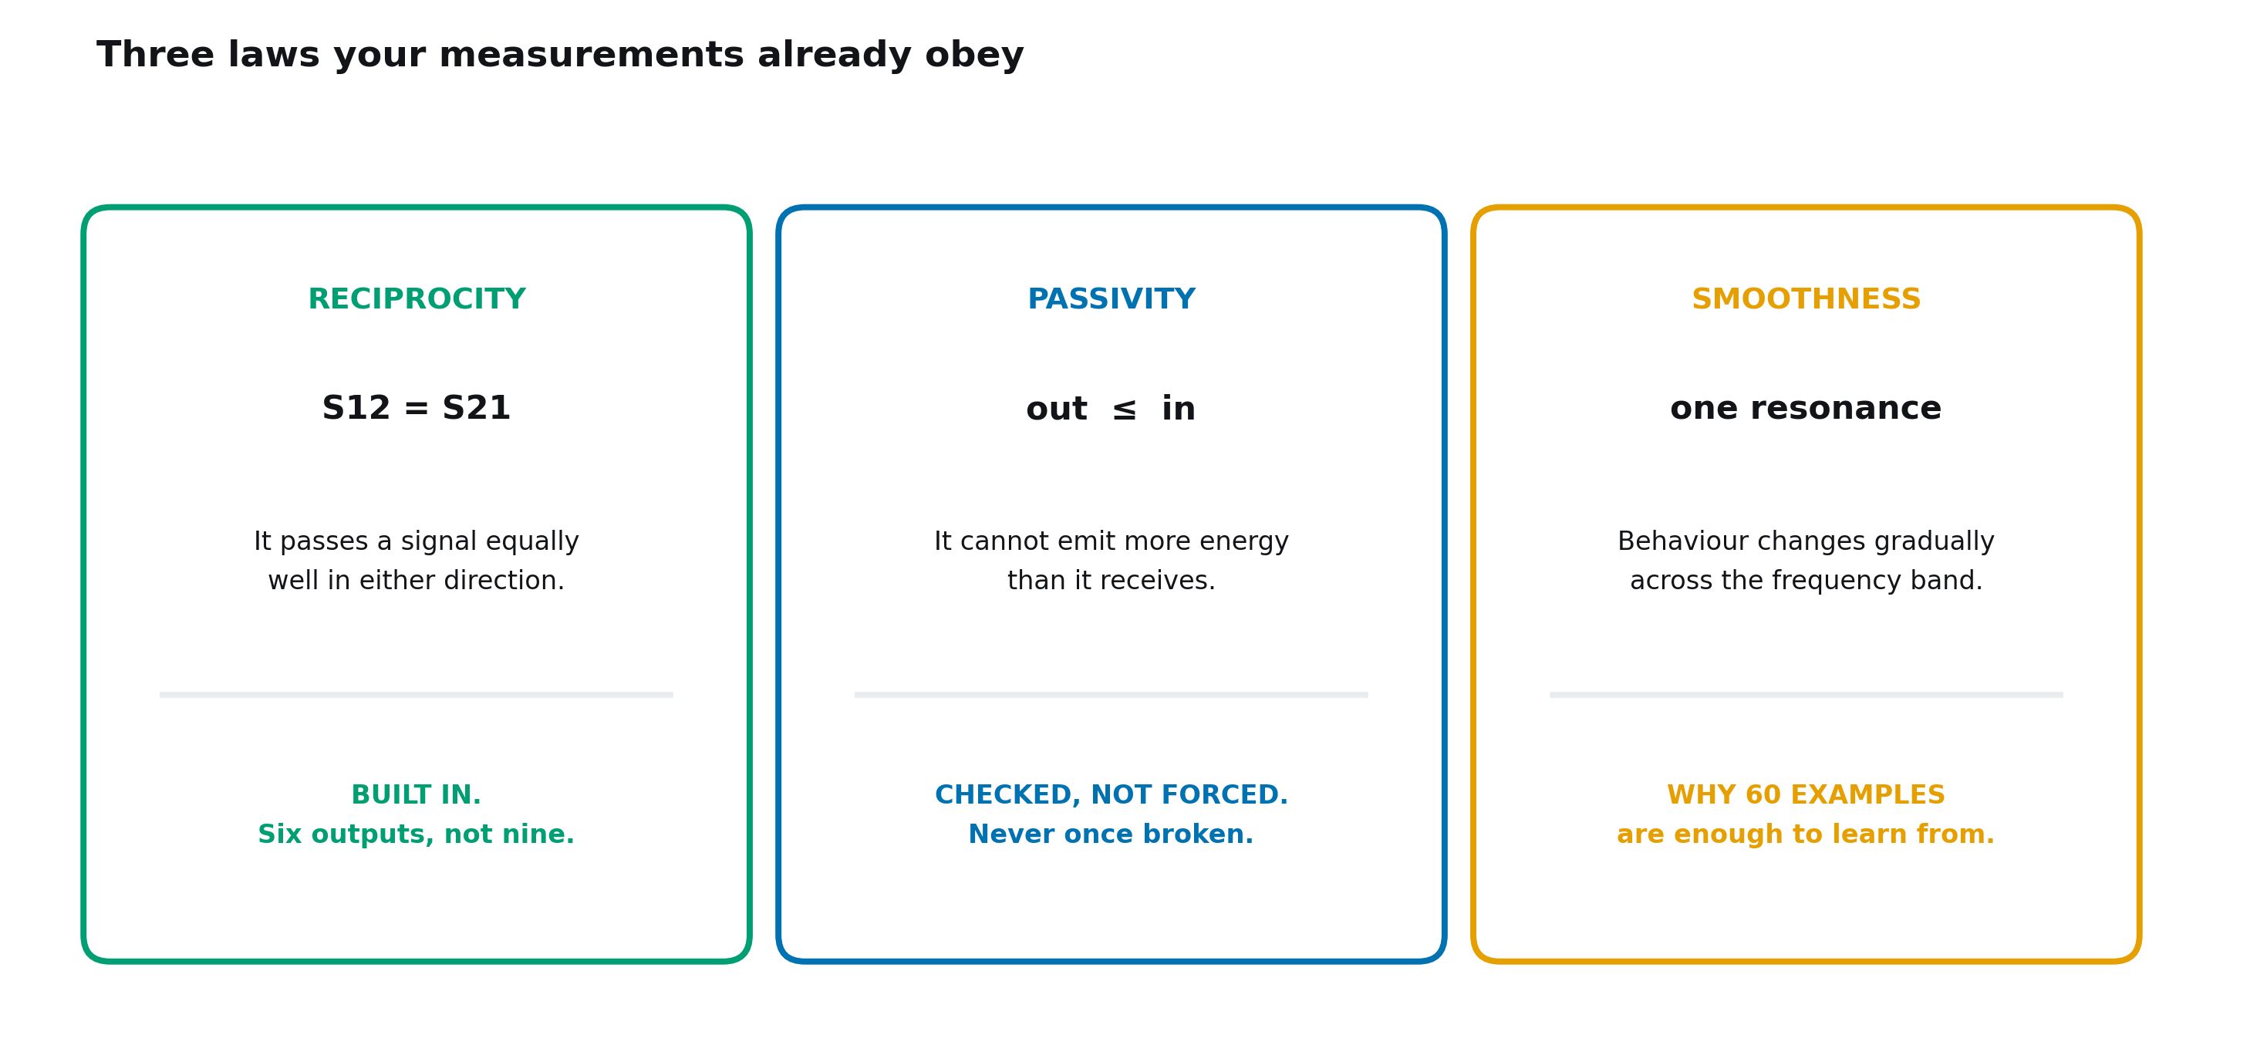
Three laws your measurements already obey
Each one is a constraint the model can respect by construction rather than learn from scratch. Testing whether each actually helps is part of the contribution.
Notes:
Each one is a constraint the model can respect by construction rather than learn from scratch. Testing whether each actually helps is part of the contribution.

Slide 14
PART 4
The project itself

Slide 15
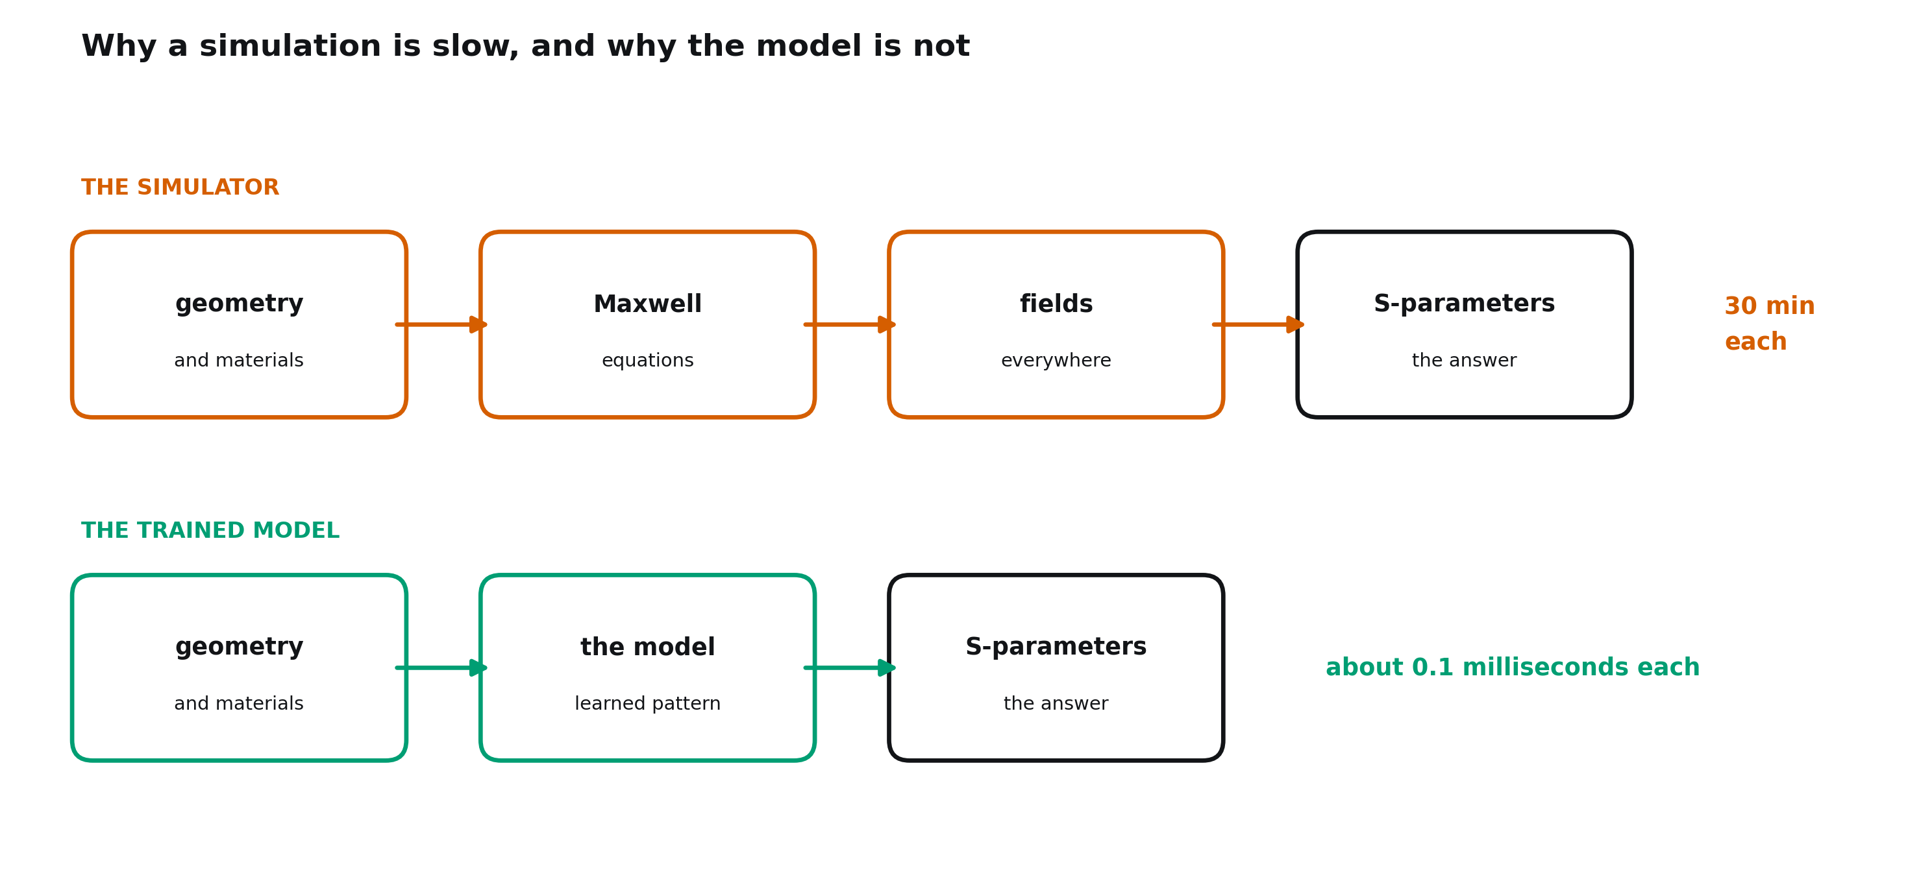
Why simulation is slow, and the model is not
One simulation takes 30 minutes. The model never solves Maxwell. It learned the pattern from examples that did, and answers in about a tenth of a millisecond.
Notes:
One simulation takes 30 minutes. The model never solves Maxwell. It learned the pattern from examples that did, and answers in about a tenth of a millisecond.

Slide 16
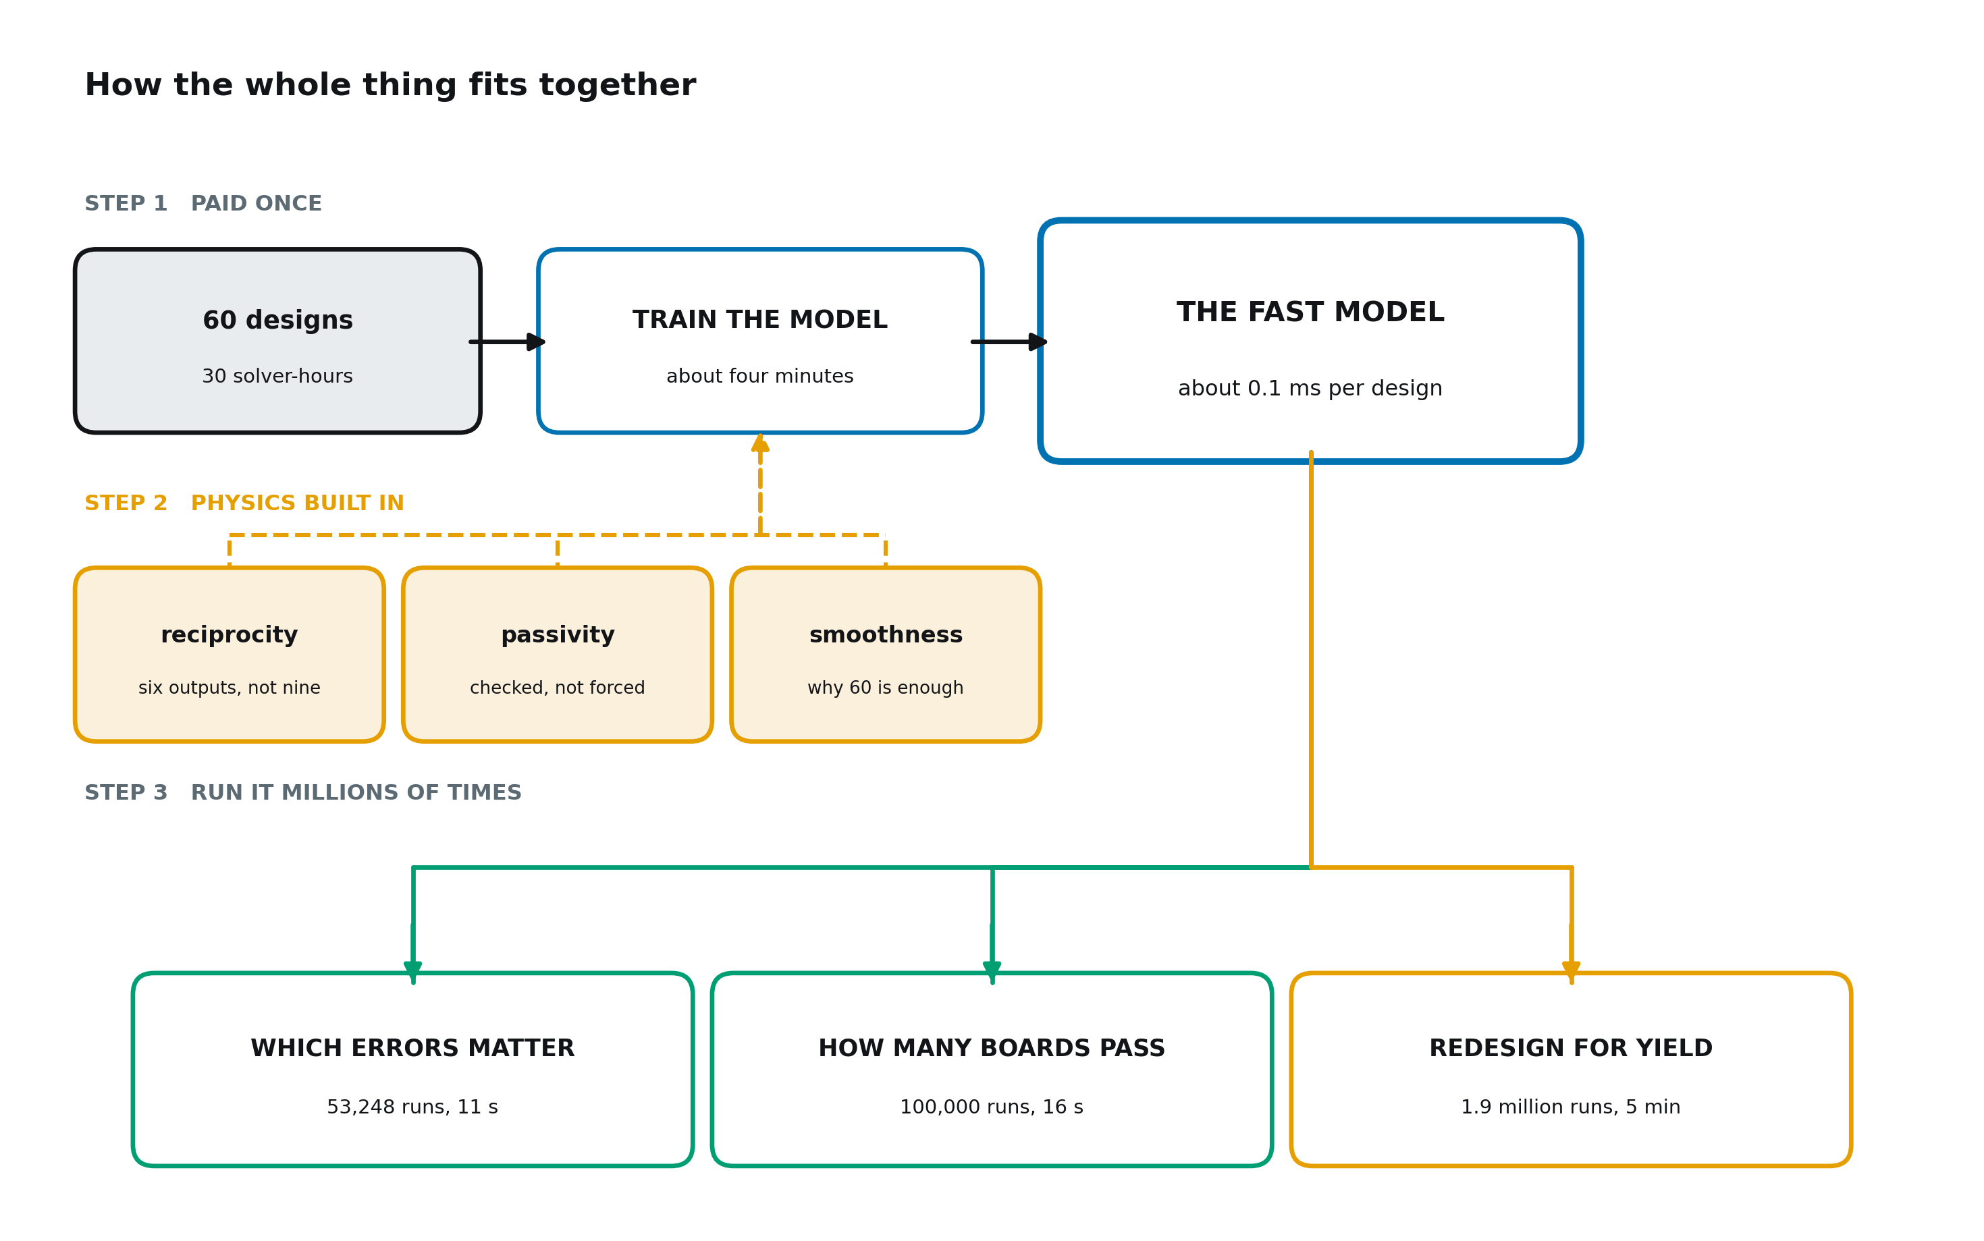
How the whole thing fits together
Pay for a small number of simulations once, train once, then ask the model millions of questions that were previously unaffordable.
Notes:
Pay for a small number of simulations once, train once, then ask the model millions of questions that were previously unaffordable.

Slide 17
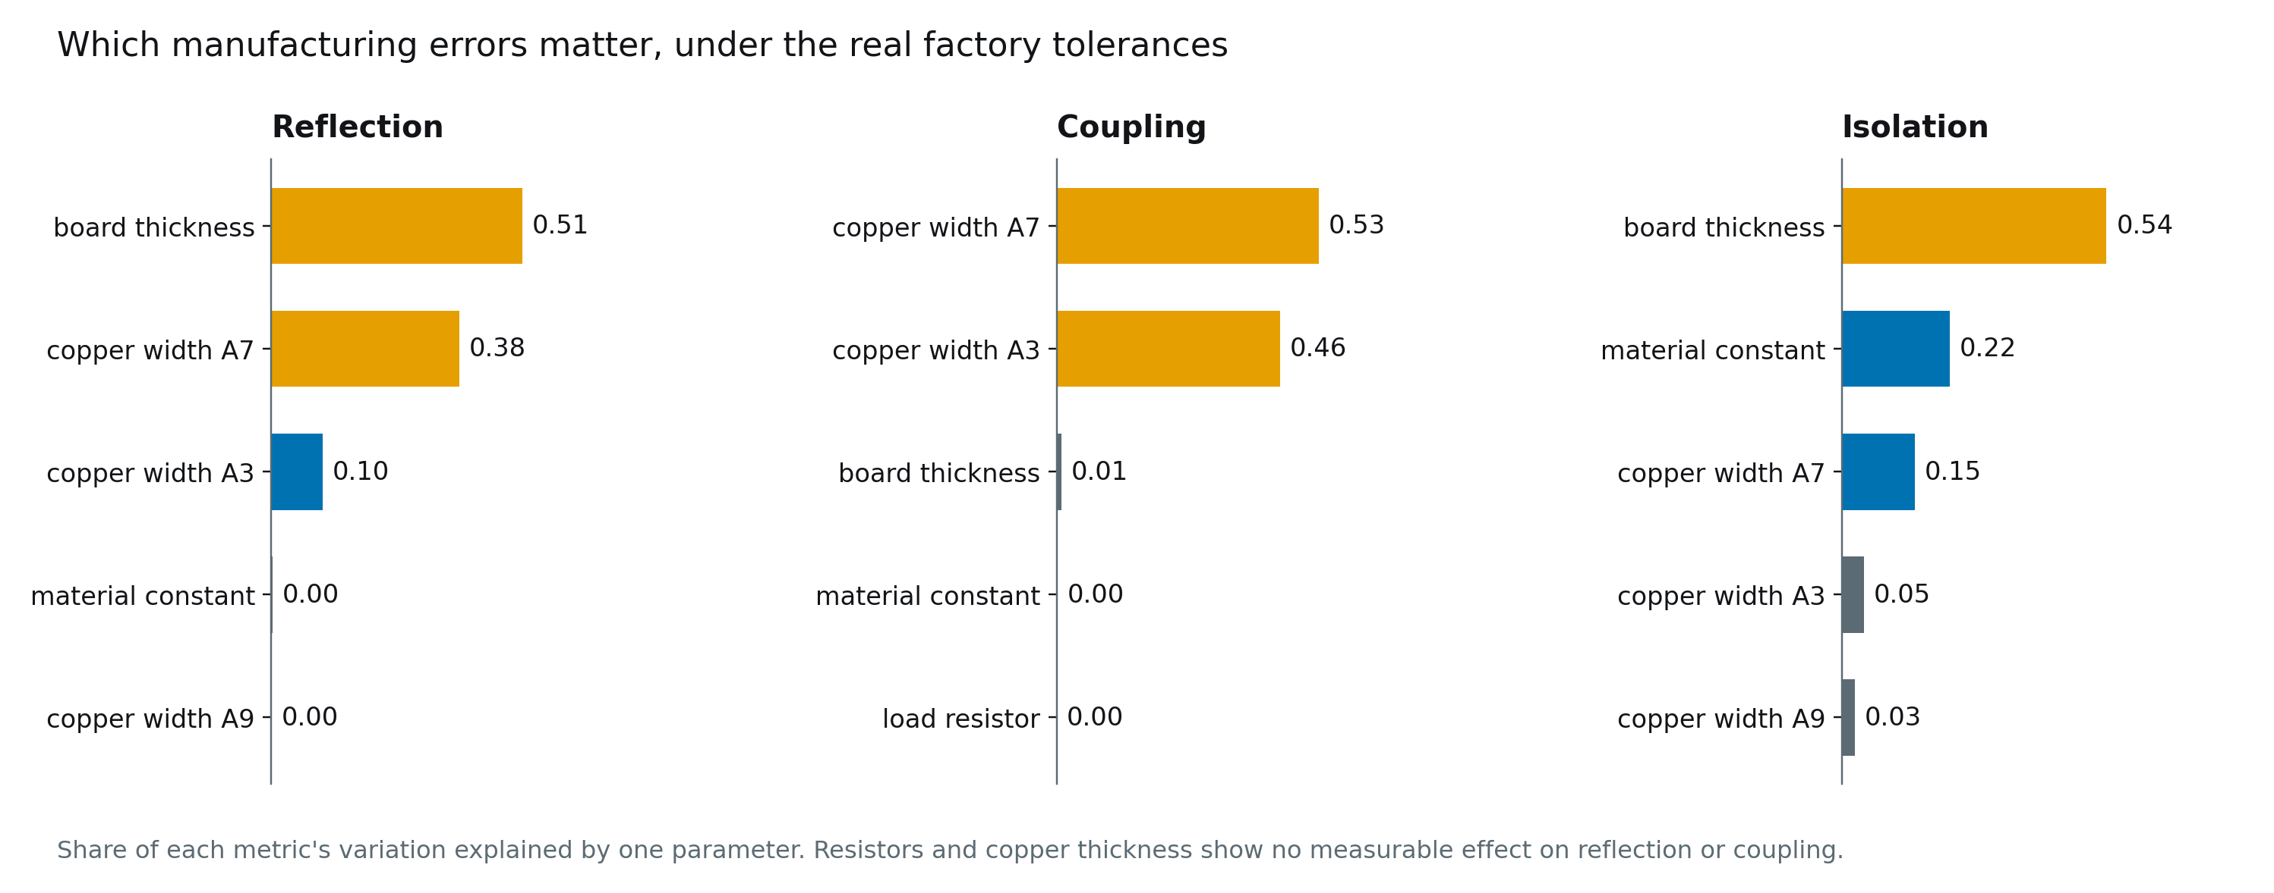
Which manufacturing errors actually matter
Under the real tolerances, board thickness and copper width A7 still explain 89 percent of reflection. For isolation the material constant fell to second place.
Notes:
Under the real tolerances, board thickness and copper width A7 still explain 89 percent of reflection. For isolation the material constant fell to second place.

Slide 18
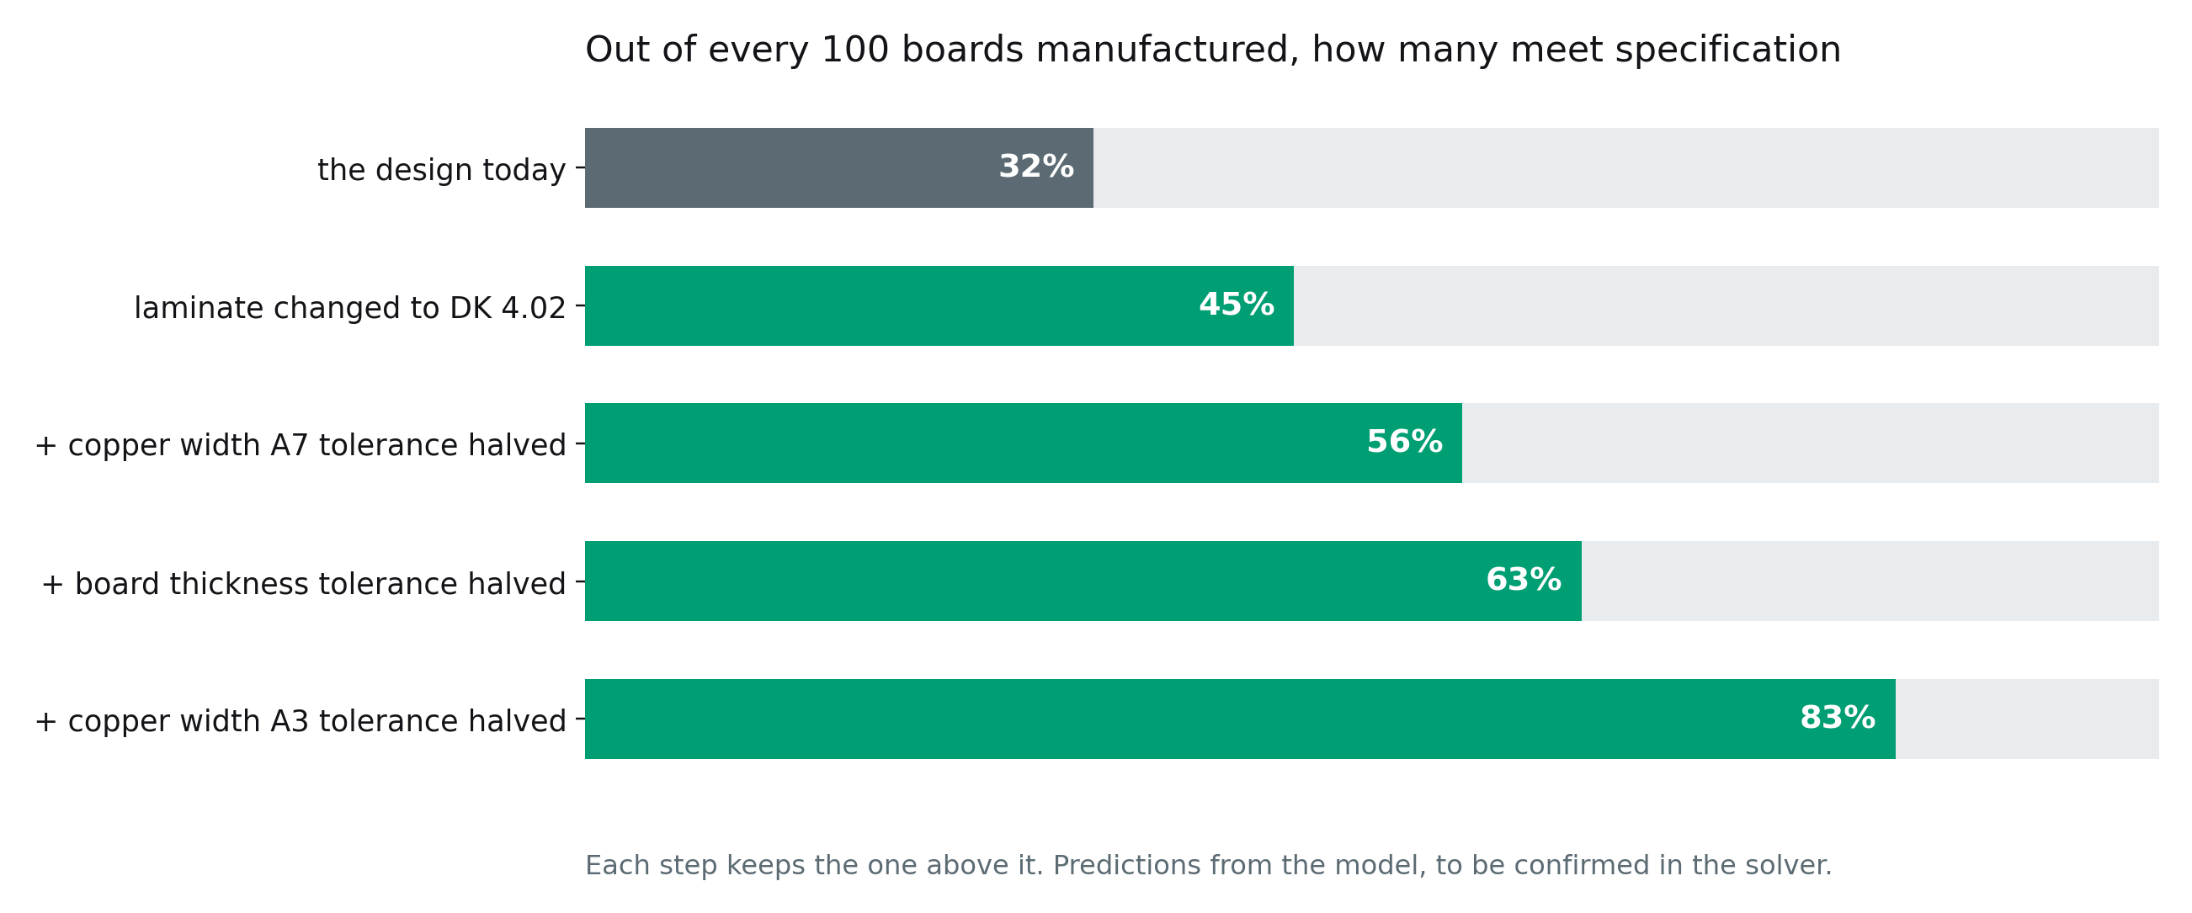
How many boards pass, and how to raise it
A laminate change takes the pass rate from 32 to 45 percent. Halving three tolerances takes it to 83. Predictions, still to be confirmed in the solver.
Notes:
A laminate change takes the pass rate from 32 to 45 percent. Halving three tolerances takes it to 83. Predictions, still to be confirmed in the solver.

Slide 19
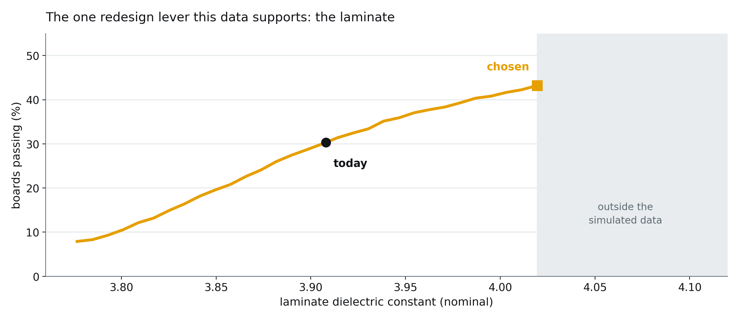
The redesign lever: the laminate
A higher dielectric constant cuts isolation failures from 24 to 3 percent. The best value sits at the edge of the data, so higher values need new simulations.
Notes:
A higher dielectric constant cuts isolation failures from 24 to 3 percent. The best value sits at the edge of the data, so higher values need new simulations.

Slide 20
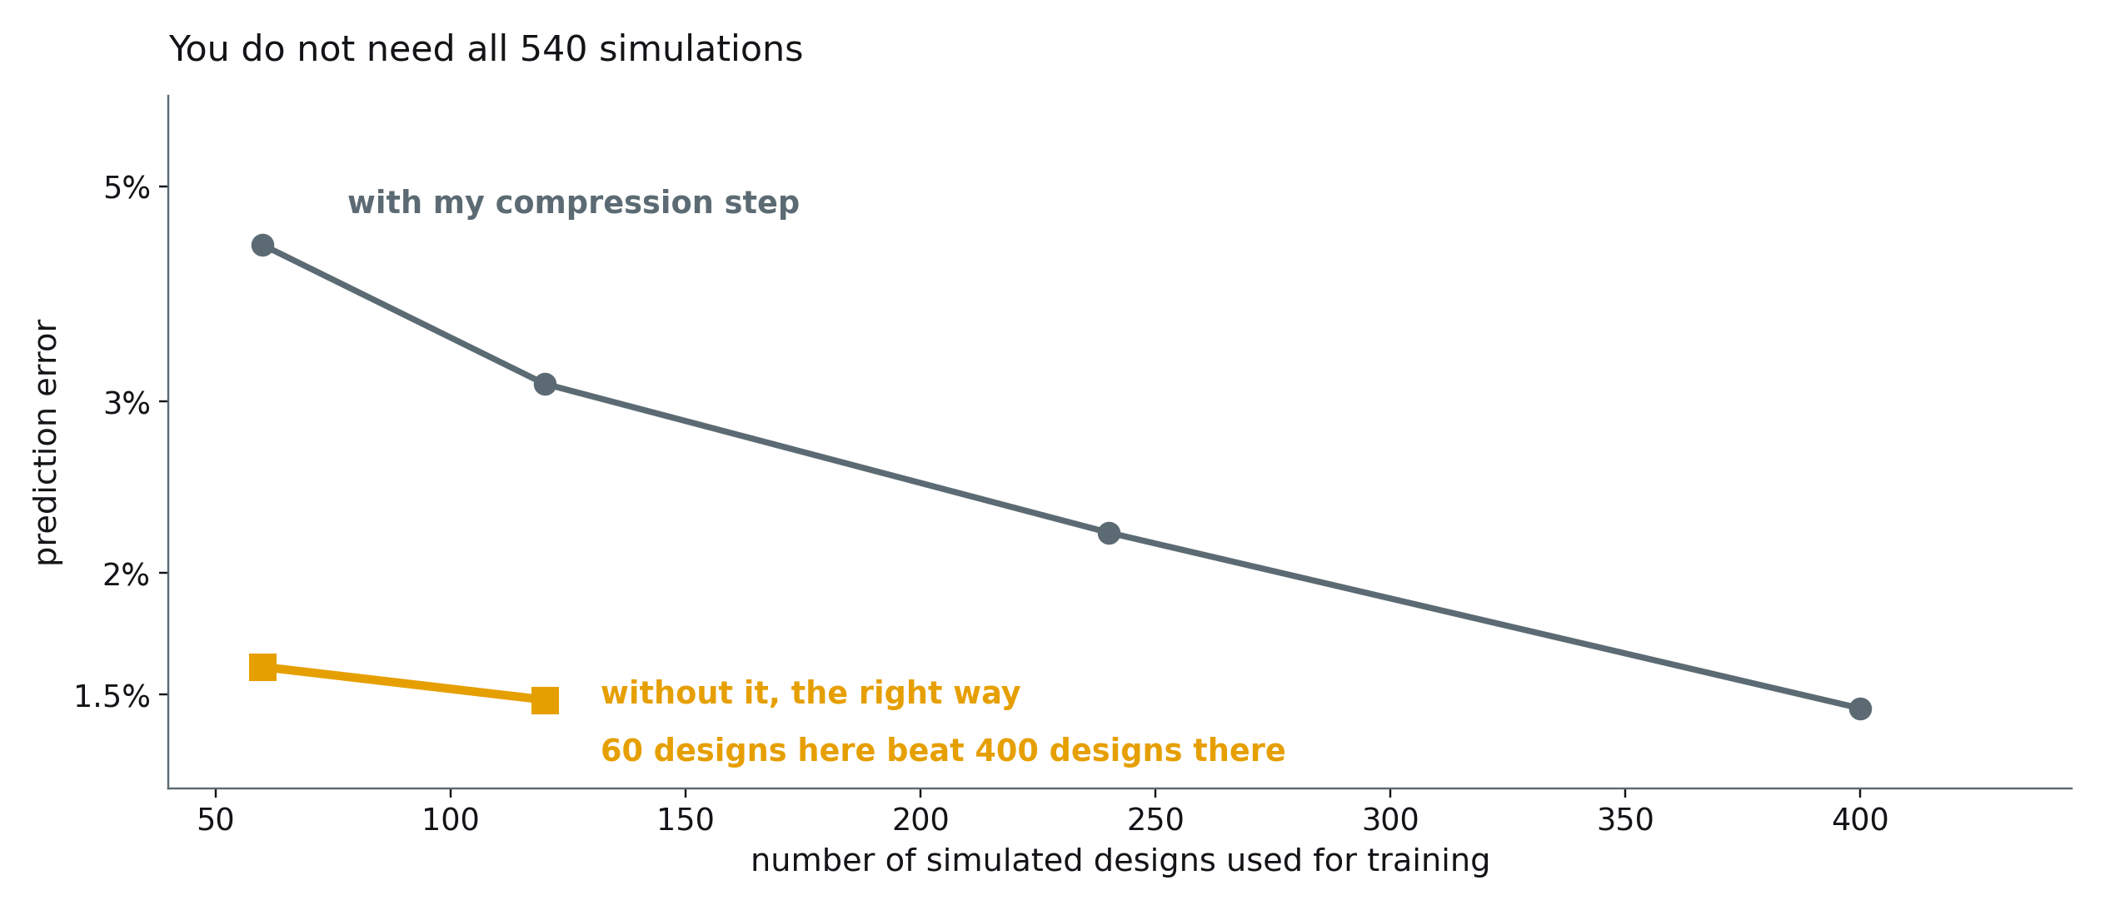
You do not need all 540 simulations
Sixty designs is enough for engineering accuracy. Needing one ninth of the supplied data is itself an answer to a challenge the brief names.
Notes:
Sixty designs is enough for engineering accuracy. Needing one ninth of the supplied data is itself an answer to a challenge the brief names.

Slide 21
PART 5
What Huawei answered

Slide 22
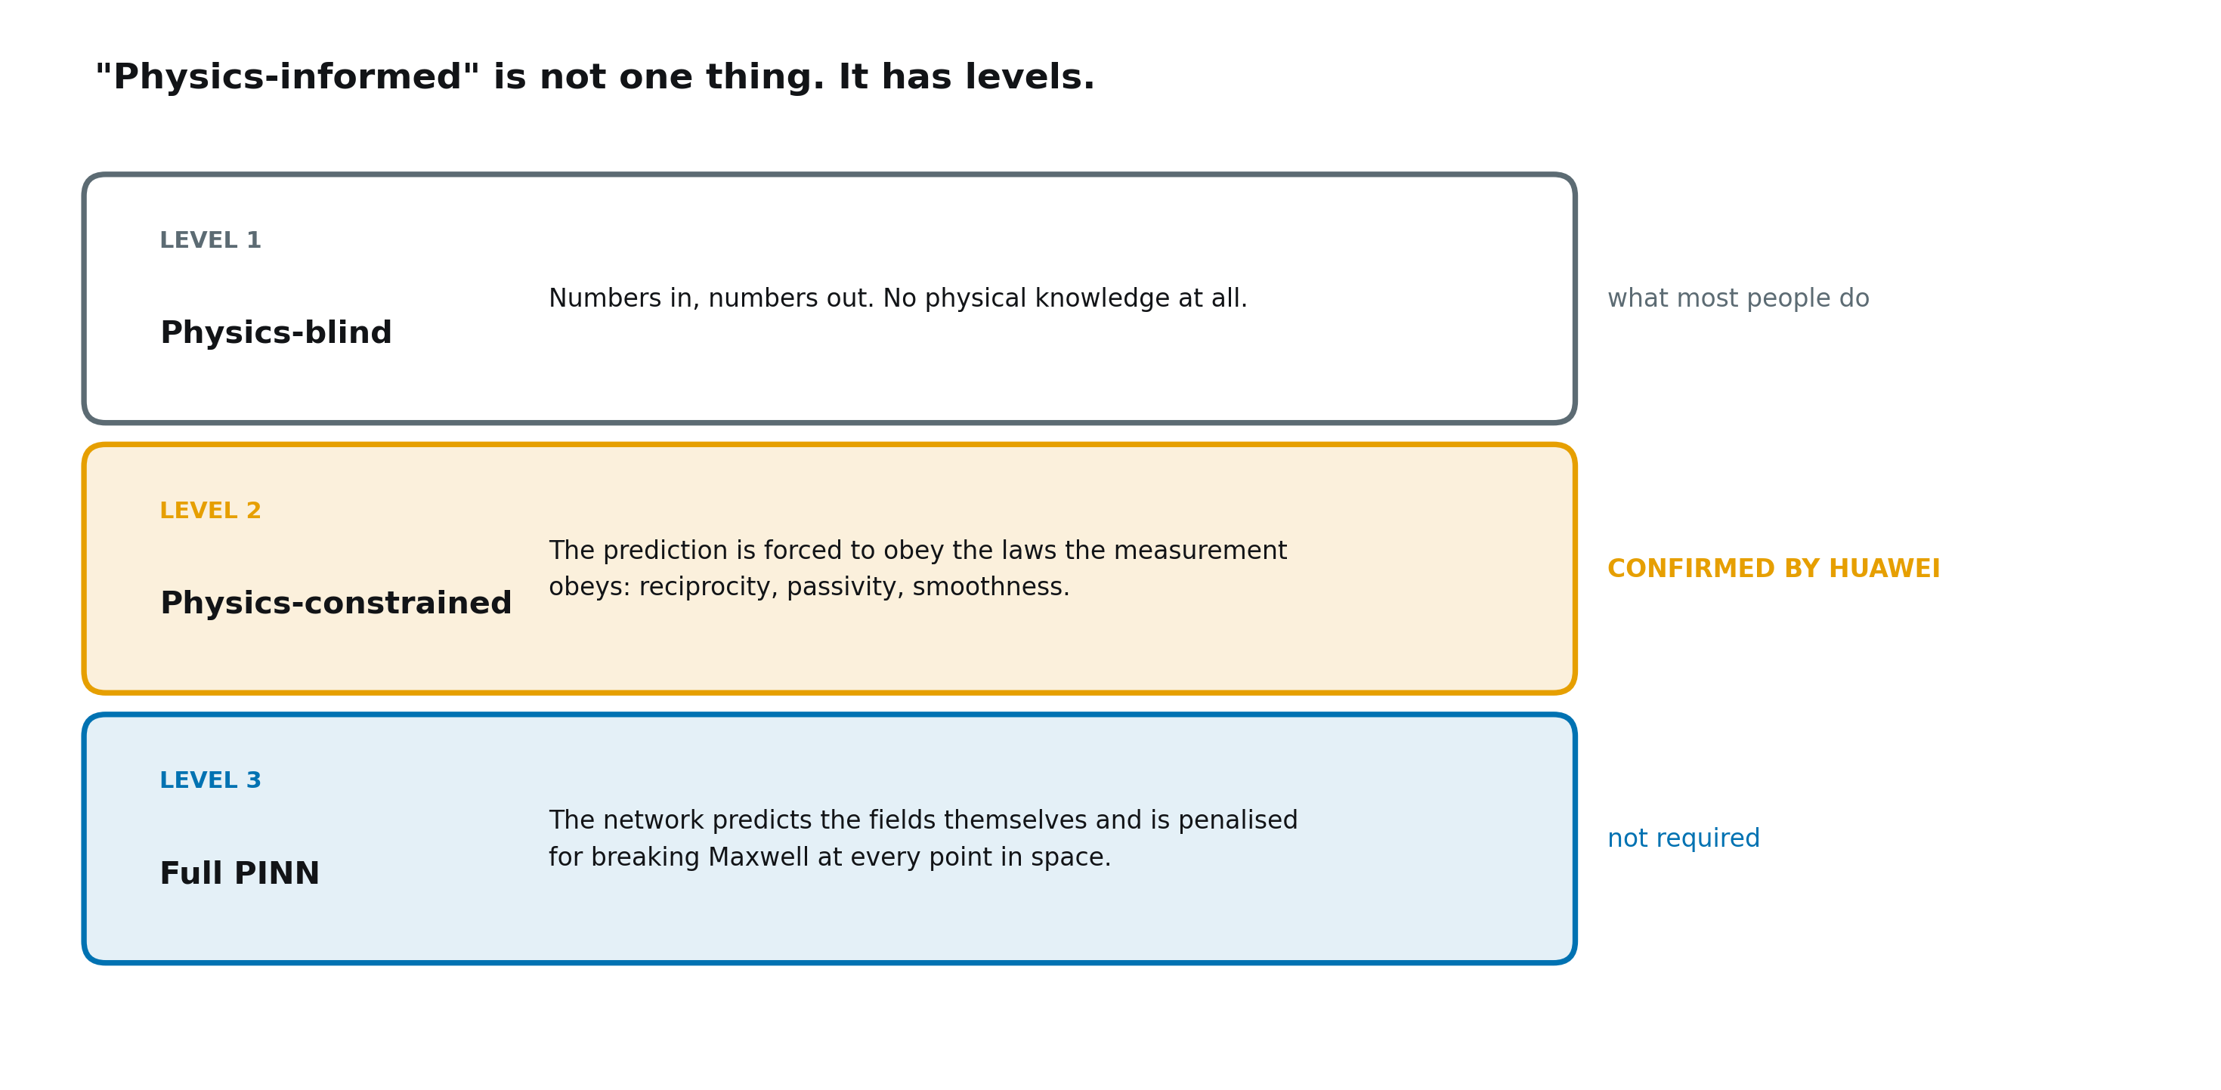
Physics-informed is not one thing
Your file has no fields, so level three was never reachable. Huawei confirmed that level two, the physics of the port measurements, counts.
Notes:
Your file has no fields, so level three was never reachable. Huawei confirmed that level two, the physics of the port measurements, counts.

Slide 23
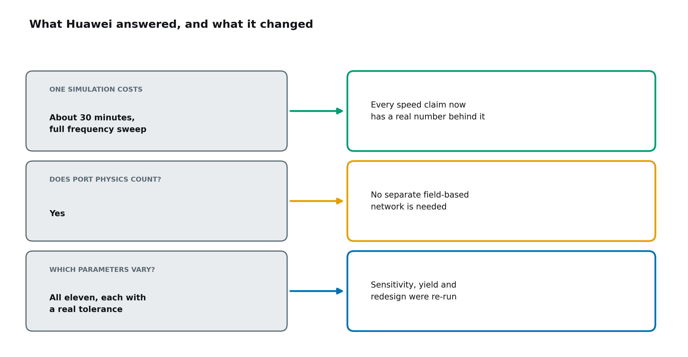
What Huawei answered, and what it changed
All three answers are now built into the pipeline. The tolerance table changed two conclusions, and both are reported.
Notes:
All three answers are now built into the pipeline. The tolerance table changed two conclusions, and both are reported.

Slide 24
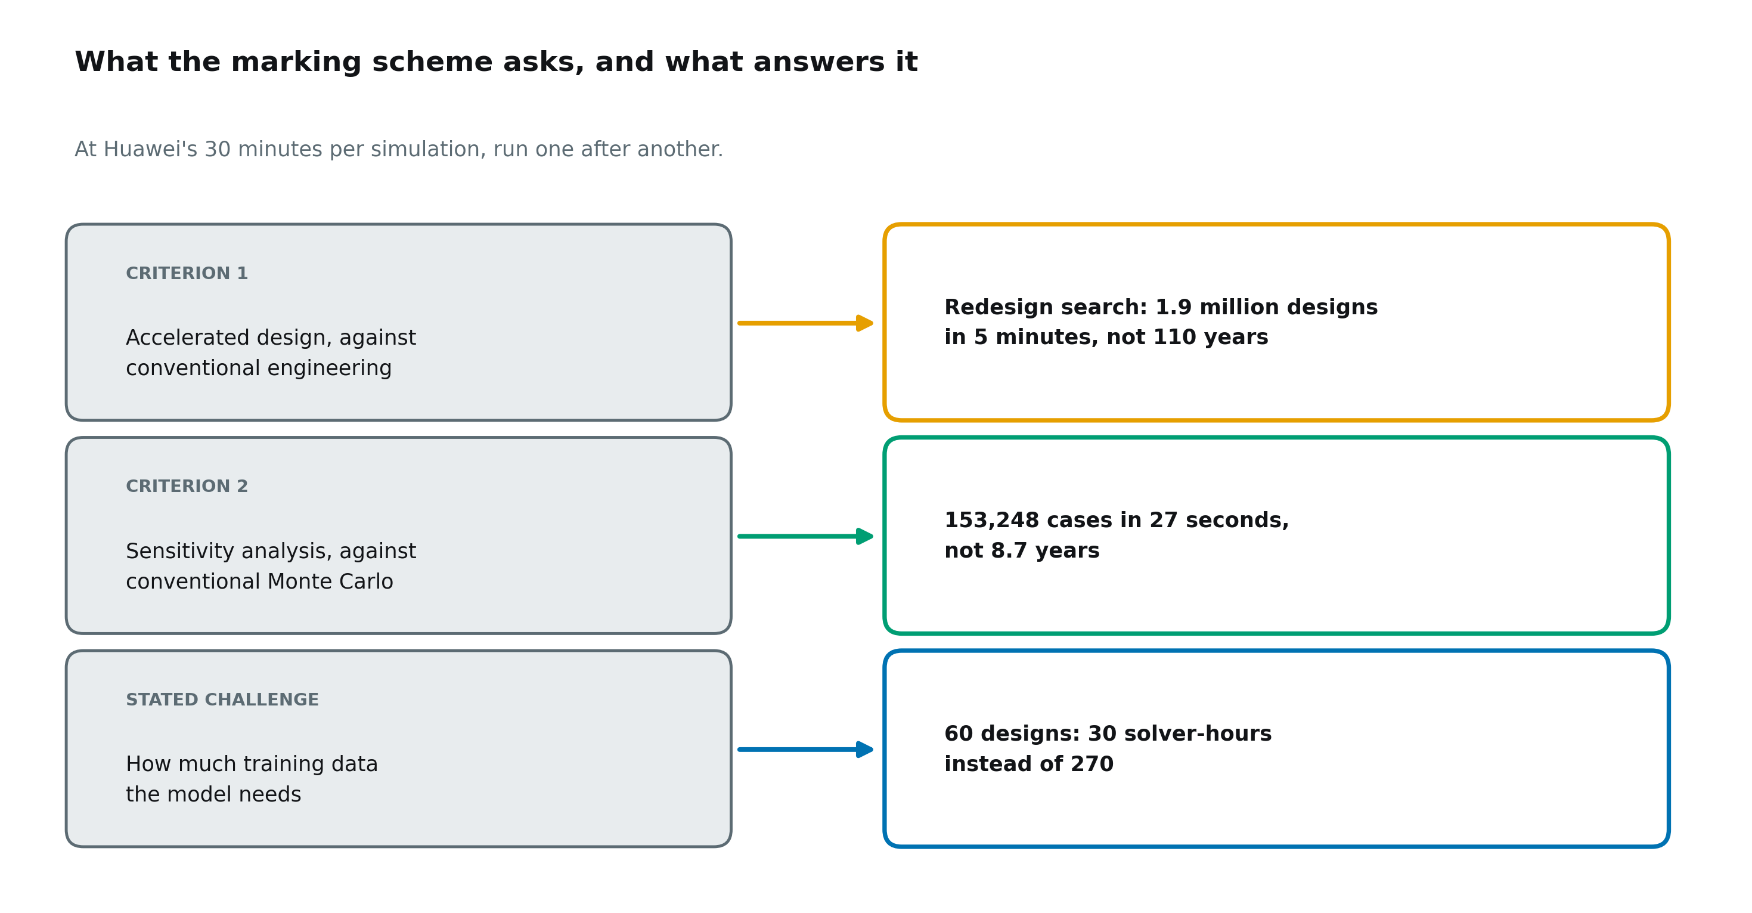
What the marking scheme rewards
Serial times at 30 minutes a simulation. Even with 100 running at once, the sensitivity study alone would take 11 days.
Notes:
Serial times at 30 minutes a simulation. Even with 100 running at once, the sensitivity study alone would take 11 days.

Slide 25
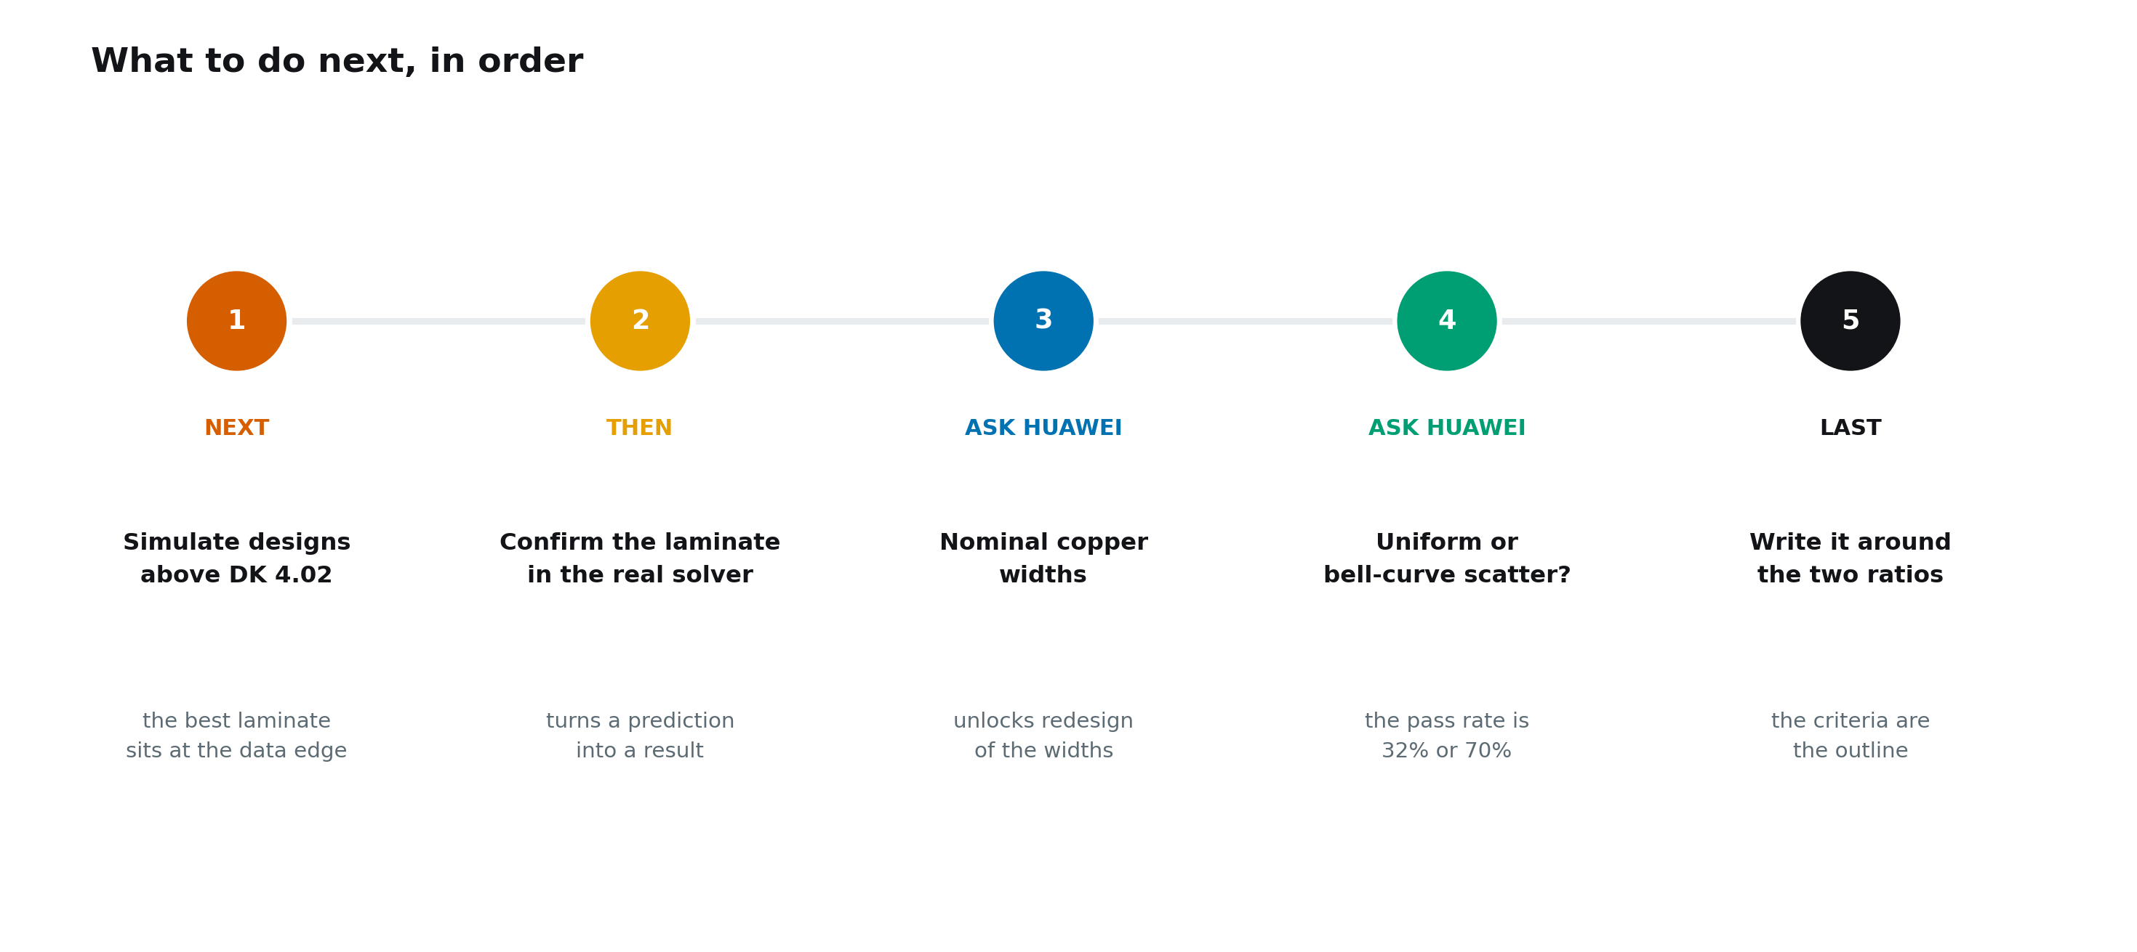
What to do next, in order
Simulating laminates above 4.02 and confirming the redesign turns a prediction into a result. The two questions for Huawei lift the last limits on the data.
Notes:
Simulating laminates above 4.02 and confirming the redesign turns a prediction into a result. The two questions for Huawei lift the last limits on the data.

