Slide 1
Physics-checked AI for RF tolerance analysis
Sub-topic 3 | A 30-minute solver run replaced by a checked surrogate model
Notes:
Opening, 30 seconds. Competence: this team treated the S-parameter physics as a hard constraint on the model, not a hope. Relevance: one full-wave run takes 30 minutes, and the two things this challenge scores – sensitivity analysis and design search – both need thousands to millions of runs. Promise: today we show one model, trained on 60 runs, that stands in for both, checked against the physics and against boards it never saw.

Slide 2
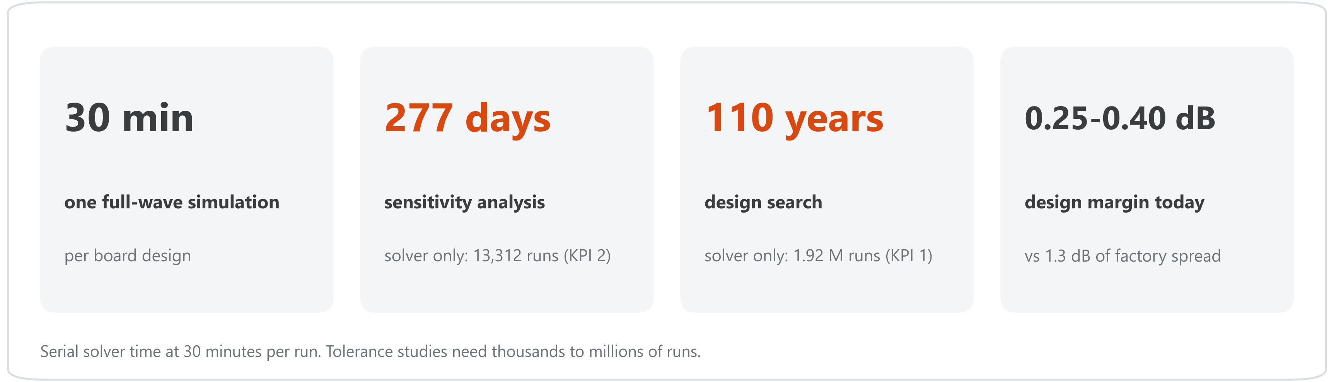
One tolerance study costs months of solver time
Only 3 in 10 boards pass today, and finding out why with the solver alone is not affordable.
Notes:
Set up the stakes before showing the solution, about one minute. Every number here comes from the mentor-supplied solver cost (30 minutes per run) and from the dataset itself – nothing is a claim about our method yet. The margin tile is why it matters: the nominal design passes, but factory scatter is three to five times larger than its margin, so about 70% of boards fail the illustrative limits.

Slide 3
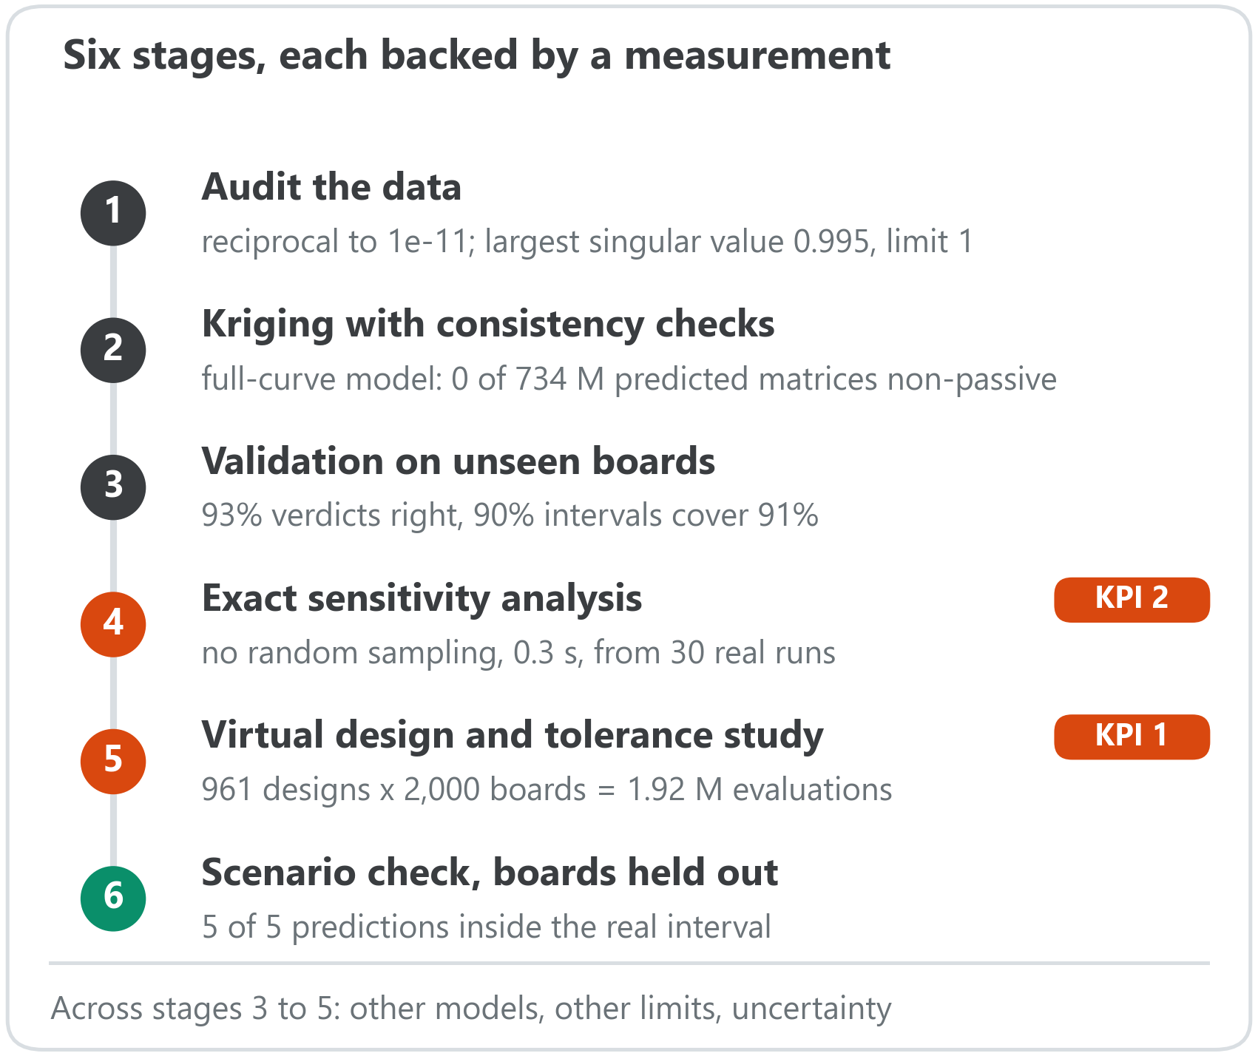
A 60-run surrogate stands in for the solver
Kriging model of the 11 tolerance parameters.
60 solver runs are enough: ten random 60-run models reproduce the 540-run results within about 3 points.
Reciprocity built in, passivity checked on every predicted matrix – confirmed by Huawei as physics-informed.
One model answers both criteria: sensitivity (KPI 2) and design search (KPI 1).
Notes:
Walk the pipeline top to bottom. Be precise if asked: the validation numbers on slide 6 come from models trained on the 540 boards minus the held-out ones; the 60-run claim rests on a separate test in which ten random 60-run models gave the same pass-rate staircase within 1.7 to 3.3 points and the same top two tolerances every time. No extra solver runs were available, so for each scenario we removed its real boards, retrained, and compared – that is the last stage. Polynomial chaos and a neural network agree within 2 points, which shows robustness to model choice, not correctness by itself: they share the same boards.

Slide 4
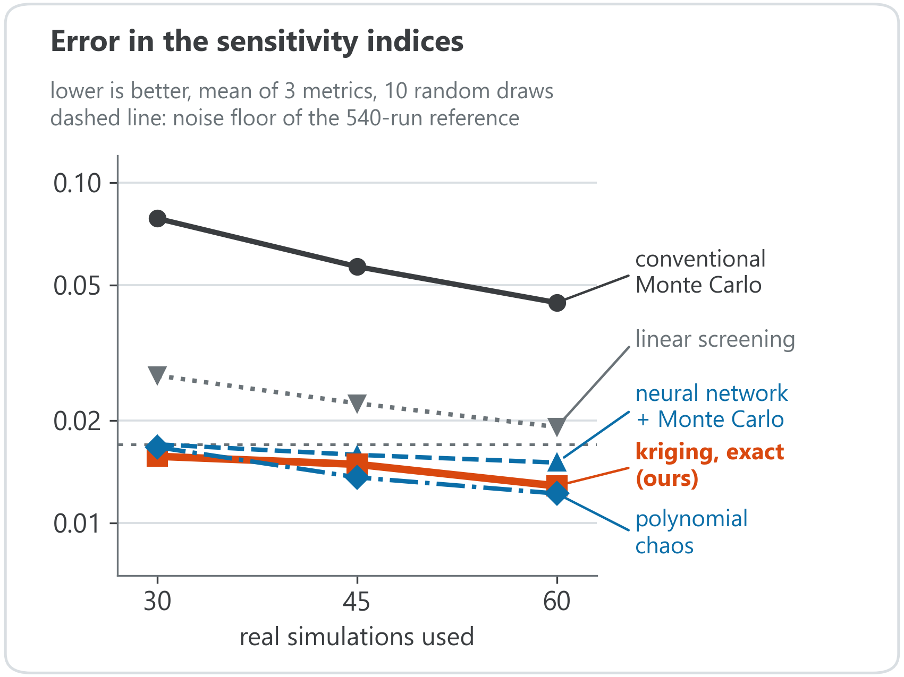
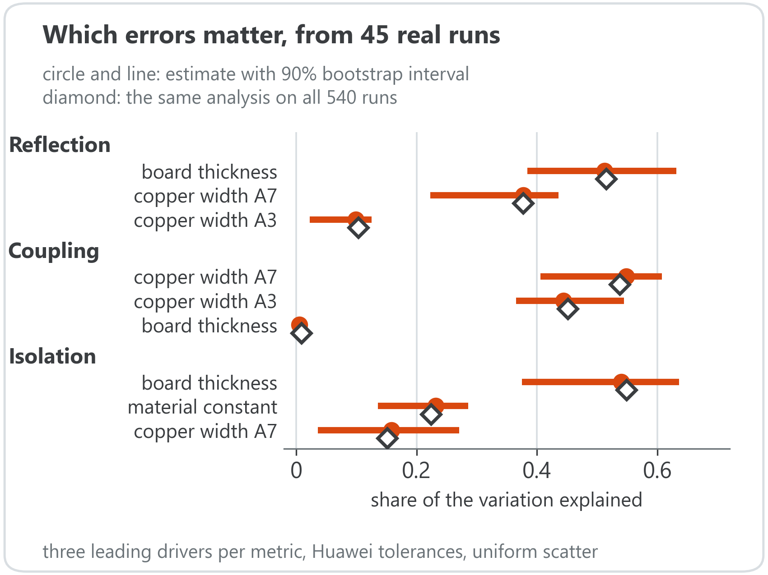
KPI 2 – sensitivity: the right drivers from 30 runs, not 13,000
At equal runs, conventional Monte Carlo is 3 to 5 times less accurate; the three surrogates tie.
Notes:
Left: reference is Monte Carlo on all 540 real runs; errors near 0.017 sit at that reference's own noise floor. Right: intervals shown for the three leading drivers only – near-zero indices give an unreliable bootstrap. Be upfront: our method ties polynomial chaos and a neural network here. The win is against conventional Monte Carlo, which is what the criterion asks for, and the closed-form indices remove sampling noise entirely.

Slide 5
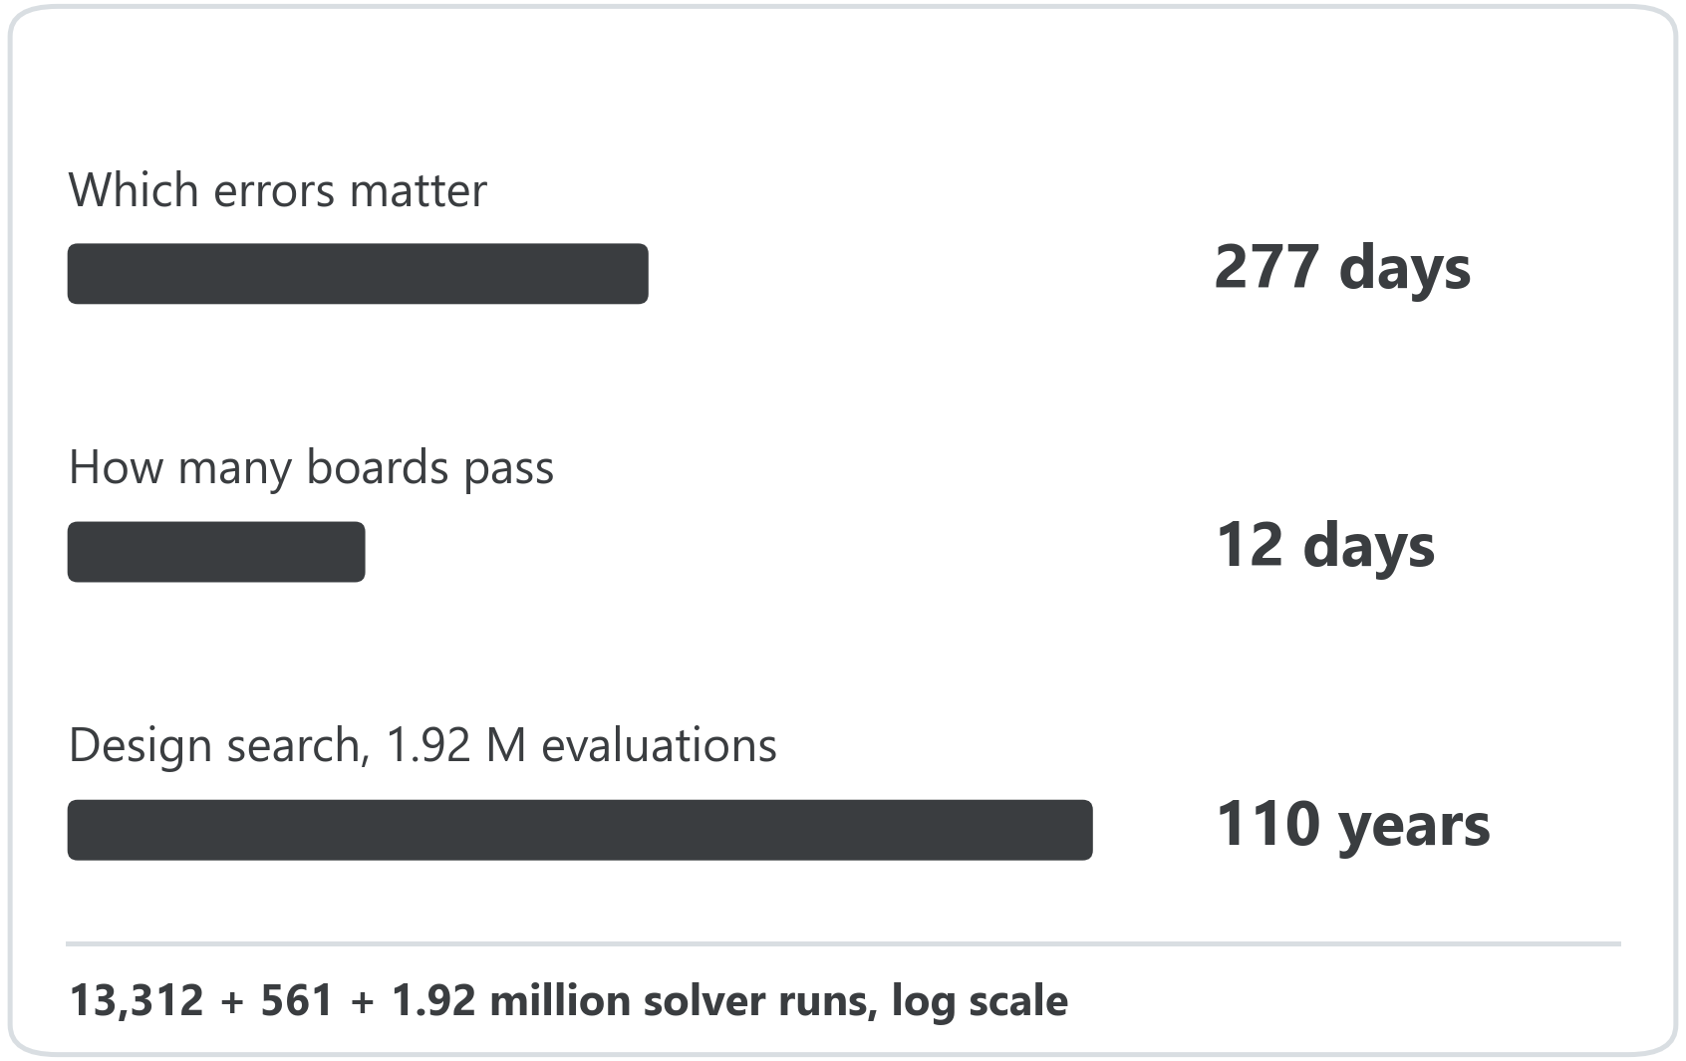
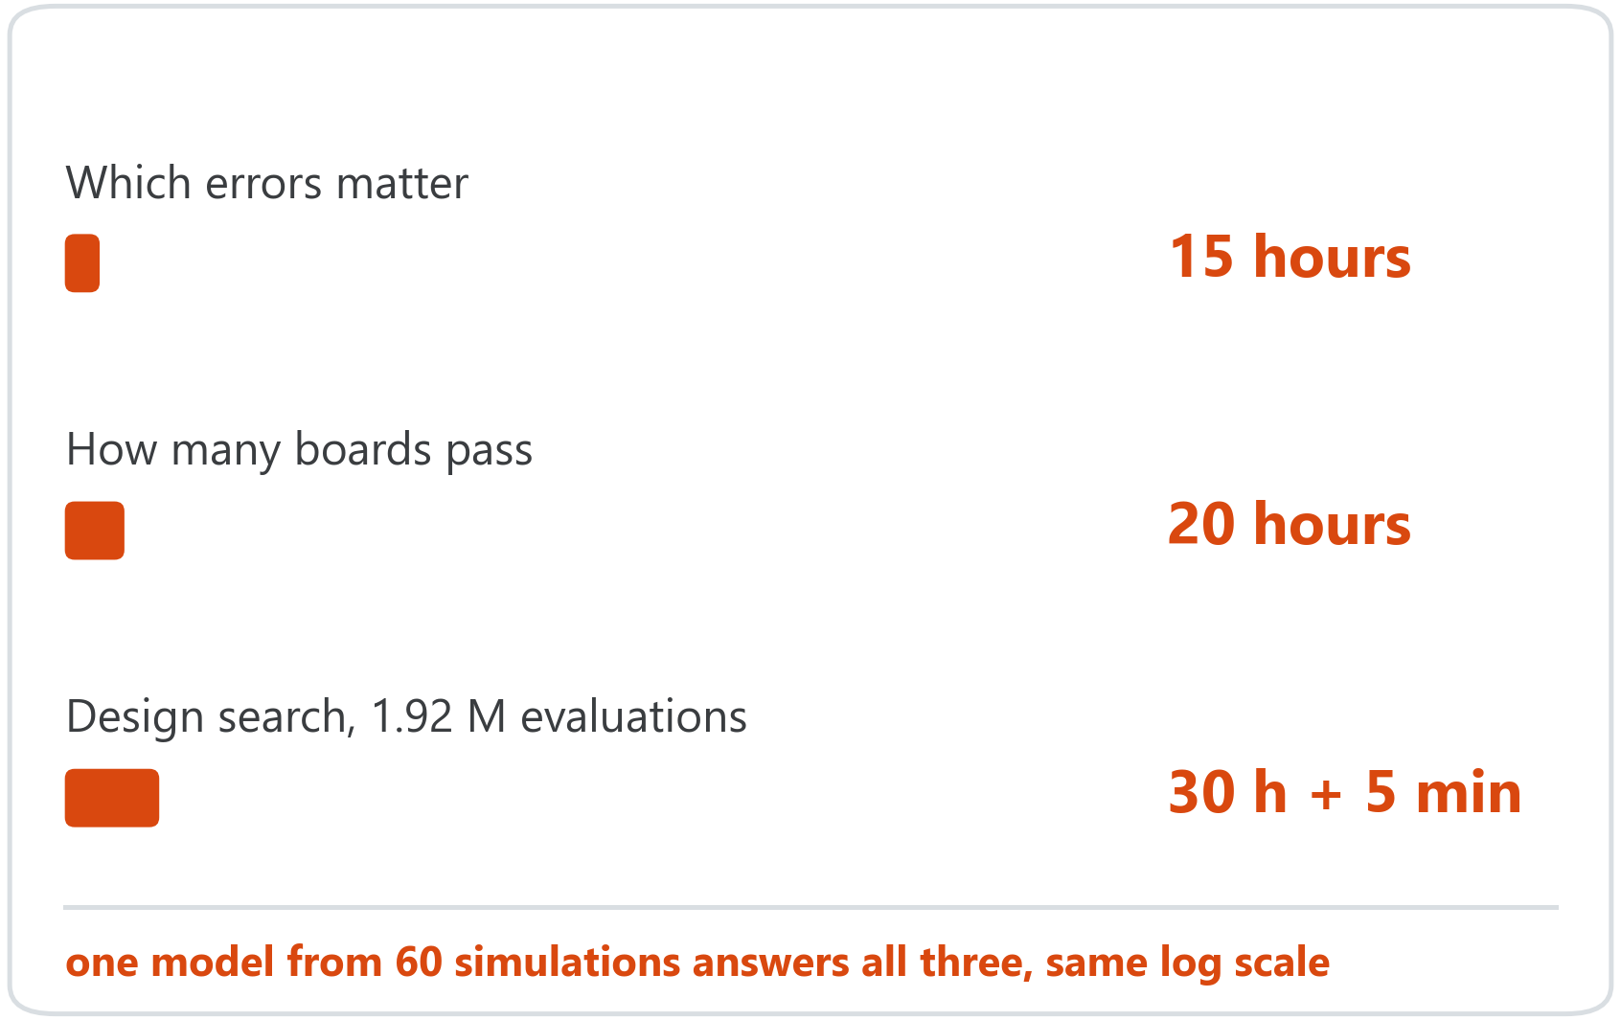
KPI 1 – design search: conventional versus this pipeline
Conventional: solver in the loop
This pipeline: one 60-run surrogate
Serial times at 30 minutes per run. With 100 solver licences in parallel, the design search alone still takes about a year.
Notes:
Criterion 1 is the third row: 961 design points, each scored on 2,000 virtual manufacturing realizations, so 1.92 million surrogate evaluations in 5 minutes on a laptop. Say plainly that these are surrogate evaluations, and give the parallel caveat first.

Slide 6
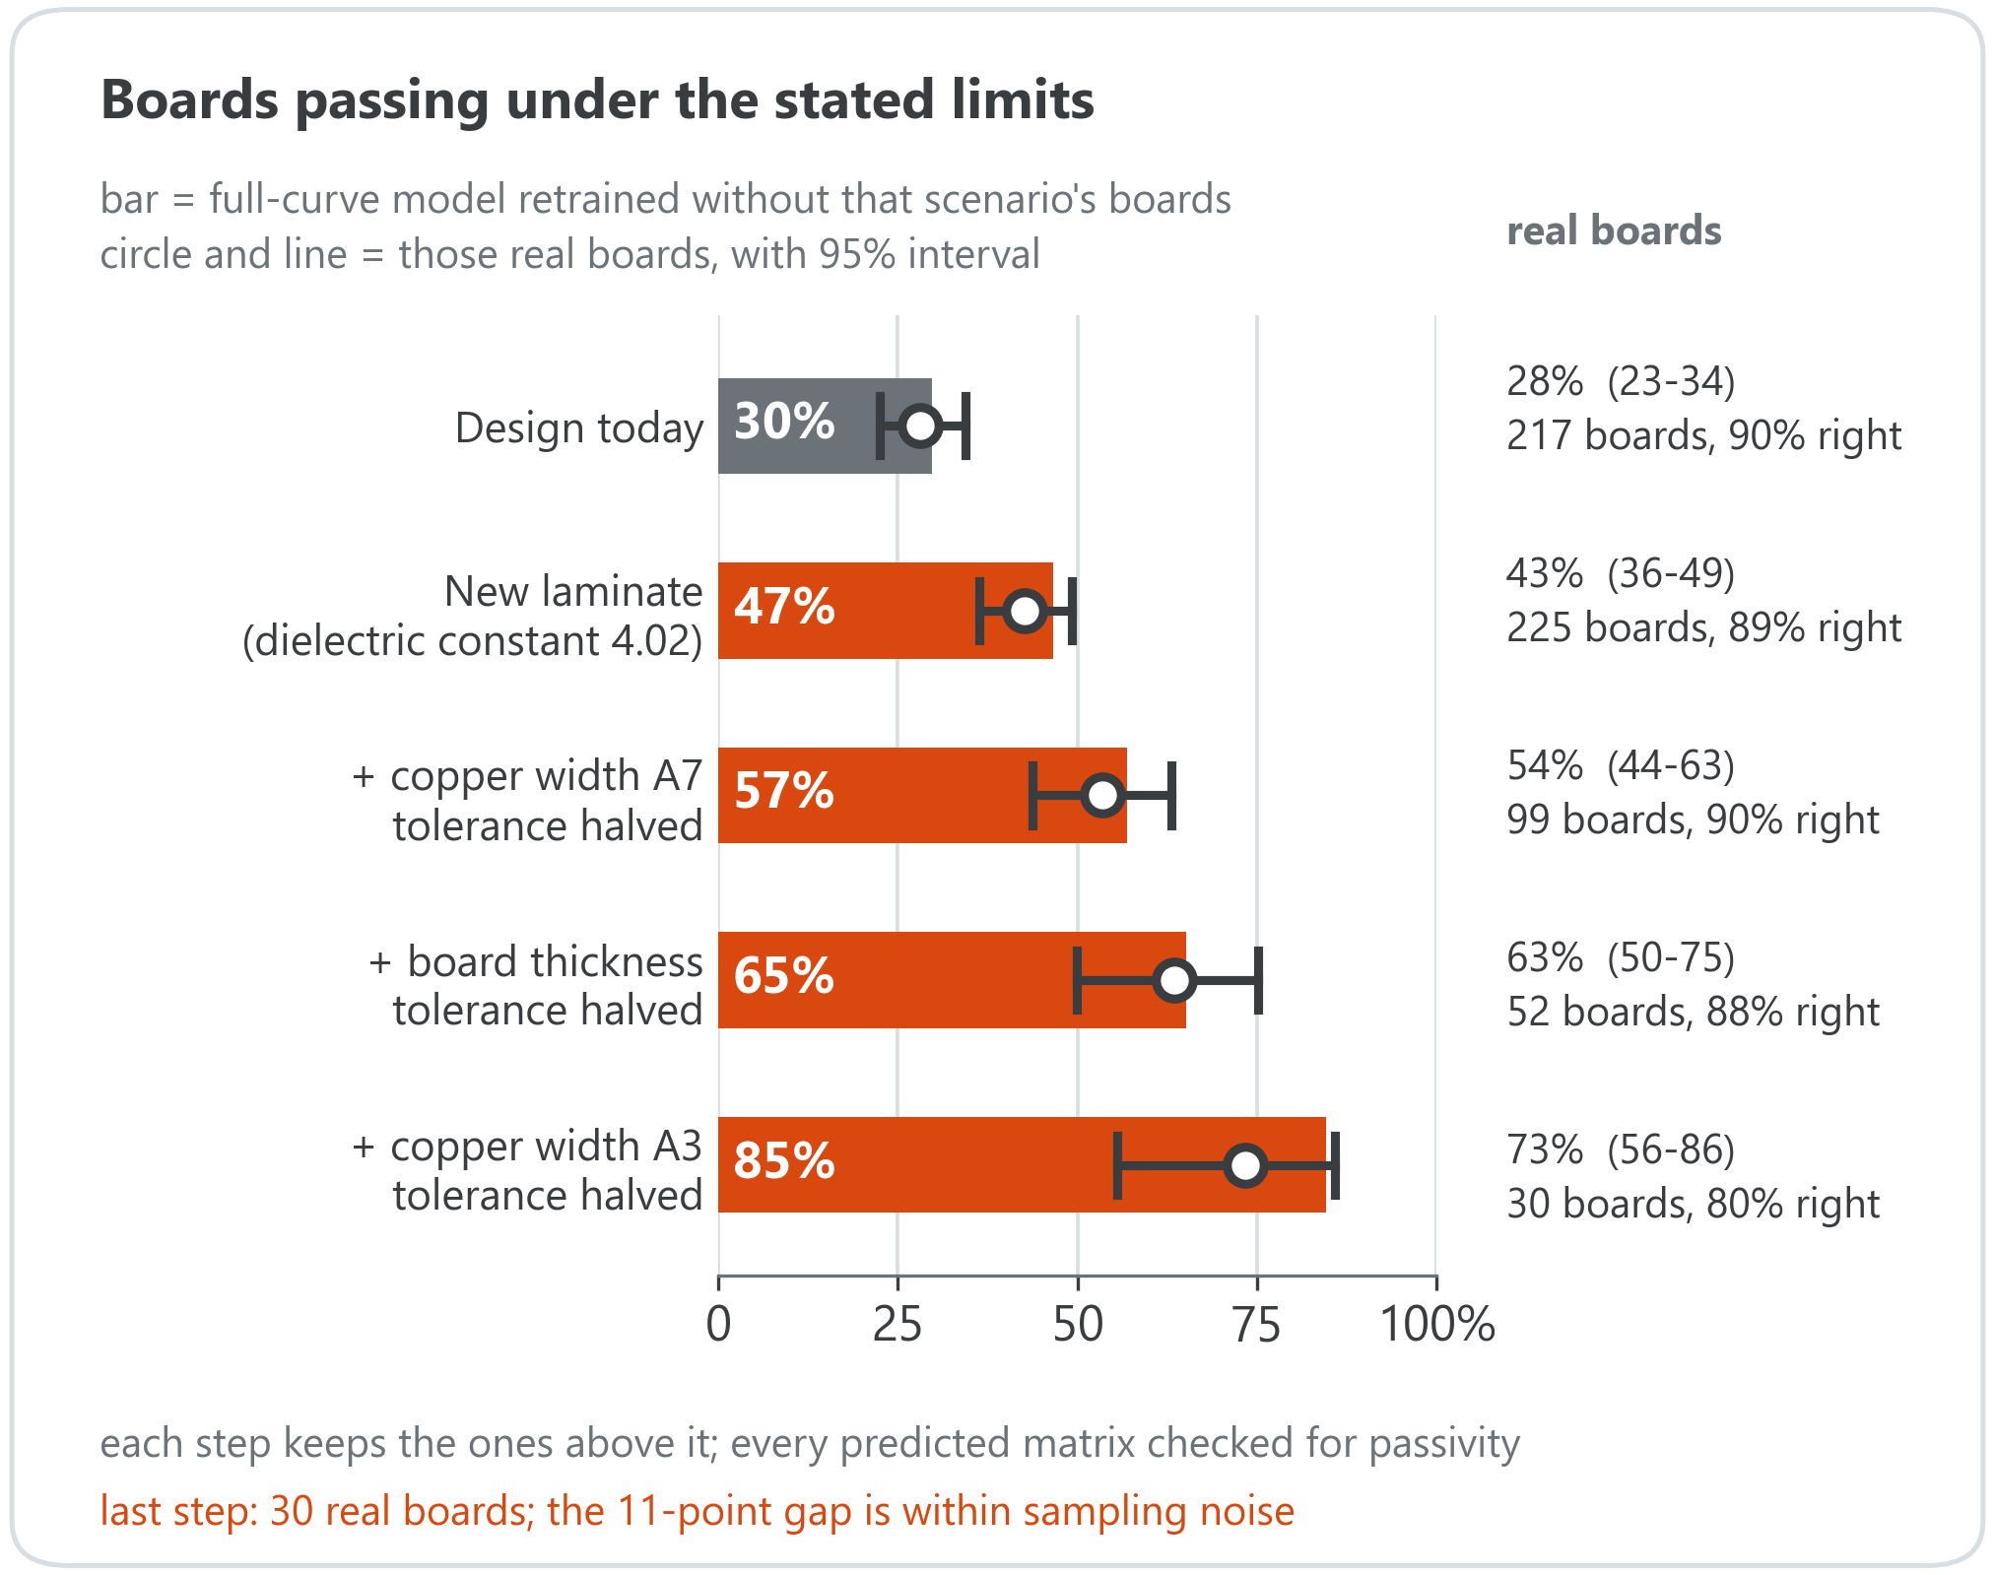
Validation: from 30% to 85% of boards passing
Each scenario's real boards were held out, the model retrained, and its prediction compared with them: 5 of 5 inside the real interval.
Last step: 85% predicted, 73% observed on 30 boards – consistent, not proof.
Pass/fail agreement stays 92-97% when the illustrative limits are halved or tripled.
Open: model bias, the confidential stack-up, no extra solver runs.
0 of 734 million predicted matrices break passivity.
Notes:
Pass rates depend on limits we chose; the mentor confirmed the challenge is not about board performance, so the message is the method and its checks, not the number itself. Sources of uncertainty are identified, not added together: sampling of the real boards (about 6 to 15 points), training-set variation (about 1 point), and model bias, which the data cannot resolve. The last bar has 30 real boards; the 11-point gap sits inside its 95% interval, so call it consistent, not a confirmation. The physics check ran on the full 3,012-output model: every one of 733.7 million predicted S-matrices, across every full-curve study (leave-window-out, 5-fold, scenario staircase, 961-point design grid), stayed passive.

Slide 7
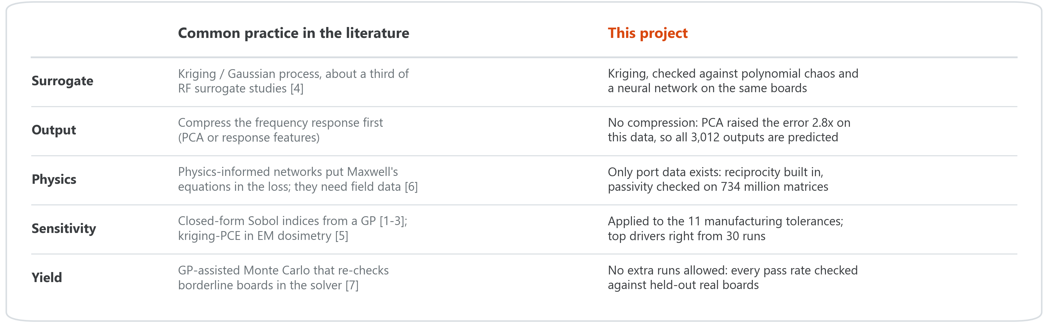
State of the art, and where this differs
[1] Oakley & O'Hagan (2004), J. R. Stat. Soc. B 66(3)
[2] Marrel et al. (2009), Reliab. Eng. Syst. Saf. 94(3)
[3] Le Gratiet, Cannamela & Iooss (2014), SIAM/ASA J. Uncertain. Quantif.
[4] Systematic review, surrogate-based EM design of RF components (2026), Sensors 26(8):2504
[5] Kersaudy et al. (2015), J. Comput. Phys. 286:103-117
[6] Khan & Lowther (2022), IEEE Trans. Magn. 58(9)
[7] Fuhrländer & Schöps (2020), J. Math. Ind. 10
Notes:
This slide is the one Huawei's 2026-09-22 e-mail explicitly allows in addition to the 5-slide core. Keep it brief if asked live: the one-line version is "kriging is already the field's default for EM surrogates; the difference here is enforcing measurement-level physics because no field data existed, and checking every choice against this specific dataset rather than assuming the literature default (PCA) would transfer."

Slide 8
Project folder
QR code goes here
run insert_qr.py with your folder link
Scan to open the full material
README: pipeline, evidence and limitations
Code that reproduces every number
Figures and the architecture report
Notes:
The template reserves this slide for a link to a folder. Share the code, README and report there. Do not put the Huawei dataset in it.

Slide 9
THANK YOU
From 277 days of solver time to 15 hours – with the physics checked on every prediction.
60 solver runs · exact sensitivity analysis · pass rates confirmed on held-out real boards
Notes:
Close on the one line to remember: 277 days of solver time become 15 hours, and every one of 734 million predicted matrices obeys the physics. Then stop -- do not trail off into a plain thank-you.

