Slide 1
BLADDER CANCER TREATMENT : INSIGHTS & STATISTICAL VALIDATION
Data-Driven Evaluation of Treatment Effectivenes
B.Jayasree Apexplanet 20-04-2026

Slide 2
OBJECTIVES:
Evaluate the effectiveness of different bladder cancer treatments
Analyze response rates and survival outcomes
Identify key factors influencing patient success
Validate findings using statistical methods

Slide 3
Dataset Overview
Source: GLOBOCAN 2022 Dataset
Domain: Healthcare / Oncology
Key Variables:
Treatment Type
Response Rate (%)
5-Year Survival Rate (%)
Cancer Stage
FDA Approval Status
Dataset enables comparison of treatment effectiveness across multiple dimensions.

Slide 4
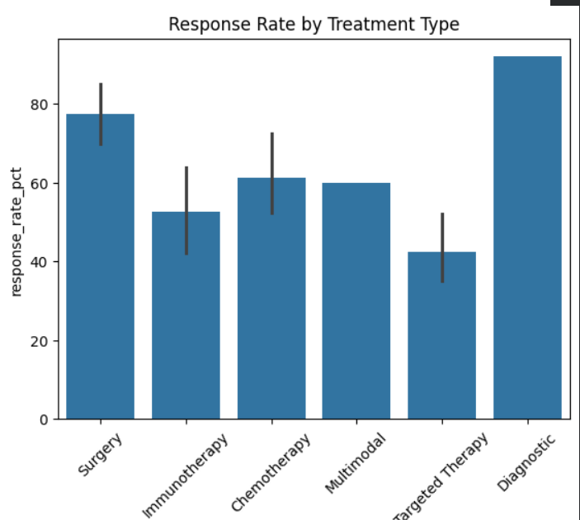
Response Rate By Treatment Type:
.Treatment Effectiveness
Response rates vary significantly across treatments
Some treatments show consistently higher effectiveness
Treatment selection directly impacts patient recovery success

Slide 5
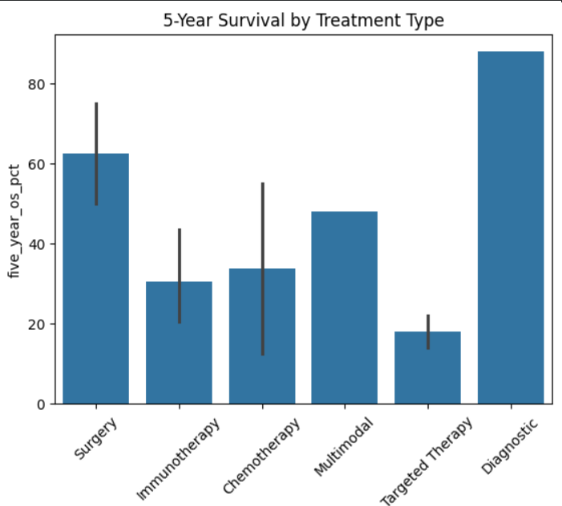
. Noticeable differences in survival rates across treatment . High-response treatments often correlate with better survival . Not all treatments deliver equal long-term outcomes.
Survival Rate By Treatment Type:

Slide 6
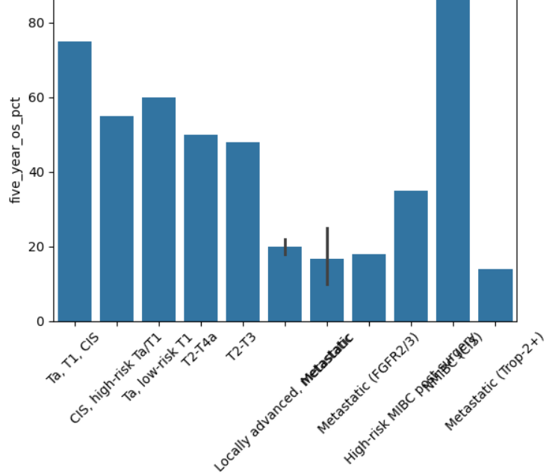
Survival Rate By Cancer Stage:
. Survival rates decrease significantly in advanced stages . Early-stage patients show a much higher survival probability . Early diagnosis is critical for improving patient survival.

Slide 7
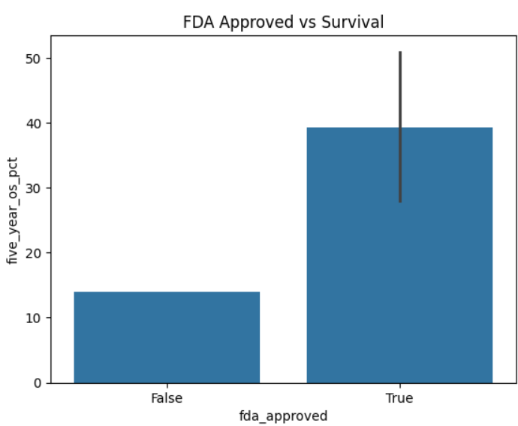
. FDA-approved treatments show more consistent outcomes . Non-approved treatments have higher variability . Regulatory approval is often associated with reliability and effectiveness.
FDA Approval vs Treatment Performance:

Slide 8
Problem Statement:
Observed differences in treatment performance
Unclear if differences are statistically significant
Need validation to support decision-making
Do treatment types significantly impact survival rates?

Slide 9
Hypothesis Formulation:
H₀ (Null Hypothesis): Treatment type does NOT affect survival rates
H₁ (Alternative Hypothesis): Treatment type DOES affect survival rates
Test Used: ANOVA (Analysis of Variance)
Reason: Comparing multiple treatment groups

Slide 10
Hypothesis Test Results:
F-statistic
P-value
If p < 0.05:
The p-value is less than 0.05, indicating a statistically significant
differences in survival rates across treatments.
If p > 0.05:
No statistically significant difference observed.

Slide 11
Recommendations:
Prioritize high-performing treatments(FDA approved tratments)
Encourage early cancer detection programs
Invest in improving low-performing treatments
Promote usage of clinically validated

Slide 12
Conclusion:
Treatment type plays a key role in patient survival
Significant variation exists across treatment methods
Statistical testing validates key findings
Data-driven decisions can improve healthcare outcomes

