Slide 1

FACE MAsK DEtECTor bot
Bushmeniov Vladislav

Slide 2
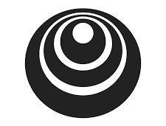
Motivation
I have completed a few courses from deeplerning.ai specialization on Coursera and started thinking about how to implement new skills in real life. After a few days of thinking about problems, which we have in our every day life – I decided to build my own face mask detector to detect whether someone is wearing a mask or not.
Let's to see implementation of my idea.
deeplearning.ai

Slide 3

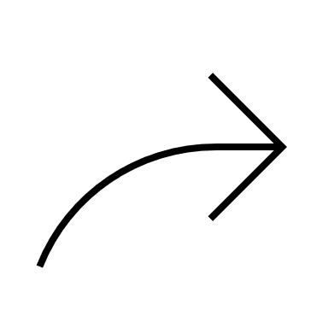


Describing how application works
Making photo
Return
prediction
Sending
photo to bot
Tensorflowserving

Slide 4

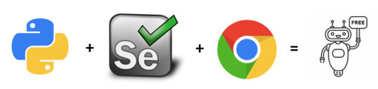






Scraping dataset with selenium
1 STEP
2 STEP
3 STEP
Collected base dataset from different resources
Train any pretrained model
(only for collecting dataset in step 3)
Continue scrapping again via model predictions.
multiprocessing

Slide 5

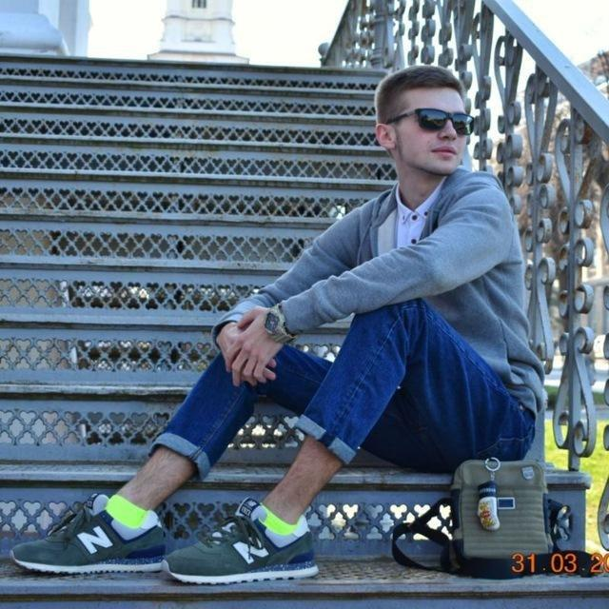
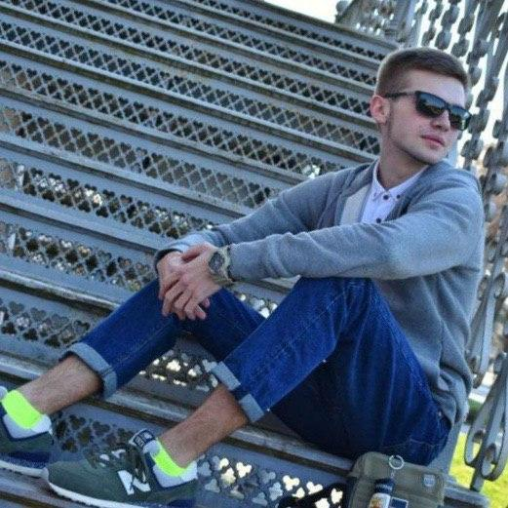
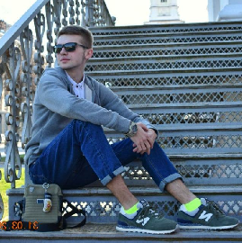
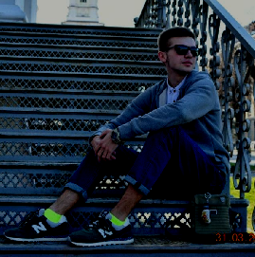
data augmentation
height_shift_range
Amount of collected photos is not enough to generalize data well on the validation and test set, as a result, we overfit to training dataset.
Original
Rotation range
Horizontal flip
Adjust brightness

Slide 6
Model STRUCTURE
224*224*3
3*3*ch
1*1*ch
3*3*ch
BN
Relu
BN
Relu
13
N filters
Depthwise Convolutions
Pointwise Convolutions
Input size
argmax
4096
4096
1028
128
Softmax
Y
FC layers
Last layer
Classes probabilities

Slide 7




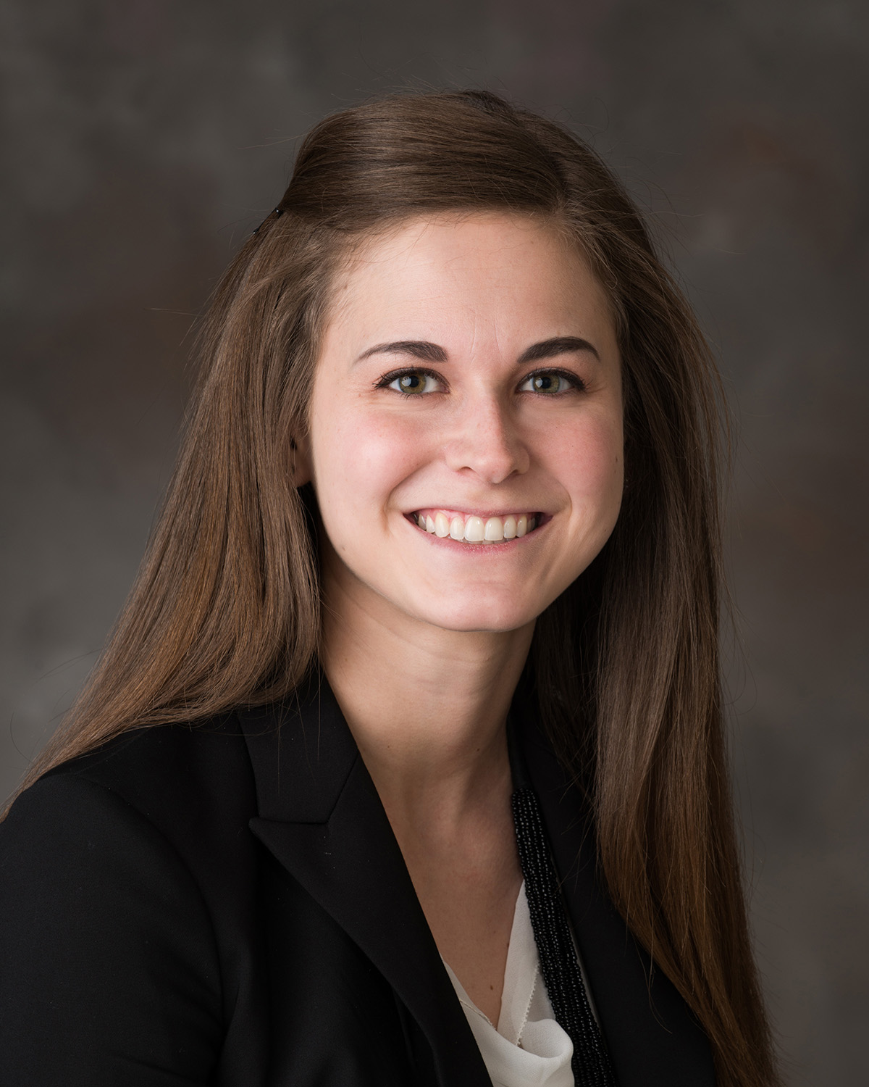
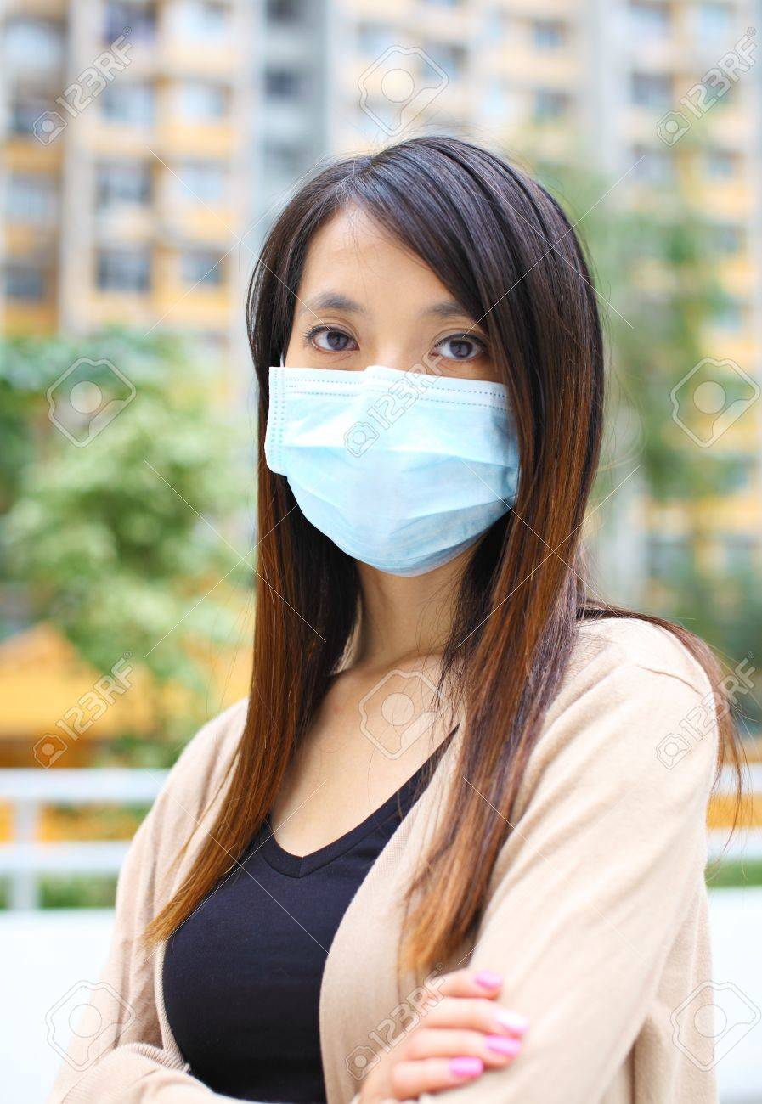
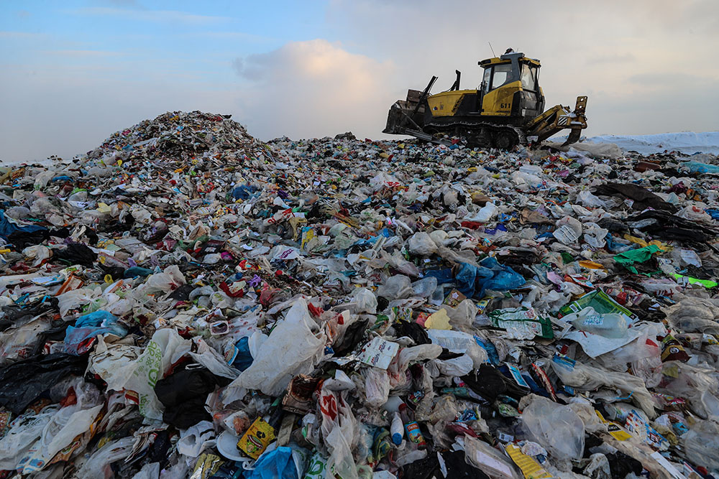

Output layer classes description
With mask
Without mask
Garbage
4 classes ??
Really ?

Slide 8



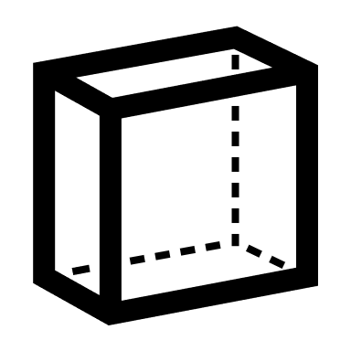
Problem with classifying “hard photos”
4

Slide 9
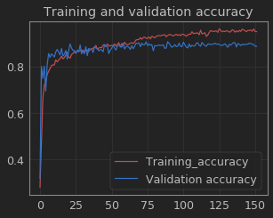
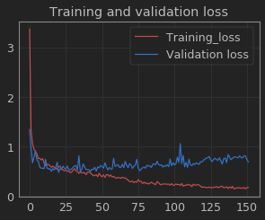
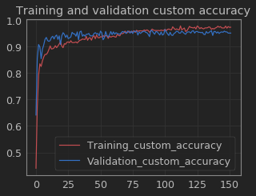
Training graphics
Top train accuracy : 95 %
Top validation accuracy : 89 %
Top train loss : 0.1758
Top validation loss : 0.73
Top train accuracy : 97.7 %
Top validation accuracy : 96.6 %

Slide 10
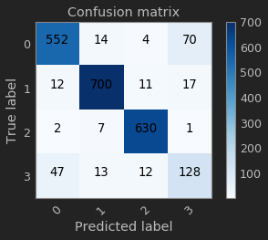
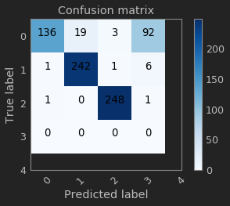
Confusion matrix on validation set
Confusion matrix on test set
Areas
description
We allow our model to make incorrect prediction in areas.
Minimize and zones.
Accuracy : 96.6 %
Accuracy : 95.8 %

Slide 11
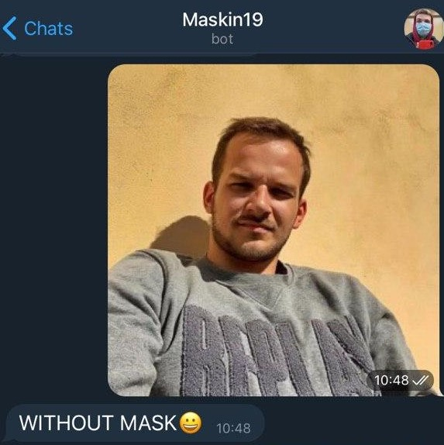
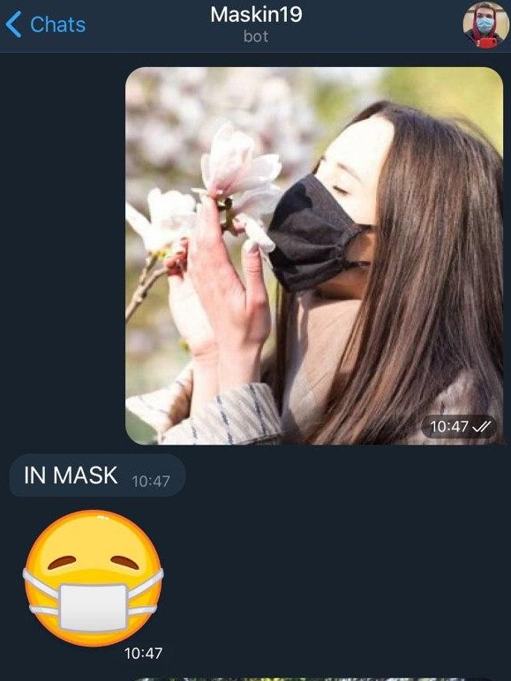
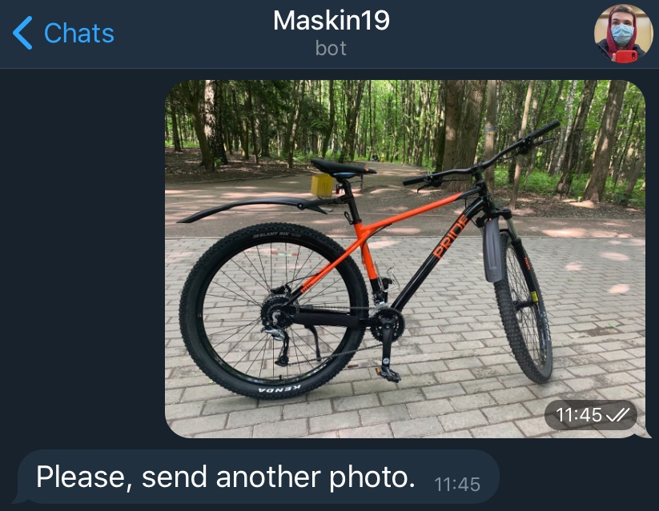
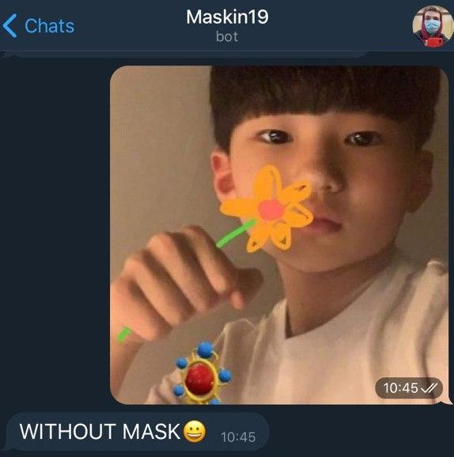
How telegram bot works
Telegram bot was tested in production with my friends.
Accuracy in production : 93.2% .

Slide 12
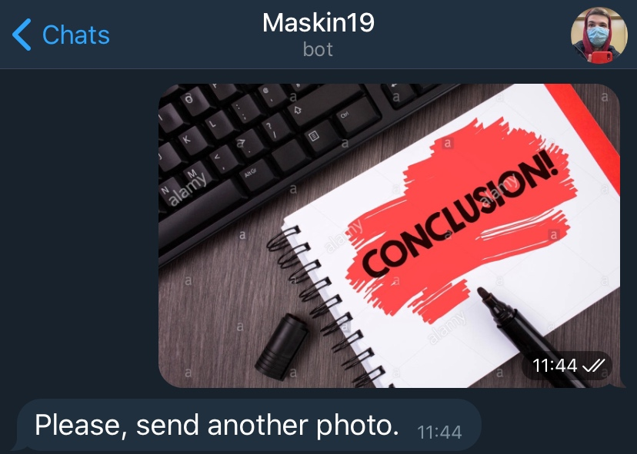

While working on the project :
Used different technics for collecting unique dataset
Tried to play around with different technics of data augmentation
Developed a personal approach to recognition problem
Tested application on real-world date in production
https://github.com/Bushmeniov/Face-Mask-Detector.git

