Slide 1
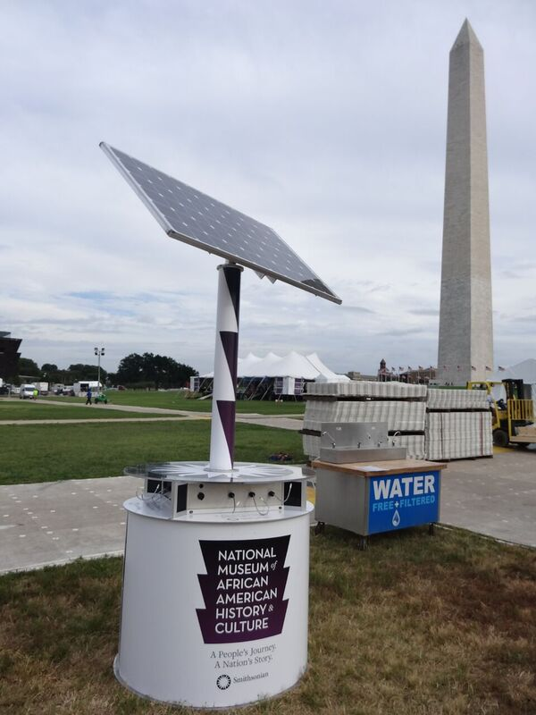
Innovative Solar
Mobile Charger
Harnessing Solar Energy for Mobile Devices

Slide 2
Table of
Contents
1. Introduction to Solar Mobile Chargers
2. Benefits of Solar Mobile Chargers
3. Solar Technology in Mobile Chargers
4. Design Features of Solar Mobile Chargers
5. Environmental Impact
6. Market Overview
7. Challenges and Solutions
8. Future Prospects
9. Case Studies
10. Conclusion

Slide 3
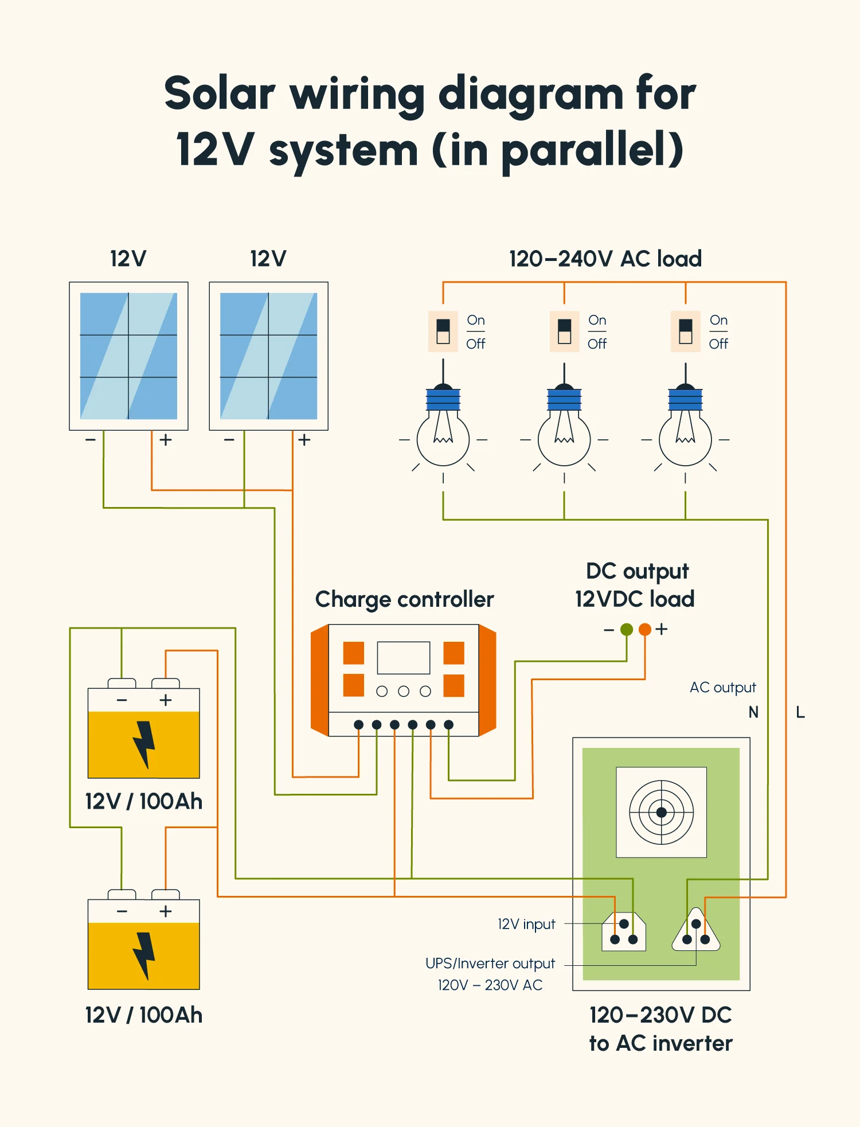
1
Introduction to Solar Mobile Chargers
Exploring the New Age Technology
• Solar mobile chargers are devices that convert solar energy into electrical energy to charge mobile devices, promoting the use of renewable energy in everyday life.
• With the rise of smart technology, solar chargers have become vital in addressing the need for sustainable and portable charging solutions.
• These devices are especially useful in regions with limited access to conventional power sources, providing an eco-friendly alternative.
• The technology has evolved significantly, offering users enhanced efficiency and portability for on-the-go charging needs.
• Understanding the mechanism and advantages of solar chargers can help users make informed decisions for sustainable energy consumption.

Slide 4
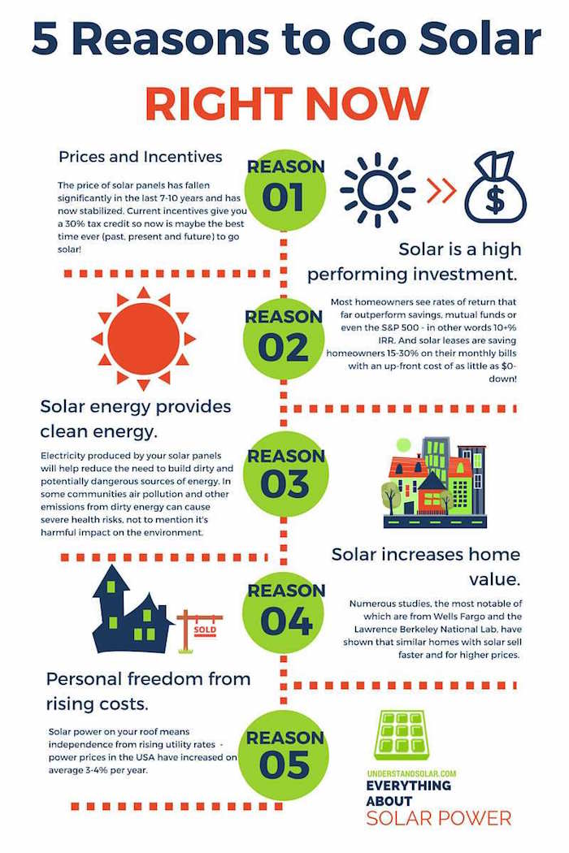
2
Benefits of Solar Mobile Chargers
Why Go Solar?
• Solar mobile chargers reduce reliance on non-renewable energy sources, thereby lowering carbon footprints through the utilization of endless solar power.
• The portability and convenience offered by these chargers make them ideal for travelers and individuals who often engage in outdoor activities, ensuring they remain connected.
• They provide cost savings over time by minimizing electricity bills, as solar energy is free and abundant.
• These chargers are designed with durability in mind, often resistant to weather conditions, promoting long-lasting and reliable usage.
• By adopting solar charging solutions, users contribute to environmental conservation efforts, supporting a sustainable future.

Slide 5
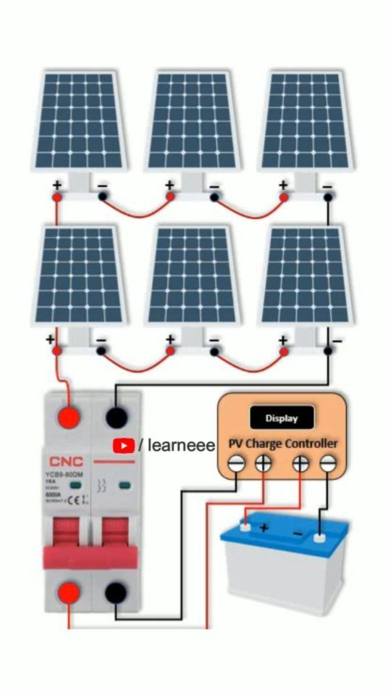
3
Solar Technology
in Mobile Chargers
Understanding the Mechanics
• Solar mobile chargers utilize photovoltaic cells to capture sunlight and convert it into direct current (DC) electricity suitable for charging mobile devices.
• Advanced solar chargers feature built-in inverters to convert the generated DC power into alternating current (AC), compatible with most mobile gadgets.
• The efficiency of the solar panels, often measured by their conversion rate, greatly affects the charging speed and effectiveness of the device.
• Most modern chargers include integrated batteries to store energy, providing a backup charge during the night or in low-sunlight conditions.
• Technological advancements continue to improve the efficiency, size, and affordability of solar panels, enhancing their practicality for personal use.

Slide 6
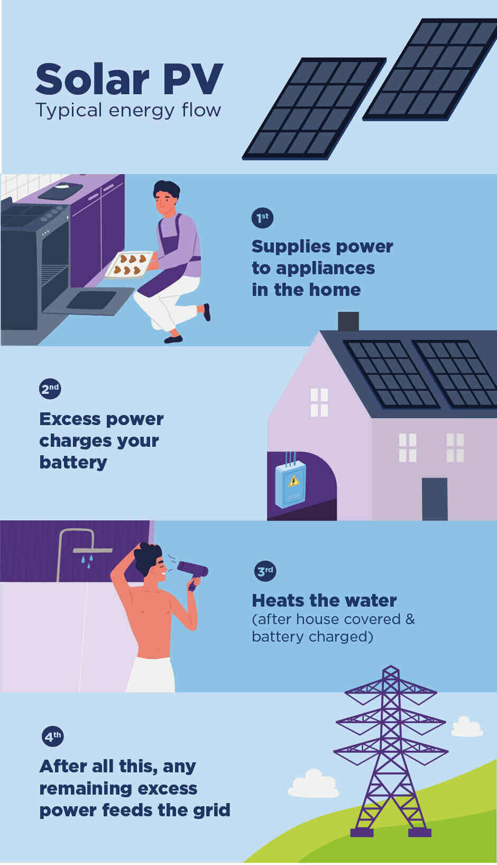
4
Design Features
of Solar Mobile Chargers
Innovation and Functionality
• Compact and lightweight design features ensure the portable nature of solar mobile chargers, allowing users to effortlessly carry them in bags or backpacks.
• Many models include foldable panels to maximize solar energy absorption when in use, while maintaining a small footprint when closed.
• Some chargers offer multiple charging ports to accommodate various devices simultaneously, enhancing their utility for multiple users.
• Waterproof and rugged designs are available to withstand outdoor conditions, making them ideal for adventurers and campers.
• User-friendly interfaces and indicator LEDs provide real-time feedback on charging status and efficiency, improving the overall user experience.

Slide 7
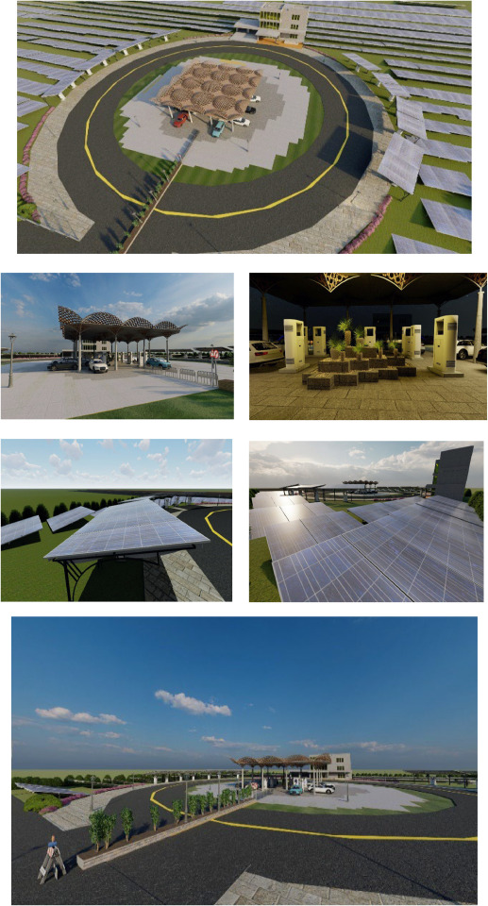
5
Environmental Impact
of Using Solar Chargers
Towards a Greener Planet
• Solar chargers have a minimal environmental footprint during operation, sourcing clean energy directly from the sun.
• By reducing dependence on fossil fuels, they play a critical role in mitigating climate change and promoting environmental stewardship.
• The production process of solar chargers has evolved to follow more sustainable practices, reducing waste and emission outputs.
• Utilizing solar energy contributes to lowering greenhouse gas emissions, aligning with global efforts towards achieving sustainability goals.
• The promotion and adoption of solar chargers encourage both manufacturers and consumers to pursue renewable energy solutions.

Slide 8
6
Market Overview
of Solar Mobile Chargers
Trends and Statistics
• The solar mobile charger market has seen substantial growth, driven by increasing consumer awareness and demand for sustainable technology solutions.
• Technological advancements have rendered solar chargers more efficient and affordable, expanding their market presence globally.
• The Asia-Pacific region remains a major market player due to heightened environmental initiatives and a large tech-savvy population.
• Consumer preference is shifting towards brands offering innovative designs, reliable performance, and value-added features.
• Forecasts indicate continued market expansion as renewable energy solutions become a central focus of future technological development.

Slide 9
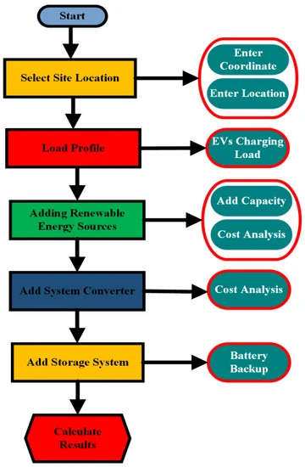
7
Challenges and Solutions
in Solar Charger Industry
Overcoming Industry Barriers
• Despite numerous advantages, the widespread adoption of solar mobile chargers faces challenges such as energy conversion efficiency and weather dependency.
• Technological improvements are needed to enhance photovoltaic cell efficiency, minimizing the impact of cloudy or low-light conditions on performance.
• The initial cost of high-quality solar chargers can deter some consumers, however, long-term savings on electricity balance the expense.
• Consumer awareness and education are crucial in promoting the benefits and correct usage of solar technology for everyday needs.
• Collaborative efforts between manufacturers, researchers, and environmental bodies drive the advancement and acceptance of innovative solar solutions.

Slide 10
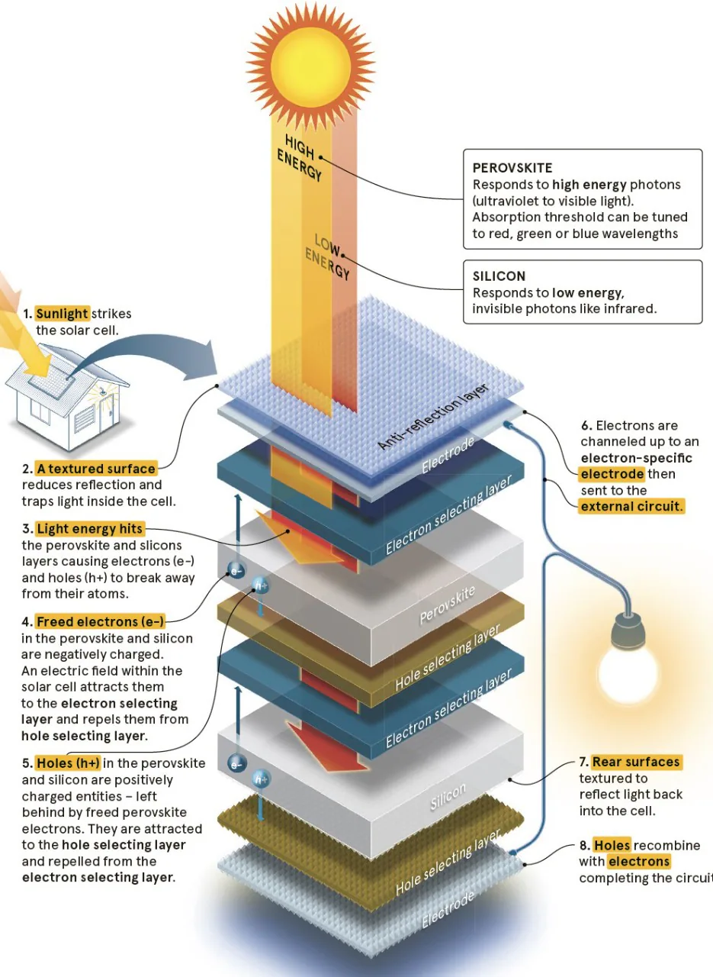
8
Future Prospects
for Solar Mobile Chargers
Infinite Potential
• The future prospects for solar mobile chargers are promising, with advancements in nanotechnology and materials science improving panel efficiency.
• Integration with smart technology may allow for more efficient energy management and customization according to user needs.
• Wider adoption of solar chargers is supported by increasing government incentives for renewable energy projects worldwide.
• Development in hybrid power systems, combining solar with other renewable sources, could enhance reliability and usage in diverse environments.
• Continuous innovation and commitment to sustainability will drive the solar charger market, leading to increased consumer adoption and technological improvement.

Slide 11
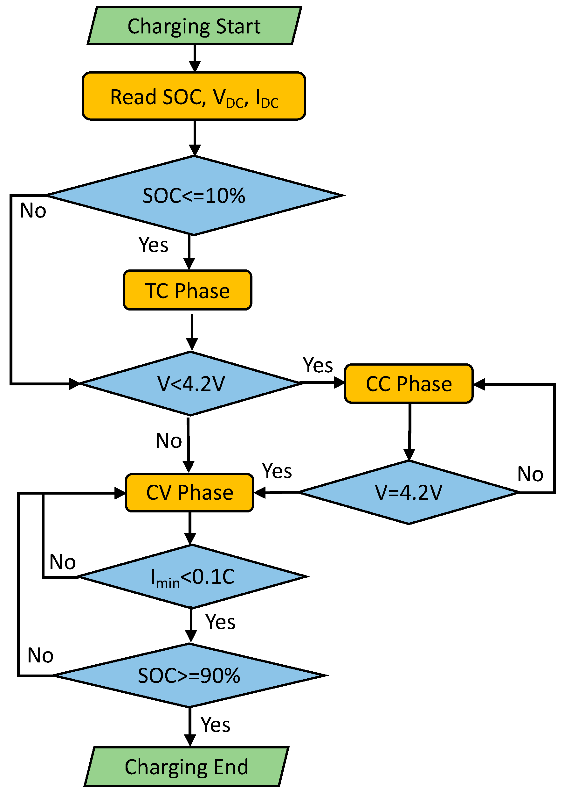
9
Case Studies
of Successful Implementation
Real-world Examples
• A case study of villages in rural India adopting solar chargers highlights the impact of renewable technology on improving access to electricity and connectivity. • Success in urban settings where solar charging stations support public mobile charging facilities demonstrates significant potential for large-scale usage. • Partnerships between non-profit organizations and tech companies have led to the distribution of solar chargers in disaster-prone regions, aiding in emergency communication. • Corporate initiatives focused on sustainability have adopted solar chargers as a standard, setting a precedent for environmentally responsible practices. • Reports of increased productivity and connectivity in communities with solar chargers underscore their role in social and economic development.

Slide 12
10
Conclusion
Summary and Final Thoughts
• Solar mobile chargers represent a significant step towards sustainable living, offering an alternative to conventional charging methods.
• Their adoption addresses environmental concerns, promotes renewable energy use, and supports individuals in regions with limited power access.
• Despite challenges, continued development and increased consumer education pave the way for broader market penetration and technological advancement.
• Encouraging case studies and forecasts suggest a bright future for solar mobile chargers, driven by innovation and sustainability goals.
• Embracing solar charging solutions aligns with global efforts to combat climate change and secure a sustainable future for future generations.

