Slide 1

Blogy Website
BY:
Ashwag Zabani
Bushra Mulla
Fatimah Alhelal
Project 4 - General Assembly- 2021

Slide 2
Contents
01
02
03
04
05
06
Project Idea
Website Users
Users Stories
Entity Relationship Diagram
Technologies Used.
Demo

Slide 3
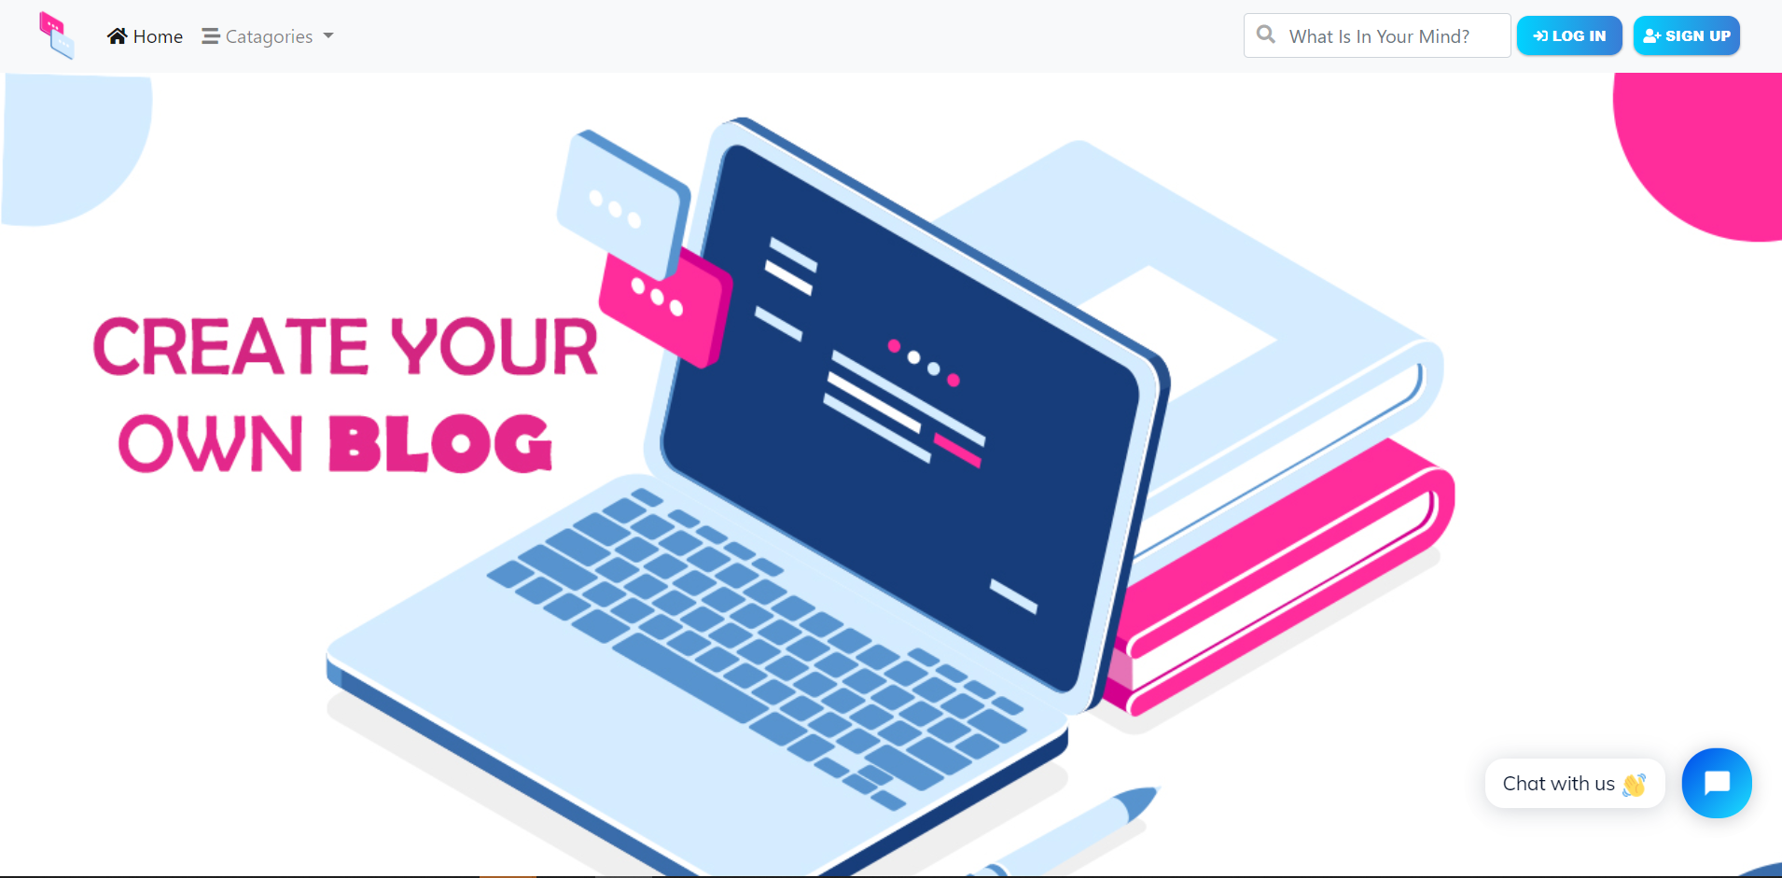
The Idea
A blog is an online diary or journal located on a website. Users can create their own blog and post content that typically articles or sharing any information with others for engaging with them.

Slide 4
Websit Users
Admin
Visited User
Logged In User
Who will manage the website and all content
Who visit the website only to read the content
Users who can share their content and interact with other

Slide 5

Admin User Stories
I should be able to manage blog website
I should be able to create post and published directly
I should be able to show list of reports
I should be able to show list of publish post requests
I should be able to confirm to publish a post on the website
I should be able to refused publish a post
I should be able to show list of reports
I should be able to access control panel

Slide 6

Visited User Stories
I should be able to see the post content
I should be able to search by post title
I should be able to see author profile
I should be able to filter the posts by its categories
I should be able to sign up
I should be able to log in
I should be able to share post link via Facebook, Twitter or Telegram

Slide 7

Logged In User Stories
I should be able to see all my posts with filtered by status
I should be able to create new post
I should be able to edit own post
I should be able to delete own post
I should be able to add comments to any post
I should be able to add likes to the user's posts
I should be able to see all likes posts list
I should be able to edit profile information
I should be able to report any post

Slide 8
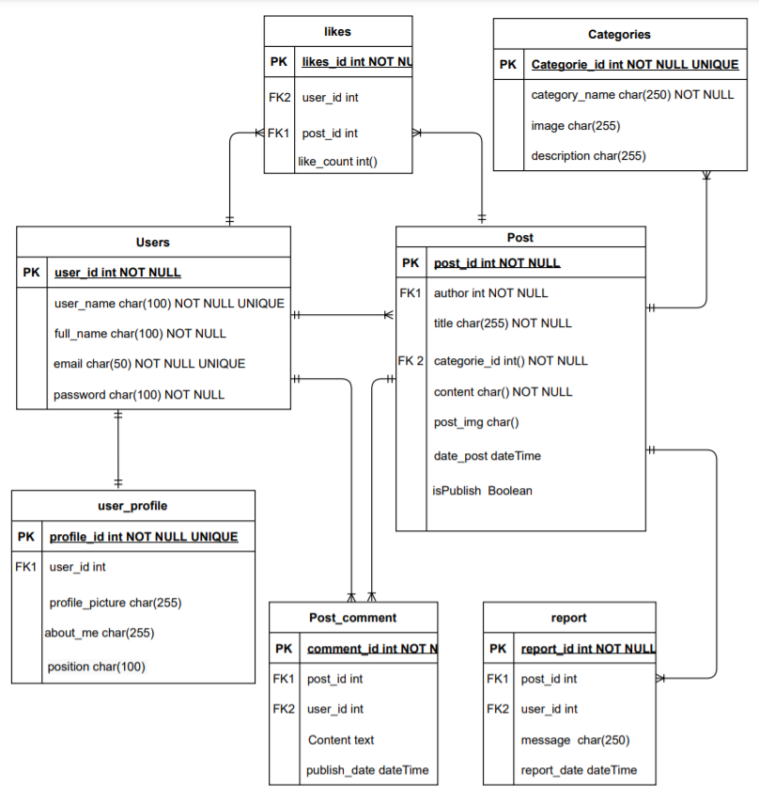
Entity Relationship Diagram

Slide 9

HTML
CSS
Bootstrap
Postages
Python
Django
Ajax

Slide 10
Demo
Blogy Website

