Slide 1

Customer Shopping Behavior Analysis
Transactional data insights across 3,900 purchases — uncovering spending patterns, segments, and product preferences.
PREPARED BY: BUSHRA ALI

Slide 2
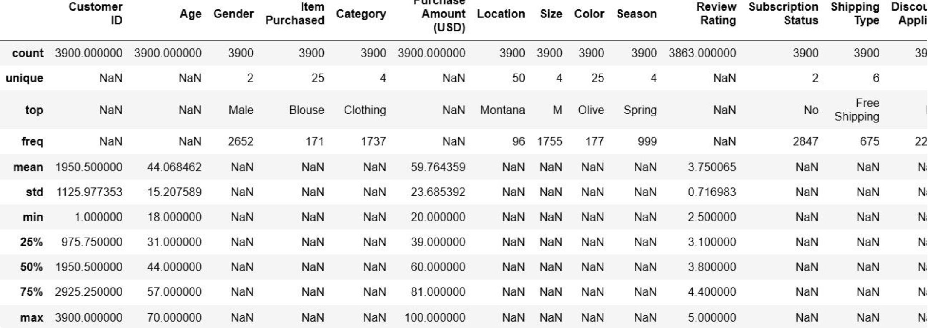
Dataset at a Glance
3,900
18
37
Transactions
Columns
Missing Values
Review Rating only
Key Features
Demographics: Age, Gender, Location, Subscription
Purchases: Item, Category, Amount, Season
Behavior: Discount, Frequency, Review Rating

Slide 3

Data Preparation in Python
Load & Explore
Feature Engineering
Read CSV with pandas
Create age_group and purchase_frequency_days
Clean Missing Data
Load to PostgreSQL
Median imputation applied
Write cleaned snake_case data
Cleaned data was standardized to snake_case, validated for consistency, and loaded into PostgreSQL for SQL analysis.

Slide 4
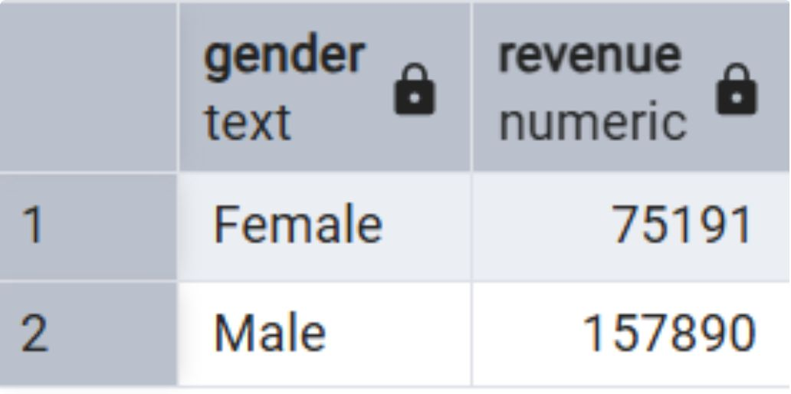
Revenue & Spending Insights
Revenue by Gender
Compared total revenue generated by male vs. female customers.
High-Spending Discount Users
Customers using discounts who still spent above average purchase amount.
Revenue by Age Group
Total revenue contribution calculated per age segment.

Slide 5
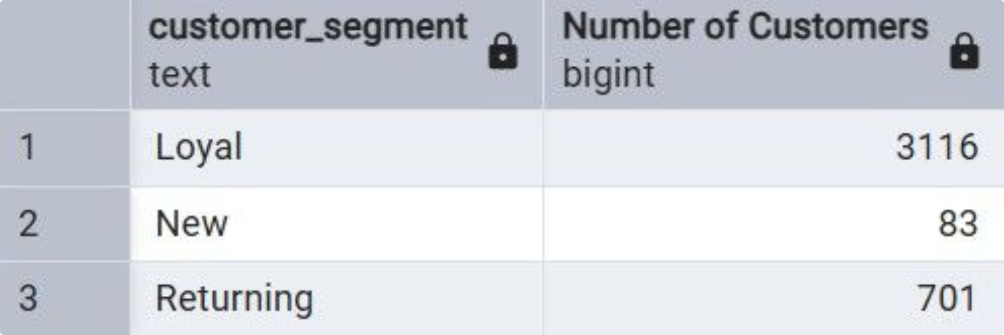
Product & Shipping Analysis
Top 5 Products by Rating
Highest average review ratings identified.
Shipping Type Comparison
Average spend: Standard vs. Express shipping.
Top 3 Products per Category
Most purchased items within each category.

Slide 6
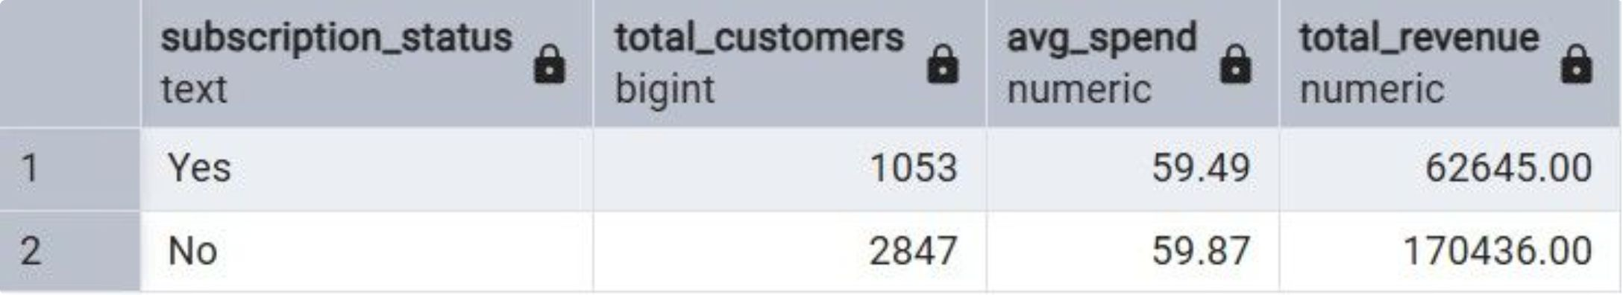
Discounts & Subscriptions
Discount-Dependent Products
5 products with highest % of discounted purchases.
Subscribers vs. Non-Subscribers
Compared average spend and total revenue by subscription status.
Repeat Buyers
Customers with >5 purchases are more likely to subscribe.

Slide 7
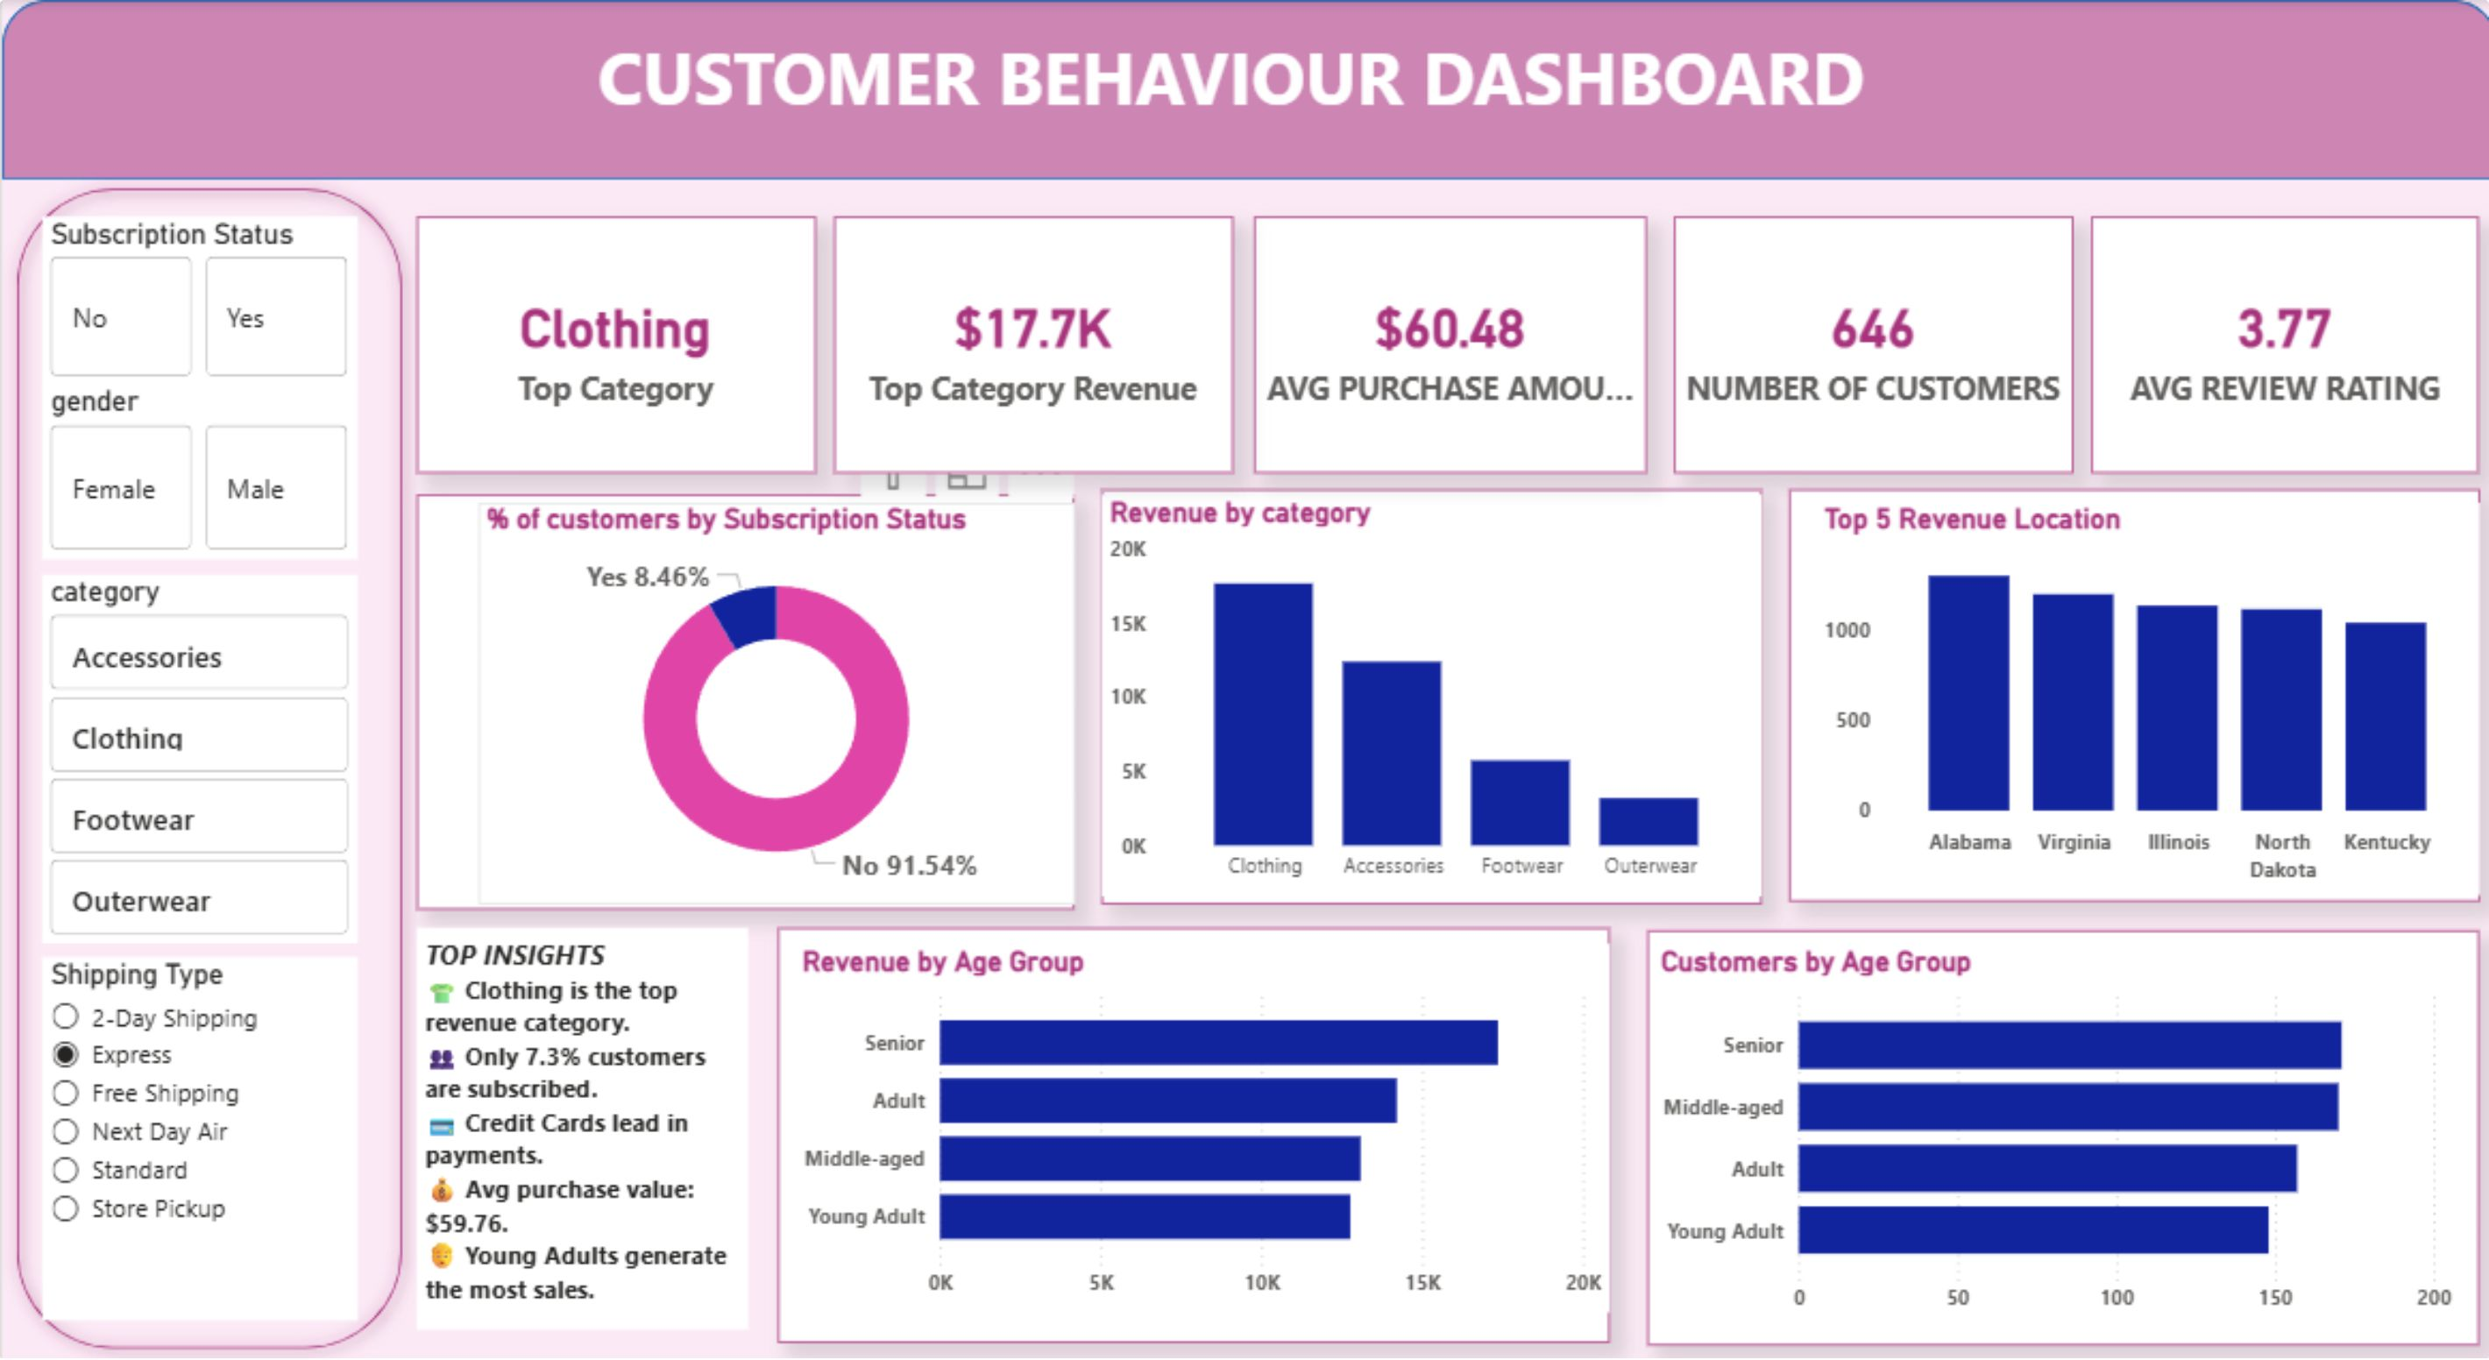
Power BI Dashboard
Interactive dashboard built to visualize all key insights — revenue, segments, products, and subscriptions — in one view.

Slide 8
Business Recommendations
Boost Subscriptions
Loyalty Programs
Exclusive member benefits
Reward repeat customers
Promote Top Categories
Optimize Discounts
Focus on high-revenue categories like Clothing
Targeted offers for profitability
Focus Marketing
Preferred Payments
High-spending age groups & top locations
Cashback on top payment methods

