Slide 1


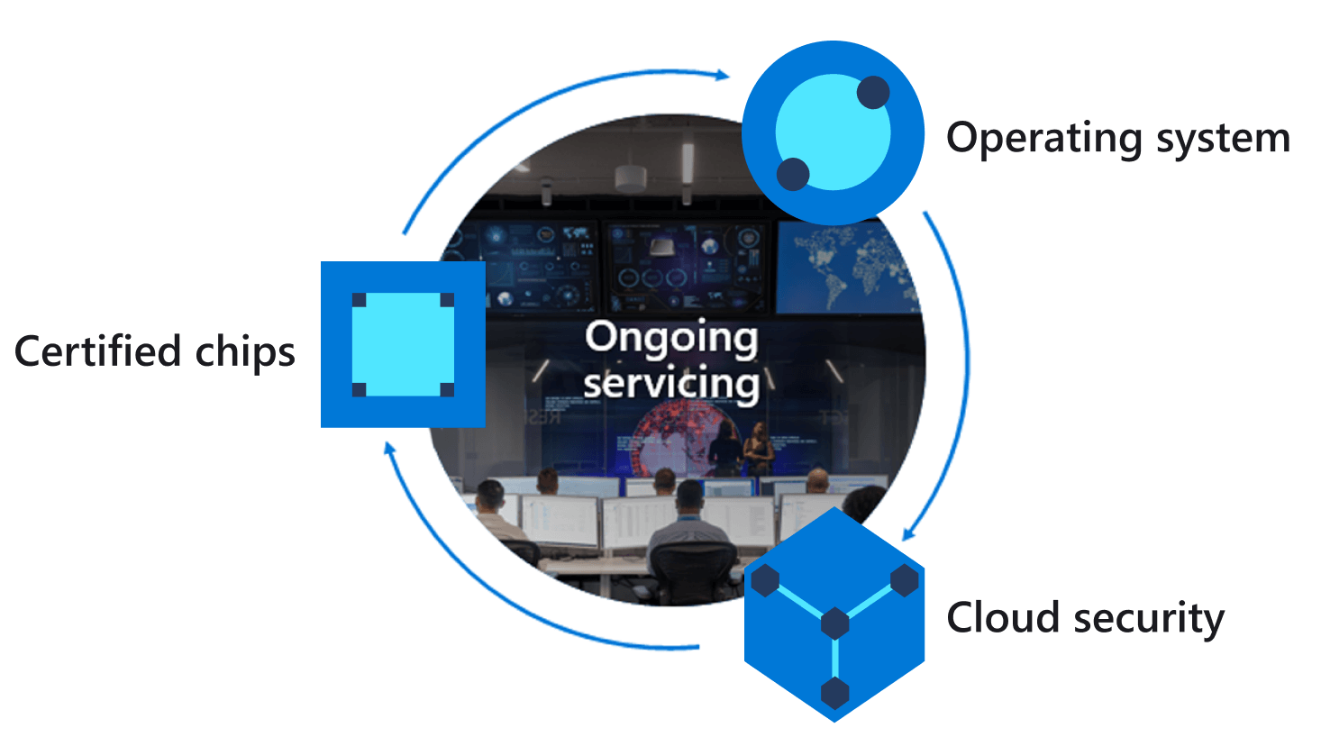

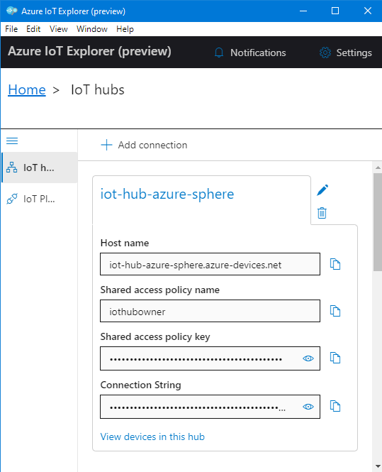
Azure IoT Explorer
Azure IoT Hub
Azure Sphere
Cortex A7 High-level
Intercore message bridge
Cortex M4 Real-time
5
4
2
3
IoT Hub Messaging
Telemetry streaming
Environment service thread
{
“Temperature”:26,
“Humidity”:55,
“Pressure”: 1100
}
7
1
Device twin
Desired Temperature
Device twin virtual HVAC control
Environment sensor thread
JSON
6
Notes:
Change the rate the sensor os measured

