Slide 1
Detect
Azure Active Directory
Identity Protection
Investigate
Remediate

Slide 2
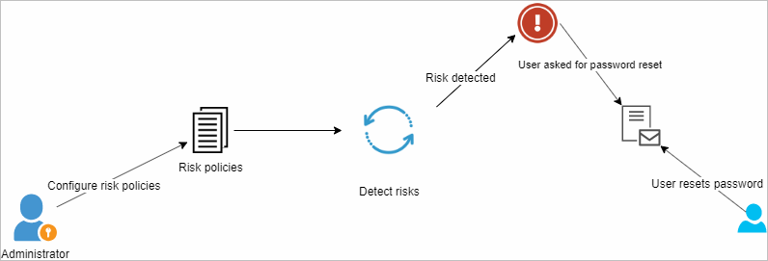





Configures
risk policies
Password reset
required
Password reset
Administrator
Detects risks
User notified
User

Slide 3
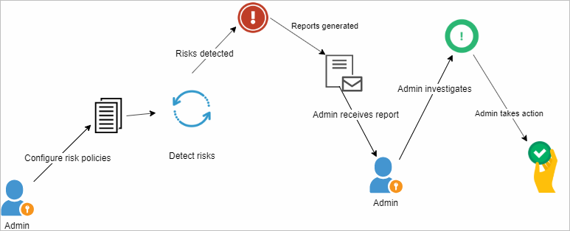


Configures
risk policies
Reports
generated
Investigates
activity
Admin
Detects
risks
Admin
notified
Admin
Takes
action

