Slide 1


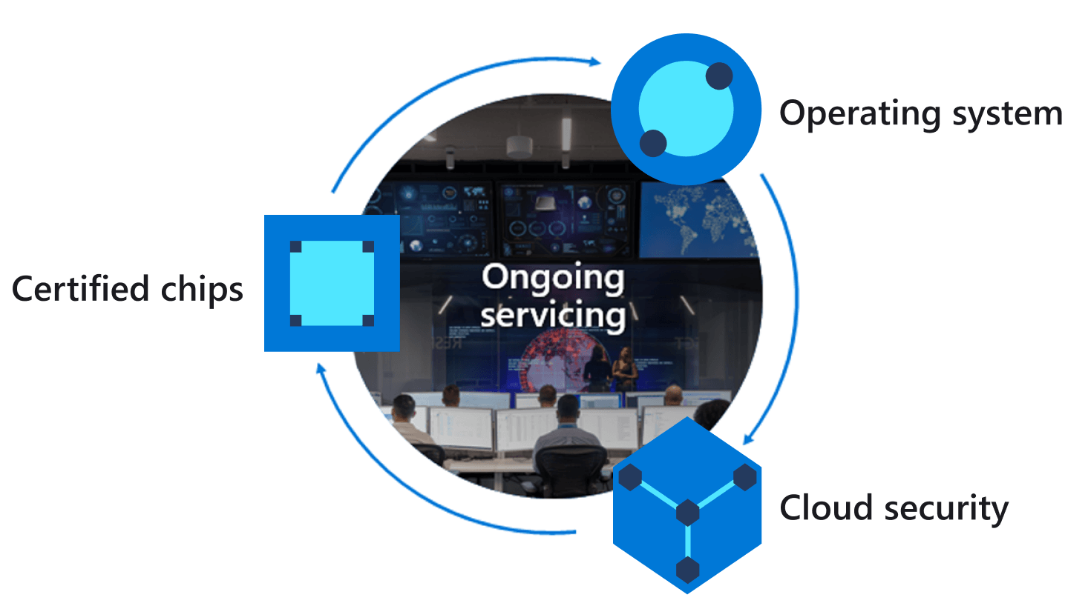
Azure IoT Explorer
Azure IoT Hub Device Twin
Azure Sphere
Properties.Desired
Report HVAC
operating mode.
For example the heating unit turned off
JSON
Query HVAC
Operating Mode
device twin
Properties.Reported
JSON
3
2
1
Notes:
Change the rate the sensor os measured

Slide 2
Azure IoT Explorer
Azure IoT Hub Device Twin
Azure Sphere
1
2
3
Properties.Desired
Device twin temperature handler
JSON
Update
desired
temperature
device twin
4
Set HVAC temperature
Properties.Reported
Acknowledge configuration
5
JSON
6
Notes:
Change the rate the sensor os measured

