Slide 1
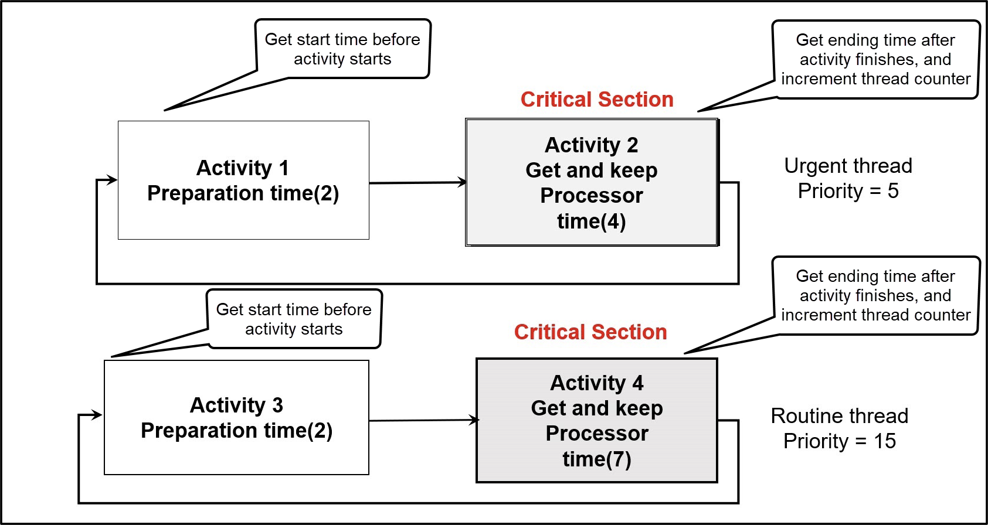
Get start time before activity starts
Get ending time after activity finishes, and increment thread counter
Critical Section
Activity 2
Get and keep
Processor time(4)
Activity 1
Preparation time(2)
Urgent thread, Priority = 5
Get start time before activity starts
Get ending time after activity finishes, and increment thread counter
Threads send messages to the rear of the queue
Critical Section
Activity 4
Get and keep
Processor time(7)
Activity 3
Preparation time(2)
Urgent thread, Priority = 15

Slide 2
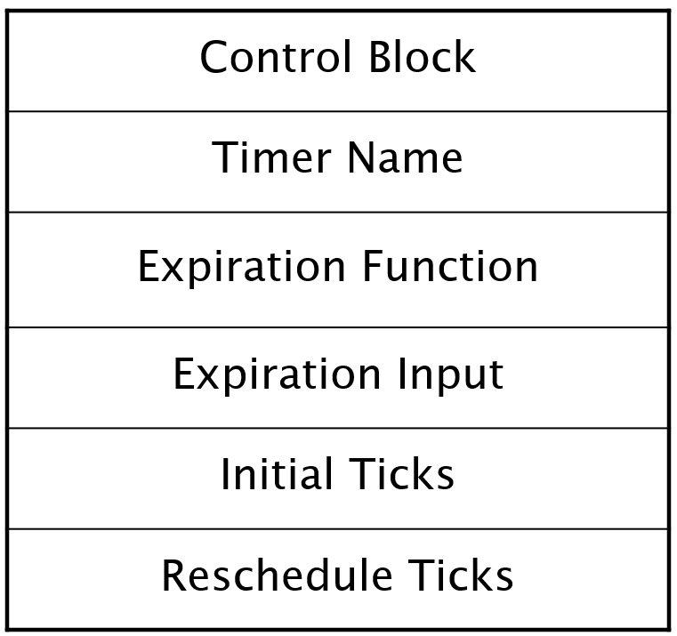
Control Block
Timer Name
Expiration Function
Expiration Input
Initial Ticks
Figure 2. Attributes of an Application Timer
Reschedule Ticks
Figure 2. Attributes of an Application Timer

