Slide 1


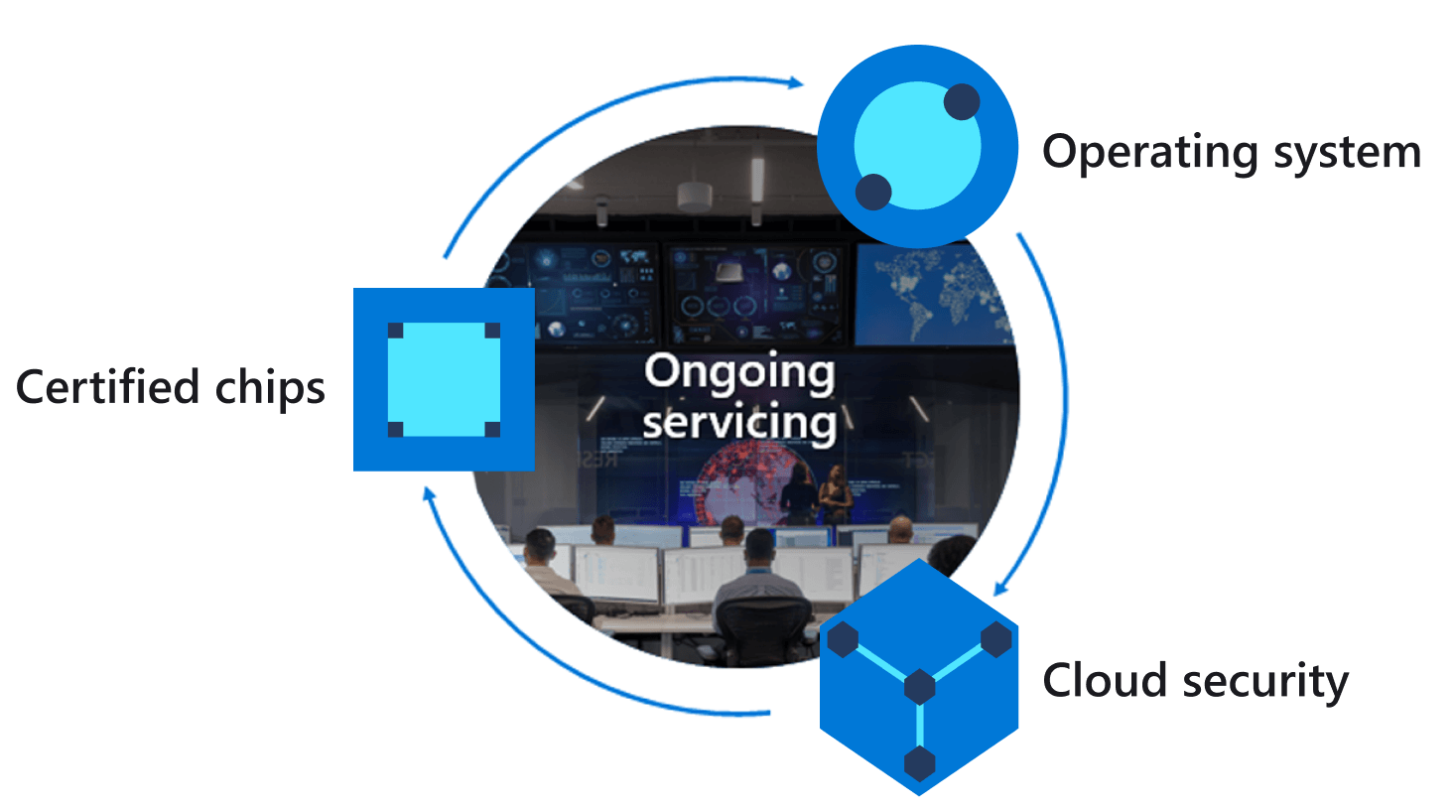
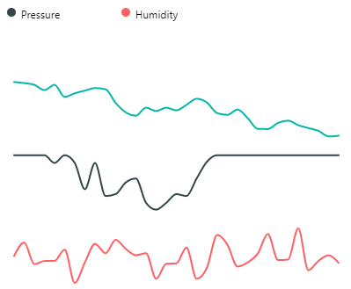
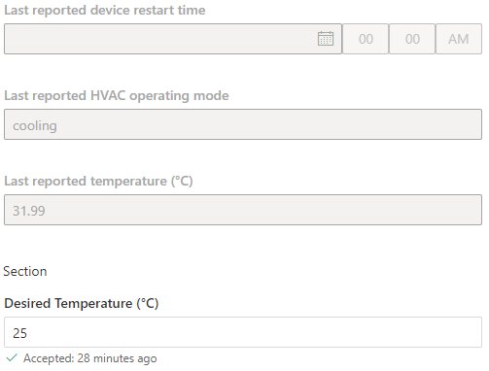
Azure IoT Central
Azure IoT Hub
Azure Sphere
Cortex A7 High-level
Intercore message bridge
Cortex M4 Real-time
1
IoT Hub Messaging
Telemetry streaming
3
4
Environment telemetry service thread
{
“Temperature”:26,
“Humidity”:55,
“Pressure”: 1100
}
2
Device twin
Desired Temperature
Device twin virtual HVAC control
Environment telemetry sense thread
5
JSON
6
Notes:
Change the rate the sensor os measured

