Slide 1
VNet
On-premises
VNet
VNet
Azure
VNet
VNet
VNet
VNet
VNet

Slide 2



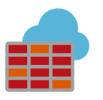






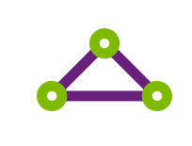



Public Internet
VNet Peering
Customers
Website
Quote App
Hub
Azure Firewall
DDOS protection
NSG
NSG
Load Balancer
Load Balancer
Management subnet
Management subnet
On-Premises
DMZ subnet
VPN
Satellite Offices
IIS
IIS
IIS
IIS
Active Directory
ExpressRoute
DB
DB
AD subnet
HQ
Workload subnet
Workload subnet
VNet
VNet
VNet

Slide 3
Virtual Network
Subnet
NSG
NSG

