Slide 1
VNet
On-premises
VNet
VNet
Azure
VNet
VNet
VNet
VNet
VNet

Slide 2



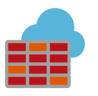






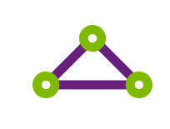



Public Internet
VNet Peering
Customers
Website
Quote App
Hub
Azure Firewall
DDOS protection
NSG
NSG
Load Balancer
Load Balancer
Management subnet
Management subnet
On-Premises
DMZ subnet
VPN
Satellite Offices
IIS
IIS
IIS
IIS
Active Directory
ExpressRoute
DB
DB
AD subnet
HQ
Workload subnet
Workload subnet
VNet
VNet
VNet

Slide 3
Public Internet
Spokes
HR
Website
Quote App
Hub
Azure Firewall
DDOS protection
NSG
NSG
NSG
Load Balancer
Load Balancer
Load Balancer
Management subnet
Management subnet
Management subnet
DMZ subnet
App
IIS
IIS
IIS
IIS
Active Directory
ExpressRoute
DB
DB
DB
AD subnet
HQ
Workload subnet
Workload subnet
Workload subnet
VNet
VNet
VNet
VNet

Slide 4
Virtual Network
Subnet
NSG
NSG

